Slide 1
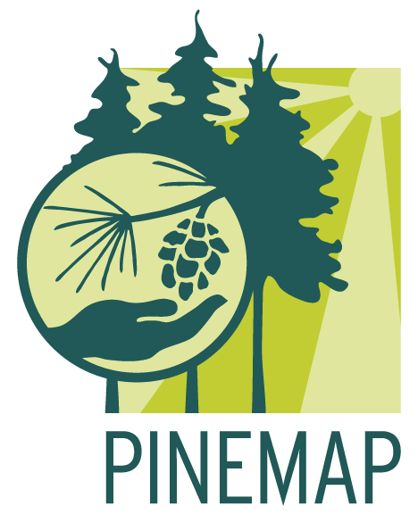

[Title]
[Authors]
The Pine Integrated Network: Education, Mitigation, and Adaptation Project (PINEMAP) is a Coordinated Agricultural Project funded by the USDA National Institute of Food and Agriculture, Award # 2011-68002-30185

