Slide 1
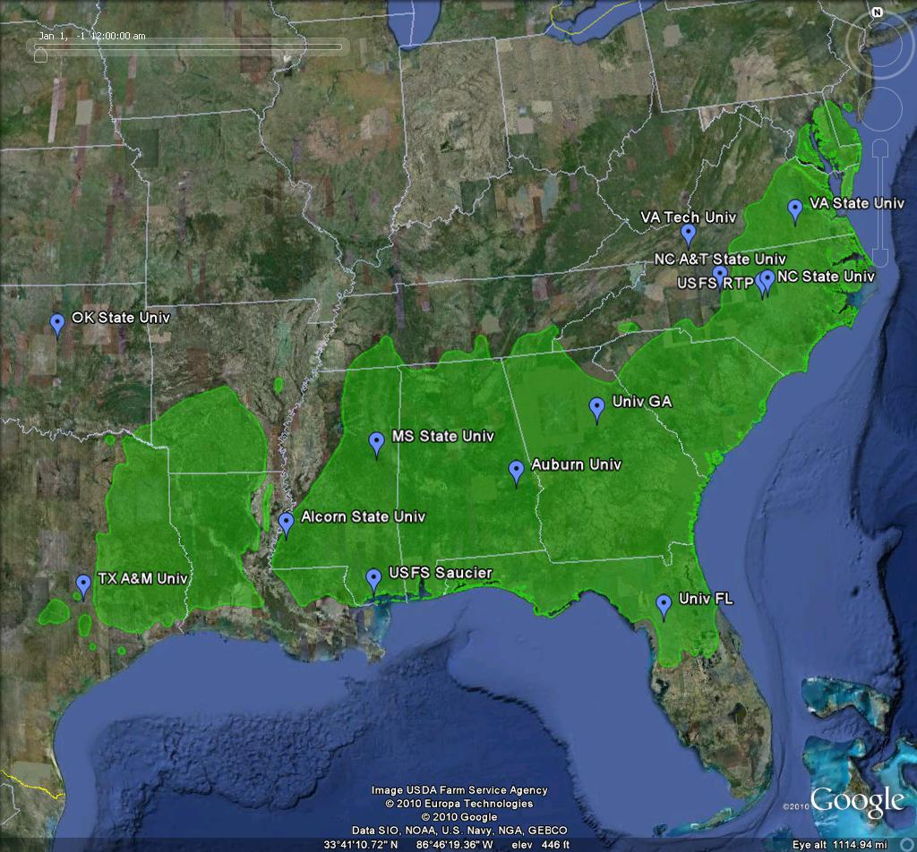
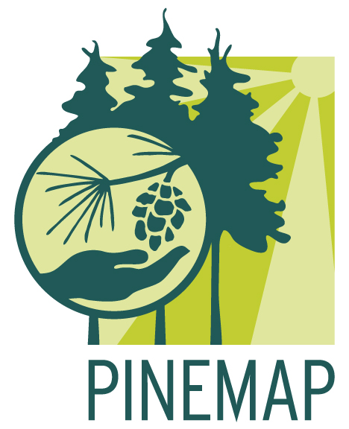
Pine Integrated Network: Education, Mitigation, and Adaptation Project
Google Earth
~126 team members, 11 southeastern universities plus the USDA Forest Service
A NIFA-Funded
Climate Change CAP
The Pine Integrated Network: Education, Mitigation, and Adaptation Project (PINEMAP) is a Coordinated Agricultural Project funded by the USDA National Institute of Food and Agriculture, Award #2011-68002-30185. For more information, visit http://www.pinemap.org.

Slide 2
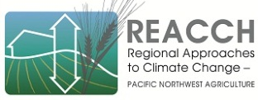
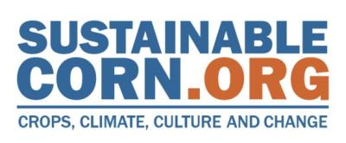

3 Coordinated Agricultural Projects (CAP)
115 PIs across 20 states

Slide 3
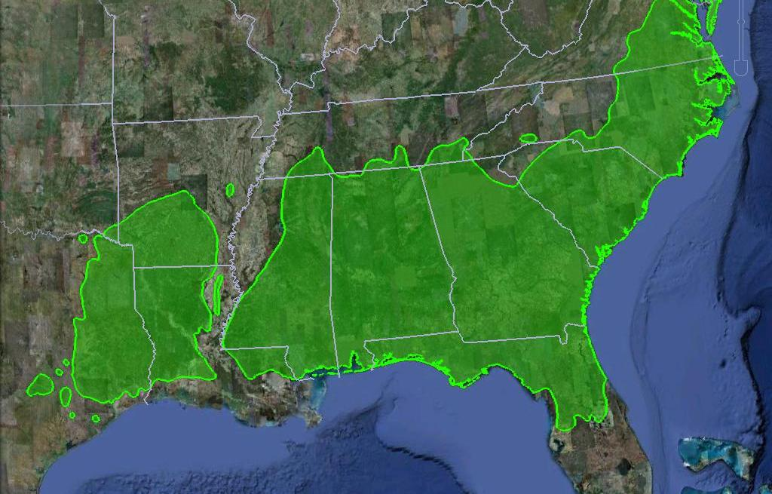
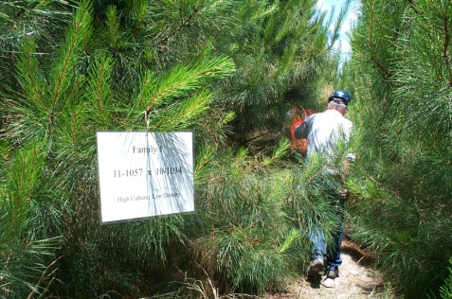
Prescribed, Outcome Based Program Dictates Project Goals
Reduce the use of (energy), nitrogen fertilizer, and (water) by 10% and increase carbon sequestration by 15% through resilient forest production systems under changing climate by 2030
Project research, education and Extension goals focused on achieving these outcomes

Slide 4
Goals
To create, synthesize, and disseminate the necessary knowledge to enable southern forest landowners to
harness pine forest productivity to mitigate atmospheric CO_{2;}
more efficiently utilize nitrogen and other fertilizer inputs; and
adapt their forest management approaches to increase resilience in the face of changing climate.

Slide 5
Global Approach: Integrating & Leveraging Existing Networks
Research Cooperative | Host University (year founded)
Cooperative Forest Genetics Research Program | University of Florida (1953)
Cooperative Tree Improvement Program | North Carolina State University (1955)
Forest Biology Research Cooperative | University of Florida (1996)
Forest Modeling Research Cooperative | Virginia Polytechnic Univ. (1979)
Forest Productivity Cooperative | Virginia Polytechnic Univ. / NC State Univ. (1969)
Plantation Management Research Cooperative | University of Georgia (1975)
Southern Forest Resource Assessment Consortium | North Carolina State University (1994)
Western Gulf Forest Tree Improvement Program | Texas A&M Univ. / Texas Forest Service (1969)
Project Learning Tree
State Climatologists
Extension Professionals: SREF, Land Grant & County Extension
University –Government -Corporate Forest Research Cooperatives

Slide 6
Disciplinary Aims Contribute to Broader Integrated Project Goals
Mitigation
Adaptation
Education and Extension
Aim 1
Field Ecology
Aim 2
Models
Aim 3
Genetics
Aim 4
LCA/Pol/Econ
Aim 5
Education
Aim 6
Extension

Slide 7
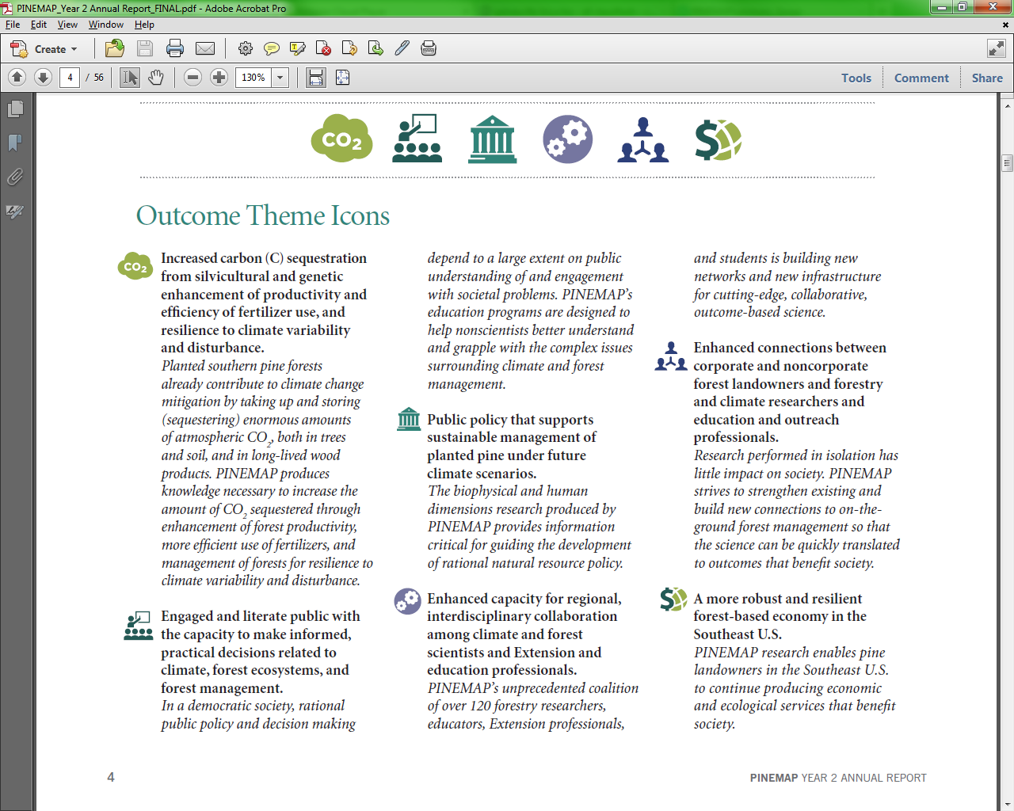
Outcome Themes

Slide 8
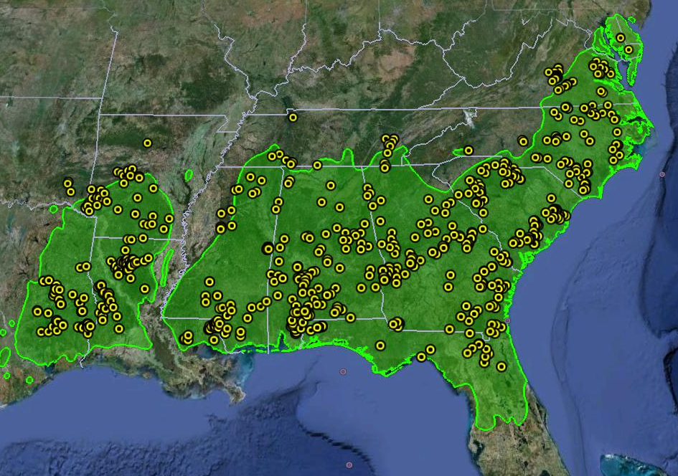
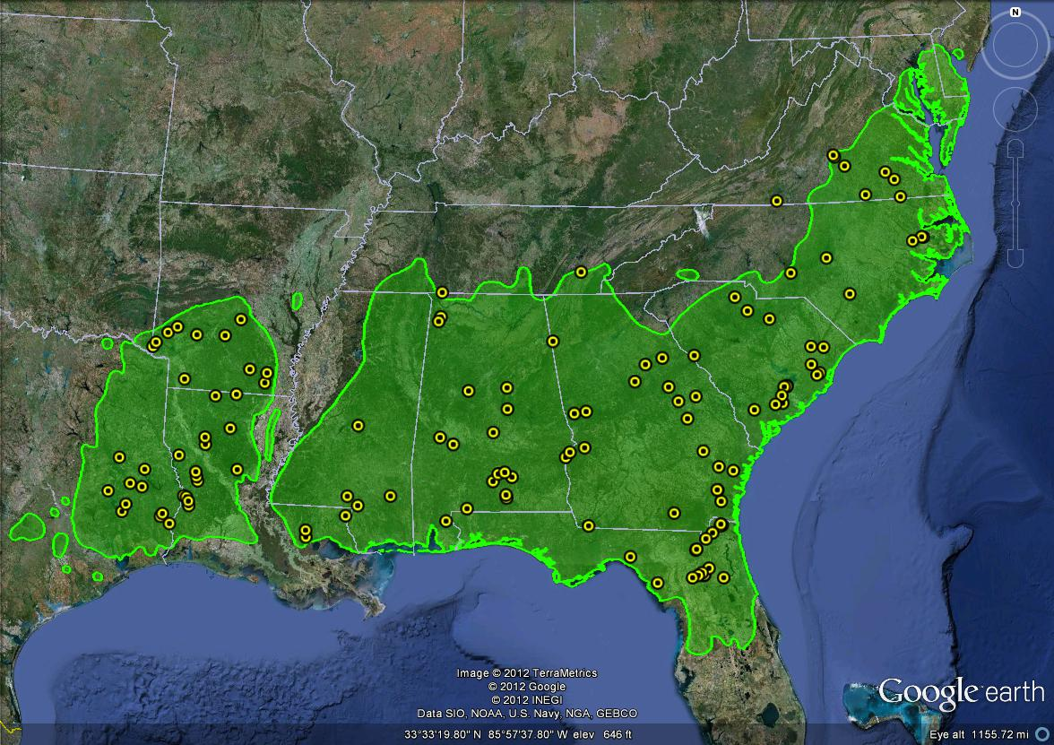
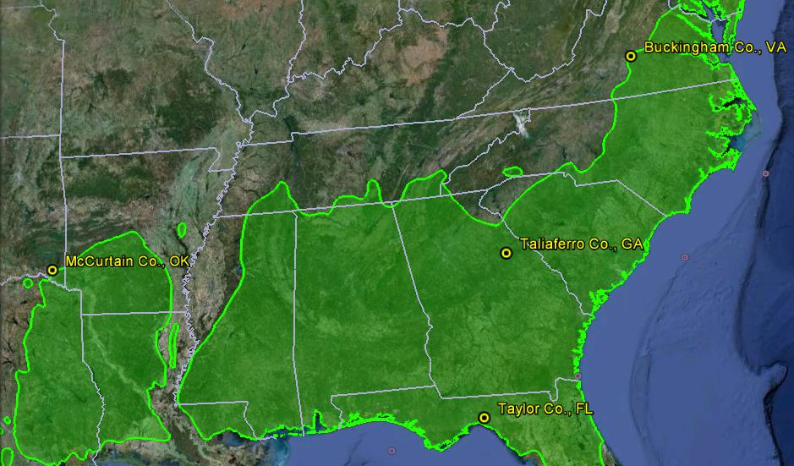
Tier 2 / Active Network
Tier 1 / Legacy Network
Tier 3 / Fert /
Throughfall Diversion Network

Slide 9
PINEMAP Tech Transfer Model
PINEMAP Extension
PINEMAP Science
Contractors
Traditional Extension
Extension Agents and County Foresters
Non-Corporate Forestlands
Consulting Foresters
Research Coops
Corporate Forestlands
Corporate Scientists
Corporate Foresters

Slide 10
Ambitious Outcomes will Require Implementation on Millions of Acres

Slide 11
Structure of PINEMAP Stakeholder Landholdings is an Advantage
Thousands of Acres
Smith et al. 2009
> 20 million acres managed by our industrial cooperators
> 95% of pine seedlings are produced by cooperators
Long-established record of successful tech transfer in cooperative framework
10% of NIPF owners manage 70% of acreage
Adoption of altered management by larger landowners will deliver largest impact

Slide 12
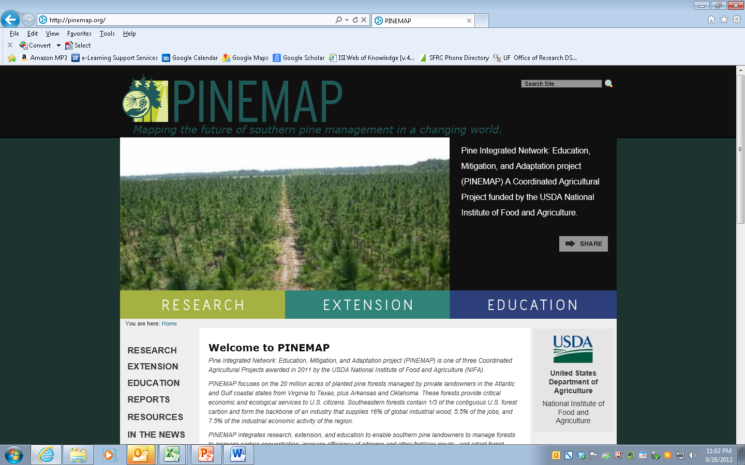
Visit our Website: pinemap.org

Slide 14
