Slide 1
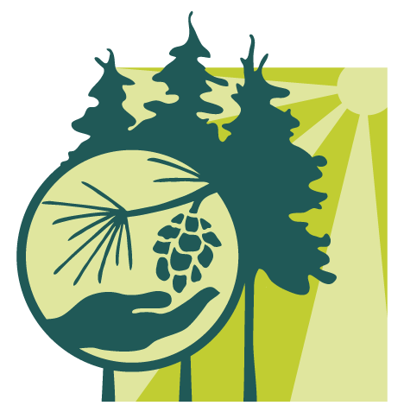
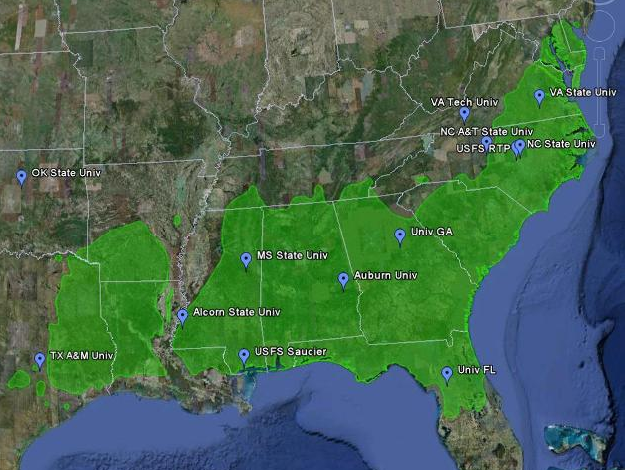
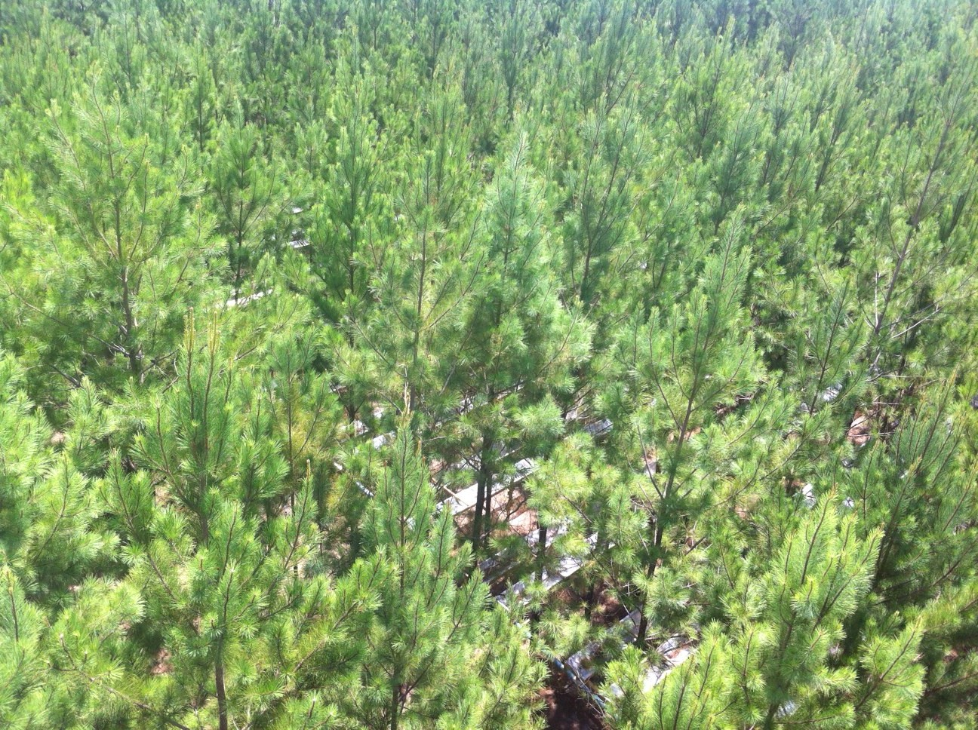
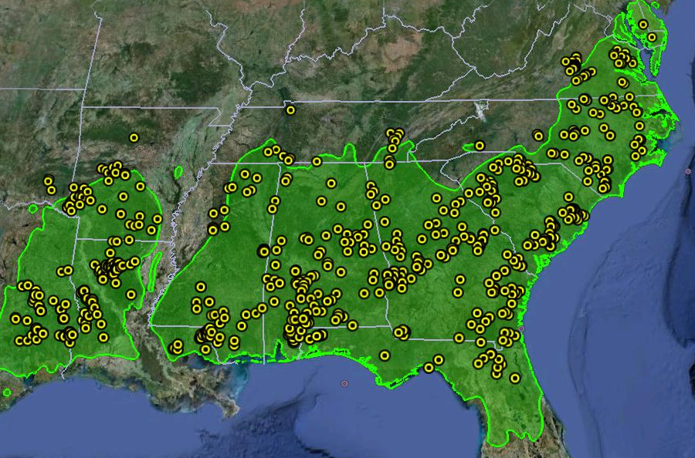
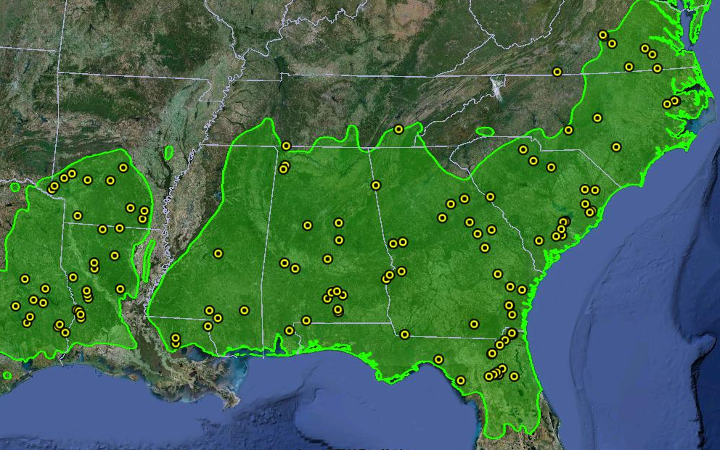
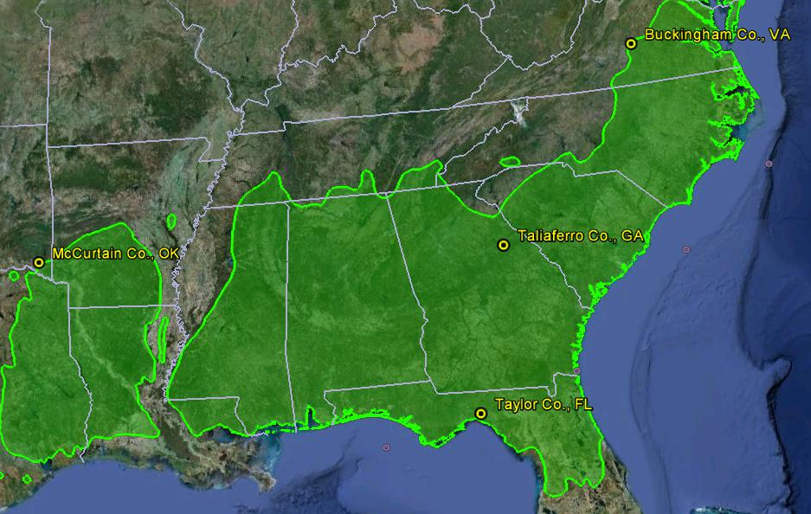
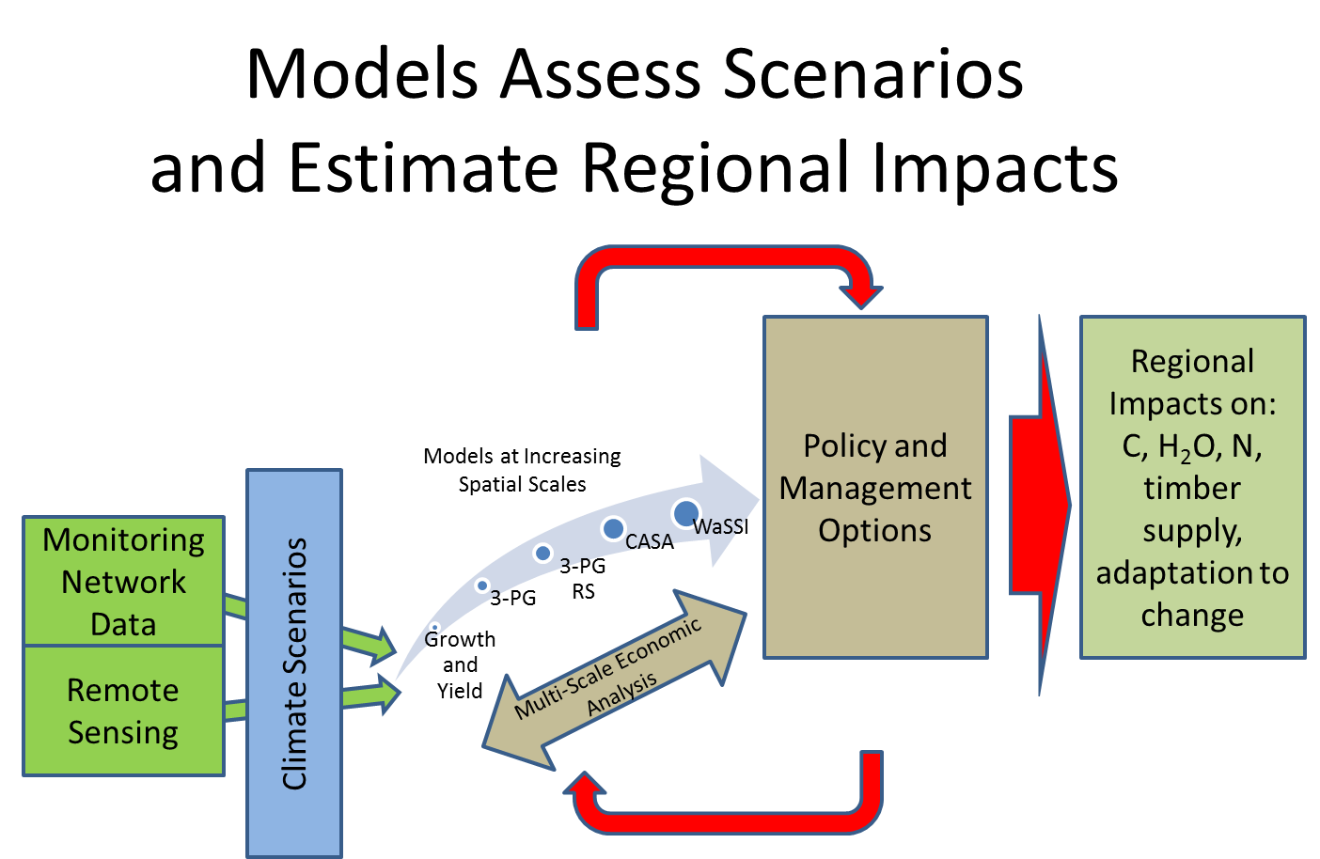
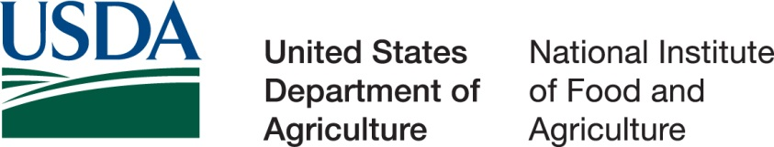
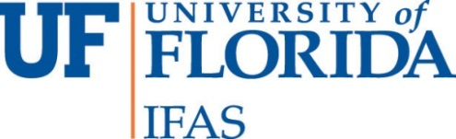
PINEMAP – Pine Integrated Network: Education, Mitigation, and Adaptation Project
Mapping the future of southern pine management in a changing world
Overview
Genetics and Breeding
The overarching goal of this project is to create, synthesize, and disseminate knowledge that enables southern pine landowners to harness forest productivity to mitigate atmospheric CO₂, more efficiently use nitrogen and other fertilizer inputs, and adapt forest management approaches to increase resilience in the face of changing climate.
PINEMAP focuses on the 20 million acres of planted pine forests managed by private landowners in the Atlantic and Gulf coastal states from Virginia to Texas, plus Arkansas and Oklahoma. We integrate disciplinary expertise from eight regional university-corporate-governmental forestry research cooperatives, as well as accumulated data, germplasm, and infrastructure, with outreach and education specialists from eleven major research universities and minority-serving institutions in the region, the USDA Forest Service, and climate scientists associated with the multi-state Southeast Climate Consortium and state climate offices.
Develop guidelines to help growers understand where to plant specific southern pine seed sources given future climate scenarios and identify genes controlling traits such as growth, nitrogen responsiveness, cold hardiness, water usage, and resistance to southern pine beetle and fungal diseases.
Economics and Policy
Analyze life-cycle carbon balance of regional forest management systems and conduct multi-scale analyses of market and non-market forest benefits and services under future management and climatic conditions.
Monitoring Network
Establish a three-tiered monitoring network based on existing cooperative research trials and develop standardized methods to quantify C, water, and nutrient storage and flux baselines and responses to climate and management.
PINEMAP collaborating institutions superimposed on the loblolly pine range.
Remote sensing image from Google Earth; range map from U.S. Forest Service.
Tier I
The network consists of hundreds of existing growth-and-yield plots (Tier I), 125 existing genetic and silvicultural trials on which detailed C and nutrient balance will be measured (Tier II), and four Tier III sites situated at the edges of the range on which nutrients and water are manipulated.
Planned Project Outcomes
Develop and facilitate implementation of management regimes and genetic systems that mitigate C and fertilizer N and increase forest resilience to disturbances.
Achieve, by project end in 2016, proportional progress toward 2030 goal of 200 million Mg C of added sequestration, which is 15% above present.
Implement 25% increased efficiency of applied fertilizer N.
Use the loblolly pine reference genotype from the Pine Genome CAP, in combination with phenotype data from extensive regional genetic trials, to indentify alleles that control productivity, disease and pest resistance, and adaptive characteristics.
Complete “cradle to grave” LCA accounting for C, N, water, and energy footprints that emphasize alternative forest management scenarios, harvesting and transportation, and processing parameters that are affected by biomass quality.
Create and foster undergraduate research and summer internship experiences.
Develop Project Learning Tree (PLT) secondary module on southern forests and climate change.
Train 7 postdoctoral associates and 29 graduate students.
Engage participation of corporate forestry professionals who manage 25 million acres in Extension programs.
Reach 10,000 family forest landowners owning a total of 10 million acres through Extension programs.
Aerial view of PINEMAP Tier III site in Taylor County, Florida.
Photo courtesy of Tim Martin.
Multi-Scaled Modeling
Apply a multi-scaled modeling program incorporating monitoring network data with spatially-explicit historical and predicted future climate data to assess alternative forest management approaches and the impacts on carbon sequestration and resilience to disturbance.
Tier II
Tier III
Education
Create educational resources and training programs to educate high school students and teachers as well as university students about the relevance of forests, forest management, and climate impacts; engage university students in collaborative, interdisciplinary research aimed at solving complex societal problems.
Extension
Disseminate emerging knowledge, practices, and PINEMAP decision support tools to enable corporate and non-corporate landowners to increase forest carbon sequestration, nitrogen fertilizer efficiency, and forest resilience under changing climate.
For more information, visit www.pinemap.org or contact Dr. Timothy A. Martin (tamartin@ufl.edu) or Jessica Ireland (jjtireland@ufl.edu).
Investing in Science | Securing Our Future
The Pine Integrated Network: Education, Mitigation, and Adaptation project (PINEMAP) is a Coordinated Agricultural Project funded by the USDA National Institute of Food and Agriculture,
Award #2011-68002-30185.

