Slide 1
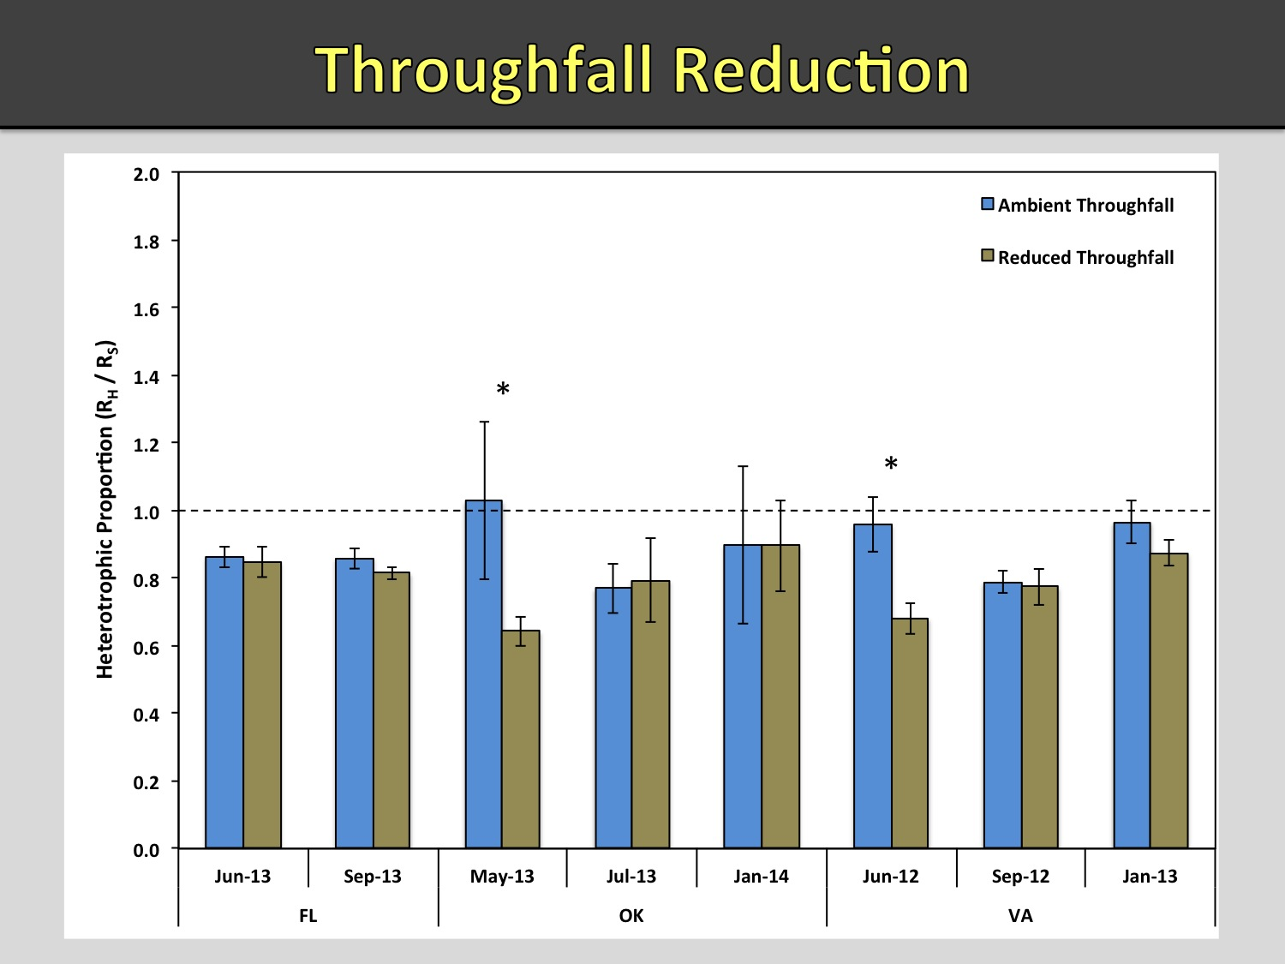

Slide 2
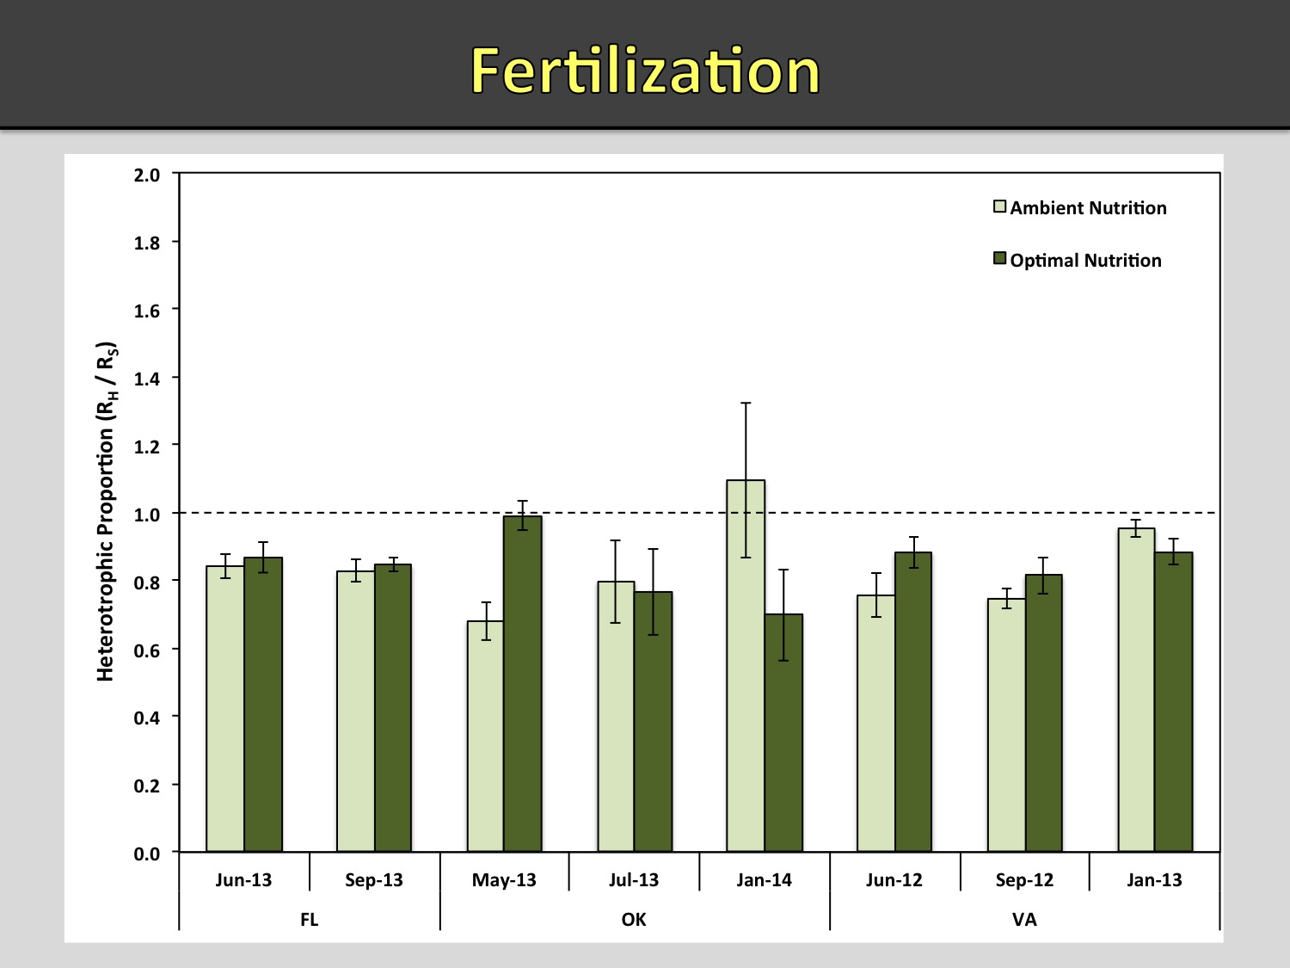

Slide 3
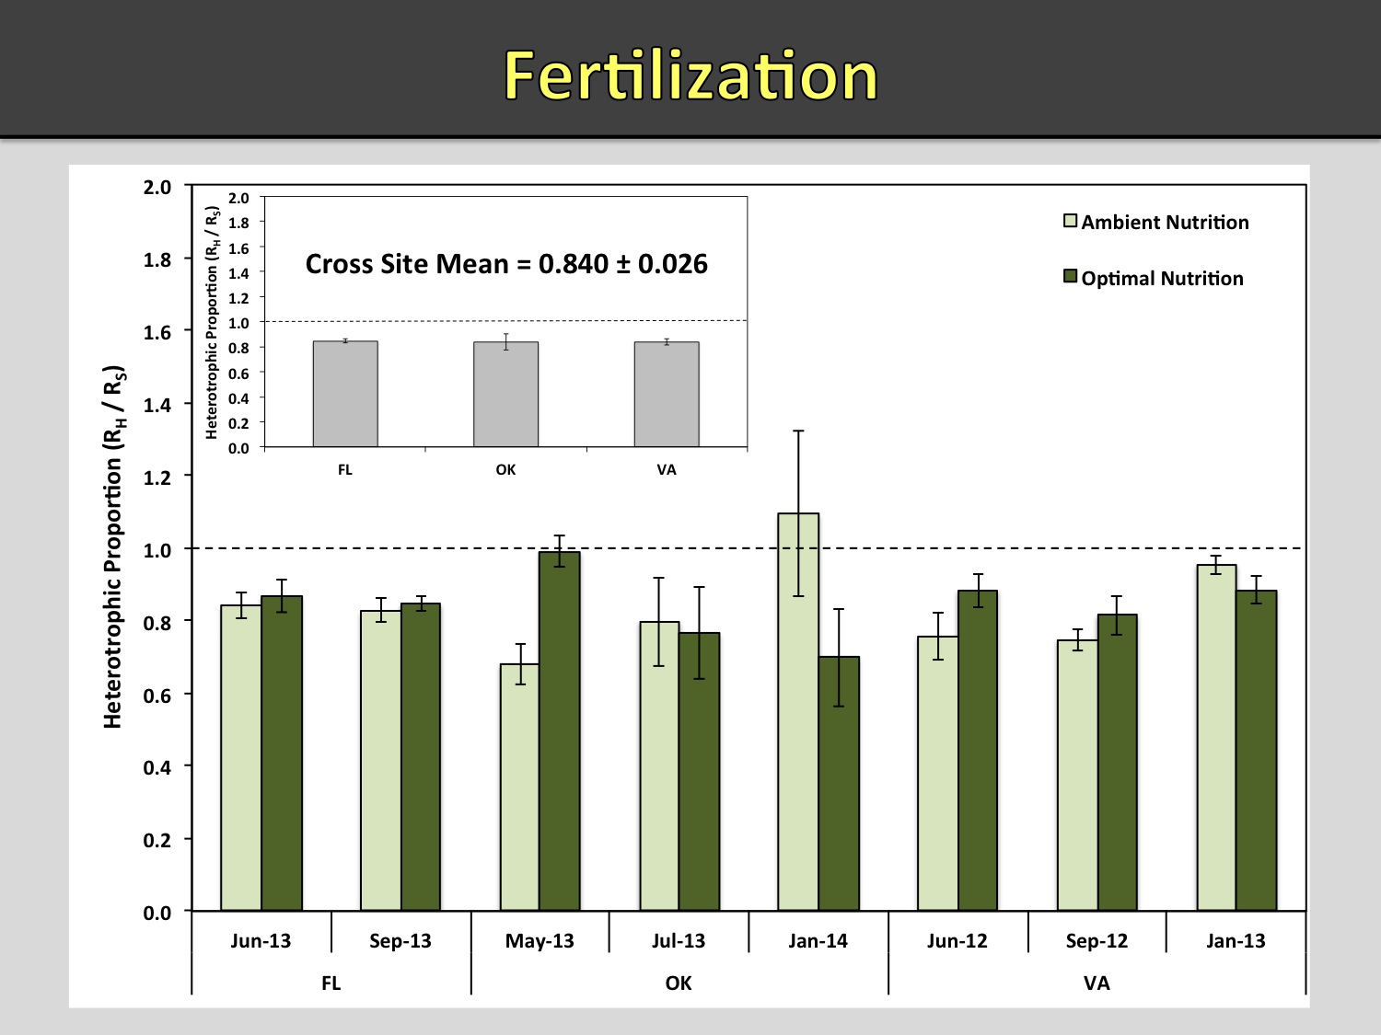

Slide 4
Ratio of heterotrophic to total soil CO₂ efflux
as influenced by stand age and season
Stand age
Summer I
Summer II
Fall
Winter
Spring
Seasonal Mean
Excluding
winter
3
9
18
25
0.54 (.12)
0.55 (.12)
0.62 (.18)
0.50 (.05)
0.68 (.03)
0.65 (.14)
0.50 (.15)
0.53 (.11)
0.73 (.19)
0.63 (.15)
0.46 (.03)
0.62 (.29)
1.11 (.05)
0.94 (.004)
0.87 (.06)
0.48 (.10)
0.79 (.07)
0.86 (.09)
0.68 (.10)
0.69 (.07)
0.77
0.73
0.63
0.56
0.69
0.67
0.57
0.59

Slide 5
Greenhouse Study
A
100
80
60
Relative mean specific root respiration (A) and relative mean microbial respiration (B) in non-fertilized and fertilized loblolly pine.
Specific Root Respiration
40
20
0
B
Percent Relative to Maximum
80
60
Microbial Respiration
40
20
0
49
197
Days Since Fertilization
Gough et al. 2004. Tree Physiology. 24:845-852

Slide 6
Heterotrophic Soil CO₂ Efflux as influenced by fertilization: FIELD STUDY Va.
Significant differences between treatments are represented by (‡) at the 0.05 and (†) at the 0.10 alpha level (n = 24)
Arrow indicates time of fertilization.
Tyree, Seiler and Fox. 2008. For. Science 54:21-30

Slide 7
Region wide effects of stand fertilization
Treatment
Total CO₂ Efflux Heterotrophic Index
(uMol/m²/s) (uMol/kg/s)
Unfertilized 3.28 a 0.17 a
Light 3.35 a 0.20 a
Heavy 4.04 a 0.09 b
Templeton et al. 2015. For. Ecol. Mgt. 355:15-22.

