Slide 2
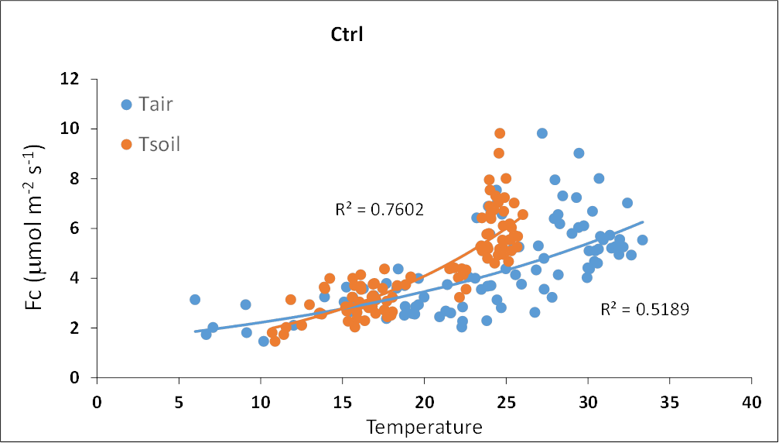
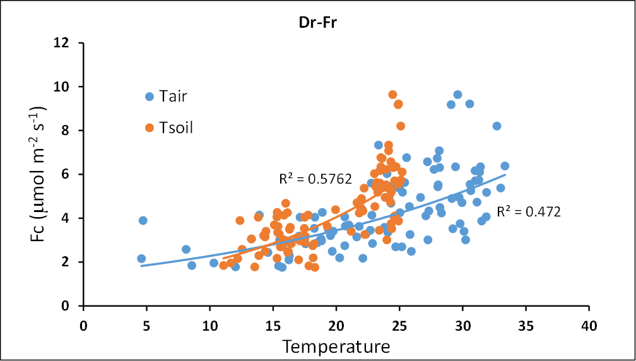
Gap filling strategy
2013 = 14.08
2014 = 13.57 (MgC ha⁻¹ yr⁻¹)
2013 = 13.78
2014 = 13.29 (MgC ha⁻¹ yr⁻¹)

Slide 3
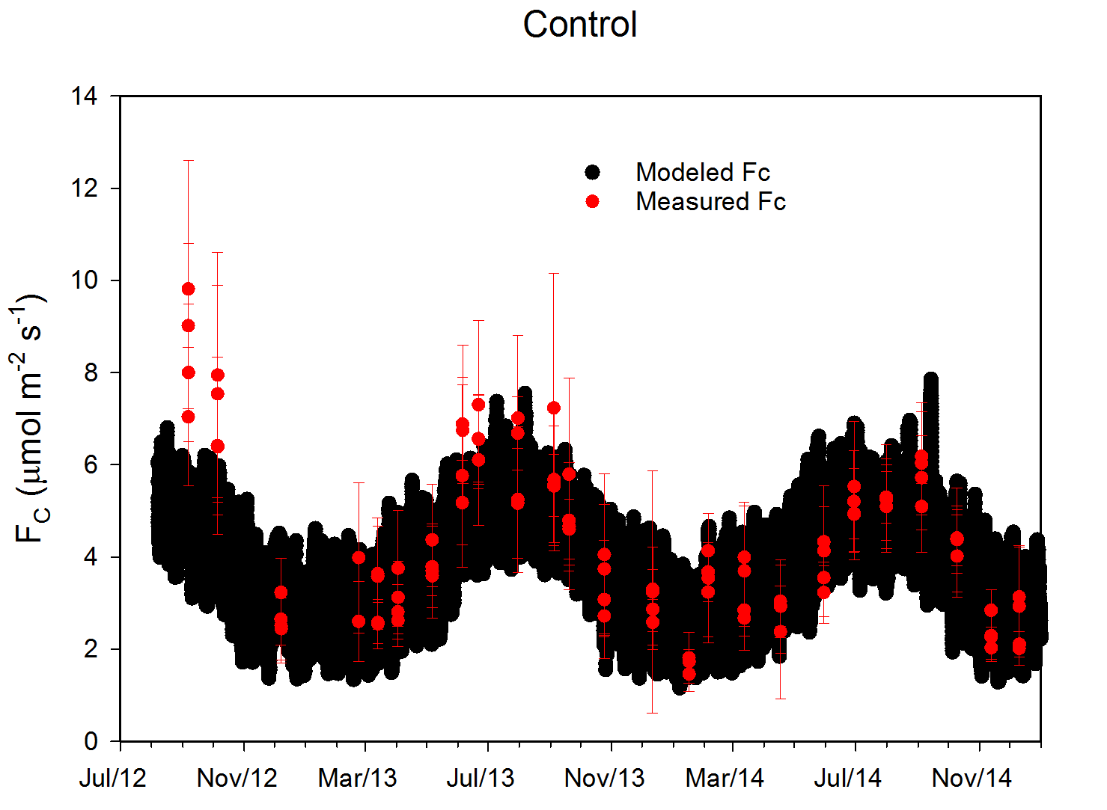
2013 = 14.08
2014 = 13.57 (MgC ha⁻¹ yr⁻¹)
Slash pine plantation
(Moncrieff & Fang 1999)
13.9 (MgC ha-1 yr-1)
Live roots res = 53%
Decomp OM = 47%

Slide 5
NEP (biometric) vs NEP eddy covariance
Bracho et al 2012

