Slide 1
A Southeastern-wide Synthesis of autotrophic and heterotrophic (R_{a}/R_{h}) partitioning of soil respiration in loblolly pine plantations of the PINEMAP Network
Pinemap et al

Slide 2
Current Available Data
Data available on google drive
  Robert Brown
  Josh Cucinella
  Wen Lin
Could not access any data on TerraC
Other contributors
  Kristin McElligott, John Seiler, Brian Strahm
  Jinyan Yang, Robert Teskey
  Jason Vogel, Casey Meek, Rod Will

Slide 3
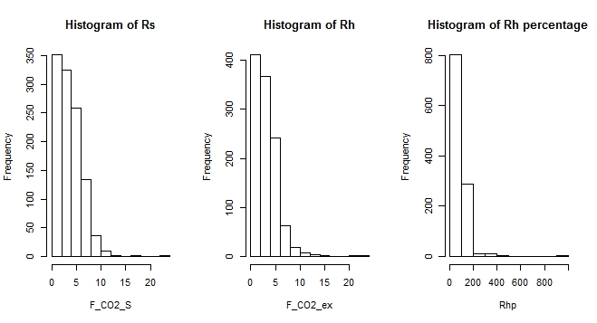
1119 total sample pairs (Rsoil, Rexlcusion)

Slide 4
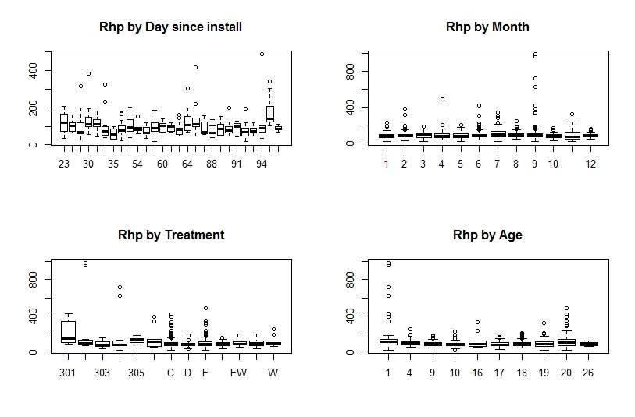
Data are for all days since installation of core

Slide 5
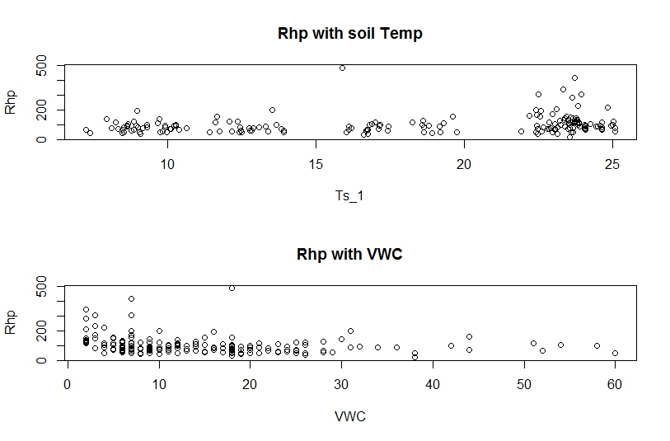
Rh percent with soil temperature and moisture
>60 days

Slide 6
Future needs
Require Qa in current data, improved formatting of template
Require additional data sources
Will develop multivariate models

