Slide 1
Regional Rs model validation
PINEMAP RhRs conference call , 11/30/2015
Asko Noormets

Slide 2
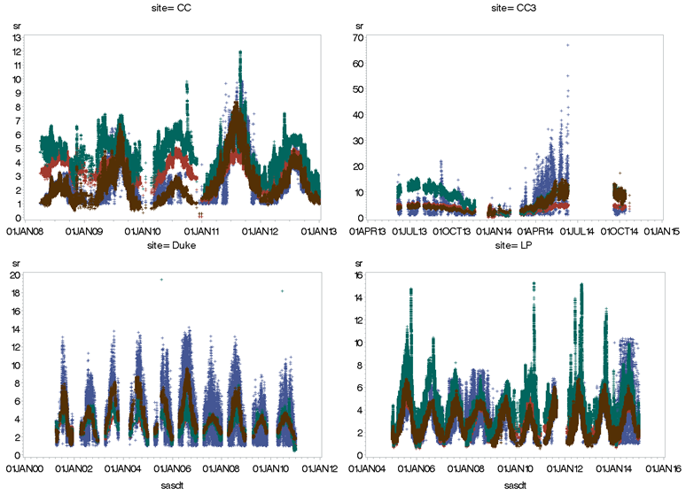
Rs (observed, 1P-, 5P- & Q₁₀- models)

Slide 3
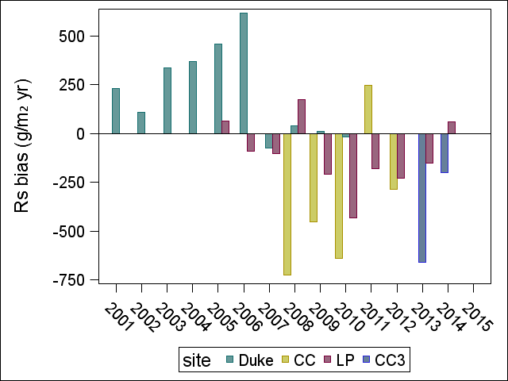
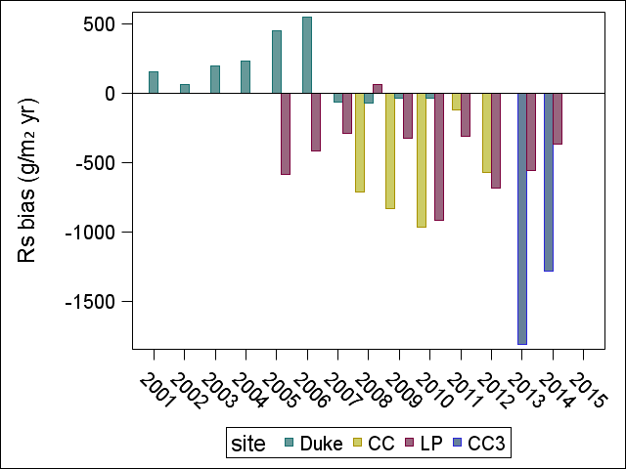
Annual flux biases (1P & 5P)
CC: -373 ± 384 g C m⁻² yr⁻¹
CC3: 171 ± 355 g C m⁻² yr⁻¹
Duke: 240 ± 382 g C m⁻² yr⁻¹
LP: -131 ± 176 g C m⁻² yr⁻¹
CC: -839 ± 134 g C m⁻² yr⁻¹
CC3: -740 g C m⁻² yr⁻¹
Duke: 190 ± 350 g C m⁻² yr⁻¹
LP: -251 ± 439 g C m⁻² yr⁻¹

Slide 4
Validating Rh:Rs partitioning coefficient
PINEMAP RhRs conference call , 11/30/2015
Asko Noormets

Slide 5
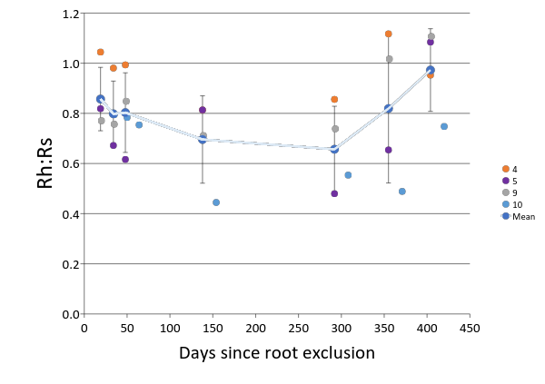
Rh:Rs ratios from 1m³ soil pits, Plymouth 2009

