Slide 1
MACA: Future Time Periods
Proposed 20-year periods (as of Dec 2014):
  2020-2039, 2040-2059, 2060-2079, 2080-2099
Several modelers already using / planning to use
Is everyone OK with these?
Notes:
*presented these at the ATP about a year ago. Do these periods work for everyone? Models that require rotation length would need to use 20-year rotations. I have been told that you don't have a ton of productivity gains after year 20. Is there another compelling reason for doing the 25-year rotations? Several modelers are already using or planning to use these future periods, e.g. WaSSI regional runs, DayCent. It seems like 20-year slices will be the most pragmatic choice, but we wanted to make sure the idea passed the group check.

Slide 2
MACA: Climate Model Baseline Period
Recommended climate model baseline period: 1950-2005
How can you run a model for the climate model baseline period (1950-2005) with models that require rotation length, e.g. 20-years?
Potential solutions:
  Two climate model baseline runs: 1950-1969 & 1970-1989 OR 1966-1985 & 1986-2005 then average the two runs?
  For models that require rotation length, use 1986-2005 period as climate model baseline period. Otherwise, use 1950-2005.
    Potential issue: outputs from WaSSI that are similar to 3PG, G&Y?

Slide 3
DSS maps: color schemes
Preferred color schemes for DSS regional model maps?
  Consistent color ramps for regional map outputs?
    If yes, what would those be?
    If no, we can create tool-specific or variable-specific color ramps.
  Examples (created for DSS tools)
Notes:
*we will look for recommendations from the modelers about any preferred colors to use for their output
*example: what are appropriate colors to use for low vs. high green weight values?
*note: colors we chose are generally unambiguous (i.e., brown = dry, green = wet) and span a fairly wide range so there is decent contrast on the maps (e.g., the summer temperature color ramp spans blue/green/yellow/orange/red/pink), so we will expect the same for the model output.

Slide 4
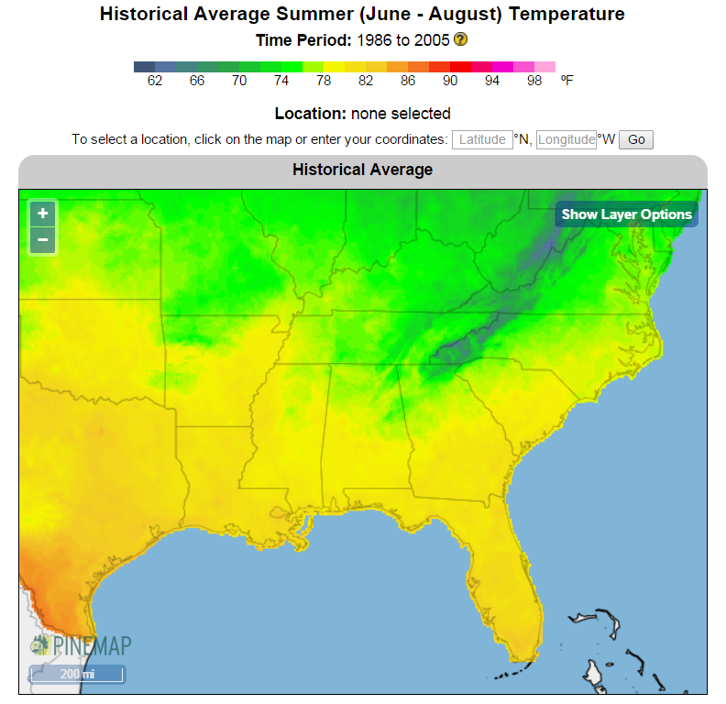
Color Scheme Examples

Slide 5
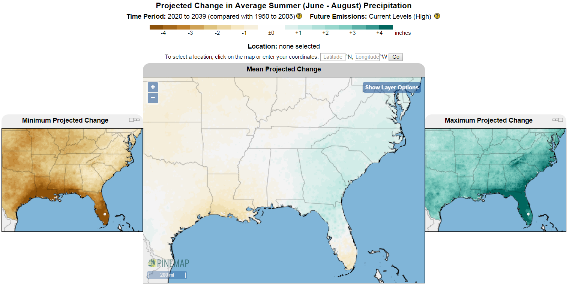
Color Scheme Examples
Notes:
*wanted to point out that change maps will likely have different color ramp than historical and projected averages

Slide 6
Extra Slides

Slide 7
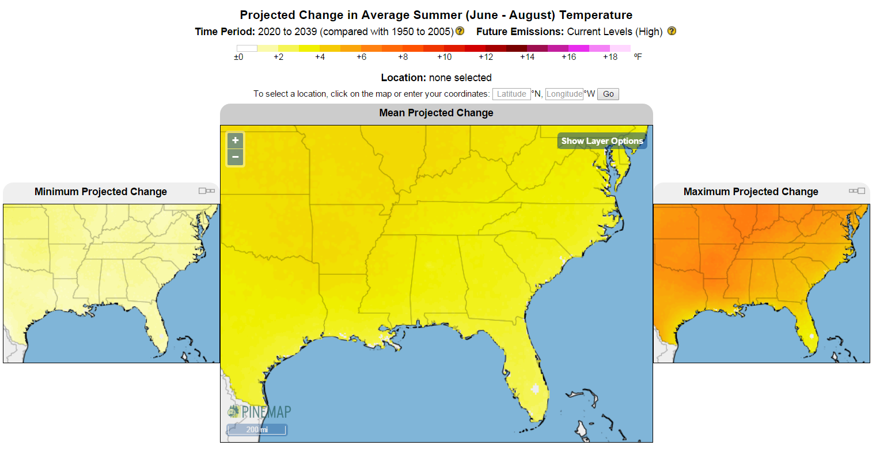
Color Scheme Examples

Slide 8
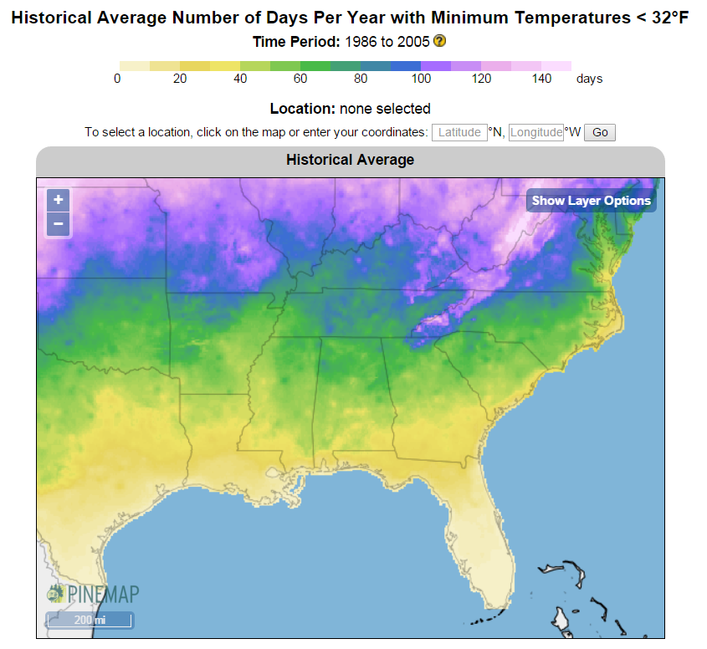
Color Scheme Examples
Notes:
*tried to mimic USDA hardiness zones

Slide 9
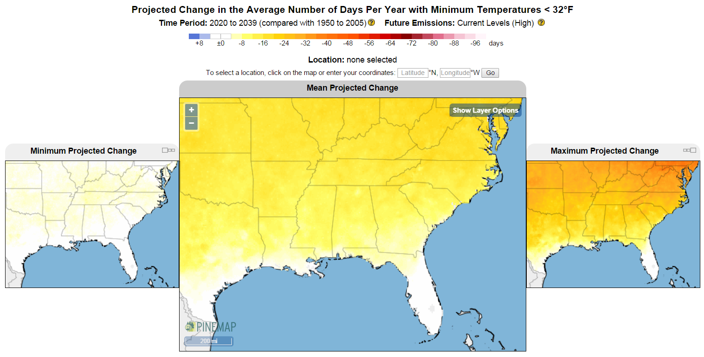
Color Scheme Examples
Notes:
*notice similar color ramp as previous projected change example despite the fact that this is a negative change and the other one (change in summer avg temp) was positive change -- overall effect is warming in both which is why we used warm colors
(in other words… even though extreme min temp is negative change, used warm colors since it is change in number of days -- because min temps are warming despite it being a negative change)

Slide 10
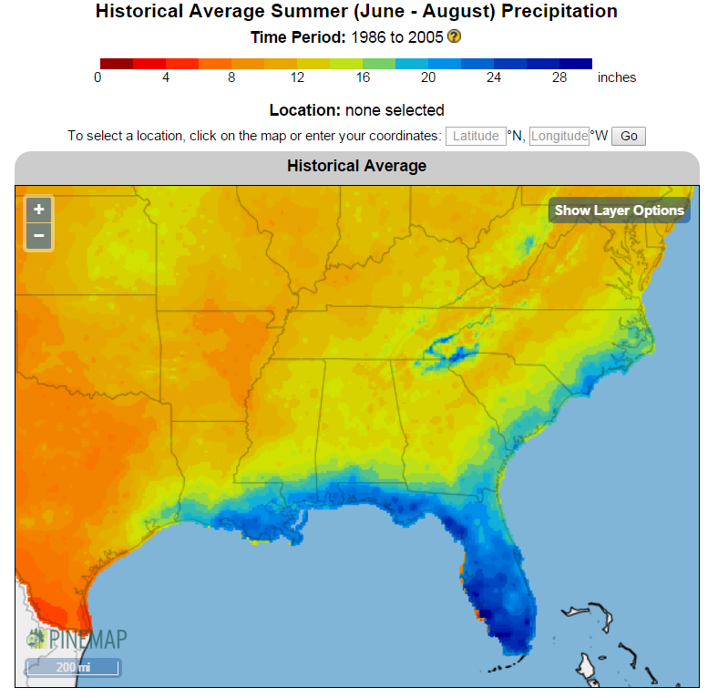
Color Scheme Examples

Slide 11
Other resources
New MACA FAQ website: http://climate.ncsu.edu/hadinon/pinemap/MACA_FAQs.php
(one of the questions addresses how to run an ecological model with MACA data and analyze the output)
Notes:
If time permits

Slide 12
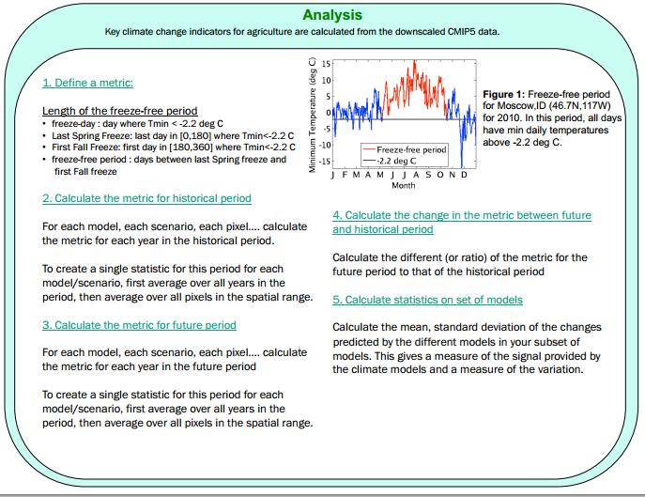
Another Example Application with MACA
Note: historical = model baseline
Notes:
*cover this if time!

