Slide 1
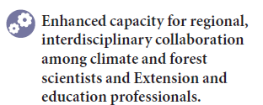

PINEMAP Outcome Theme

Slide 2
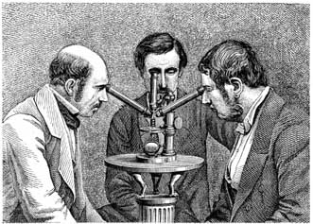
Team Science
Crossing boundaries
  Institutions
  Geography
  Disciplines
  Research + Education + Outreach
  Academia Stakeholders

Slide 3
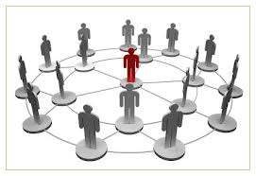
Know the net, Knit the net
Valdis Krebs

Slide 4
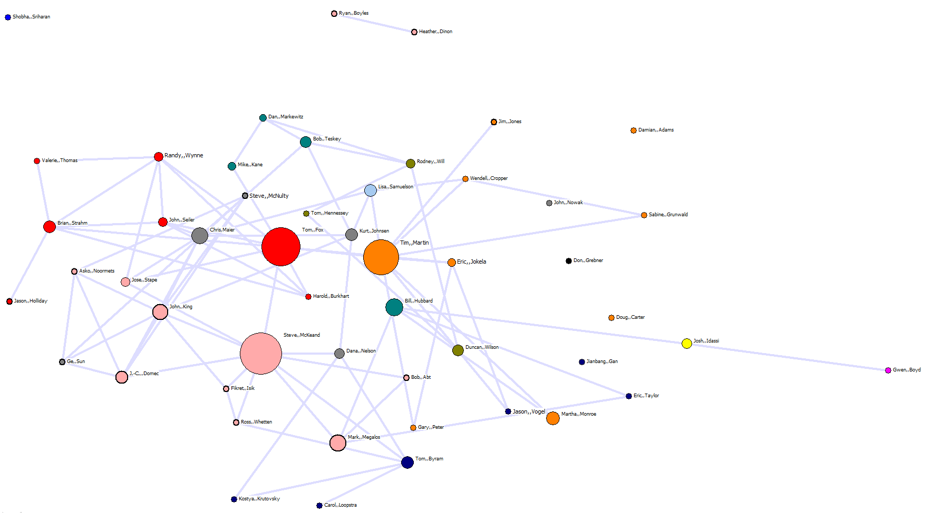
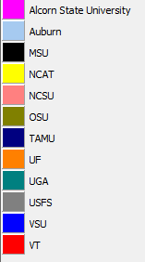
Network BASELINE
Shows the 51 original PIs with visualization based only on the STRONGEST TIES (people who worked together very closely prior to PINEMAP)
Node color = INSTITUTIONS (see legend)
Node size is betweenness centrality (larger nodes are in key positions to broker interactions across the whole PINEMAP network )

Slide 5
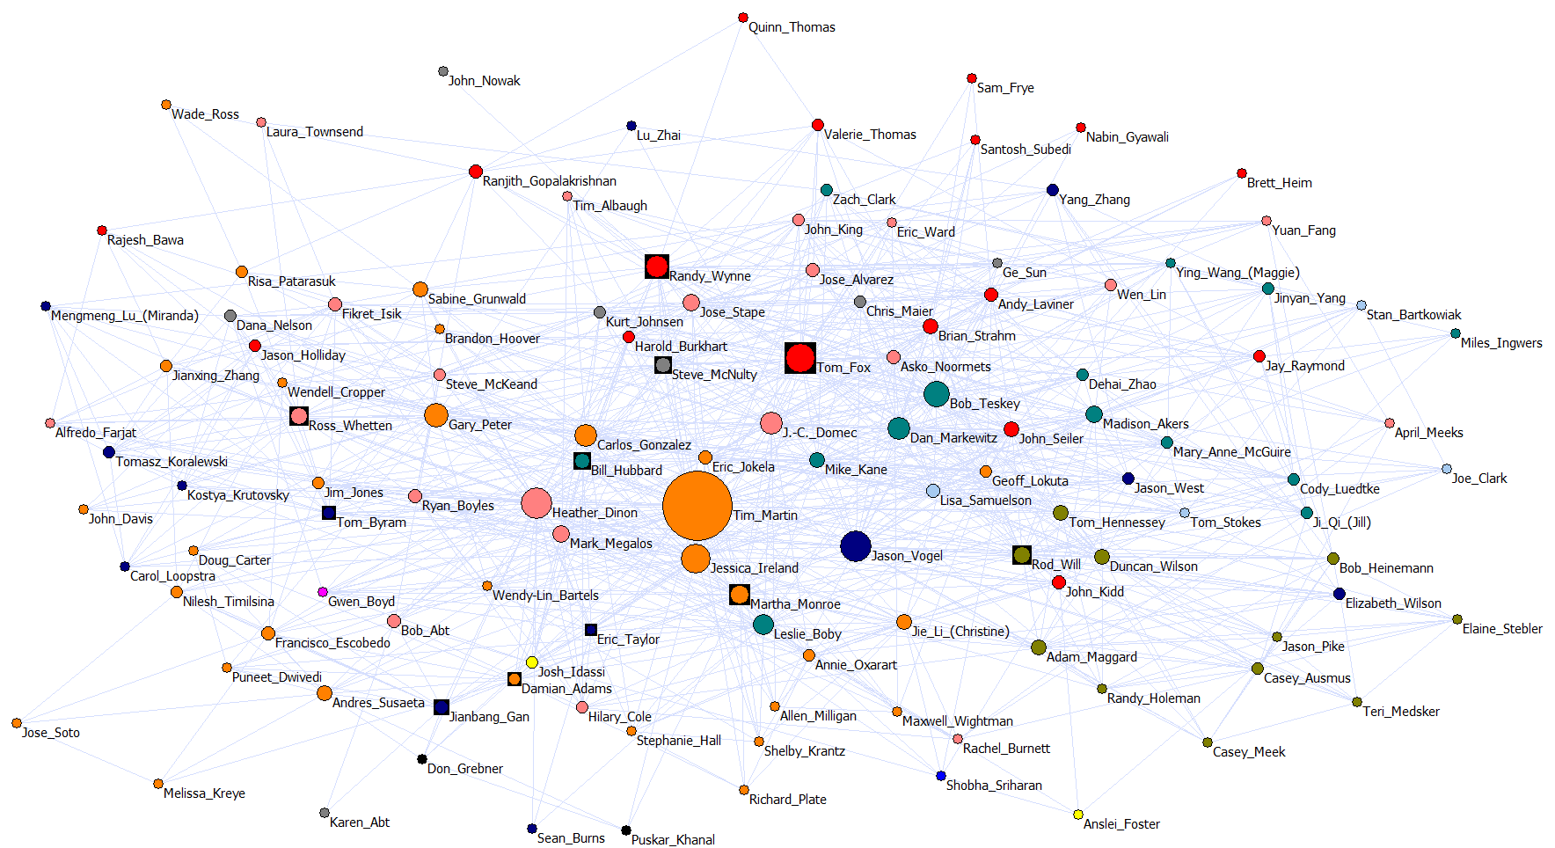
Whole PINEMAP network (2013)
Visualization based only on strong ties (3-4 tie strength --- collaboration & shared thinking)
Node color = INSTITUTIONS (see legend).
Boxes = AIM leaders.
Node size is betweenness centrality (larger nodes are in key positions to broker interactions for collaboration and shared thinking across the whole PINEMAP network )

Slide 6

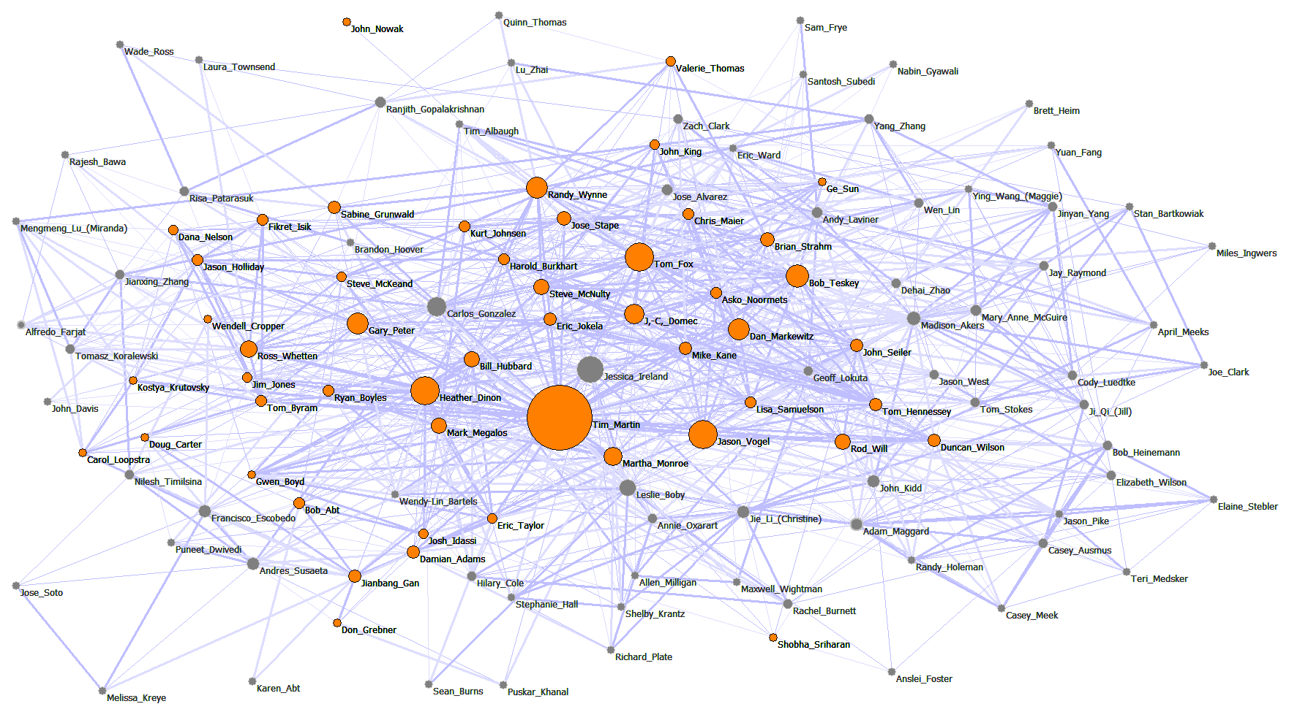
WHOLE PINEMAP Network (2013)
Visualization based on strong ties (3&4 – collaboration and shared thinking).
Orange nodes are the original 51 PIs.
Node size is betweenness centrality (larger nodes are in key positions to broker interactions across the whole PINEMAP network )
2013
Baseline

Slide 7
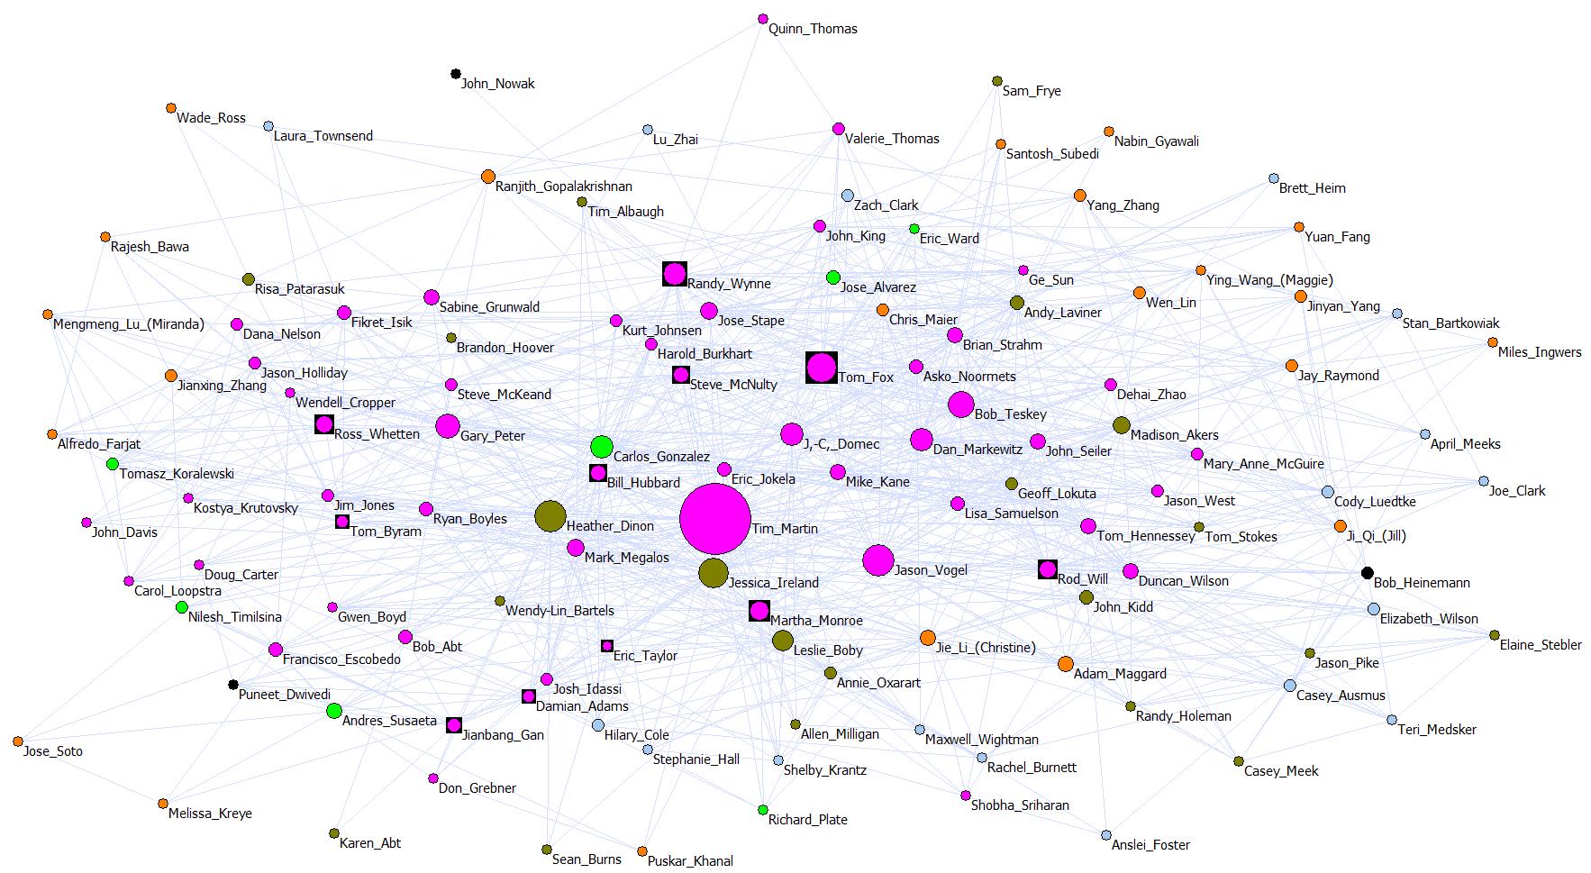
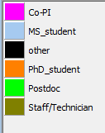
Whole PINEMAP network (2013)
Visualization based only on strong ties (3-4 tie strength --- collaboration & shared thinking)
Node color = ROLES (see legend).
Boxes = AIM leaders.
Node size is betweenness centrality (larger nodes are in key positions to broker interactions for collaboration and shared thinking across the whole PINEMAP network )

Slide 8
Intensity of Interactions in whole PINEMAP network (2013)
Intensity | # Ties | % of the Whole Network
o Limited engagement (0 and 1) | 11978 | 78.5
o Communication (2) | 1746 | 11.4
o Collaboration (3) | 866 | 5.7
o Shared thinking (4) | 662 | 4.3
Total | 15252 | 100

Slide 9

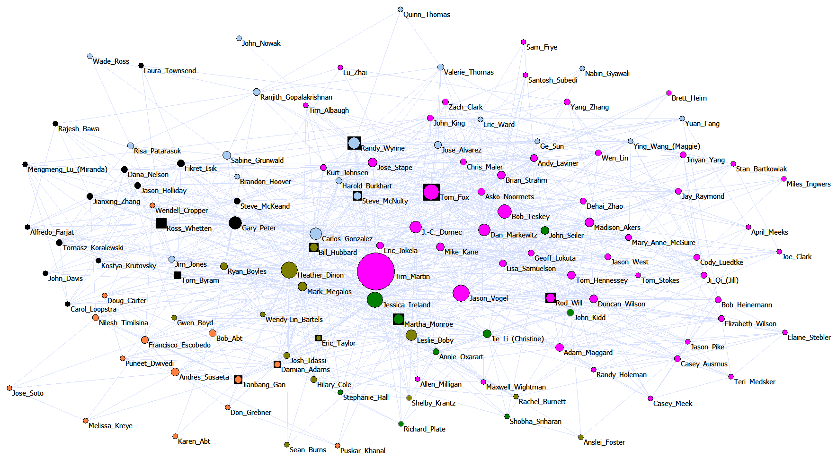
Whole PINEMAP network (2013)
Visualization based only on strong ties (3-4 tie strength --- collaboration & shared thinking)
Node color = AIMS (see legend).
Boxes = AIM leaders.
Node size is betweenness centrality (larger nodes are in key positions to broker interactions for collaboration and shared thinking across the whole PINEMAP network )

Slide 10
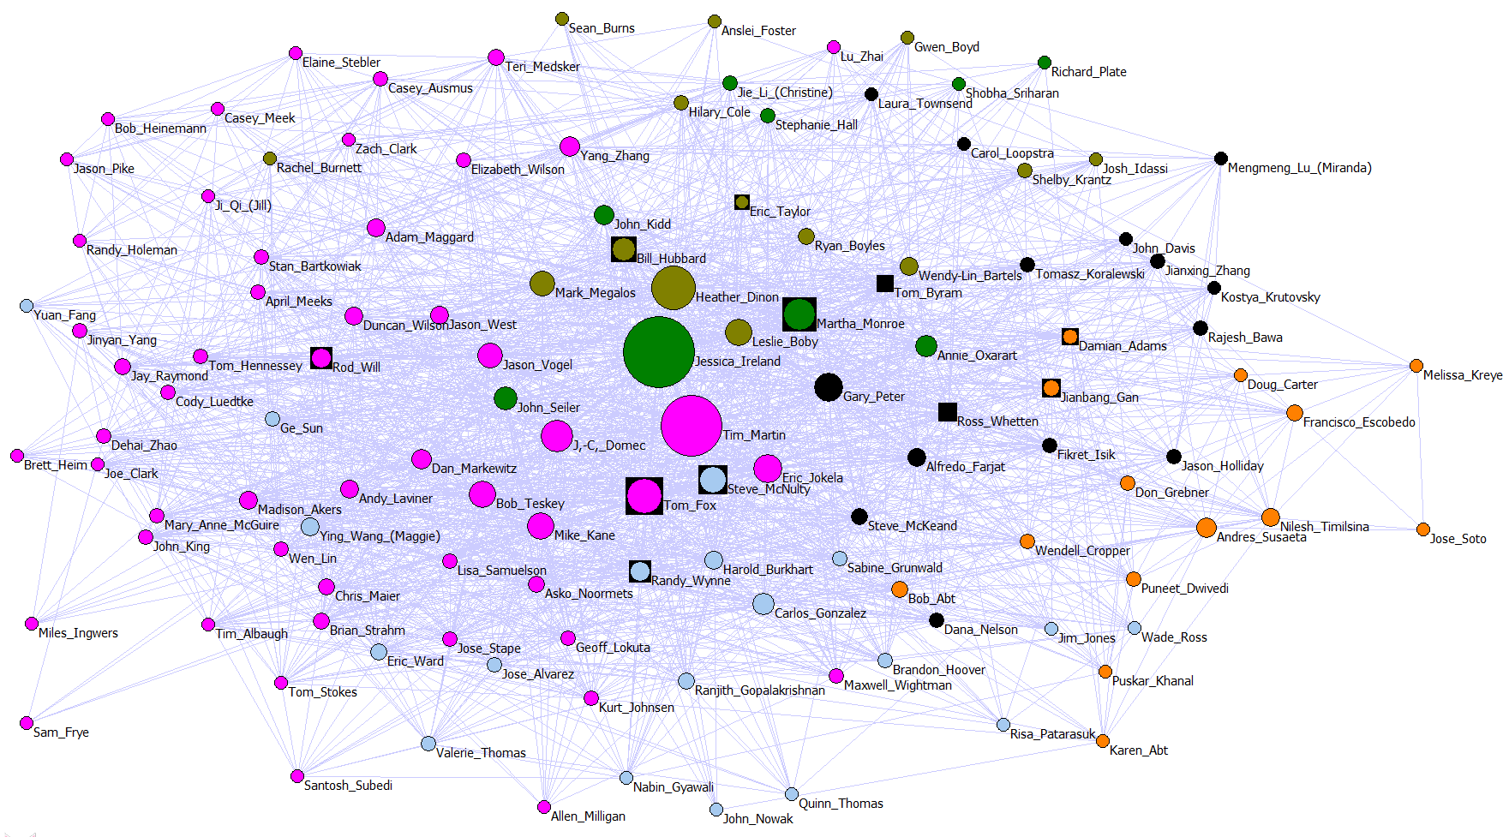
Whole PINEMAP network (2013)
Visualization based on interactions that include communication (2-3-4 tie strength)
Node color = AIMS (see legend).
Boxes = AIM leaders.
Node size is betweenness centrality (larger nodes are in key positions to broker interactions for collaboration and shared thinking across the whole PINEMAP network )

Slide 11
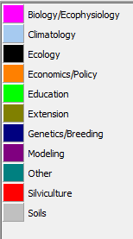
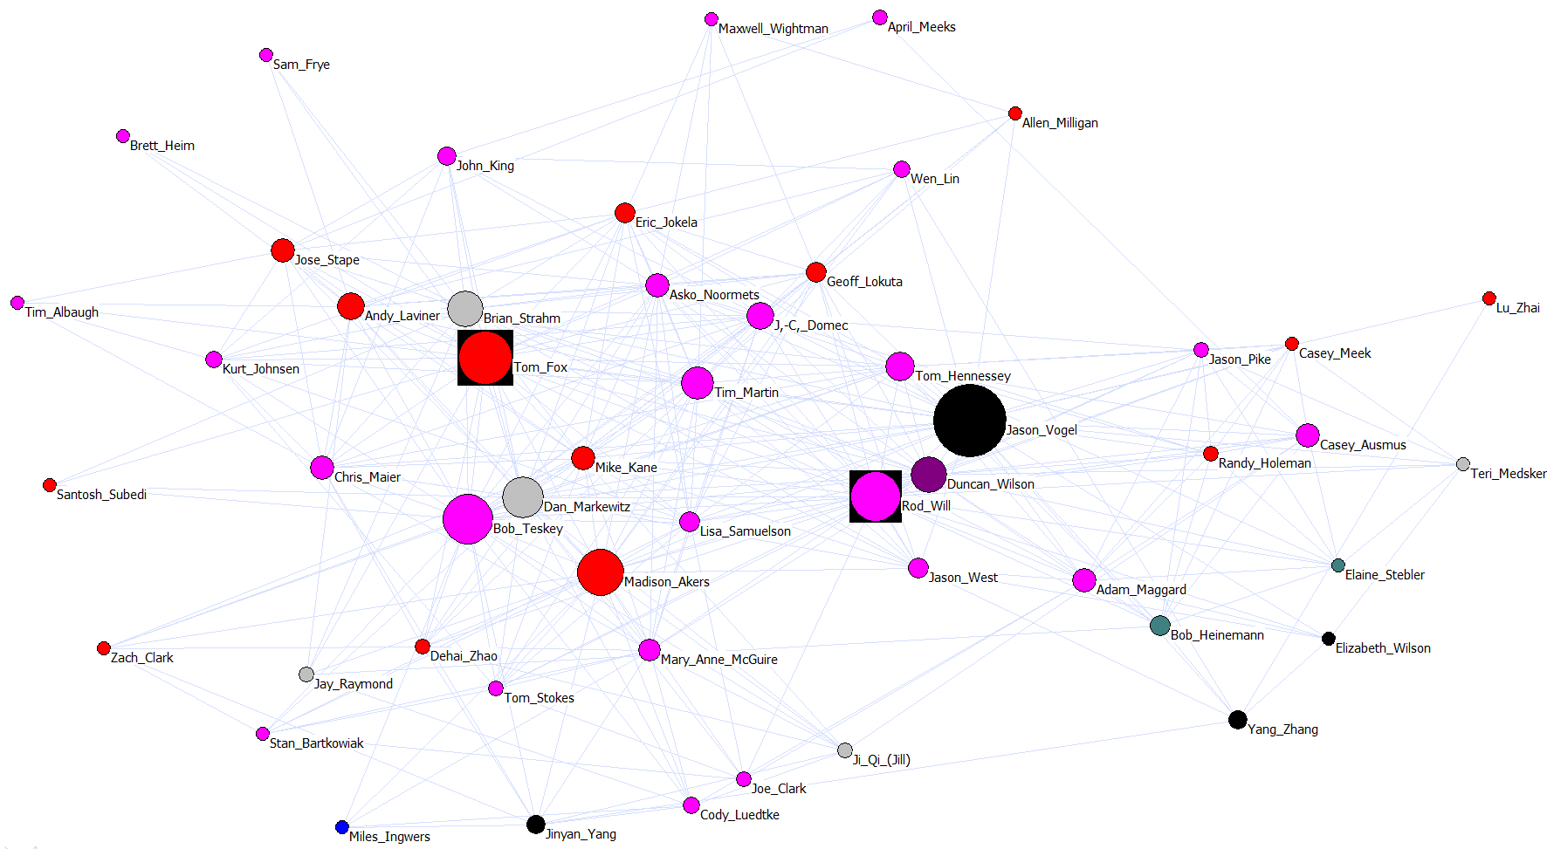
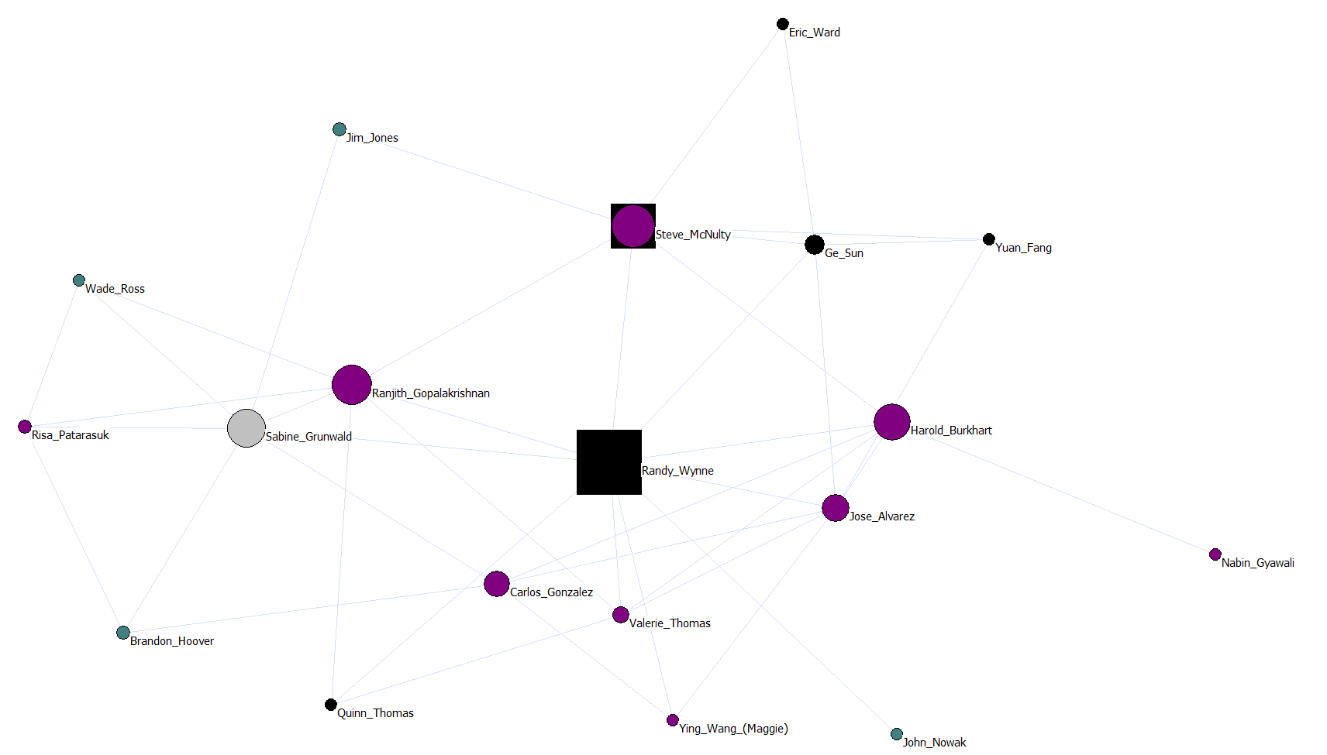
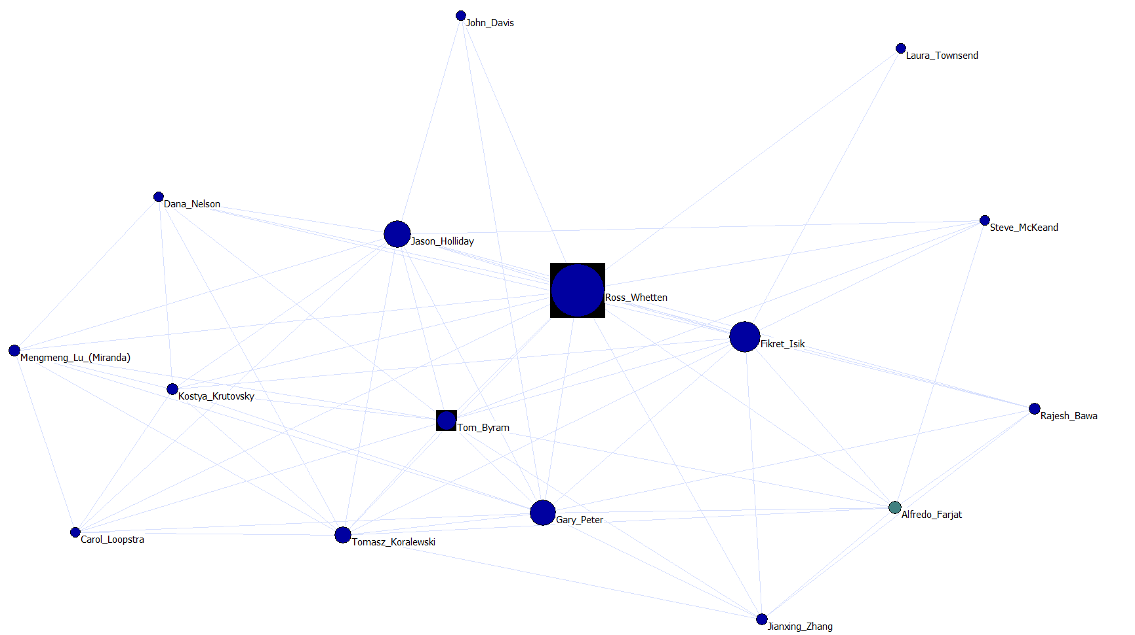
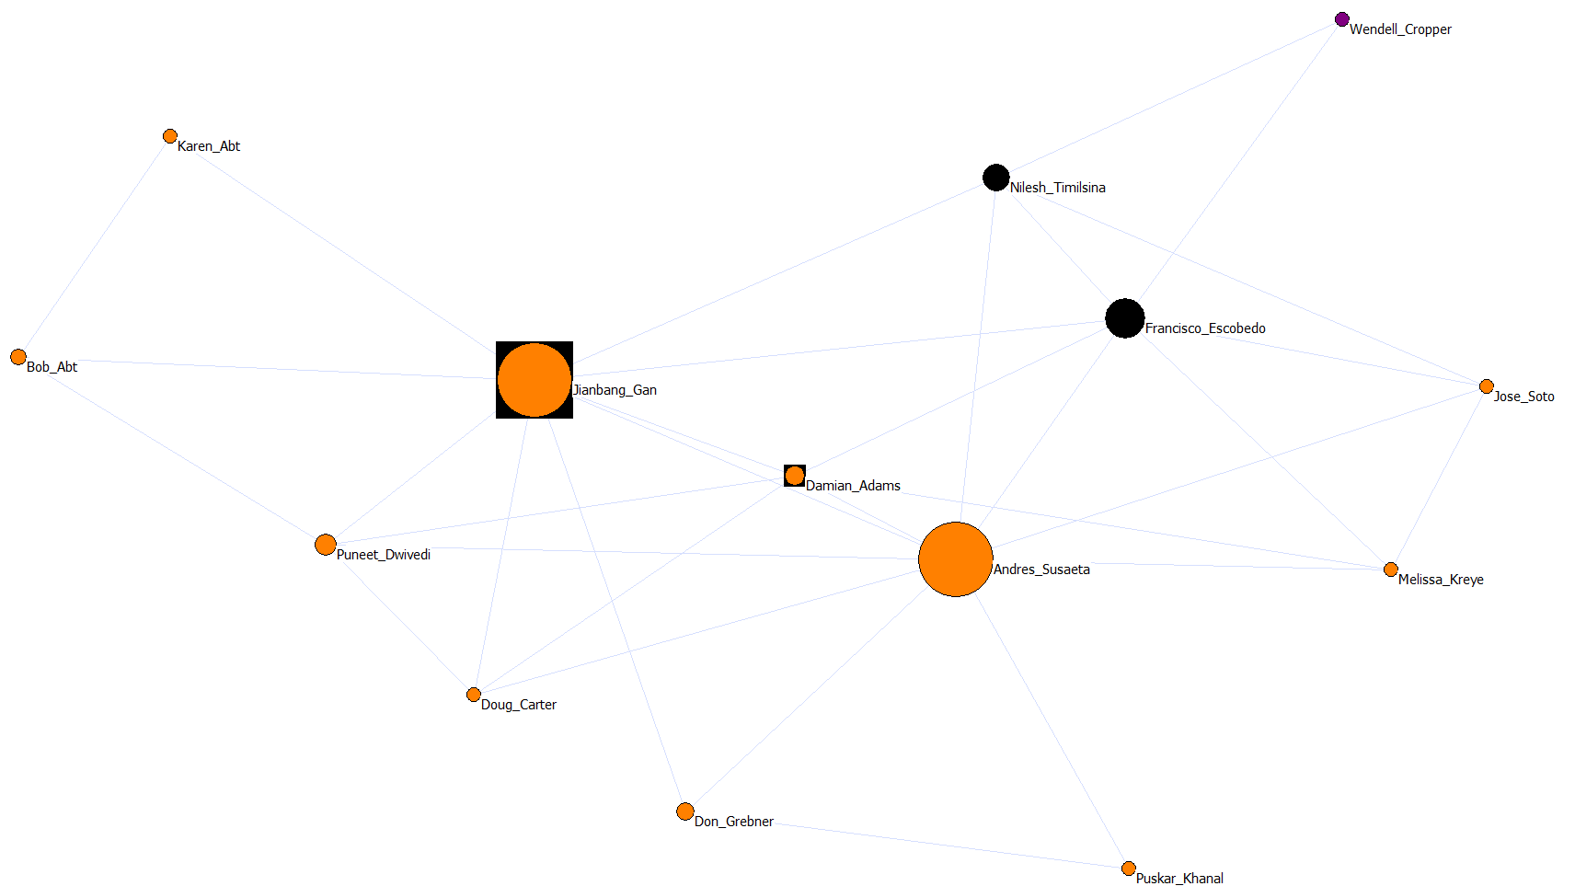
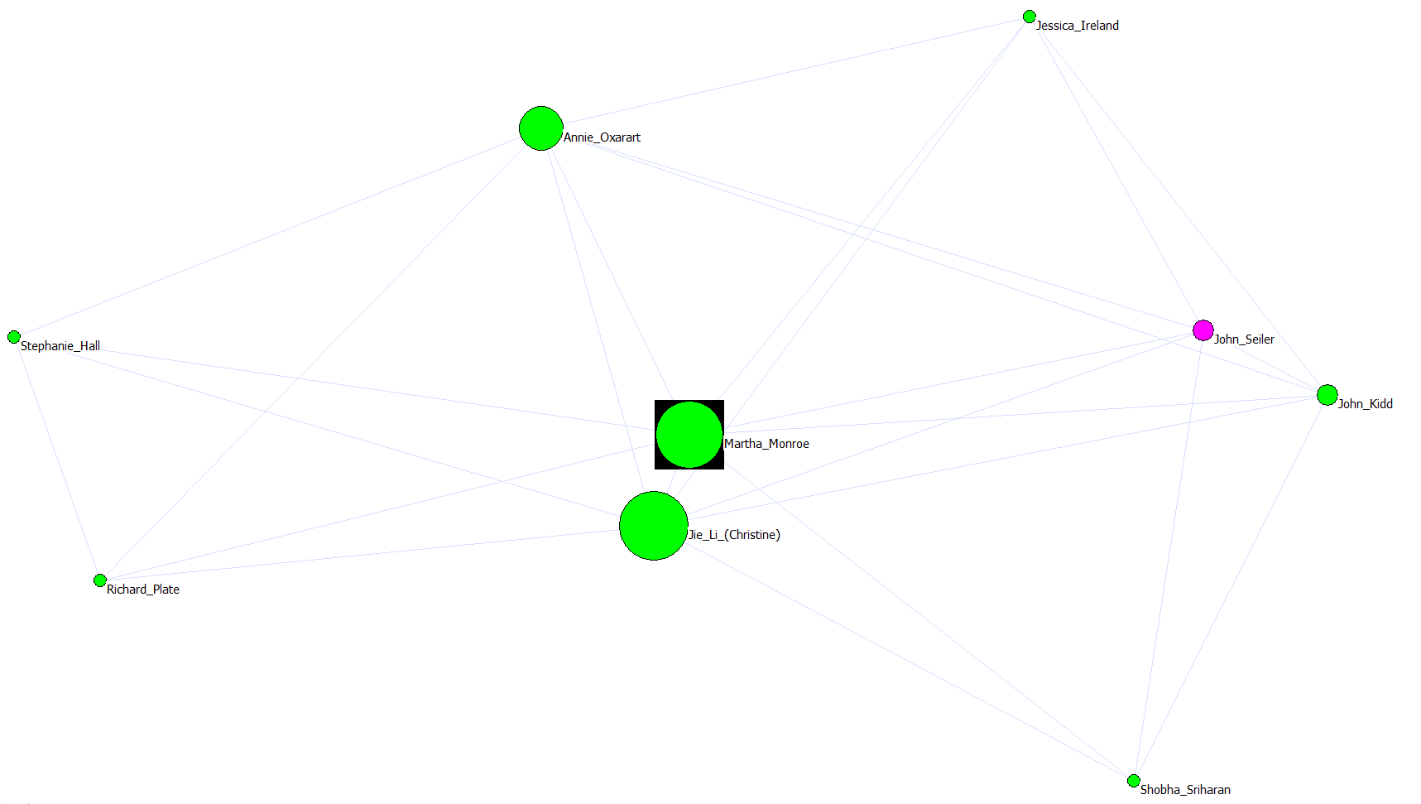
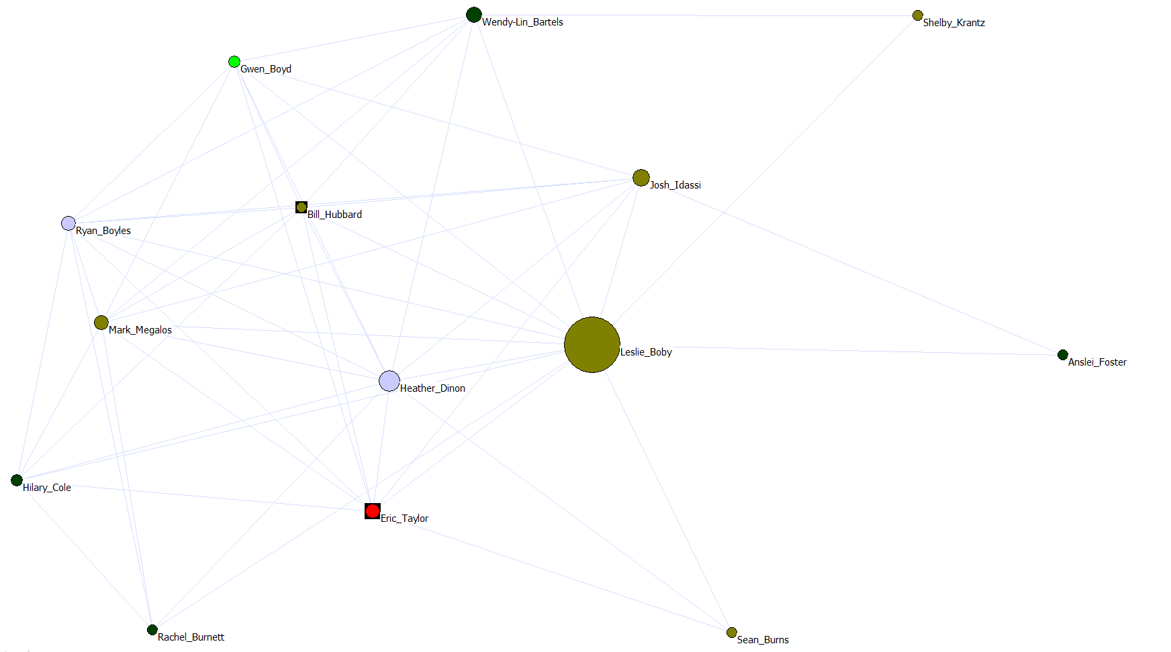
AIMS
1
2
Functional Units within PINEMAP
3
4
5
6

Slide 12
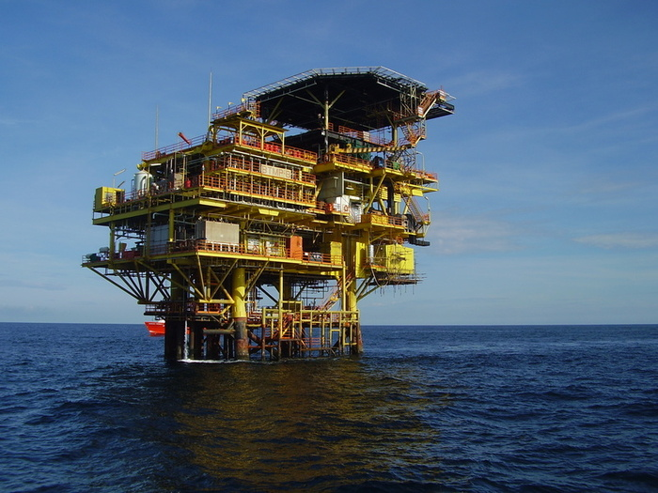
To achieve project OUTCOMES…
Motivate collaboration beyond AIM groups…
How will we cross borders?
Through tasks, activities, questions, or approaches that unite us =INTEGRATION PLATFORMS

Slide 13
PINEMAP
Integration Platforms
Integrating modeling with economic analysis
– Bob Abt
Seed deployment tool development
– Tom Byram
PINEMAP scenario development
– Bob Teskey
DSS tools - Decision Support System development
– Heather Dinon
PLT modules - Project Learning Tree secondary module development
– Martha Monroe
Tech Transfer / Outreach / Extension
  Non-corporate – Eric Taylor
  Corporate – Tim Martin

Slide 14
Using SNA as a tool for reflection
WHO
  Management Team
  Leadership Team (Exec Comm.)
  AIM Teams
  Integration activity members
HOW
  Customized Aim reports
  ATP meetings
  Virtual “public space” for on-going feedback & discussion
WHY
  Raise awareness - Situation assessment
  Build / strengthen relationships – Champion integration

Slide 15
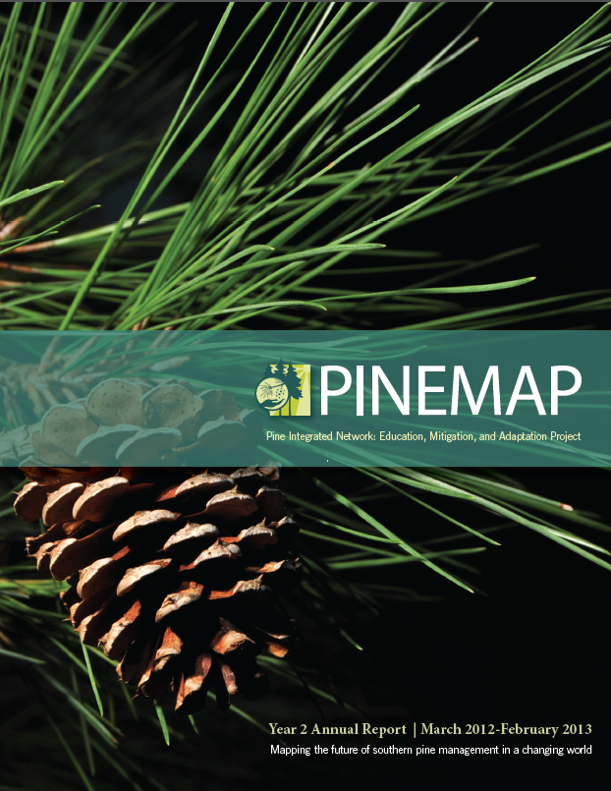
What will our next annual report say about our level of integration?
?
Who needs to step up
to the integration plate?

