Slide 1

2012 Annual Meeting Evaluation Report
PINEMAP Executive Committee Meeting
July 19, 2012

Slide 2
EVALUTATION OBJECTIVES/METHODS
Objectives
Evaluate meeting logistics and degree to which meeting met its objectives
Evaluate effectiveness of project administration, management, and communication
Learn about perceptions of integrated team science
Methods
Data collected via 3 part survey—general meeting evaluation, project administration, integrated team science
20 questions—6 background, 6 closed-ended, 8 open-ended
65 surveys completed
Graphs for quantitative data; theme analysis/synthesis for qualitative data
Notes:
The RFA requires these CAP projects to be integrated, interdisciplinary efforts.
By surveying team members on perceptions of integrated team science, barriers, and solutions, we can quantify how we change as an integrative team over the course of the 5-year project while also identifying areas for improvement, therefore helping us to be more effective.
We can also work with the corn and wheat CAPs to do some cross-CAP comparison and ultimately provide input and feedback to NIFA regarding how these mega, integrated, interdisciplinary projects work, what the challenges are, and suggest some ideas and solutions.
Finally, W-L Bartels who is leading this effort/research needs some scientific, research based material.

Slide 3
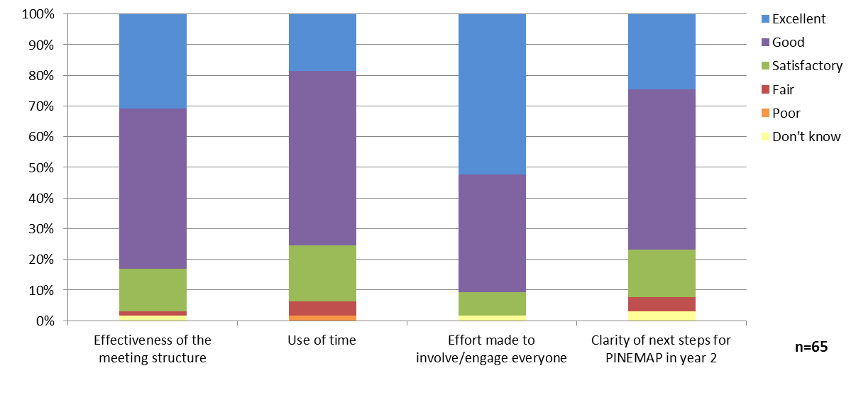
General meeting evaluation
Notes:
In general, we received positive feedback about the meeting structure, use of time, participant engagement, and next steps. Participants were most satisfied with the effort made to involve everyone at the meeting

Slide 4
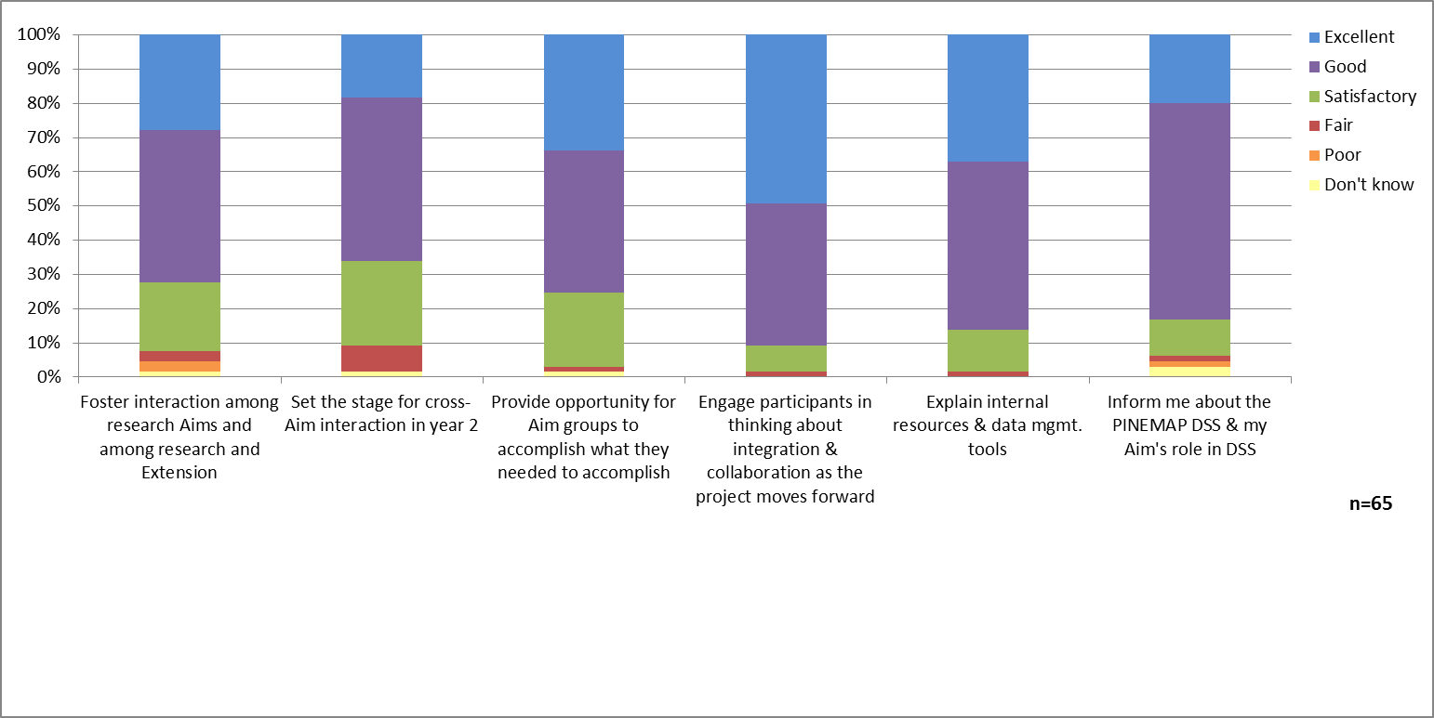
General meeting evaluation
Notes:
In terms of achieving our specific meeting objectives, responses indicate that we could perhaps have done better at setting the stage for cross Aim interaction in year 2 as well as fostering interaction among Aims and specifically among research and extension

Slide 5
General meeting evaluation
Most valuable component
Interaction and network building
Aim breakout sessions
What was missing
Cross-Aim meetings
Research results, technical presentations
Progress updates
Unstructured/informal time
More Aim breakout time
Graduate student engagement
Notes:
Qualitative results show that participants most valued interaction opportunities for network building, learning, sharing and exchange as well as the Aim breakout sessions.
In response to what was missing from the meeting, participants indicated that they would have liked more progress reports and scientific or technical presentations. Furthermore, opportunities for cross-Aim integration and planning meetings were somewhat lacking. A few respondents also felt that use of time during Aim breakout sessions could have been better managed. In future meetings, planners might consider providing space for more unstructured/informal time.

Slide 6
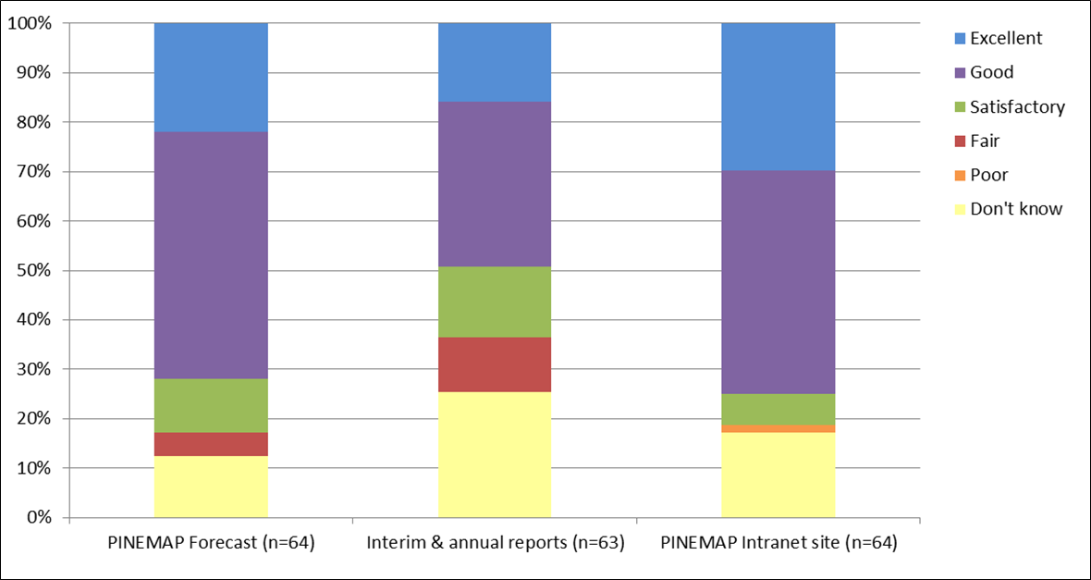
Project administration: Communication resources
Suggestions for improving materials:
Reduce level of detail in reports
Share success stories/progress updates
Use Intranet for sharing results, protocols, etc.
Notes:
Results show that approximately 85% of respondents read the PINEMAP Forecast and 81% access the PINEMAP Intranet site and find these resources useful to them personally.

Slide 7
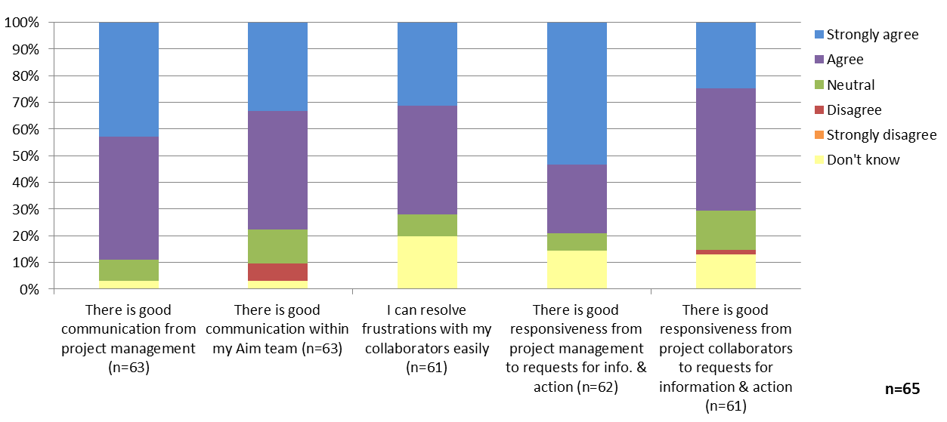
Project administration: communication
Notes:
The majority of respondents (89%) agree that there is good communication from project management. In addition, although most participants are satisfied with communication among members of Aim groups, almost 20% of individuals responded neutrally or somewhat negative regarding within Aim communication. Participants also provided specific, qualitative feedback and suggestions on what is working and what is missing related to project management communications.

Slide 8
Project administration: communication
What is working
Most people satisfied with communication from project management (informative, efficient, about right given needs)
What is missing/what could be improved
Decision-making/Coordination
Need to est. decision-making processes
Consistency—need clear direction in terms of goals/objectives
Need for better coordination:
More within Aim progress updates/communication
Cross-Aim linkages
Extension Aim feels out of the loop
Communication
More periodic Aim meetings, interactions
Emphasize efficiency
Recognize personal responsibility/commitment

Slide 9
Integrated team science
Challenges
Diversity
Different disciplinary backgrounds, priorities, expectations
Difficulty understanding others research areas, getting on the same page, hard to relate to other’s findings
Preconceived notions of other Aims, concentration on one Aim
Time
Communication
Process of team work
Different working styles, procedures
New and unfamiliar, lack of expertise
Varying needs and incentives
Synchronization
Speed of deliverable development
Keeping up with outcomes
Distance
Notes:
As might be expected, participants perceive the major challenges to integration within PINEMAP to be limited time, problems with communication, and distance among participants.
Interestingly, however, the largest number of responses relates to the challenge of managing diversity within the context of disciplinary backgrounds, priorities, and expectations, the ability to relate to one another’s work, preconceived notions of other Aims, etc.
Many participants also mentioned that teamwork presented difficulties, especially to those unfamiliar with working in an integrated manner.
Synchronizing the timing of completion of deliverables and outputs across Aims appears to be another important problem PINEMAP is likely to face.

Slide 10
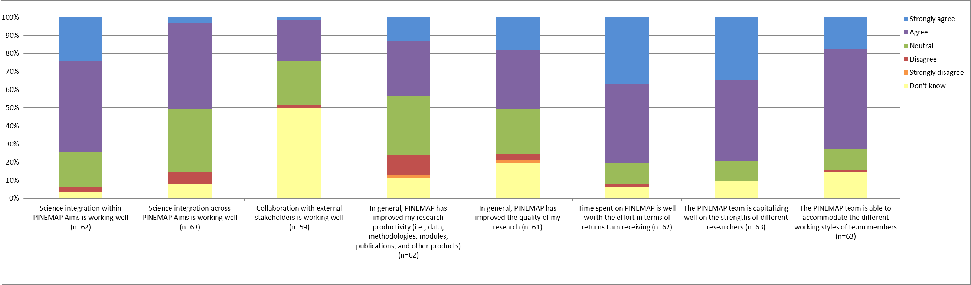
Integrated team science
Notes:
We asked respondents to think about science integration within PINEMAP—how well it is working, if PINEMAP is improving research productivity and/or quality, if PINEMAP is capitalizing on strengths of different researchers and able to accommodate different working styles.
When asked about science integration within PINEMAP Aims, 74% of respondents agreed that it is working well. However, only 51% agreed that cross-Aim integration is working well.
Furthermore, although 44% of respondents believe that PINEMAP is improving their research productivity, 13% of respondents do not agree. At this stage, we all realize that there is a lot of input and effort, or “transaction costs” without a lot of outputs—this is to be expected at this stage in the project, and we are glad folks are being honest.

Slide 11
Integrated team science
Notes:
At the same time, 51% of respondents agree that PINEMAP has improved the quality of their research and 81% feel that time spent on PINEMAP is well worth the effort in terms of returns they receive.
Results also suggest that the PINEMAP team is doing a fairly good job of accommodating the different working styles of team members and capitalizing on strengths of different researchers

Slide 12
Integration: Ideas to create success
Short, focused on site workshops around particular objectives; more face-to-face problem-specific (focused) working groups
Regular meetings and interactions among Aim members
request feedback from Aim members on current needs and impacts
make sure to clearly define areas of responsibility
More cross-Aim meetings to illustrate how different Aims relate to each other; create cross-Aim sub-groups (like the DSS sub-group)
Water cooler idea—regularly scheduled meetings for all PINEMAP team members to discuss issues, ask questions, brainstorm, etc.
Research summaries for each pub.
Closer interaction with Extension to better understand the client base; include scientists in outreach
Sharing success stories (both internal and from other integrative projects); disseminate information about outcomes
Identify examples of integrated outputs
Notes:
Some ideas to create success in integration within PINEMAP included…

Slide 13
Next steps
Capitalize on what is working well!
Identify key areas for improvement: coordination/decision-making, communication, and integration
Identify solutions to overcoming challenges
Implement/revamp resources, tools, and mechanisms to facilitate communication and interaction within/among Aims
Notes:
If you’ve had a chance to review the annual meeting report, we’d like to hear your input/feedback before it is rolled out to the entire team.

