Slide 1
Genetics Aim: ATP meeting 10/31/2014
Tom Byram, Alfredo Farjat, Jason Holliday, Fikret Isik, Tomasz Koralewski, Kostya V. Krutovsky, Carol Loopstra, Mengmeng Lu, Steven McKeand, Dana Nelson, Gary Peter, Ross Whetten, Jianxing Zhang
NC State University, Texas A & M, University of Florida, Virginia Tech

Slide 2
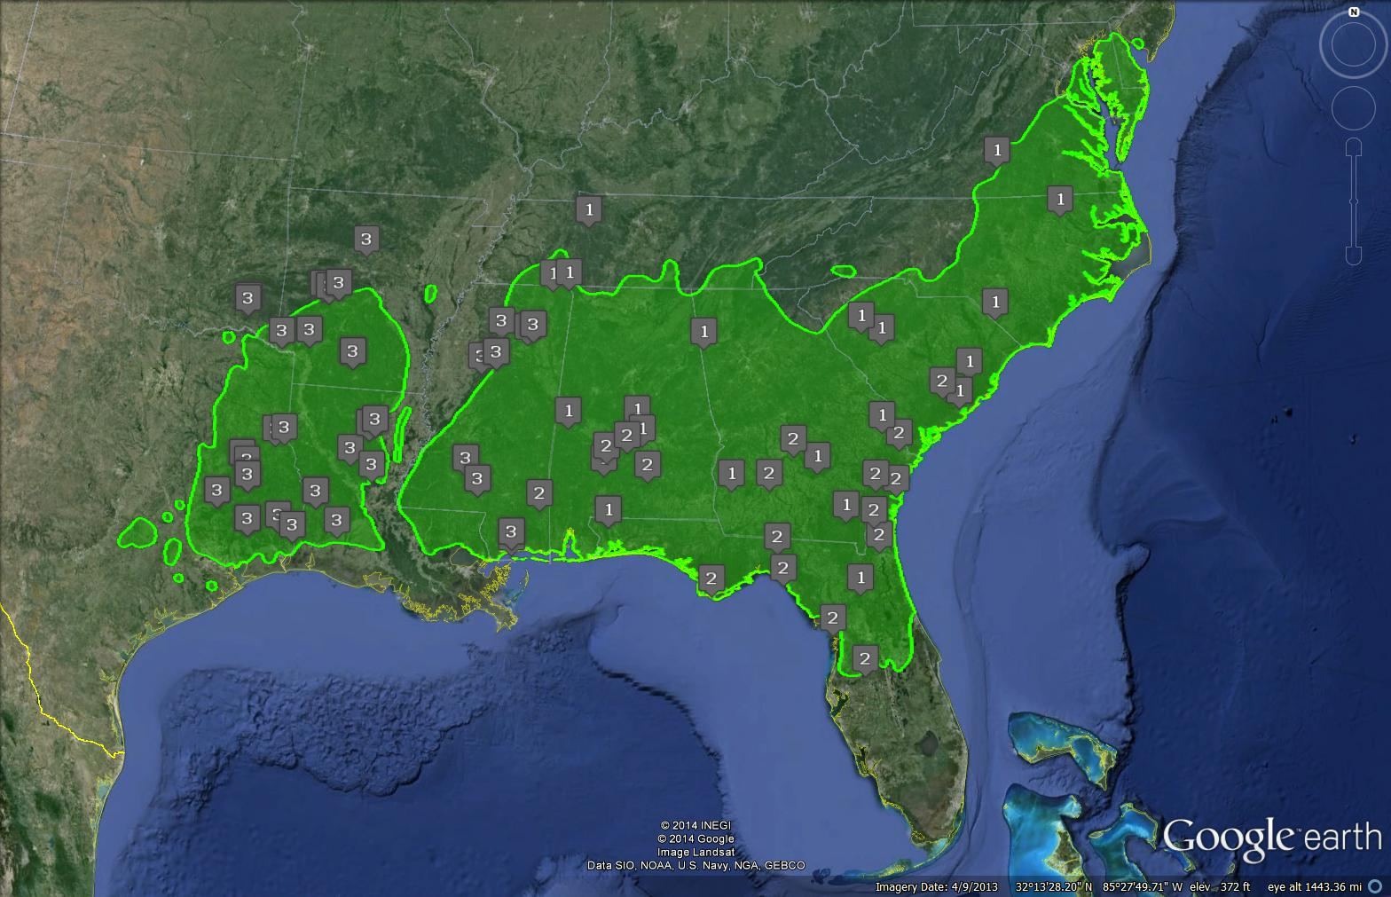
Two Objectives
Deliver deployment guidelines for genotypes suited for varied climatic conditions to maximize resiliency and reduce adverse impacts of climate change on productivity
Deliver deployment guidelines for genotypes suited for varied climatic conditions to maximize resiliency and reduce adverse impacts of climate change on productivity
Analyze genetics of breeding and natural populations to discover alleles in genes controlling important adaptation and mitigation traits that enable future tree breeding strategies
Analyze genetics of breeding and natural populations to discover alleles in genes controlling important adaptation and mitigation traits that enable future tree breeding strategies

Slide 3
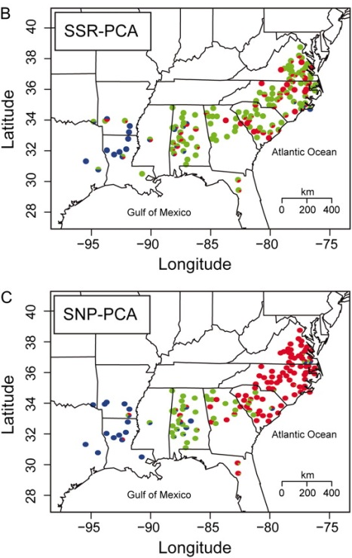
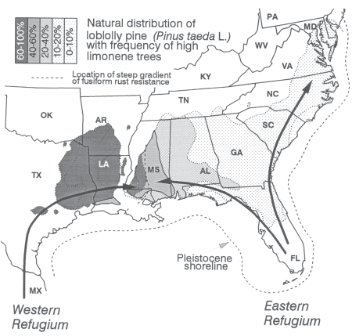
Genetic Diversity of the Natural Loblolly Population
Eckert A J et al. Genetics 2010;185:969-982
Western & Eastern populations
Analysis of population structure based on ~3000 genetic variants in 622 trees from across the range is consistent with a 2 population model
Schmidtling, R., 2003, ISHS Acta Horticulturae, 615: 203-209

Slide 4
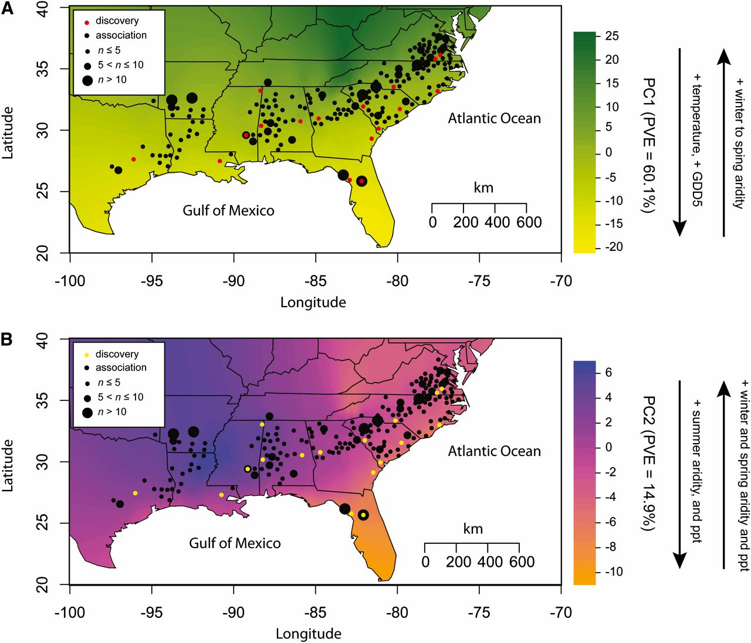
Genetic Basis & Evolution of Fitness-related Traits in Loblolly
Height
Goal: identify alleles of genes in breeding populations that affect growth and adaptation in order to improve performance prediction and minimize risks of loss
Eckert A J et al. Genetics 2013;195:1353-1372

Slide 5
Loblolly Pine Breeding Populations
Northern ACP
Piedmont
Upper Gulf
 | Wild Seed Selection | Phenotypic selection Location of origin = Provenance
Cycle 1 | Genetic Testing | Common garden plantings to evaluate maladaptation, growth, form, disease…
 | Selection | Rank parents for genetic merit
Cycle 2 | Breeding | Inter-mate to maximize genetic gain and manage relatedness
 | Genetic Testing | Multi-environment, progeny/clonal tests
Cycle 3 | Selection | Rank
 | …
Mnt. Lob
Central ACP
Southern ACP
Lower Gulf
ACP - Atlantic Coastal Plain
100% of planted seedlings have been through at least 1 selection cycle
2013 Seedling Survey
 | # Planted (x10⁶) | % Planted
OP seedlings | 619 | 84.3
FS seedlings | 59 | 8.0
Clones | 17 | 2.3

Slide 6
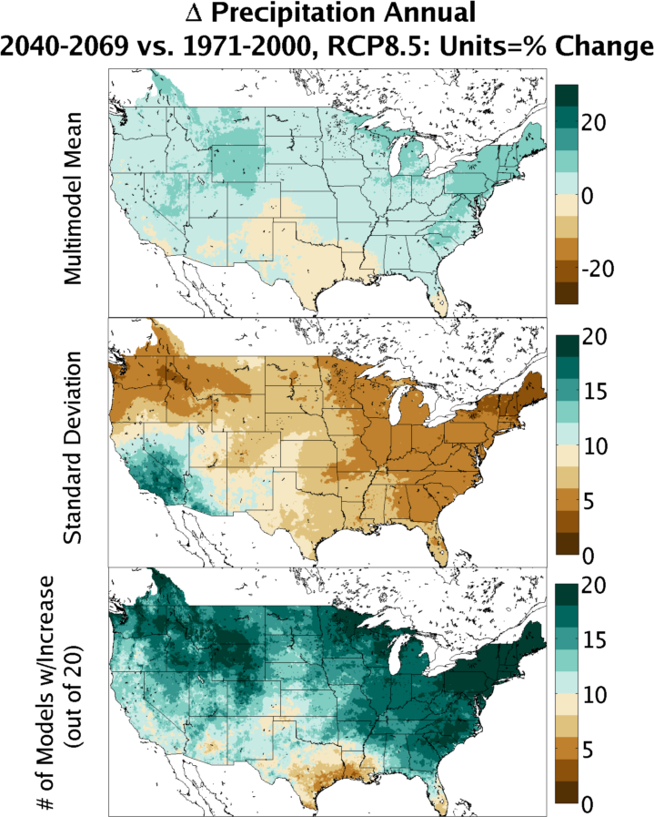
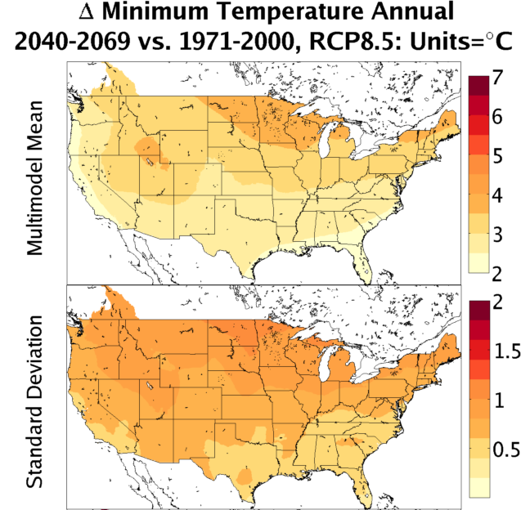

Predicted Annual Temperature & Precipitation Differences 2040-2069 vs. 1971-2000
All 20 models predict 2-3ºC increase in min & max temps

Slide 7
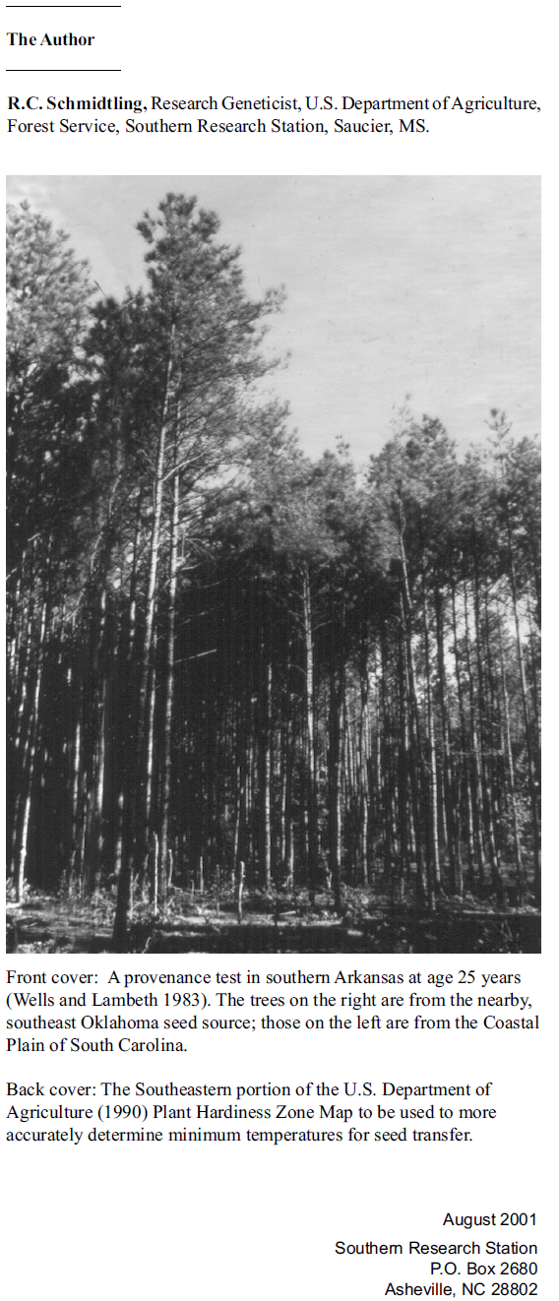
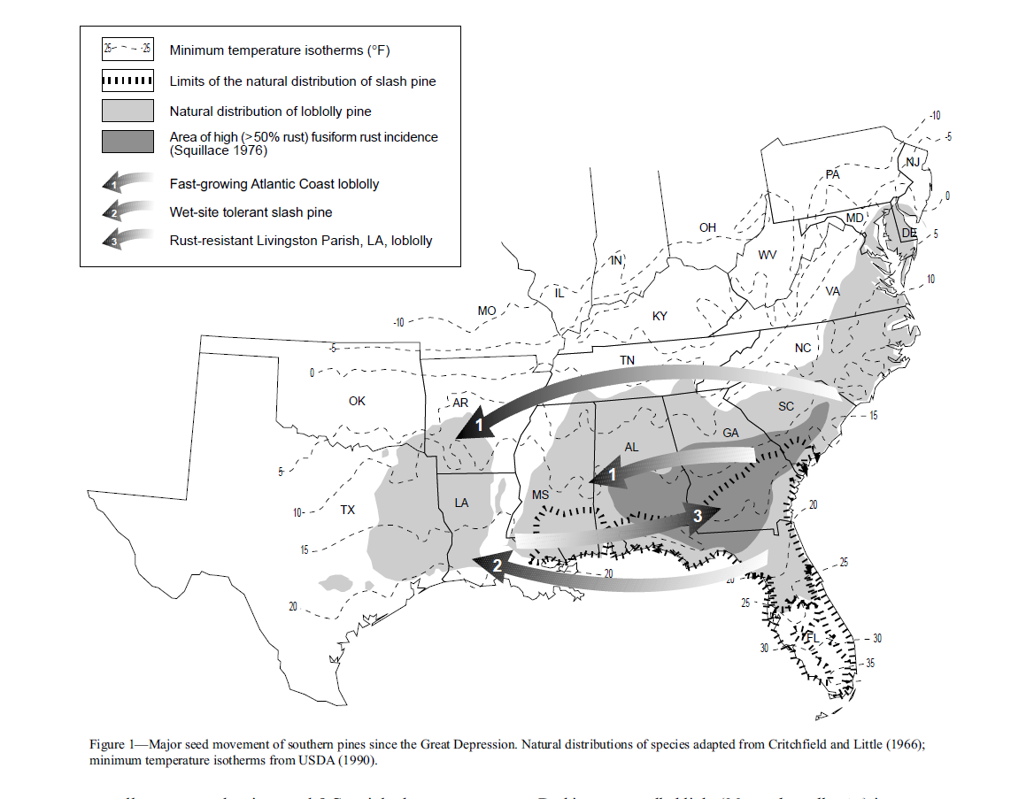
Seed Source Movement
R.C. Schmidtling, 2001, Southern Pine Seed Sources, USFS General Technical Report SRS-44
Notes:
Gary: Please make a point about the importance of identifying plastic families that can overcome some of the assumed clinal limitations

Slide 8
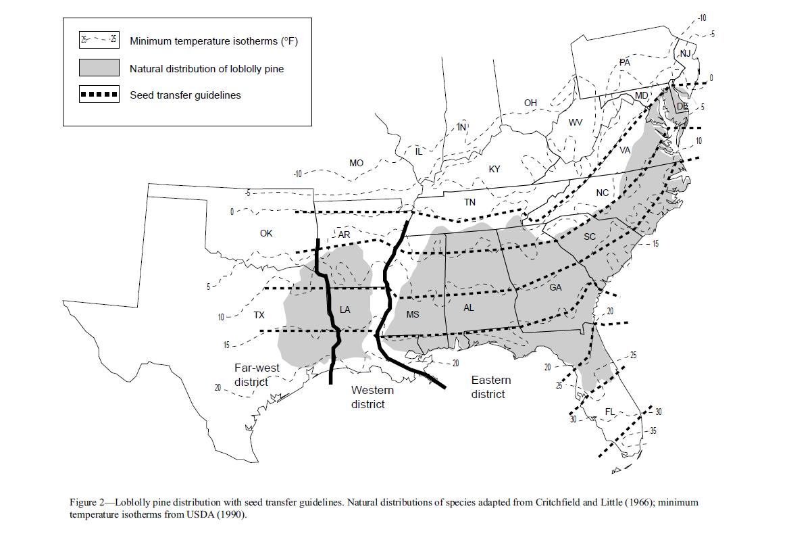
Current USFS Seed Deployment Guidelines
R.C. Schmidtling, 2001, Southern Pine Seed Sources, USFS General Technical Report SRS-44

Slide 9
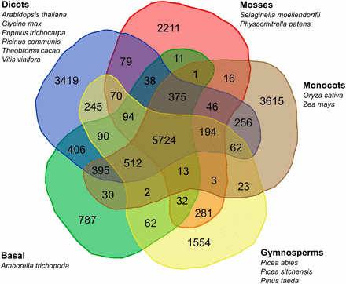
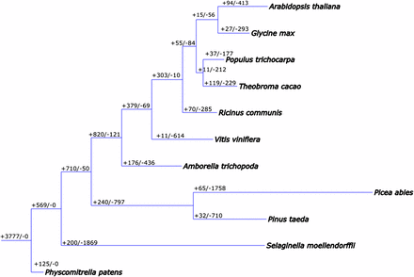
Loblolly Pine Reference Genome
A draft genome sequence of one loblolly pine genotype was created (Neale et al., 2014, Genome Bio. 15:R59)
23.3 billion base pairs containing 50,172 predicted genes
Wegrzyn et al., 2014 Genetics 196: 891-909

Slide 10
Why genotyping?
Most families in current use have not been tested across a wide range of sites/climates
The ability to predict performance and adaptability of untested families is currently limited to provenance-based information (explains 22% of phenotypic variation in PSSSS experiments from climate variables)
A stable relationship between phenotype and genomic attributes can allow prediction of future performance
Genotyping may allow us to transfer information from experiments such as ADEPT2, CCLONES 1, and PSSSS to other families
Variables that predict the performance of family #119 (TMIN, TMAX, PPT) explained 40% - 60% of total variation for most of the 140 loblolly pine families in the PSSSS trials

Slide 11
Molecular approaches to breeding
Goal is to accurately predict phenotypic variation – shown to be useful in livestock, annual crops, and model systems
The ideal method would be based on data from trees planted across a wide range of climate conditions and accurately predict phenotypes of trees in those climate conditions
These methods can be used both to guide breeding decisions (which parents to cross) and to guide deployment of existing families into regions where they have not been tested

Slide 12
Molecular approaches to breeding
Top-down and bottom-up approaches are possible
Top-down uses data on genetic variation across the whole genome to analyze and predict phenotypic variation: “genomic selection”
Bottom-up uses data on genetic variation at a single genomic position at a time to analyze phenotypic variation, and tries to identify which variants have the strongest effects on phenotype: “genome-wide association study”

Slide 13
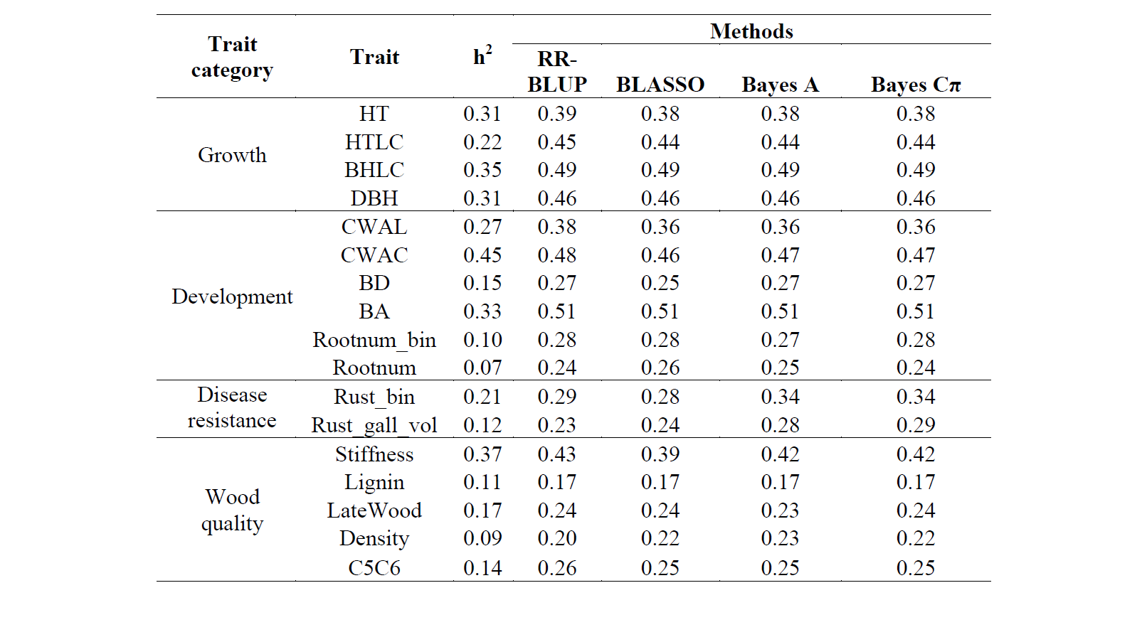
Genomic selection in pine
Most complex traits of interest are controlled by many genes, each of small effect; including all genes in statistical analysis captures these effects efficiently
Analysis of phenotypic variation as a function of all genome variants is validated by prediction of phenotype based on genotype for individuals NOT used in creating the statistical model
Genomic prediction models for a large range of traits show accuracies (based on cross validation) similar to or better than phenotypes
Little ability to identify causal mutations in specific genes or pathways
Resende et al, 2012, Genetics 190: 1503-10

Slide 14
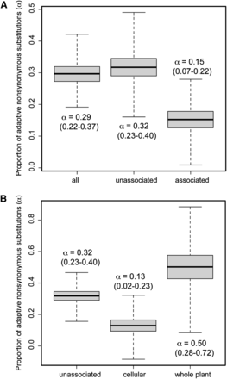
Genome-wide association in pine
Some genes have relatively large effects on complex traits of interest (even though many other genes are involved)
Association of specific genetic variants with specific traits can identify genes and pathways involved in phenotypic variation
This genetic information can be integrated with biochemical and physiological knowledge to guide future experiments, and in breeding to guide mating designs and deployment decisions
Eckert et al., 2013, Genetics 195: 1353-72

Slide 15
How will we use this?
Breeders currently rely on pedigrees
Relationships are used for phenotype analysis
Test data from unrelated individuals or from different regions are less useful
Are genetic variants associated with traits?
Yes, so we expect their use will reduce dependence on time consuming common garden and progeny tests, and guide deployment as climate changes over the next 40 years
Top-down and bottom-up approaches can be used to analyze the same phenotype and genotype data for different goals – predictive accuracy vs. mechanistic understanding
Predictive accuracy will be key for near-term applications guiding practical breeding and deployment

Slide 16
What have we learned so far?
Genetic variation in gene sequences:
Two different systems compared
Better system: ~$122 per sample, 2.8 million SNPs
63% of SNPs in coding sequences, 2% - 3% in flanking regions, 32% in unannotated regions
Genetic variation in non-coding genomic DNA sequences:
Random sampling of genomic DNA – not yet targeted to regulatory sequences
Less expensive and less data - ~$20 per sample, 75,000 SNPs

Slide 17
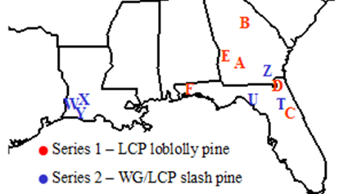
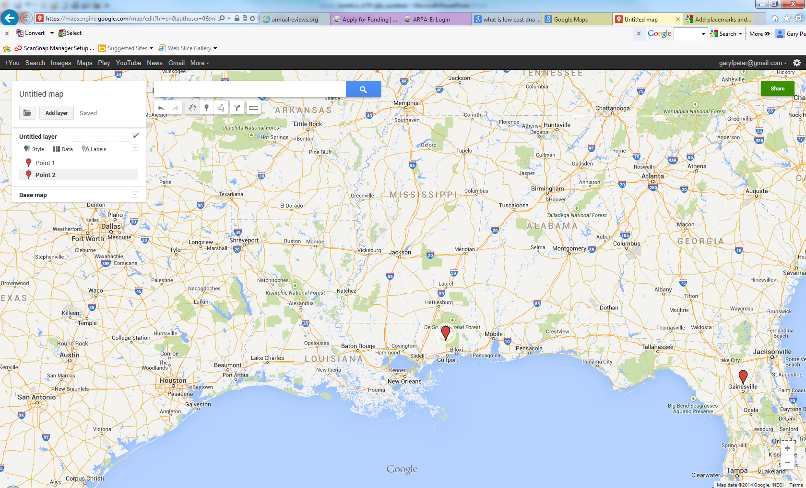
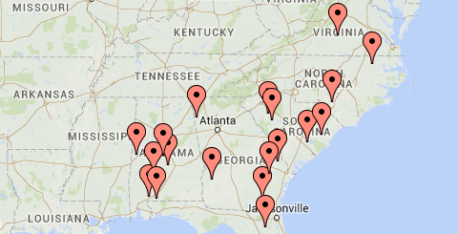
Test Series for Phenotyping & Genotyping
Test Series | Genetic Material | Phenotypes
CCLONES 1: 6 sites | 3- provenances 43-parents 71-FS families 1212-clones | HT, DBH Y1-9, Shoot phenology Y2, Needle D¹³C Y2, Width Y2 & 6, HT of live crown, Branch angle, diameter Y6, Wood chemistry Y3-4, wood density Y2-4, Y5-7, stiffness Y5, Fusiform rust & pitch canker RSC-Y1, Field-Y1-8, Oleoresin flow Y6-9, Resin canal # Y6-7; Wood terpene Y8
ADEPT 2: 2 sites | 384- clones | HT Y2& 4, delta C13 Y2 & 4, DBH Y4, Crown Width Y4, Branch Angle Y4, Specific Leaf Area Y4, Wood chemistry Y4
Plantation Selection Seed Source Study: 18 sites | 7-provenances 140 -PMX families | HT, DBH, & Vol Y8

Slide 18
Quantitative Genetics Group (Tree Improvement Cooperatives)
Objectives
Provide retrospective progeny test data as a resource to the PINEMAP Community
Add to what we already know about seedling deployment
Facilitate development of the DSS

Slide 19
Quantitative Genetics Group (Tree Improvement Cooperatives)
Objectives
Provide retrospective progeny test data as a resource to the PINEMAP Community
Add to what we already know about seedling deployment
Facilitate development of the DSS
Provide insights into important environmental variables and make available progeny test plantings to validate hypotheses from other groups

Slide 20
Objective 1: TerraC
Subsets of our progeny test data bases
Multiple locations
Multiple measurement cycles
Known family structure
Accessed by
University of Florida
Texas A&M University
North Carolina State University
Virginia Tech
University of Georgia

Slide 21
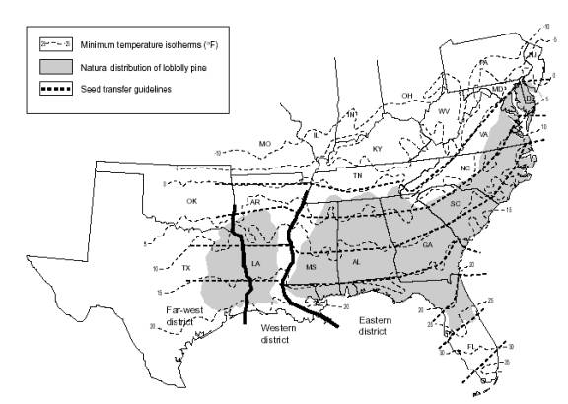
Objective 2: Seedling Deployment
Rationale
Methodology
Examples
Conclusions
Common results
Unique observations
Implications for PINEMAP
R.C. Schmidtling, 2001, Southern Pine Seed Sources, USFS General Technical Report SRS-44

Slide 22
Seedling Deployment Rationale
Trees from the same area (provenance) represent lineages that have experienced similar climates and have evolved local adaptations
Results: Genotype by Environment Interactions
Weather conditions at progeny test sites (6 to 15 years) can serve as a surrogate for future climates

Slide 23
Seedling Deployment Background Universal Response Function (URF)
First developed in 2010 Wang et al. Ecological Applications, 20(1), 2010, pp. 153-163
Caveats:
Gene flow, demographic history, and colonization contribute to between and within population variation
Weather records miss a lot of site to site variation
Y_{ij} = f(weather at the test site i
and climate at the provenance j)

Slide 24
What we hoped to add:
Try different statistical techniques
Estimate predictive reliability
Incorporate risk assessments
Refine predictions from the provenance to the family level to support DSS development
Identify important abiotic stressors that limit growth

Slide 25
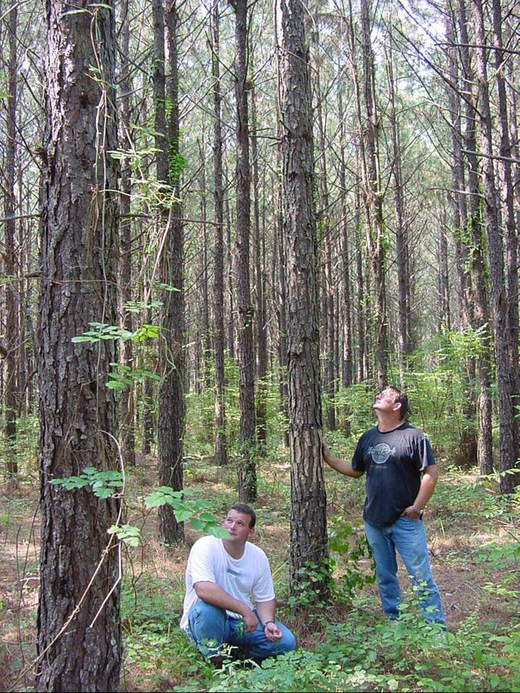
Seedling Deployment Methodology
Multiple locations of Common Garden Studies
(same genetic sources tested in multiple environments)

Slide 26
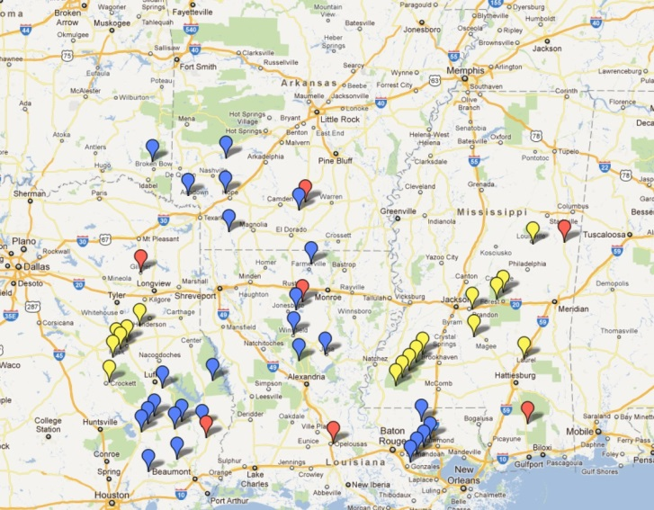
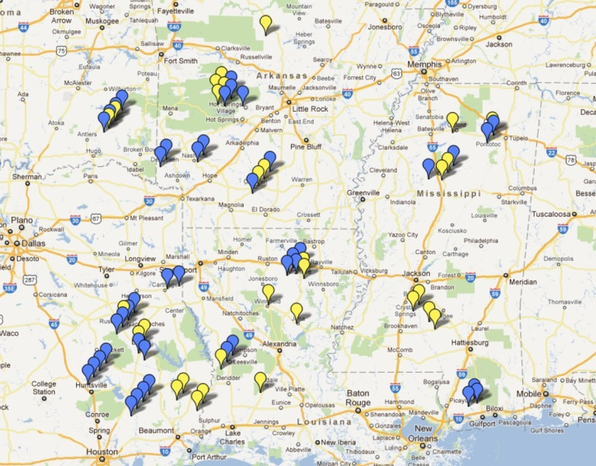
Seedling Deployment Methodology
PINEMAP used five non-overlapping test series across the entire loblolly pine range
Families
Test Sites

Slide 27
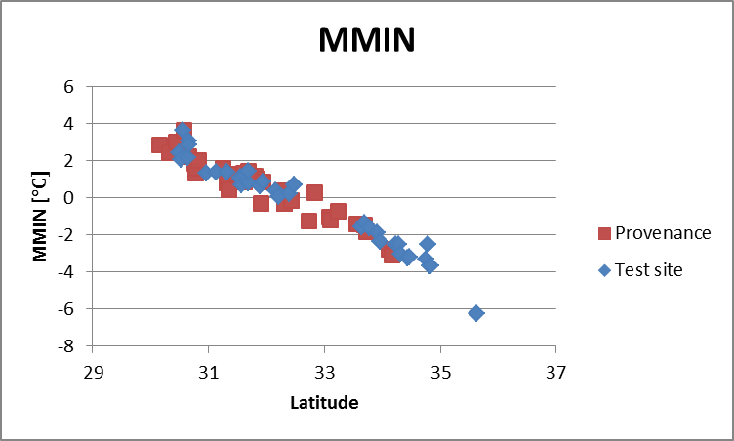
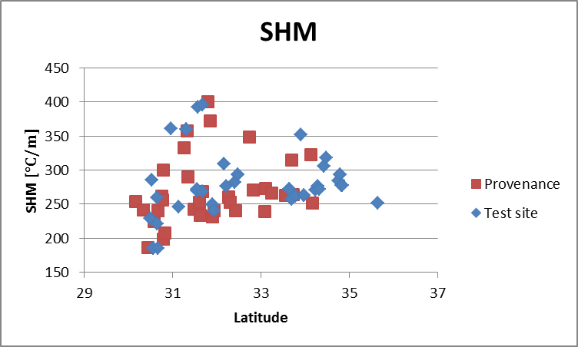
Weather
PRISM
SECC
Idaho

Slide 28
Regression Methods
Ordinary Least Squares Regression
LASSO
Multiple Linear Regression
Multinomial Logit Regression
Ridge Regression

Slide 29
Locations – Test Sites

Slide 30
Locations
Data Series | Families | Test Sites
Provenance-Progeny (PP) Tests | 58 | 7
Florida Wild-Seed (FWS) Tests | 211 | 10
Plantation Selection Seed Source Study (PSSSS) | 140 | 16
Geographic Seed Source Study (GSSS), Series I | 25 | 40
Geographic Seed Source Study (GSSS), Series II | 17 | 26
Total | 451 | 99

Slide 31
Methods Comparison
 | UF | NCSU | TAMU
Regression method | LASSO | Multiple linear regression | Multinomial logit regression
Weather data | Idaho | PRISM | PRISM
Response variable | Height DBH Volume per acre | Height | Volume per acre
Age | 10 (PP) 6 (FWS) | 8 | 15
Variation explained | Up to 62% (Height; pooled PP/FWS data) | 40% - 60% (most families) | N/A (AUC = 0.80)

Slide 32
Results Comparison
Variable | UF | NCSU | TAMU
Minimum Temperature | X¹ | X² | X³
Maximum Temperature | X⁴ | X²
Precipitation |  | X² | X⁵
Annual Heat-Moisture Index | X
Humidity | X
Longitude (Provenance) | X
SD (Minimum Temperature) |  |  | X
CV (Precipitation) |  |  | X
Interactions | X | X | X
¹ coldest 3 days mean
² annual mean
³ monthly mean (coldest month)
⁴ warmest 3 days mean
⁵ summer (June-August)

Slide 33
More details…
PINEMAP website, publications section: http://www.pinemap.org/publications

Slide 34

Results: University of Florida
Pooled LASSO regression analysis of Florida Provenance-Progeny and Wild Seed Tests

Slide 35


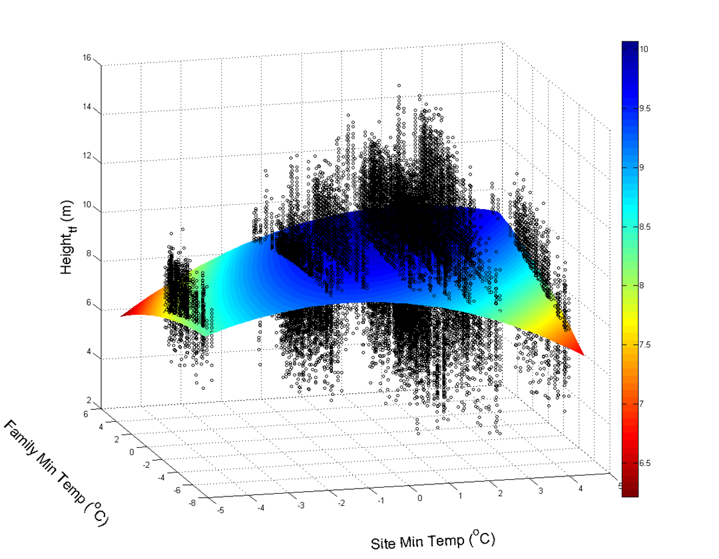
Results: North Carolina State University
Response surface.
Black dots represent observed 8-year height.
Notes:
Pick one of the two response surfaces to present (slide 25 or slide 26)

Slide 36
Results: North Carolina State University
Mean height deviation of seven seed sources (average of families) from site mean. Each curve represents the relative performance of families from a geographic region (seed source) across test sites from southwest to northeast.

Slide 37
Results: North Carolina State University
Predicted scaled deviations in Height (age 8) from local checklots across the Southeast for family #119 (from VA) under current climate conditions. The model explained about 55% of the observed total variation.

Slide 38
Methods & Results Texas A&M University
Multiple linear regression
Series I:
Height: R² = 0.46
Volume: R² = 0.29
Series II and pooled Series I and II – explanatory power dropped
Multinomial logit regression
Volume ranked into five categories
Family performance relative to performance of all families:
1 – very poor (399 obs.)
2 – poor (1,788 obs.)
3 – fair (2,876 obs.)
4 – good (1,491 obs.)
5 – very good (474 obs.)
Notes:
Is this needed?

Slide 39

Results: Texas A&M University
1
2
3
Performance Categories: 5 is best
4
5
Shading indicates Probability of a Seed Source falling into a site performance category

Slide 40
Common conclusions
Temperature and rainfall are important
Heritability is important
Climate variables that change clinally are links to local adaptations
Provenance-level modeling is easier
Confirmed Schmidtling’s conclusions on the importance of minimum winter temperatures
Provided cautions on direct application of the Universal Response function (Wang et al. 2010)

Slide 41
Unique contributions
Extreme events matter more than averages for minimum temperature
Can model family performance but many more test locations need to be evaluated than are normally established
Importance of weather variability increases at the western edge of the species distribution range
Probabilities/risks are explicitly incorporated by multinomial logit regression models

Slide 42
Implications for PINEMAP (and beyond)
Room for input from silviculture and forestry
Water manipulation
Variability should be considered in climate projections
Impact of the extreme minimum temperatures needs more investigation (physiology?)

Slide 43
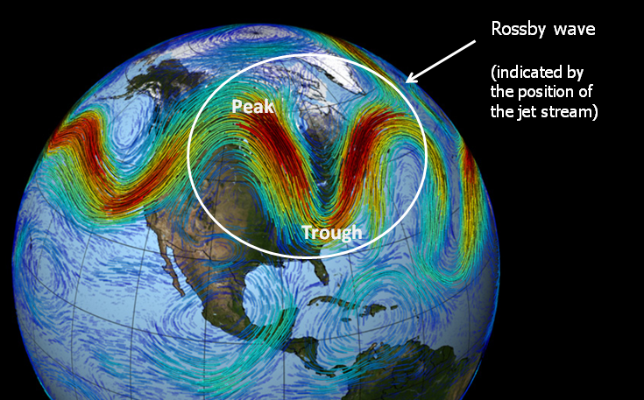
Minimum winter temperatures?
Source: http://disc.sci.gsfc.nasa.gov/gesNews/airs_christmas_ice_storm

Slide 44
Summary
Deliver deployment guidelines for genotypes suited for varied climatic conditions to maximize resiliency and reduce adverse impacts of climate change on productivity
Confirmed that minimum winter temperature is one of the most important climate variables affecting performance
Working with R. Boyles & H. Dinon to develop map based seed deployment tool for DSS
Analyze genetics of breeding and natural populations to discover alleles in genes controlling important adaptation and mitigation traits that enable future tree breeding strategies
Standardized two complementary methods for genotyping loblolly pine; utilizing information from loblolly pine genome sequence
Genotyping of three populations in progress
Most phenotypes are available for analysis
Goal is to develop models to predict performance at untested sites

