Slide 1
All Team PINEMAP meeting
March 17, 2016

Slide 2
Upcoming dates
ATP meeting 4/21 (NEP and Tier II)
Modeling summits 3/28, 4/25 3pm ET
Executive committee meeting 4/22 10am ET

Slide 3
Meeting registration
www.pinemap.org/intranet for links to register for food and posters, block code for hotel
Hotel block drops April25! Fewer rooms reserved for 3rd night (5/25), so please reserve early if possible
Would like a numbers count for catering

Slide 4
Final meeting structure
Presentations of the 1st set of integrative papers, followed by discussion of key confirmatory/ surprising results, linkage to other findings
Workshop sessions to develop 2nd level integrative papers
Final poster presentation opportunity
Discussions of:
  building a consensus PINEMAP message
  areas of disagreement (controversy) - future research needs
  communication barriers and strategies to deal with them
  adapting message for varied stakeholder audiences
  opportunities for using networks and data for answering other burning questions

Slide 5
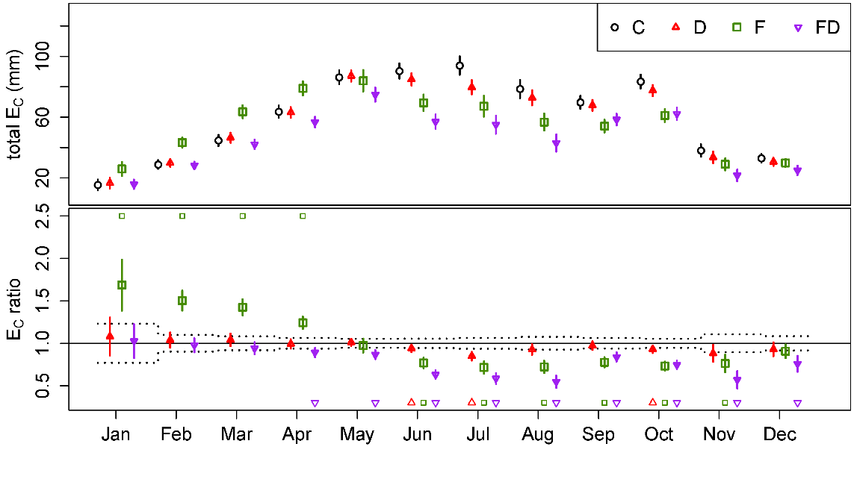
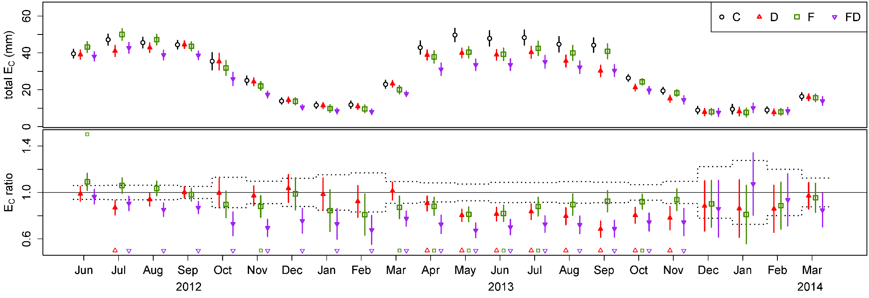
Sap Flux Integration
Ran StaCC for GA 2014 data
Pattern similar to VA 2012-2013
  C > D ~ F > FD
Results very similar to that of Bartkowiak et al.
  2013: 576.7-652.4
  2014: 539.8-725.5
Big Challenges remaining: Soil Moisture, LAI
GA Tier 3
2014
VA Tier 3

Slide 6
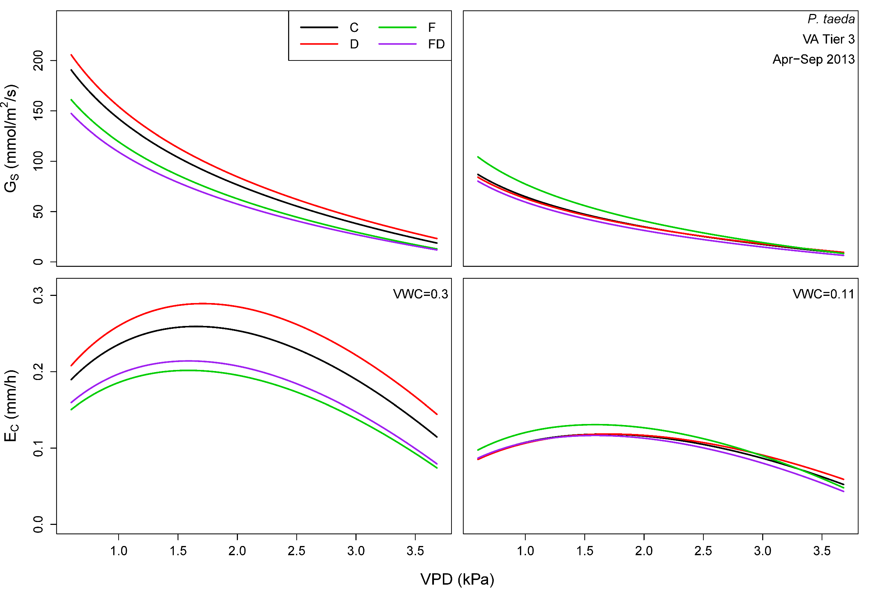

Slide 7
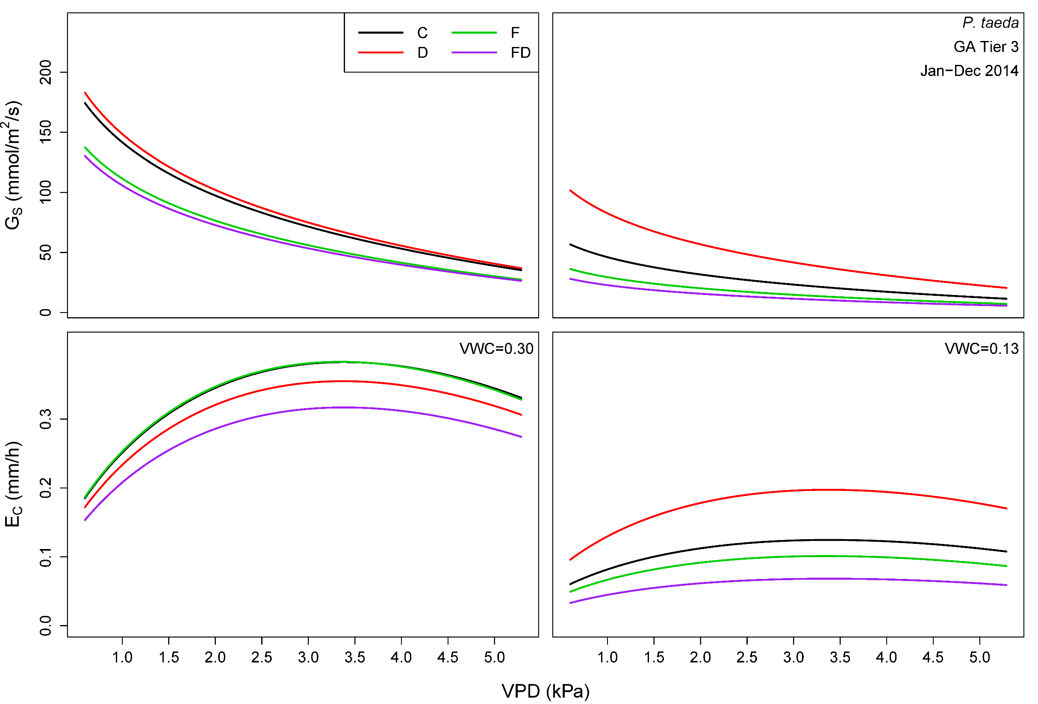

Slide 8
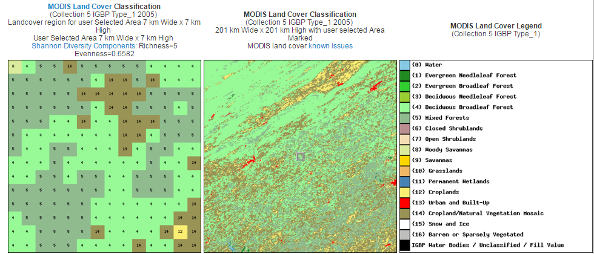
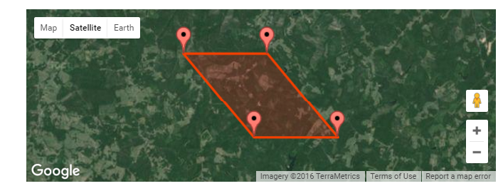
MODIS LAI
VA

Slide 9
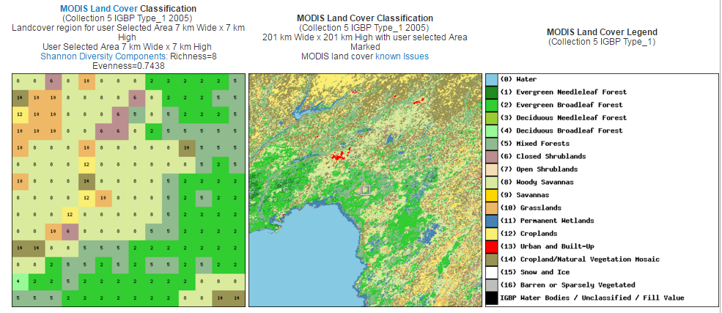
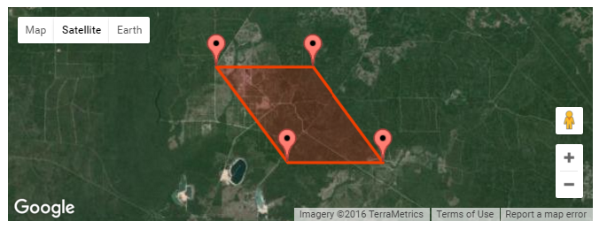
MODIS LAI
FL

Slide 10
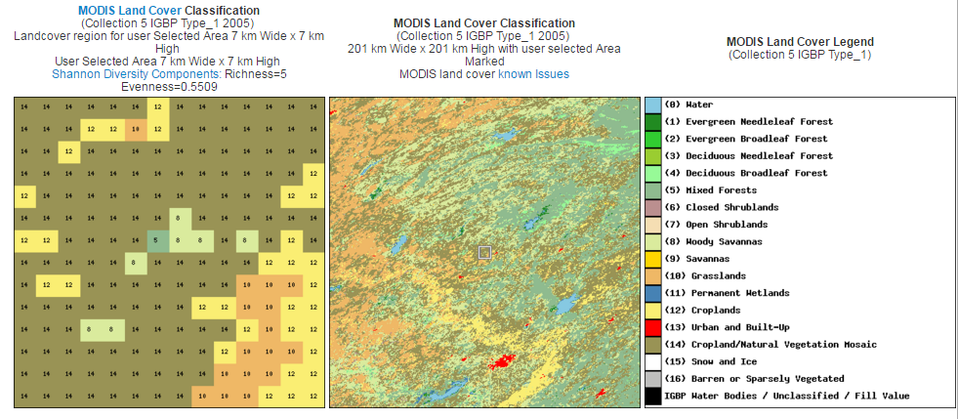
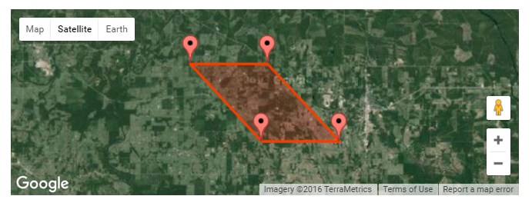
OK

Slide 11
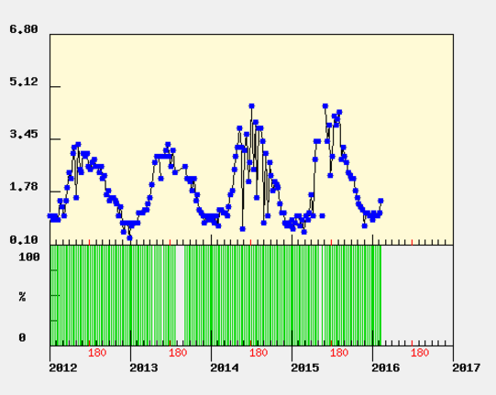
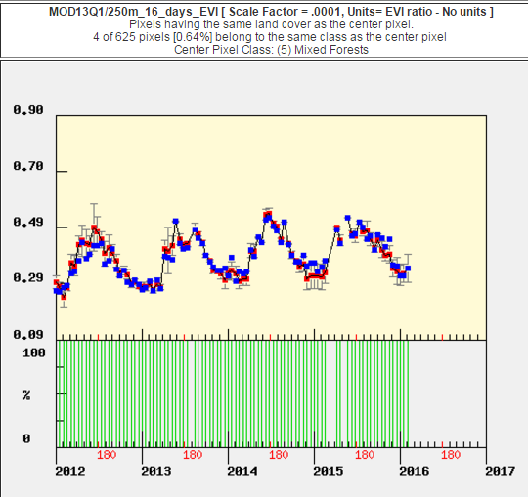
OK
MODIS LAI
MODIS EVI

Slide 12
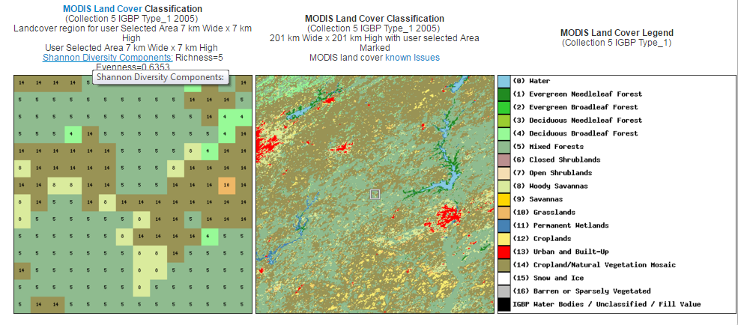
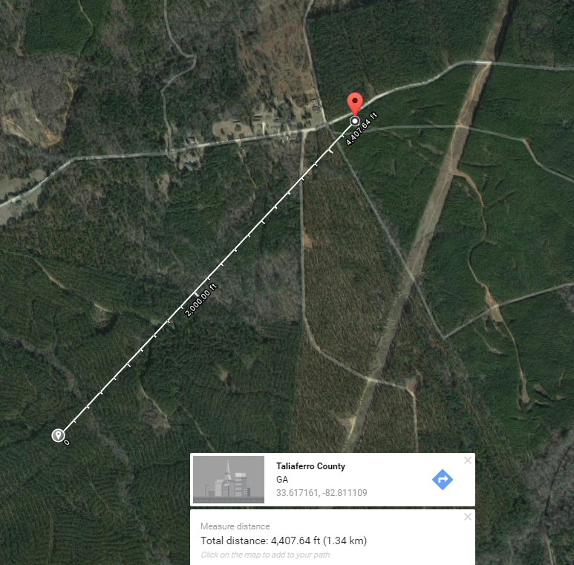
GA

Slide 13
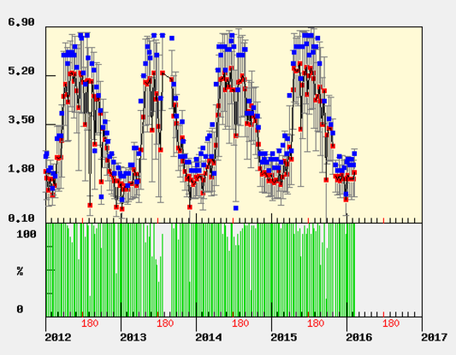
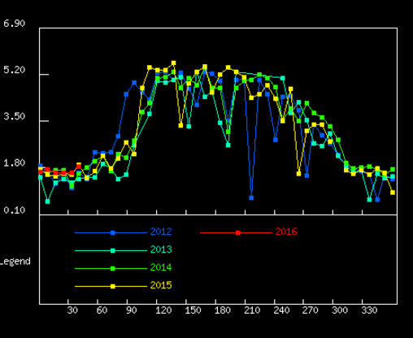
GA

Slide 14
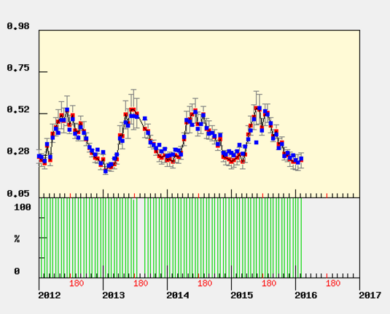
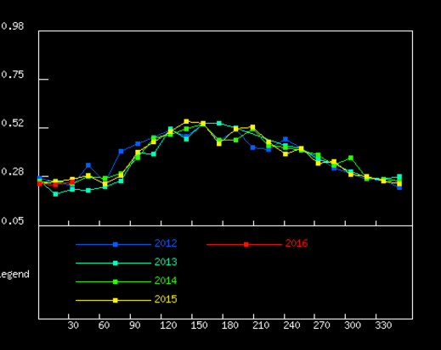
GA

Slide 15
Growth & Yield
Loblolly Pine Growth & Yield Regional Simulations Under Changing Climate Scenarios and CO₂ Fertilization

Slide 16
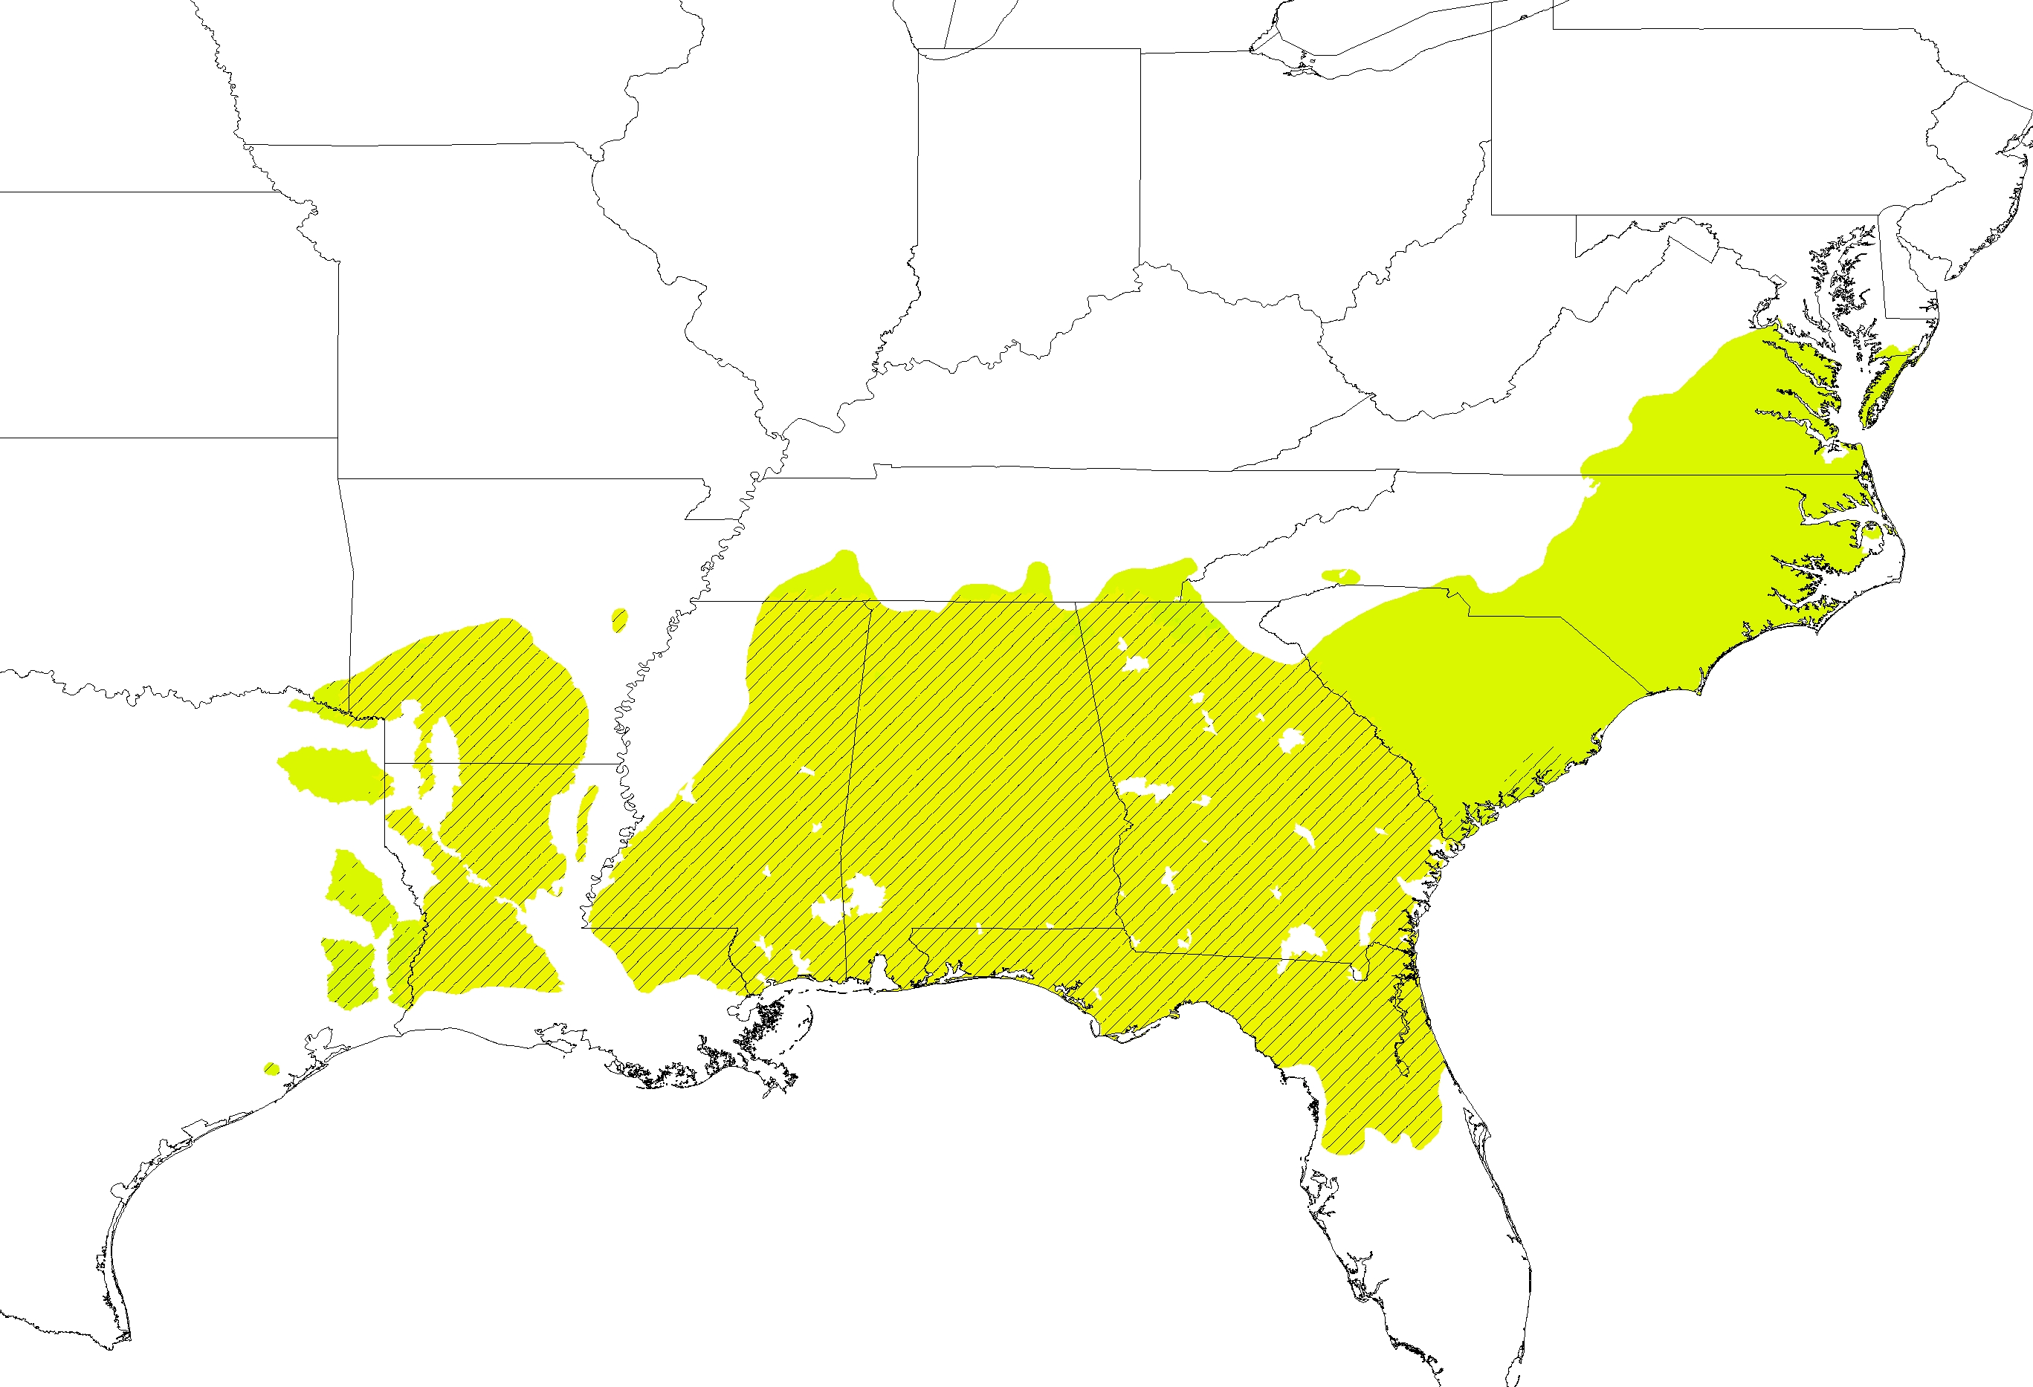
2060-2079
(Age 25 Carbon Percent Difference, RCP 8.5)
Unimproved Management
CO2 Only
+45%
+/-0%
-45%

Slide 17
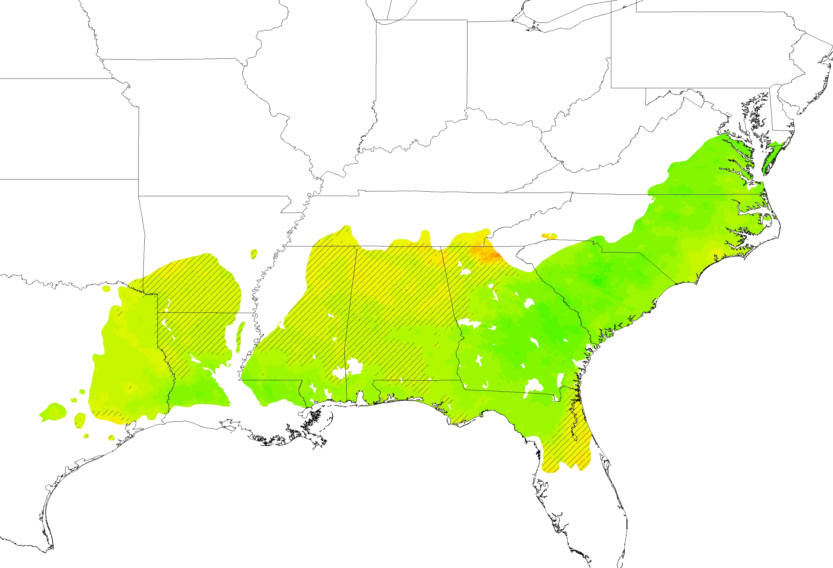
2060-2079
(Age 25 Carbon Percent Difference, RCP 8.5)
Unimproved Management
Climate Only
+45%
+/-0%
-45%

Slide 18
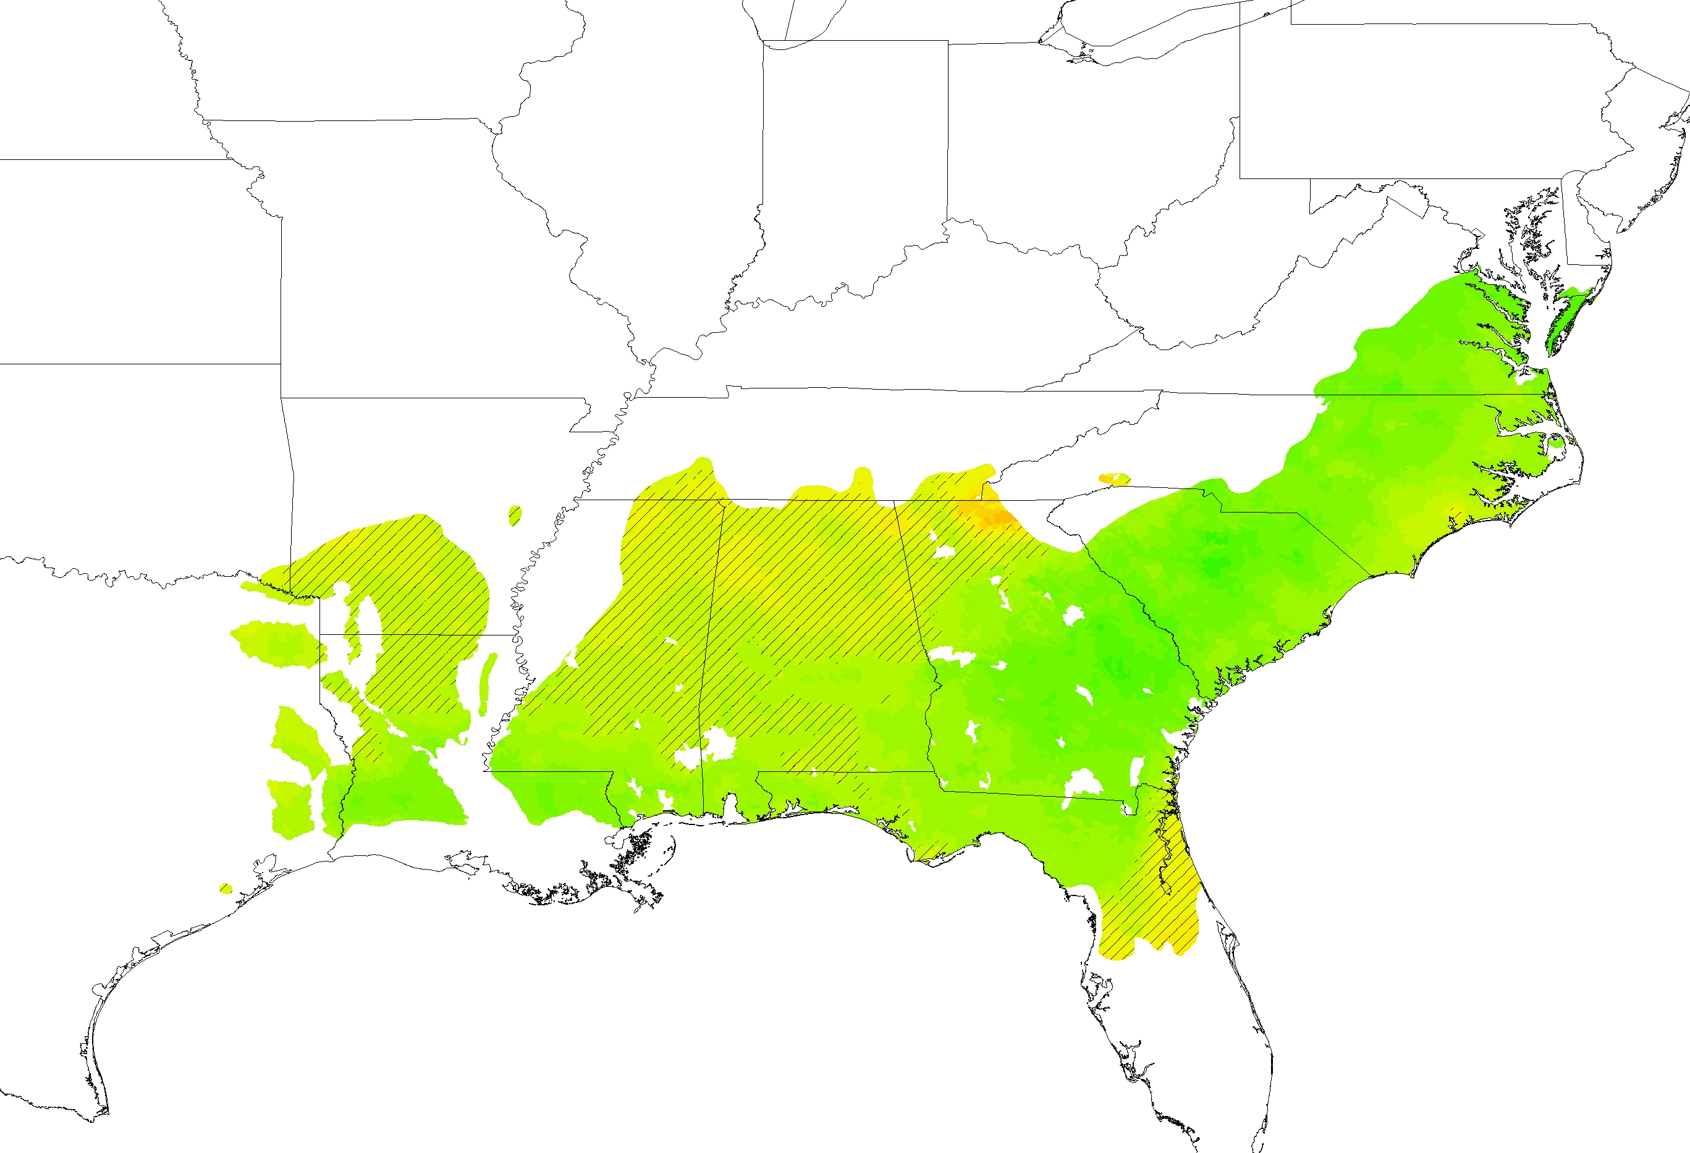
2060-2079
(Age 25 Carbon Percent Difference, RCP 8.5)
Unimproved Management
CO2 + Climate
+45%
+/-0%
-45%

Slide 19
WaSSI MACA Modeling Updates
Ge Sun, Eric Ward, Erika Cohen, Steve McNulty, Heather Dinon Aldridge, Carlos Gonzalez-Benecke
PINEMAP ATP Meeting, March 17, 2016

Slide 20
Hypotheses
A warming climate and increased precipitation in the south will increase southern forest ecosystem productivity.
A warming climate will decrease water yield from forests and aggravate water supply stress for people.
CO2 fertilization alone will increase GPP, but NOT ET or water yield.
Tradeoffs (carbon gain and water loss) will increase under future climate change and forest management that maximizes productivity and water use efficiency.
Notes:
*biggest issue with NARCCAP: temporal extent since 2041-2070 was the only future time slice

Slide 21
Modeling Schemes
Model Forests: Two ages
  17 yrs old; WUE= 2.54 g C/m2/kg H2O mean LAI=4.0
  7 yrs old WUE =1.9 g C/m2/kg H2O; LAI = 2.3
CO2 Scenarios
  CO2 fertilization will not affect ET, but will increase 30% GPP based on Duke FACE data
Climate change: for 20 MACA GCMs and two different scenarios (RCP4.5 and RCP8.5)
Notes:
*biggest issue with NARCCAP: temporal extent since 2041-2070 was the only future time slice

Slide 22
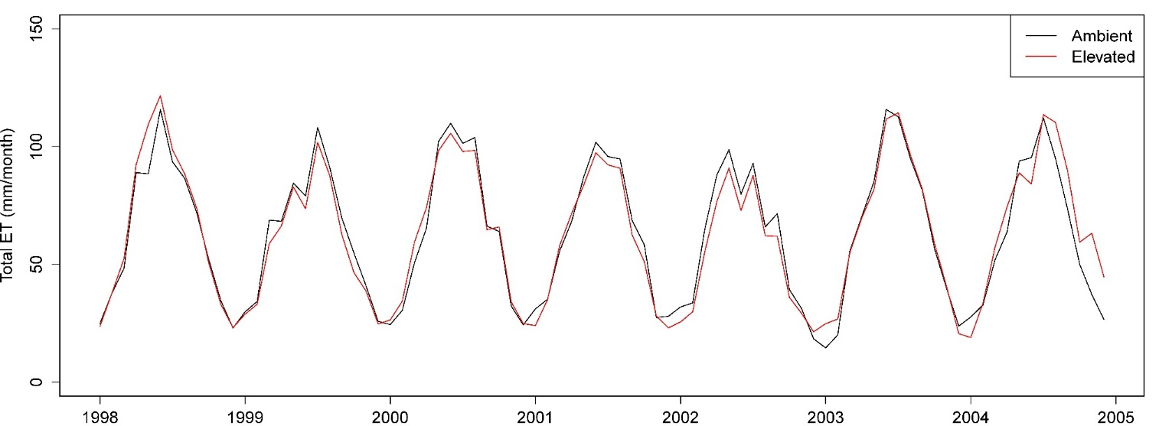
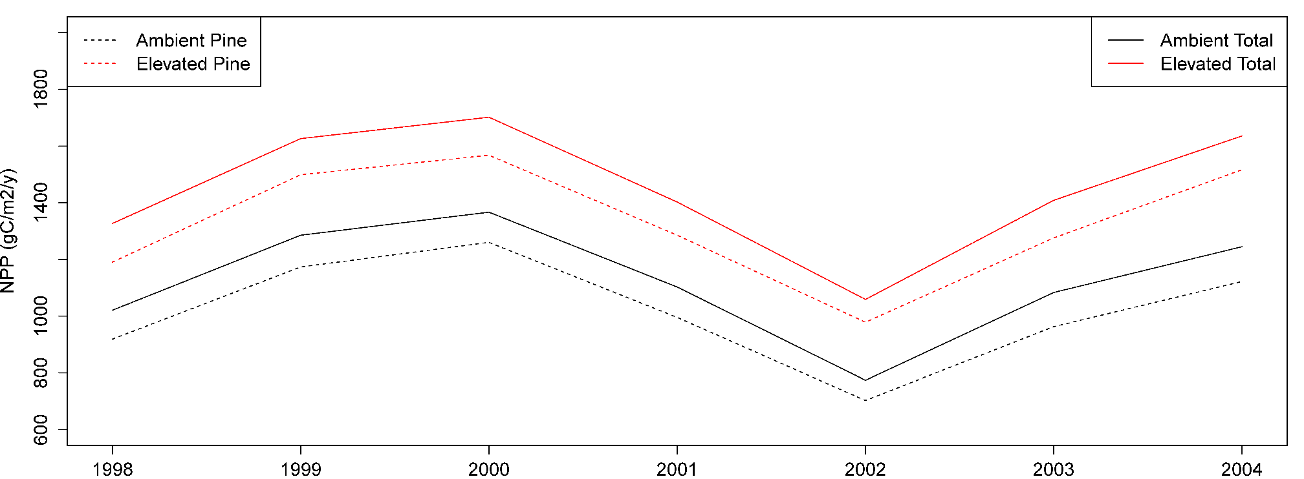
Duke FACE (1998-2004)
Elevated CO₂ vs Ambient CO₂
+ 0.2% total Evapotranspiration
+ 9.7% Evaporation
- 8.8% HW Transpiration
+ 5.1% PT Transpiration
+ 29.% Total NPP
+ 30.5% PT NPP
+ 14.2% HW NPP
Note that response is dominated by PT overstory vs HW understory.

Slide 23
Model Forest
ET = 0.725*PET + 5.0 *LAI
R²=0.86, RMSE = 14, n =120
Notes:
*biggest issue with NARCCAP: temporal extent since 2041-2070 was the only future time slice

Slide 24
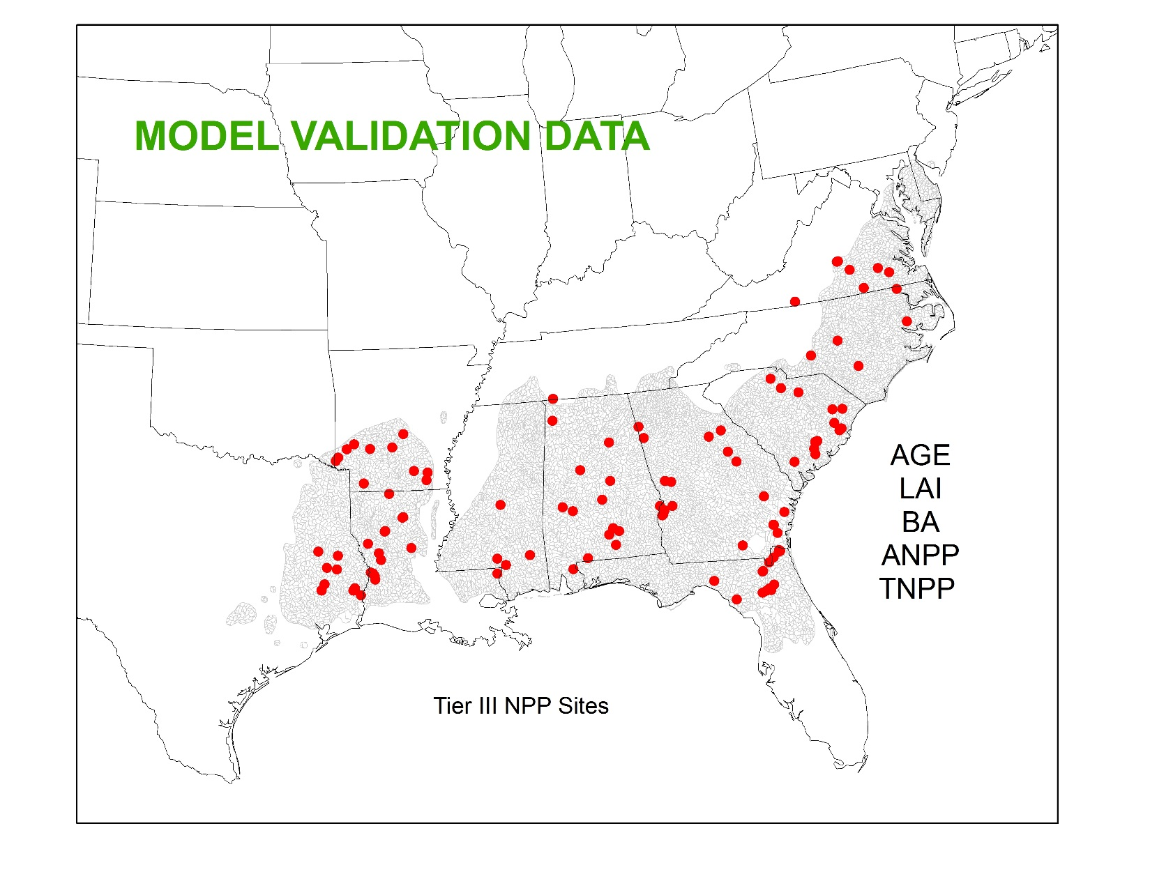
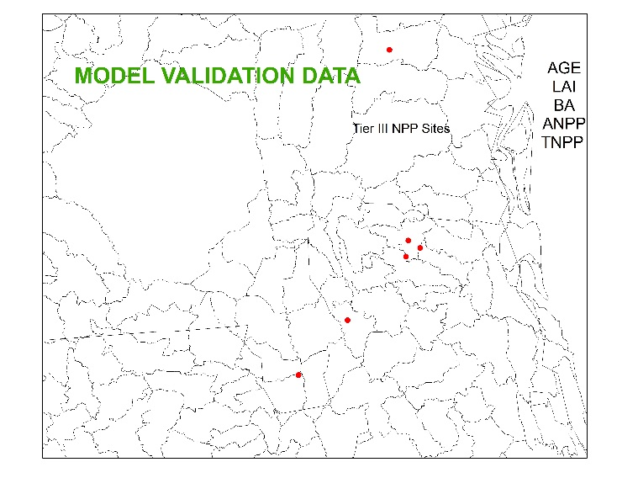
Model Validation (TierII NPP)
Notes:
*biggest issue with NARCCAP: temporal extent since 2041-2070 was the only future time slice

Slide 25
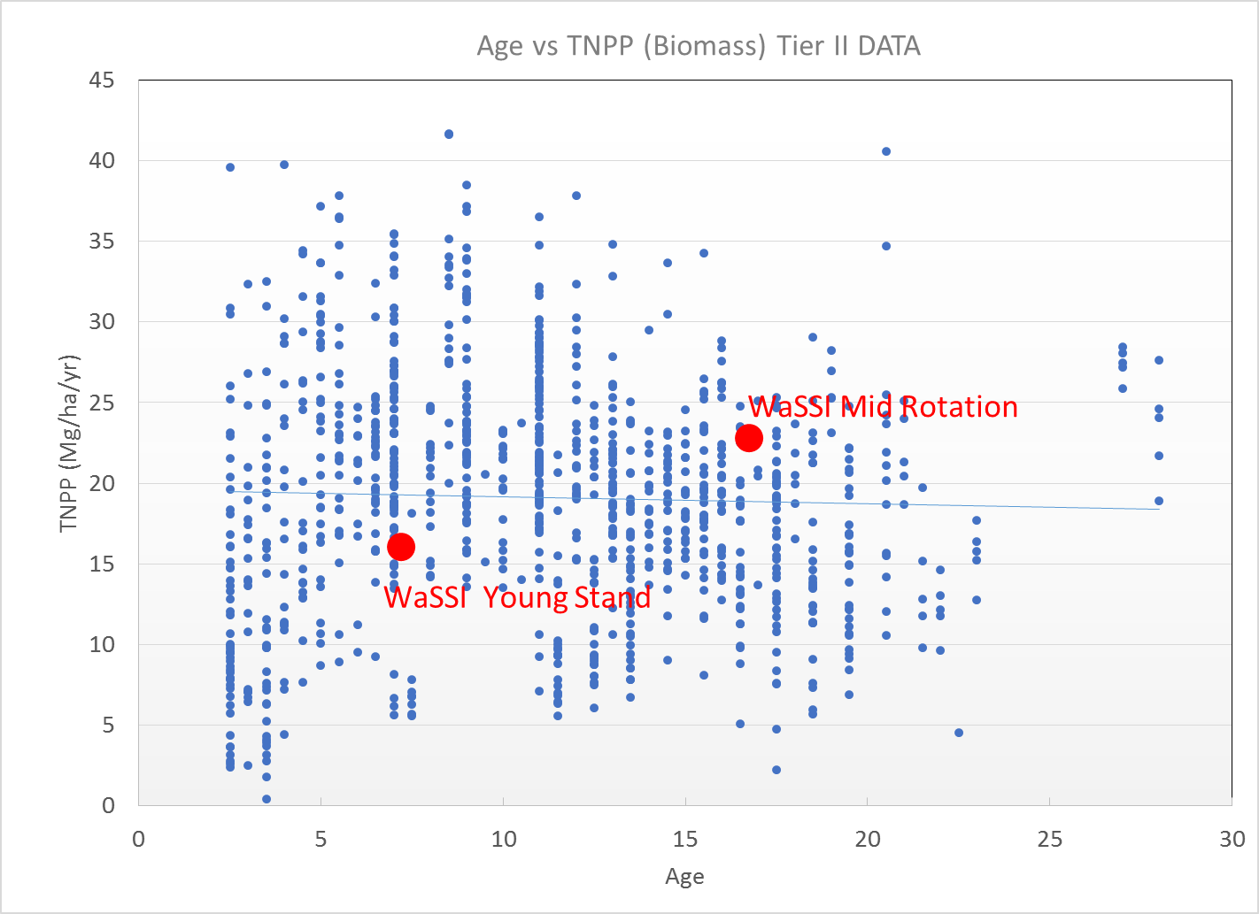
Model Validation (TierII NPP)
Notes:
*biggest issue with NARCCAP: temporal extent since 2041-2070 was the only future time slice

Slide 26
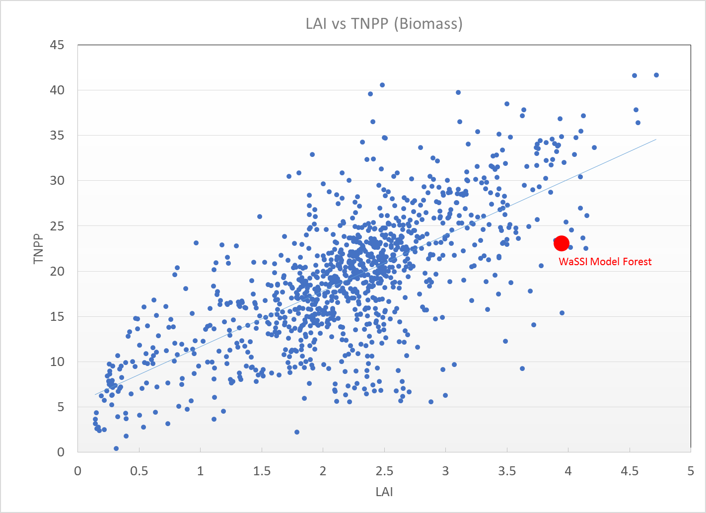
Model Validation (Tier II NPP)
Young
WaSSI
Mid-rotation
WaSSI
Young stand
Notes:
*biggest issue with NARCCAP: temporal extent since 2041-2070 was the only future time slice

Slide 27
Definitions: Time Periods Used
Historical data (1986-2005):
  Based on gridded observations
Model baseline (1950-2005):
  reference period for calculating future changes
  same statistics as actual years (1979-2009) from training data
Model future periods (2020-2039, 2040-2059, 2060-2079, 2080-2099):
  To assess climate, take averages over at least 20 yrs
Notes:
***The model baseline period of the MACA data is from 1950-2005, but these years do not correspond to the actual years 1950-2005. What is important here is that these years have the same statistics as the actual years 1979-2009 (from the training data). The year 1987 of MACA data is not meant to be a hindcast of the weather from that year.
***GCM experiments are meant to say something about the future projections of climate. To assess climate, you should be taking averages of the weather over at least 30 years of data. So 5 future years is too short to assess the climate and even 10 years of historical is too short.
Also, note that the choice of the model baseline period may have other consequences on your comparison. The model baseline period is a reference period for calculating the respective future climate change. Choosing different reference periods for the model baseline will result in different projections for change. Further, model baseline periods that are chosen as subsets of the period 1950-2005 (i.e. 1990-2000 or 1971-2000) will result in variations in the baseline between the models since the MACA process maps the statistics of the period 1950-2005 to the statistics of the training data. If you wish to avoid inter-model variations in the baseline, choose 1950-2005 as a baseline. As seen in the 'Analysis - Bias Maps' tab on this webpage, this will result in minimal biases between the models and the training data.

Slide 28
Modeling Water and Productivity using 20 GCMs
Step 1: run with a historical dataset (Training data)
Step 2: run with baseline dataset. Compare model baseline output to historical output (Step 1) to generate error statistics.
Step 3: run with projections data per model, per RCP, and per 20 yr time slice for future periods
Step 4: compute difference between step 3 and step 2
Step 5: calculate mean of these differences across all models per rcp and per 20 yr future time slice
Step 6: add mean of the differences back to the historical map of GEP or Q (from Step 1)
Step 7: repeat steps 5 and 6 except with std. deviation

Slide 29
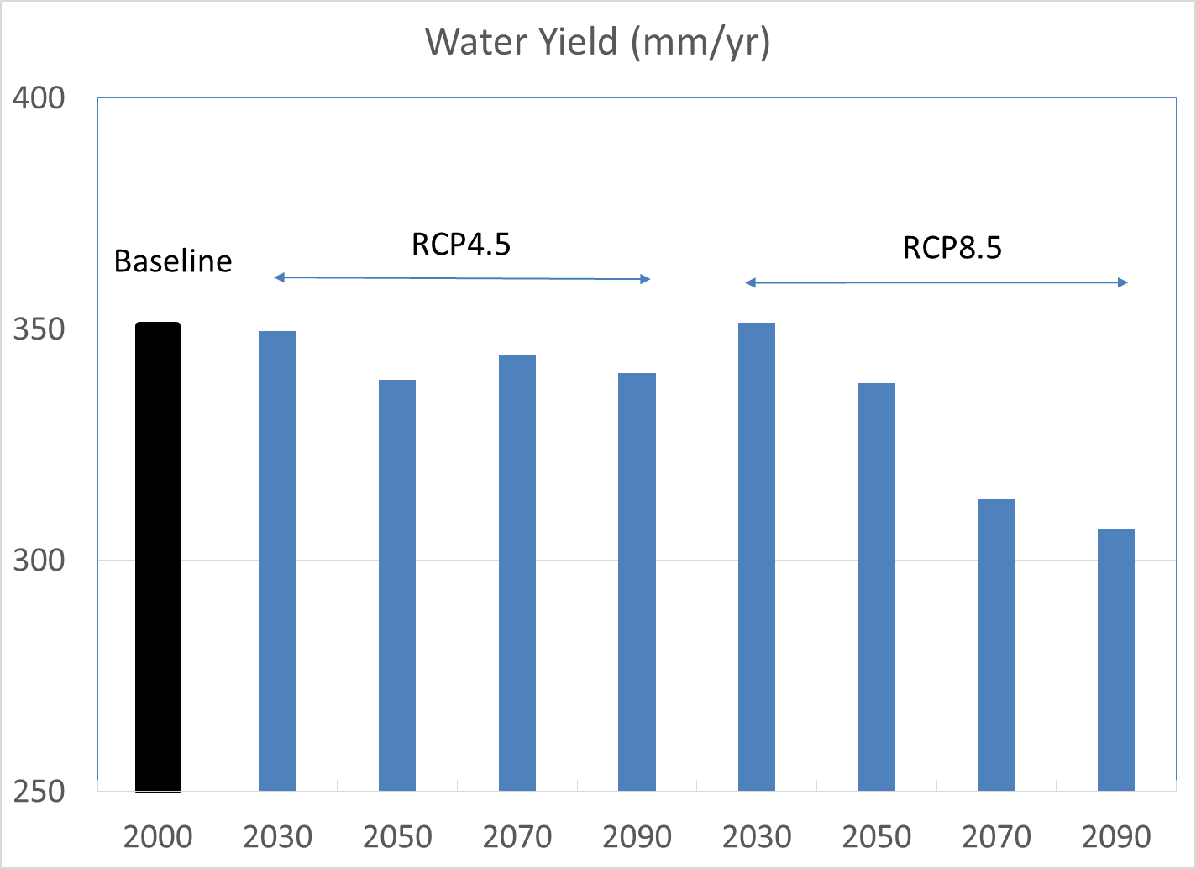
WaSSI Modeled Mean Changes (all GCMs)
Notes:
*biggest issue with NARCCAP: temporal extent since 2041-2070 was the only future time slice

Slide 30
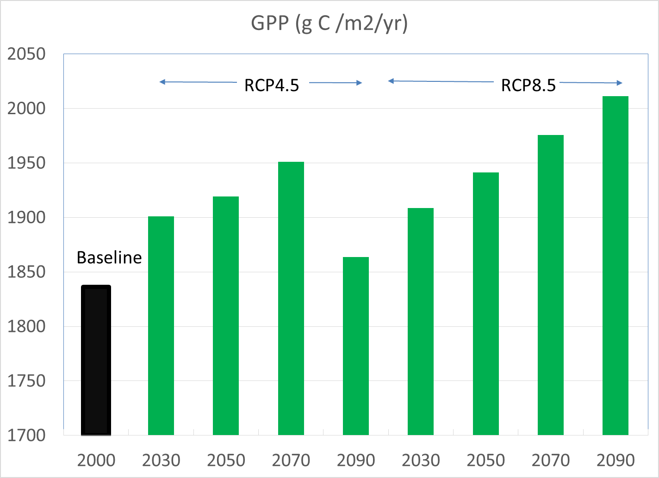
WaSSI Modeled Mean Changes (all GCMs)
Notes:
*biggest issue with NARCCAP: temporal extent since 2041-2070 was the only future time slice

Slide 31
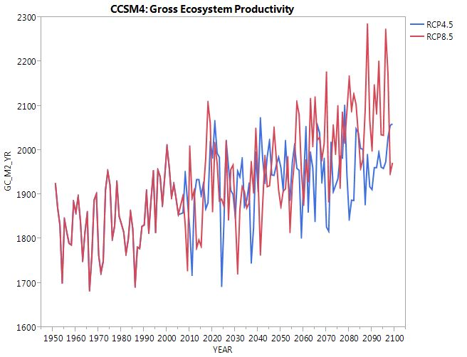
Modeled GEP
Notes:
*biggest issue with NARCCAP: temporal extent since 2041-2070 was the only future time slice

Slide 32
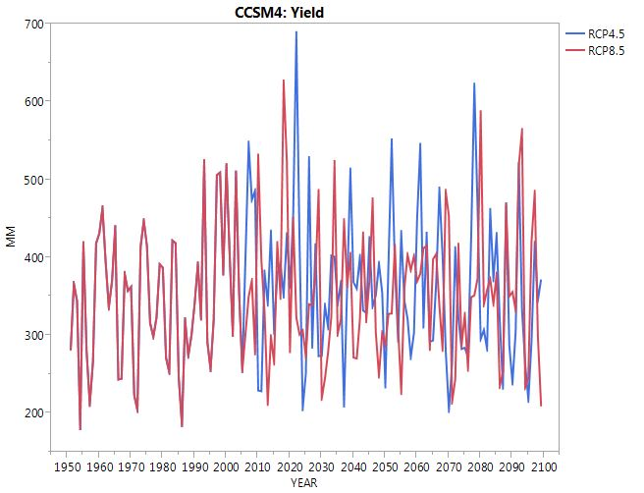
Modeled Water Yield
Notes:
*biggest issue with NARCCAP: temporal extent since 2041-2070 was the only future time slice

Slide 33
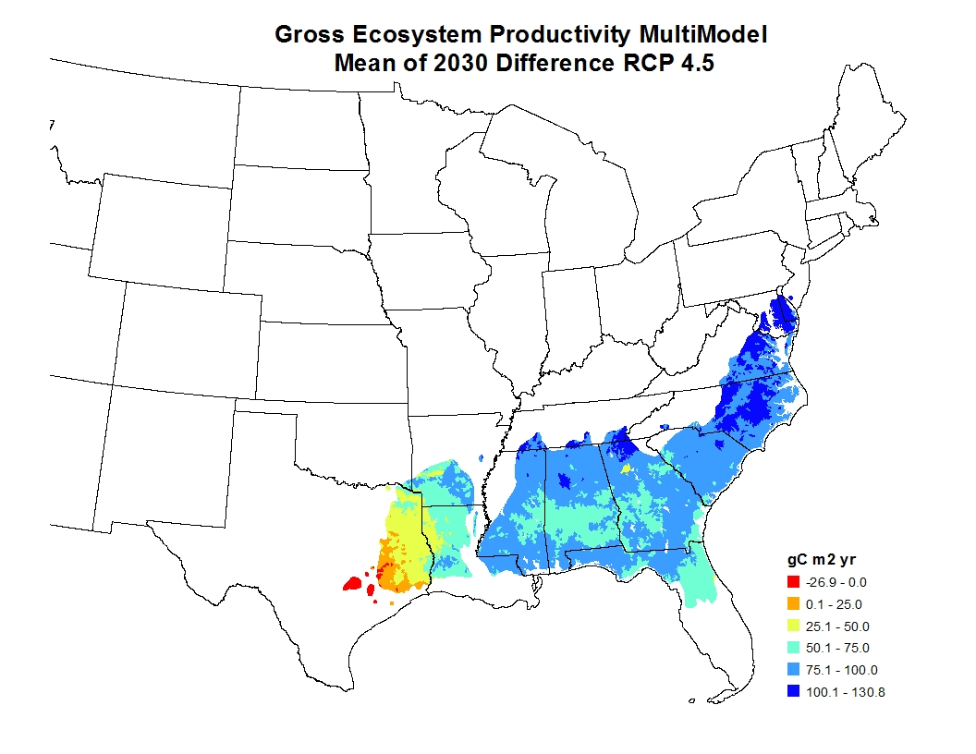
WaSSI Modeled Mean Changes by 2030 (all GCMs)
Notes:
*biggest issue with NARCCAP: temporal extent since 2041-2070 was the only future time slice

Slide 34
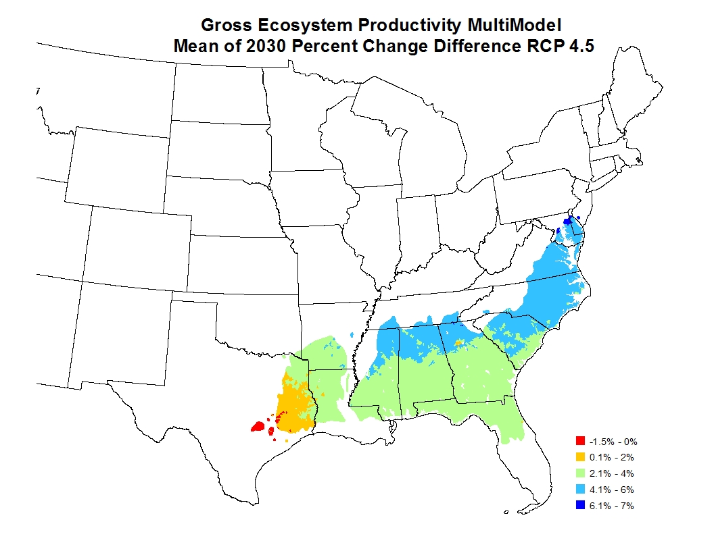
WaSSI Modeled Mean Changes by 2030 (all GCMs)
Notes:
*biggest issue with NARCCAP: temporal extent since 2041-2070 was the only future time slice

Slide 35
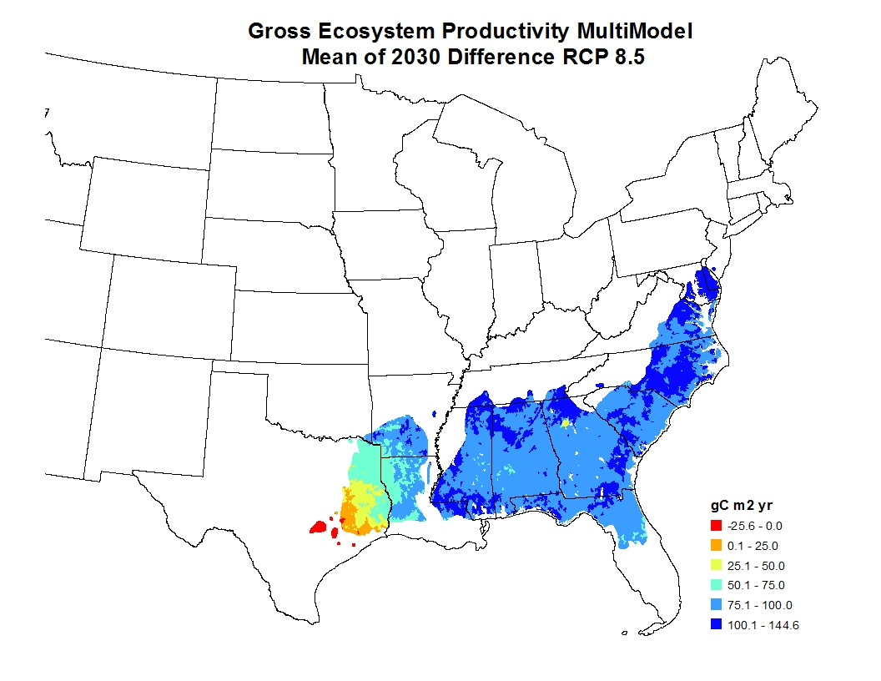
WaSSI Modeled Mean Changes by 2030 (all GCMs)
Notes:
*biggest issue with NARCCAP: temporal extent since 2041-2070 was the only future time slice

Slide 36
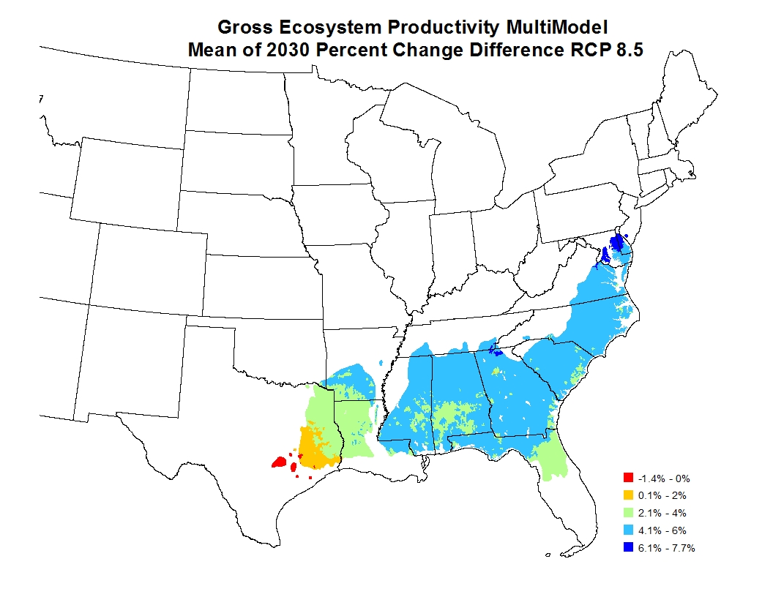
WaSSI Modeled Mean Changes by 2030 (all GCMs)
Notes:
*biggest issue with NARCCAP: temporal extent since 2041-2070 was the only future time slice

Slide 37
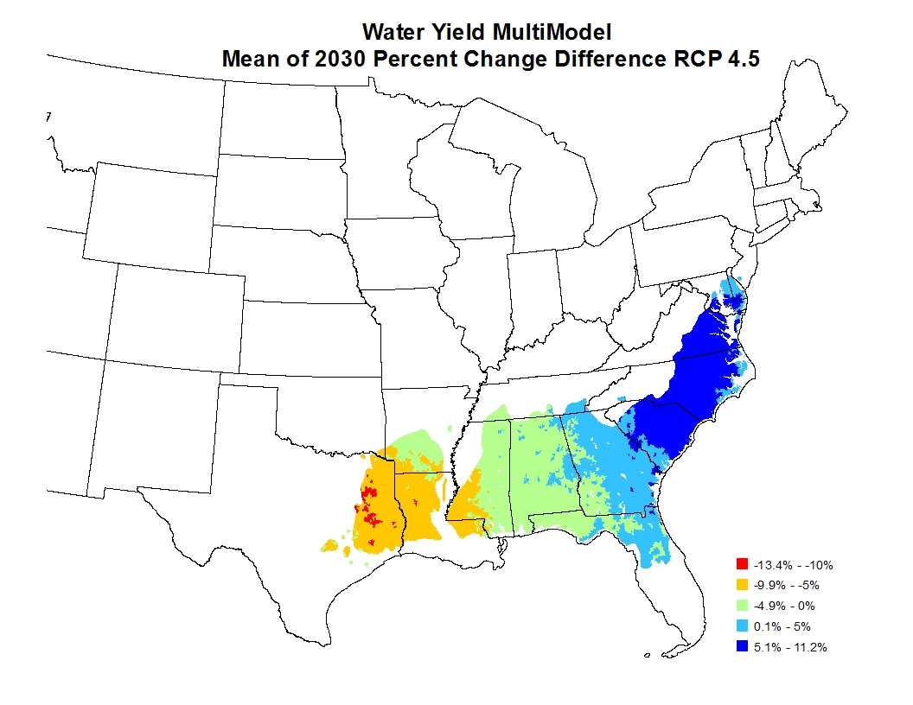
WaSSI Modeled Mean Changes by 2030 (all GCMs)
Notes:
*biggest issue with NARCCAP: temporal extent since 2041-2070 was the only future time slice

Slide 38
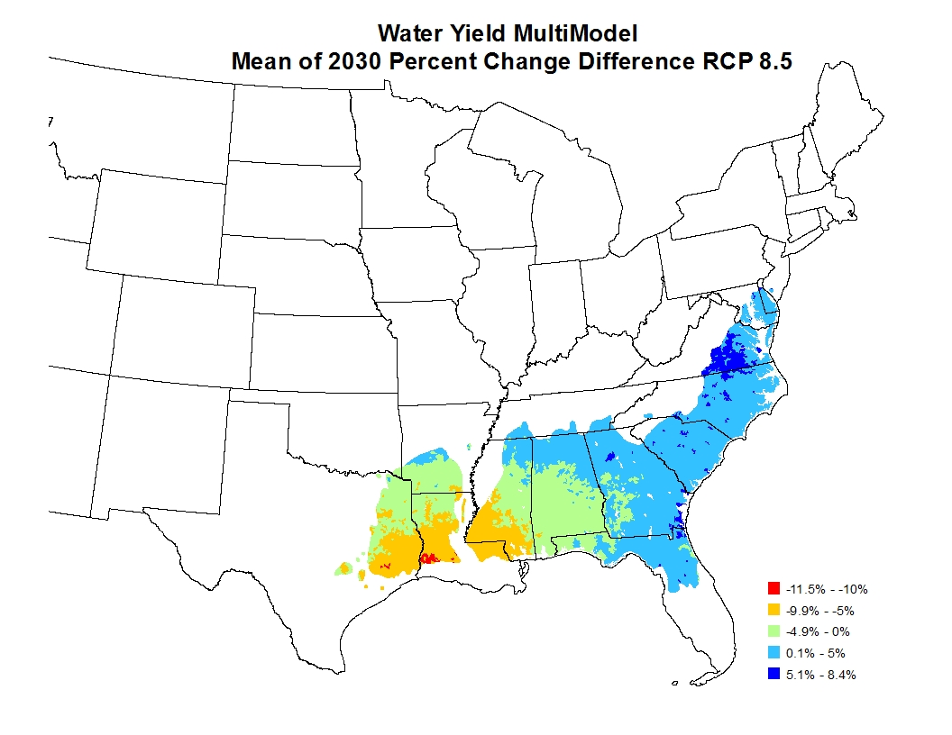
WaSSI Modeled Mean Changes by 2030 (all GCMs)
Notes:
*biggest issue with NARCCAP: temporal extent since 2041-2070 was the only future time slice

Slide 39
Summary and Next steps
Divergent response? Productivity increases but water supply decreases at the regional scale.
Will work on other scenarios: CO2 fertilization with altered WUE
  Young stands (LAI-2.3)
  Mature stands (LAI=4)
Provide DSS required datasets
  Young stands (LAI=2.3)
  Mature stands (LAI=4)

