Slide 1
All Team PINEMAP meeting January 23, 2015

Slide 2
Agenda
Welcome and updates
Sap Flux Regional Analysis progress report
Updates from other Integration Platform Groups:
Tier II,
Soil Respiration,
Genotyping,
Scenario Development,
Regional Modeling (3-PG and CLM),
MACA/DSS,
PLT,
Undergrad Fellowships,
Corporate Outreach,
Extension Outreach
Annual meeting brainstorming/ Wrap up

Slide 3
Welcome and Updates
Renewal proposal and budgeting/spending reminder
Annual report articles due February 2
Quarterly Executive Committee meeting 2/12/15
Interim progress reports due 3/20/15
Graduate/ undergraduate student profiles for report
Pictures for report
Annual meeting discussion at end of this meeting – think about ideas during presentations

Slide 4
Sap Flux Integration Platform
How to make an ecophysiological study at multiple sites, and conducted by multiple labs, work for everyone

Slide 5
Outline
1. How to facilitate multi-site synthesis
...and make sure everyone gets what they need.
2. Specific obstacles for our cross-site synthesis
...and some of the solutions (hopefully).
3. Features of integration platform
...and the kinds of analyses we can look forward to.
4. Progress Update

Slide 6
A Traditional Field Study
Plan Experiment
Set Up Experiment
Collect Data
Put Data and Analysis into Database
Discuss in Context of Previous Studies
a.k.a. Publish
Analyze Data

Slide 7
A Traditional Field Study
Plan Experiment
Set Up Experiment
Collect Data
REALITY
Put Data and Analysis into Database
Discuss in Context of Previous Studies
a.k.a. Publish
Analyze Data

Slide 8
A Traditional Field Study
Plan Experiment
Set Up Experiment
Collect Data
REALITY
Put Data and Analysis into Database
Discuss in Context of Previous Studies
a.k.a. Publish
Analyze Data

Slide 9
A Multisite Field Study
Plan Experiment
Set Up Experiment
Collect Data
Put Data and Analysis into Database
Discuss in Context of Previous Studies
a.k.a. Publish
Analyze Data

Slide 10
A Multisite Field Study
Plan Experiment
Set Up Experiment
Collect Data
Set Up Experiment
Collect Data
Set Up Experiment
Collect Data
Set Up Experiment
Collect Data
Put Data and Analyses into Database
Publish
Analyze Data
Publish
Analyze Data
Publish
Analyze Data
Publish
Analyze Data

Slide 11
A Multisite Field Study
Set Up Experiment
Collect Data
Plan Experiment
Set Up Experiment
Collect Data
Set Up Experiment
Collect Data
Set Up Experiment
Collect Data

Slide 12
A Multisite Field Study
Set Up Experiment
Collect Data
Plan Experiment
Set Up Experiment
Collect Data
Set Up Experiment
Collect Data
Set Up Experiment
Collect Data
REALITY
Analyze Data
Analyze Data
Analyze Data
Analyze Data

Slide 13
A Multisite Field Study
Plan Experiment
Set Up Experiment
Collect Data
Set Up Experiment
Collect Data
Set Up Experiment
Collect Data
Set Up Experiment
Collect Data
Put Data and Analyses into Database
Publish
Analyze Data
Publish
Analyze Data
Publish
Analyze Data
Publish
Analyze Data

Slide 14
Data Assimilation
Build Model
Make Predictions
Collect Data
Update Model
a.k.a.
Analyze Data
Put Data into Database

Slide 15
Data Assimilation
Build Model
Make Predictions
Collect Data
Publish (?)
Update Model
a.k.a.
Analyze Data
Put Data into Database

Slide 16
Data Assimilation
Build Model
Make Predictions
Collect Data
?
Publish (?)
Update Model
a.k.a.
Analyze Data
Put Data into Database

Slide 17
A Multisite Field Study
Set Up Experiment
Collect Data
Plan Experiment
Set Up Experiment
Collect Data
Set Up Experiment
Collect Data
Set Up Experiment
Collect Data

Slide 18
A Multisite Field Study
Set Up Experiment
Collect Data
Plan Experiment
Set Up Experiment
Collect Data
Set Up Experiment
Collect Data
Set Up Experiment
Collect Data
Publish
Analyze Data
Put Data into Database
Publish
Analyze Data
Publish
Analyze Data
Publish
Analyze Data

Slide 19
A Cross-Site Field Study
Set Up Experiment
Collect Data
Plan Experiment
Set Up Experiment
Collect Data
Set Up Experiment
Collect Data
Set Up Experiment
Collect Data
Publish
A Cross Site Analysis
Analyze Data
from All Sites in Same Framework
Put Data into Database

Slide 20
Outline
1. How to facilitate multi-site synthesis
...and make sure everyone gets what they need.
2. Specific obstacles for our cross-site synthesis
...and some of the solutions (hopefully).
3. Features of integration platform
...and the kinds of analyses we can look forward to.
4. Progress Update

Slide 21
A Multisite Field Study
Set Up Experiment
Collect Data
Plan Experiment
Set Up Experiment
Collect Data
Set Up Experiment
Collect Data
Set Up Experiment
Collect Data
REALITY
Publish
Analyze Data
Put Data into Database
Publish
Analyze Data
Publish
Analyze Data
Publish
Analyze Data

Slide 22
Issues for Cross-Site Analysis
1. Gap Filling of Soil Moisture Data
-Dangers of adopting new technology
2. Standardize Equations Sapwood Area and Radial Sap Flux Variation
-Small differences in scaling = large differences in outputs
3. Interpolation of Semiannual LAI data
-What works for one site might not work for all

Slide 23
Issues for Cross-Site Analysis
1. Gap Filling of Soil Moisture Data
-Dangers of adopting new technology
2. Standardize Equations Sapwood Area and Radial Sap Flux Variation
-Small differences in scaling = large differences in outputs
3. Interpolation of Semiannual LAI data
-What works for one site might not work for all

Slide 24
Soil Moisture Data
All sites have some 0-12 cm data from wireless sensors
All sites have additional measurements, but not the same
Current approach is to gap fill 0-12 cm, using an algorithm aggregating larger and larger sets of data
Interpolating over rainless periods <2 weeks
Using sensors in same treatment/position (between/under excluder)
Using sensors in same position in all treatments
Using sensors in all positions in all treatments
Using other types of sensors from same site
Using NCDC sites near each site

Slide 25
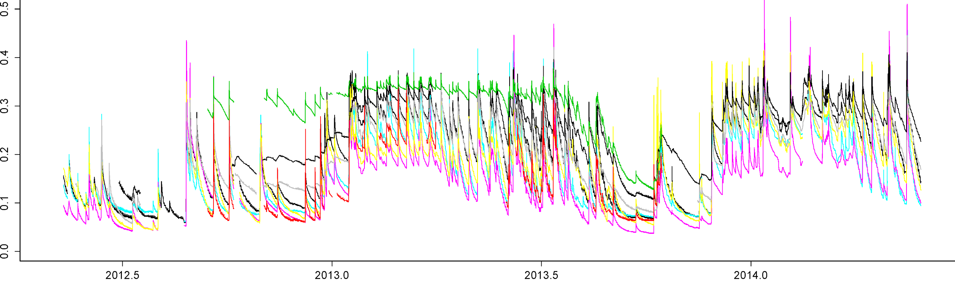
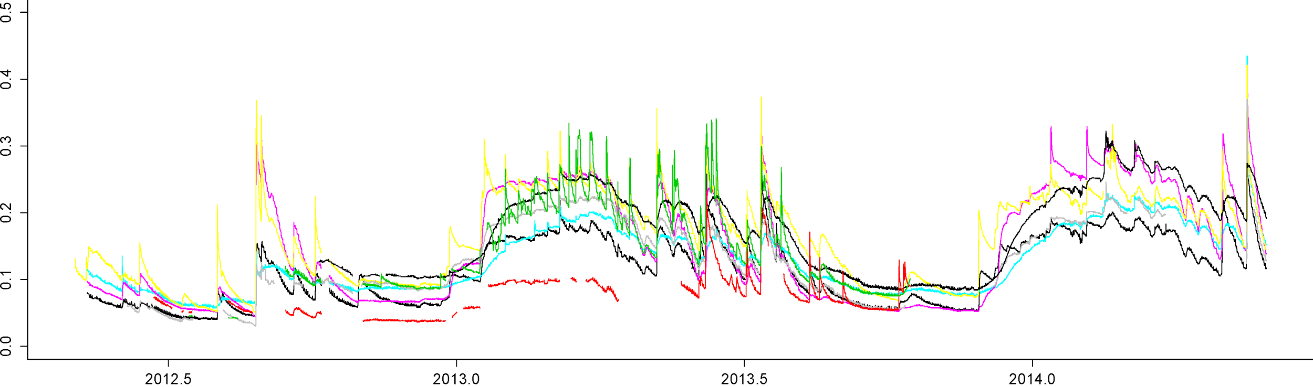
Soil Moisture Data

Slide 26
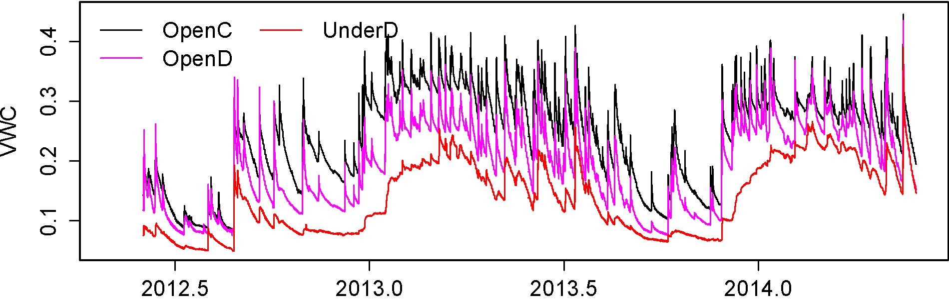
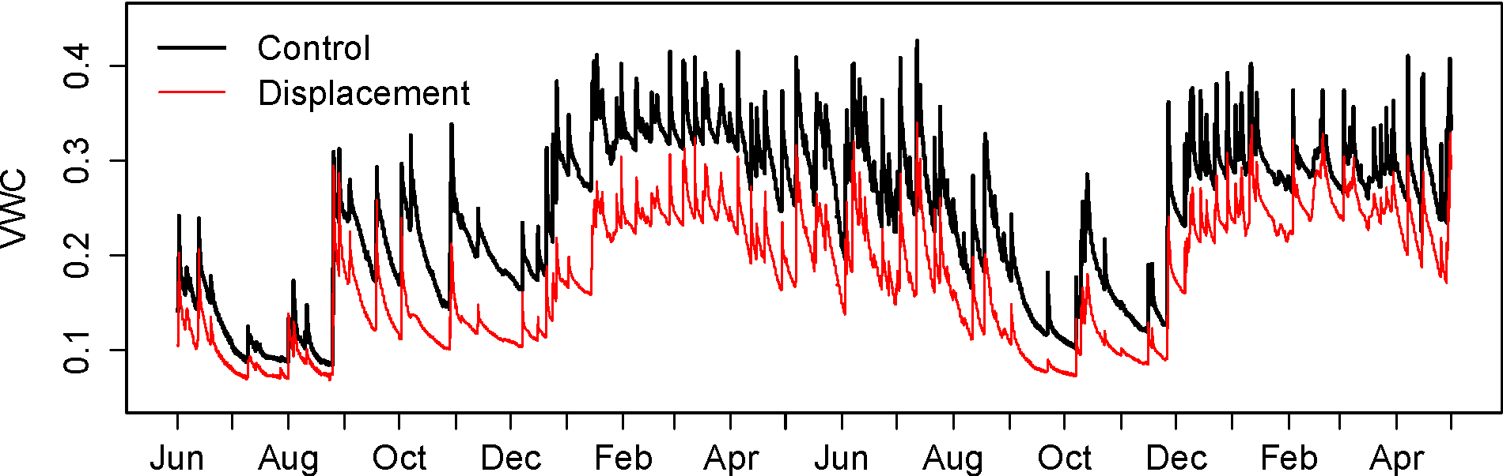
Soil Moisture Data

Slide 27
LAI Interpolation
LAI development is an important factor influencing transpiration rate, but original plan was only 2 measurements per year.
Different approaches at different sites
Some sites collect more than 2 per year (e.g. monthly)
For VA site, phenology from another site in same region was used as basis for a generic yearly curve
Currently pursuing remote sensing solutions with members of Aim 2.

Slide 28
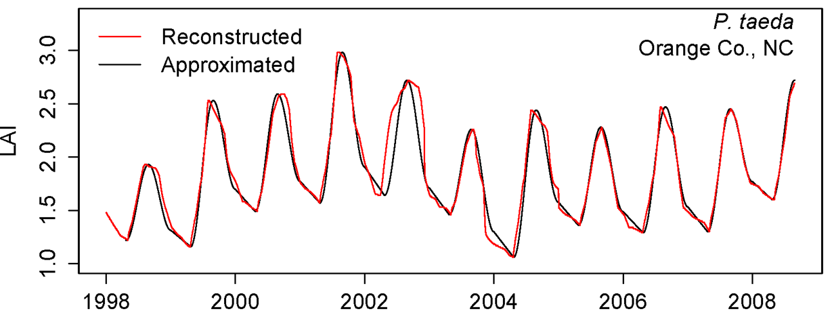
LAI Interpolation

Slide 29
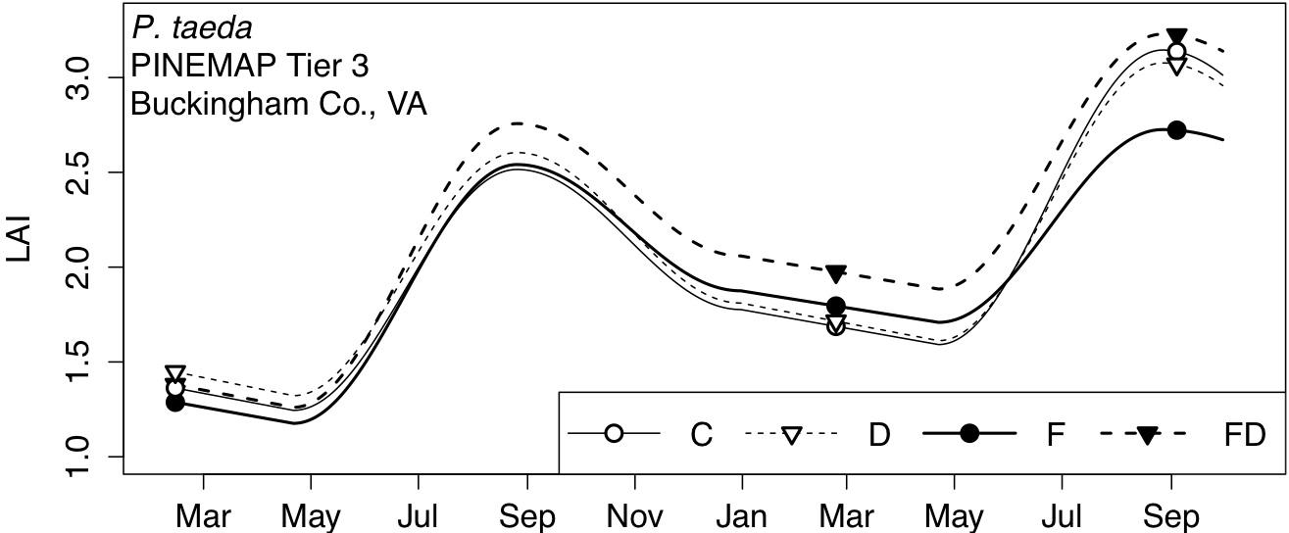
LAI Interpolation

Slide 30
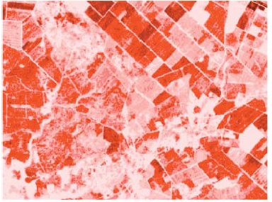
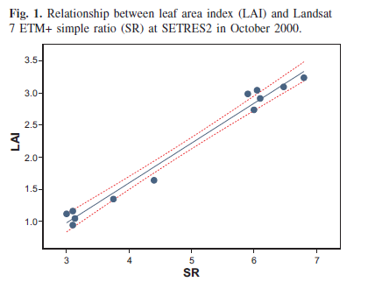
LAI Interpolation
Using multispectral satellite imagery to estimate leaf area and response to silvicultural treatments in loblolly pine stands
Francisco J Flores, H Lee Allen, Heather M Cheshire, Jerry M Davis, Montserrat Fuentes, Daniel Kelting
Canadian Journal of Forest Research, 2006, 36(6): 1587-1596, 10.1139/x06-030

Slide 31
Outline
1. How to facilitate multi-site synthesis
...and make sure everyone gets what they need.
2. Specific obstacles for our cross-site synthesis
...and some of the solutions (hopefully).
3. Features of integration platform
...and the kinds of analyses we can look forward to.
4. Progress Update

Slide 32
StaCC Model
State-Space Canopy Conductance
Key Features
Hierarchical: Explicitly handles data at multiple scales to assess a process at another scale.
Provides a consistent estimate of transpiration and stomatal conductance across sites.
Simultaneously fills gaps in sap flux data to provide a continuous time series of these processes, while including the additional uncertainty associated with missing data.

Slide 33
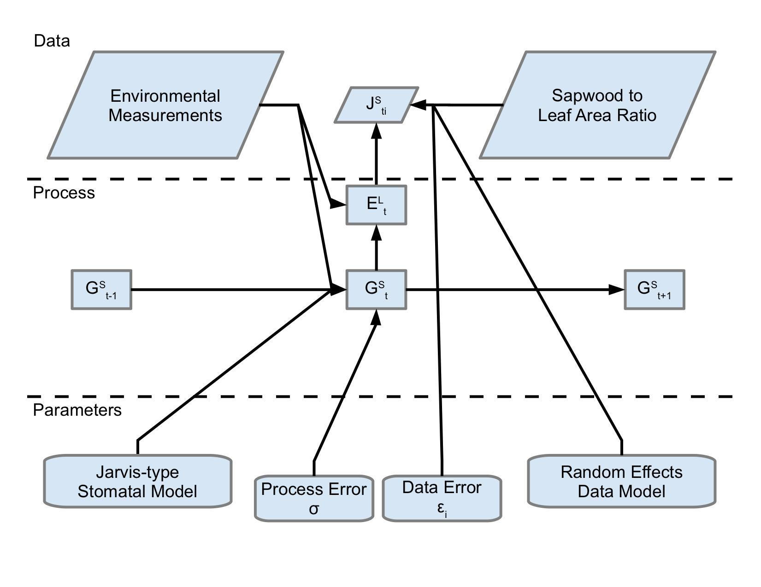
StaCC Model

Slide 34
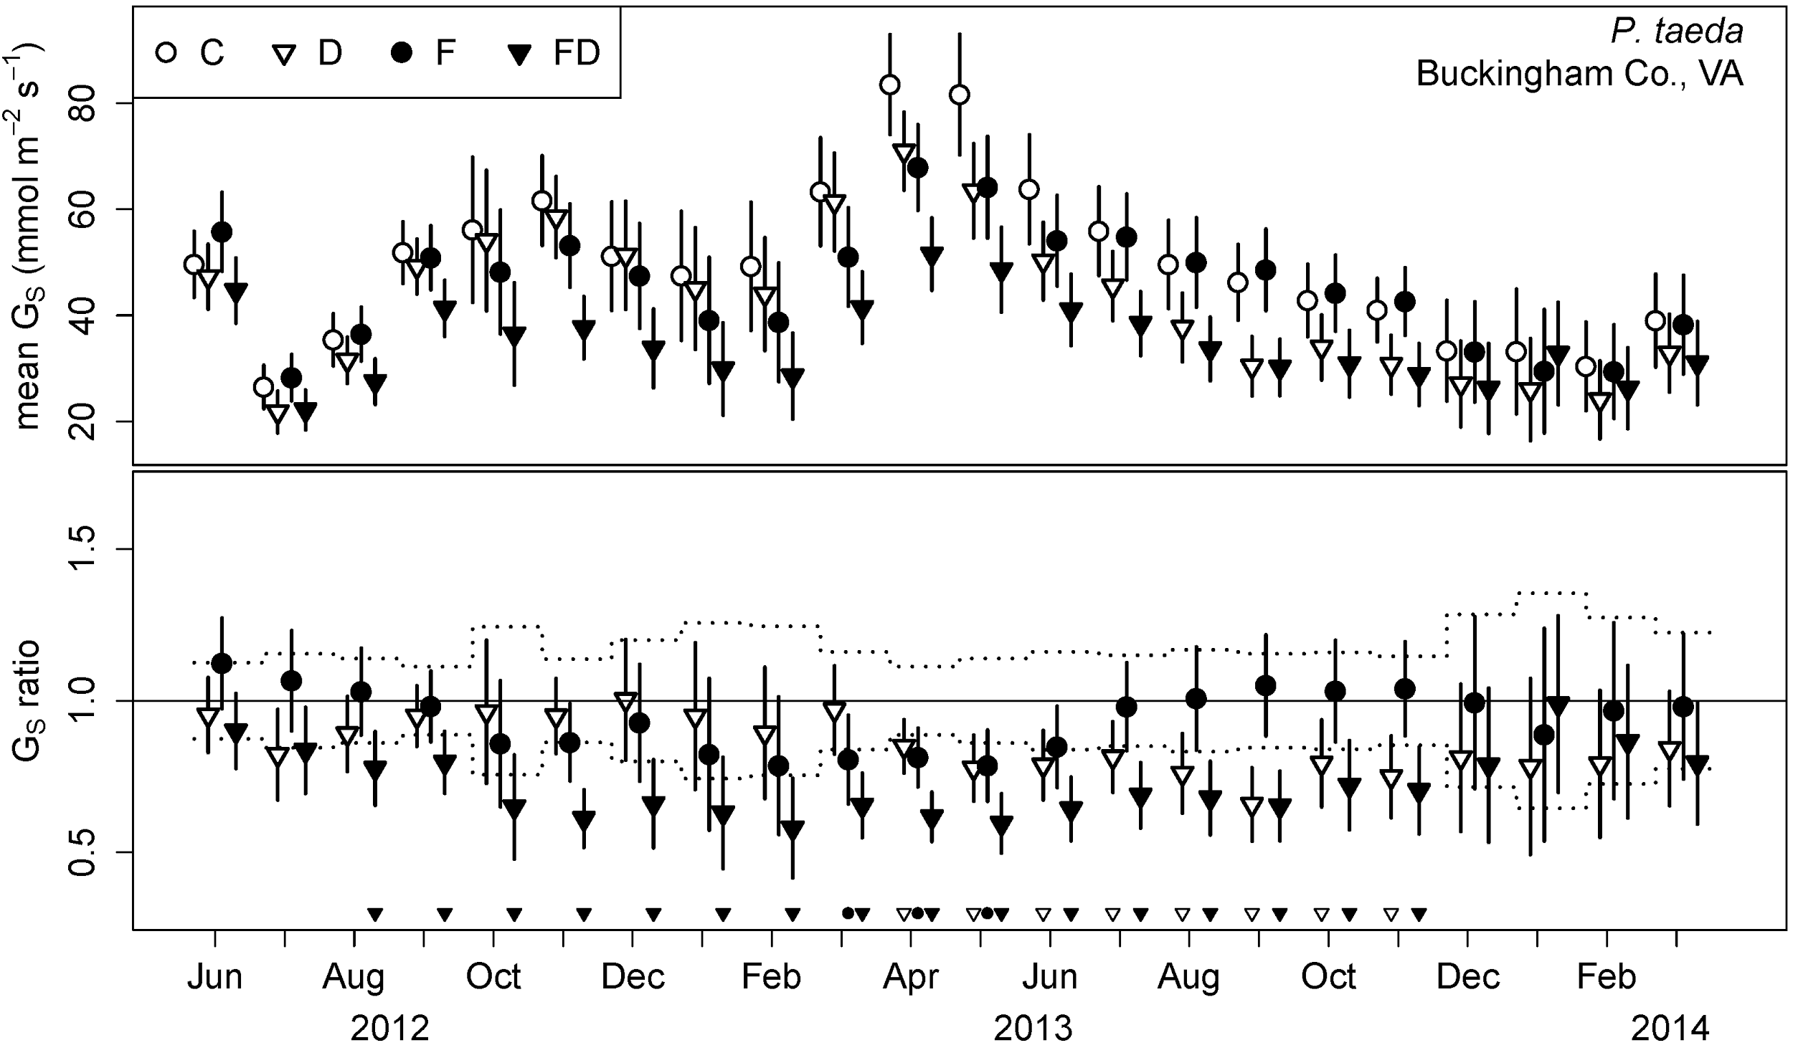
StaCC Model

Slide 35
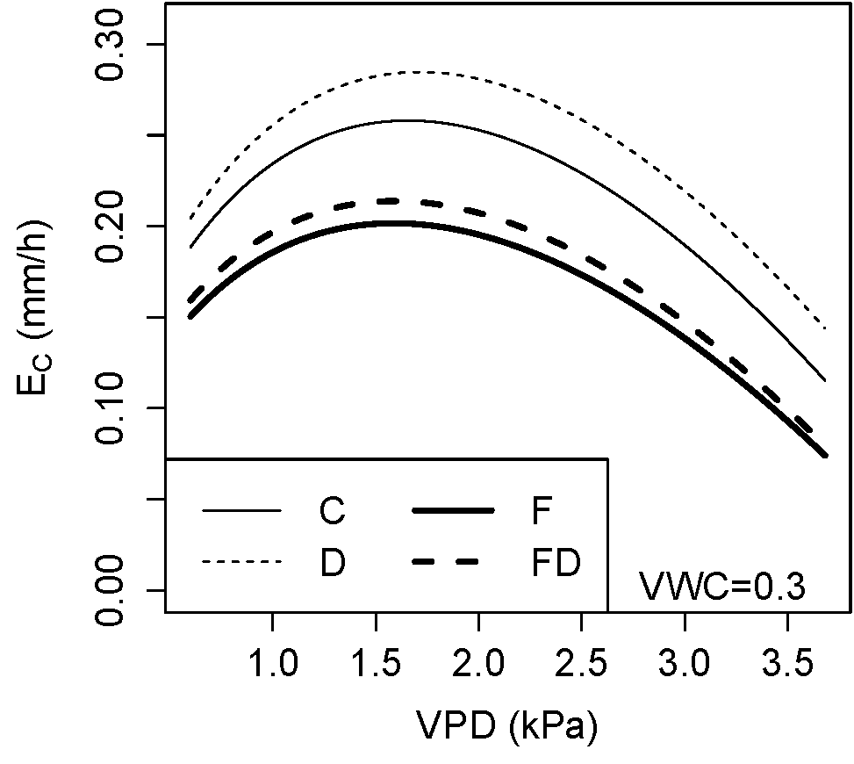
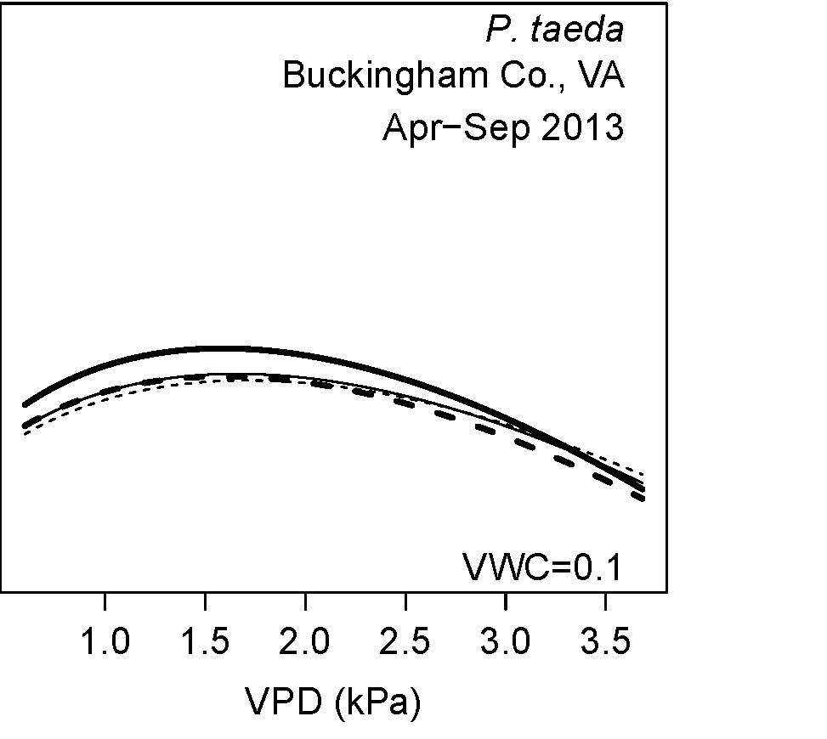
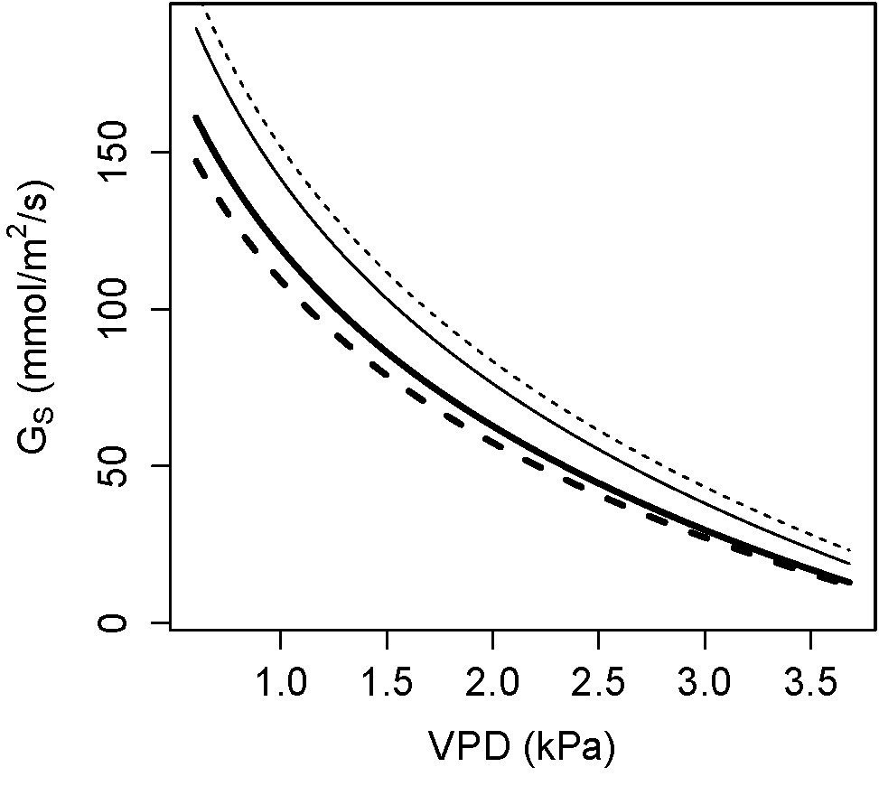
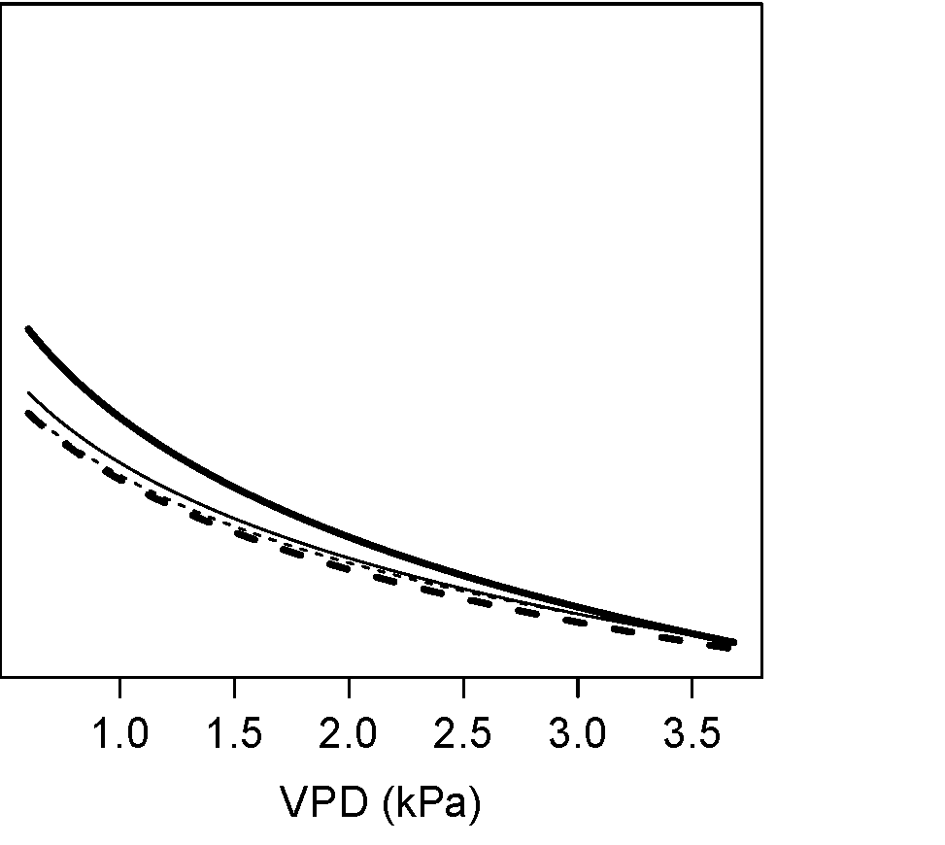
StaCC Model

Slide 36
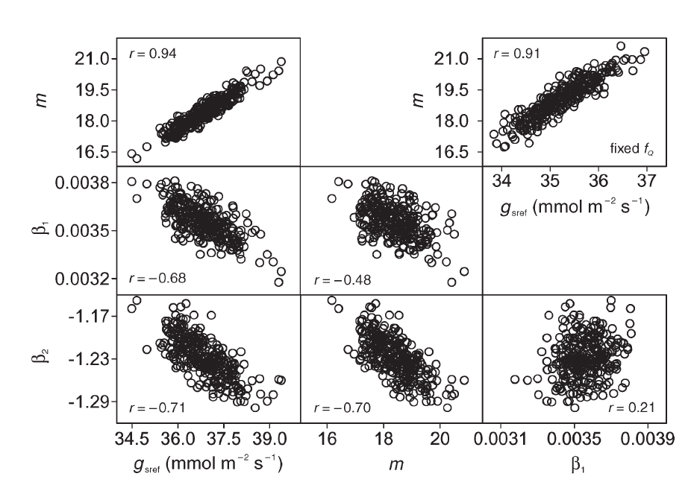
StaCC Model

Slide 37
Outline
1. How to facilitate multi-site synthesis
...and make sure everyone gets what they need.
2. Specific obstacles for our cross-site synthesis
...and some of the solutions (hopefully).
3. Features of integration platform
...and the kinds of analyses we can look forward to.
4. Progress Update

Slide 38
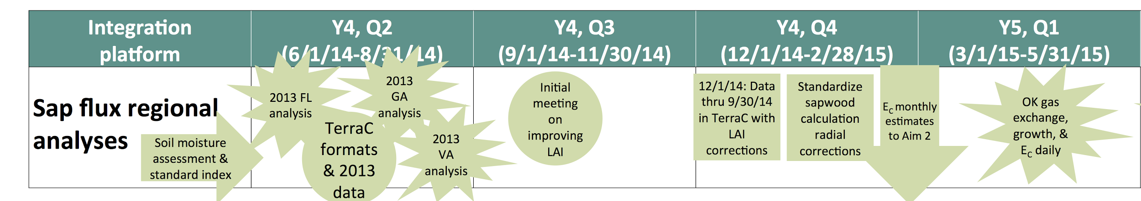
Timeline

Slide 39
Timeline
Near Completion
Will Hold meeting early Feb
Working with Aim 2 members on remote sensing solutions
Complete ASAP
Met with Larger Aim 1 Group
Complete by Feb 1
Submitted for Review

Slide 40
Questions?

Slide 41
Tier II Integration Platform
Jason will give a verbal progress report

Slide 42
Soil Respiration

Slide 43
ln R_{S} = 0.941 (ln T_{S}) – 1.482
R² = 0.452

Slide 44
Genotyping Integration Team Update
Genotyping experiments are still underway on 2 populations
ADEPT2 clonal population, MS and FL sites (Mengmeng Lu, Carol Loopstra, Kostya Krutovsky)
PSSSS seedling population, VA site (Jason Holliday) – 1/8 data in hand, preliminary review indicated good quality; waiting on the rest

Slide 45
Genotyping Integration Team Update
Genotyping platform development for future breeding applications derived from PINEMAP-supported experiments
Deliverables with value for tree breeders and forest genetics researchers envisioned:
(1) a “fingerprinting” panel with ~100 to 200 markers, for use in identification and parentage analysis and
(2) a “medium-density” panel with ~50,000 markers for use in association genetics and genomic selection work
Quotes for production and use of both products are in hand
Next step: making decisions about which markers to include, and assembling sequences for assay designs
Coordination with industry partners and other pine breeding/ genetics research community members took place at Plant and Animal Genome Conference (San Diego last week); more coordination planned

Slide 46
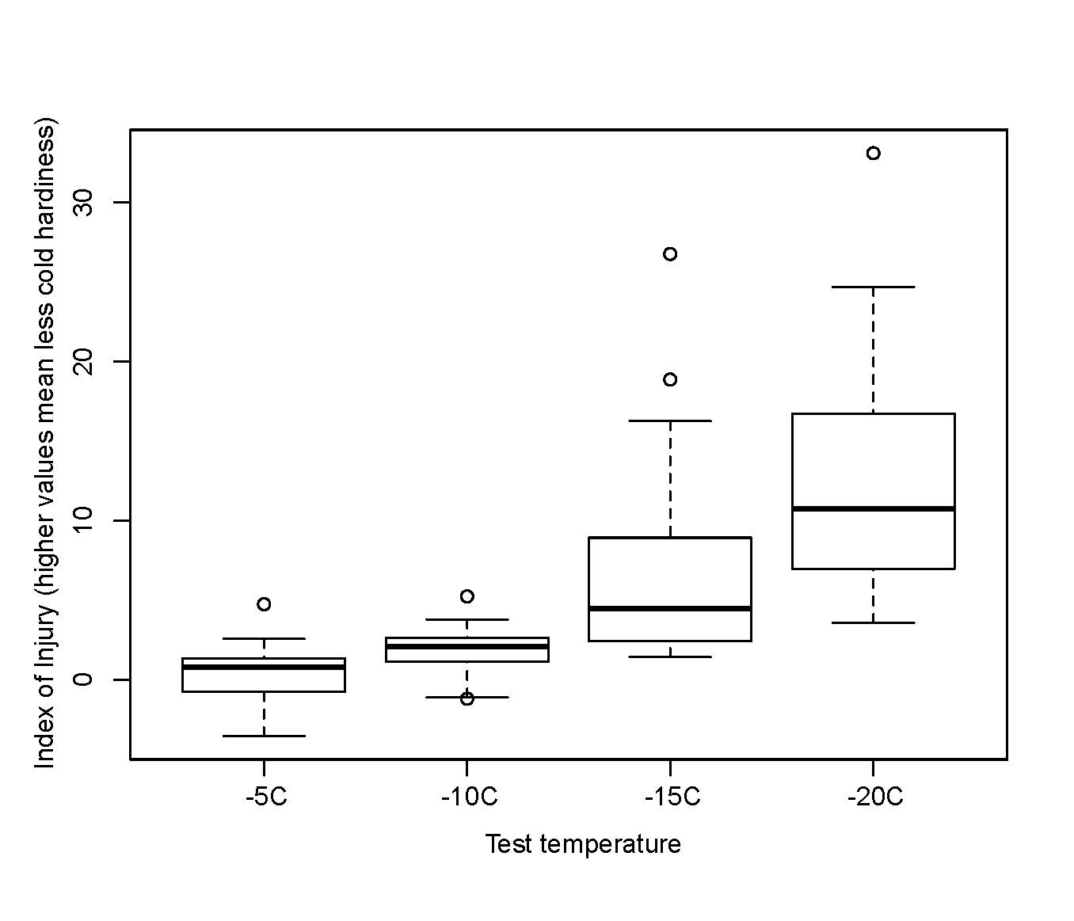
Genotyping Integration Team Update
Cold-hardiness testing of ADEPT2 populations in FL and MS
Preliminary test of small sample in MS conducted Dec 2014 showed little difference among clones above -10C, greater variation in damage below -10C; more samples from MS and FL to be tested in next few weeks

Slide 47
PINEMAP Scenarios for Model Simulations
The scenarios are a framework for assessing the potential for increasing carbon sequestration in loblolly pine plantations.
The four components of the scenarios are: Environment, Productivity, Land Use & Disturbance.
Update: Initial scenario runs will focus on Environment (climate change). We are waiting for the downscaled climate data to be available and the results from some additional testing of 3-PG.
Update: The second level of scenario runs will focus on change in Productivity from management/genetic improvement options. We have a framework in place to make these runs.
- Bob Teskey

Slide 48
3-PG Regionalization Update

Slide 49
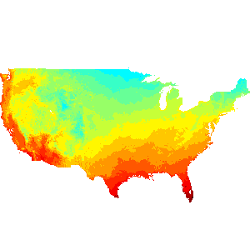
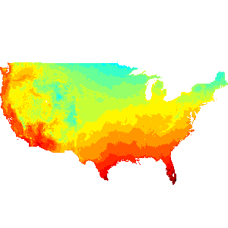
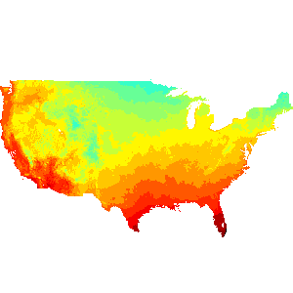
Climate Scenarios and Models
Two radiative forcing scenarios
RCP 8.5 (business as usual)
RCP 4.5 (no further increase in emissions)
20 different global climate models provide opportunity to assess variability in predictions
Mean of differences (relative to the historical baseline) across all 20 climate models + historical
Mean +/- 1 standard deviation of differences across all 20 models + historical

Slide 50
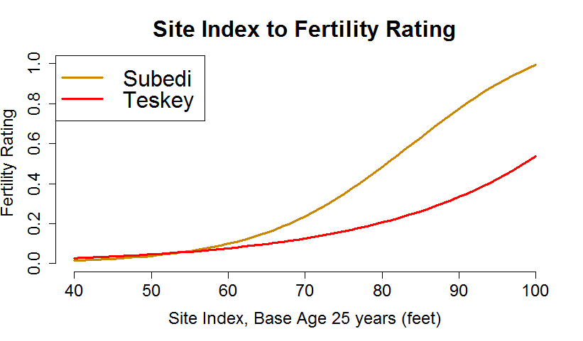
Fertility Rating
We have two models which translate site index (aggregated to HUC level from SSURGO data) into fertility rating, a key input to 3-PG

Slide 51
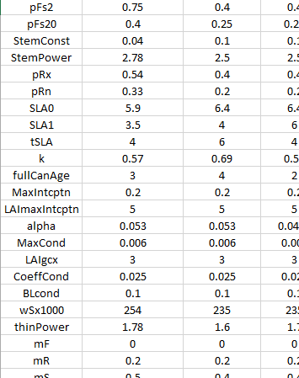
Parameter Sets
There are multiple parameter sets available to use with 3-PG
The values of the parameters fine-tune the model’s behavior and are set with loblolly pine as the focus
Candidate parameter sets
Bryars/Teskey (2013)
Gonzalez-Benecke
Sampson
Subedi

Slide 52
3-PG Model
A variety of executable 3-PG models are also available
These differ in the equations and functions used to simulate growth
Candidate models are
Bryars/Teskey (2013)
Landsberg/Sands (2001)
Gonzales-Benecke
Modifies several functions in the Bryars/Teskey model

Slide 53
Timetable
Input data are now available and processed
January 2015 | February | March | April
Initial regional run | Factorial comparisons | Full-scale regional runs | Results assessment
1x Climate scenario 1x Climate model 1x FR model 1x Parameter set 1x 3-PG model | 1x Climate scenario 1x Climate model 2x FR model 4x Parameter set 2x 3-PG model | 2x Climate scenario 20x Climate model 1x FR model 1x Parameter set 1x 3-PG model | Mean and variance of outputs
Establish processing infrastructure | Select most appropriate combination | Compile results by scenario/model | Submit to SRTS, DSS, etc.

Slide 54
Update on the Community Land Model
Completed evaluation of the CLM historical simulation (1970-1995) using Tier 1 NPP data.
The default parameterization for temperate needle-leaf evergreen trees predicted lower woody biomass, lower ANPP, and higher LAI than observed.
Developed a new loblolly-specific plant functional type.
Removed the bias in woody biomass and ANPP; reduced bias in LAI
Still considerable uncertainty when comparing to Tier 1 data, as expected given the model-observation scale mismatch (~100x100 km grid-cell vs. plot scale)
Ran RCP 4.5 and 8.5 using the new loblolly parameterization.
Only running the predictions from the CCSM model because the CLM requires sub-daily weather inputs that are not available in the MACA data
CCSM is one of the models included in the MACA data so we can compare to the other 3 models used in the integration.
Currently running simulations to attribute the predicted change between the 1970-1995 period and the 2070-2095 period.
How much change in woody biomass is due to rising CO₂?
How much change in woody biomass is due to a changing climate?

Slide 55

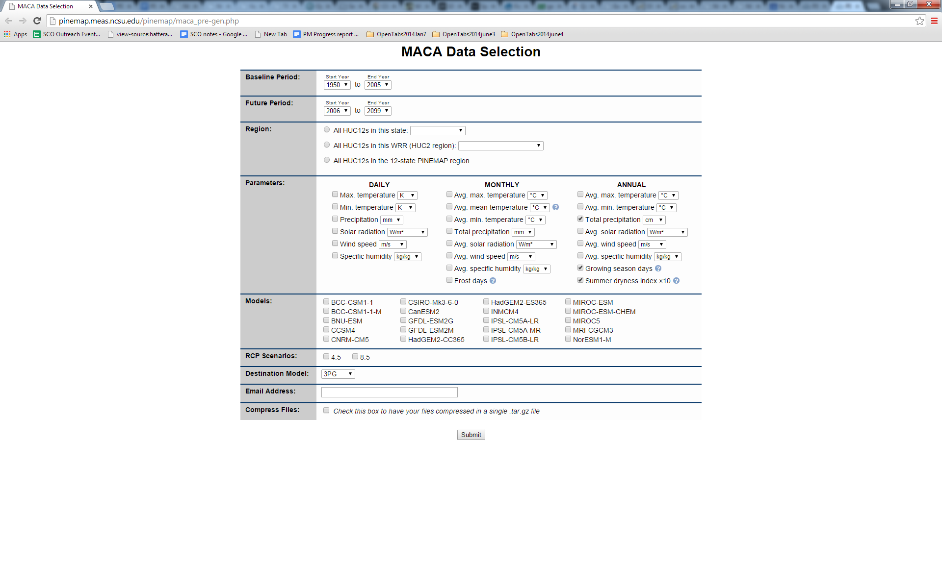



MACA data: Modeling Needs
Growth & Yield:
3PG:
HUC12 averages
WaSSI:

Slide 56
MACA data processing updates
All "priority" region data have been processed
3PG: 1200 files per state (14,400 total)
G&Y: 780 files per state (9,360 total)
WaSSI*: varies by HUC2 (Evan’s format: 62,400 total;
customized format: 360 files for 6 HUC2’s)
Total data size (some compressed files): 80G
3PG and G&Y: one file per state and per ecological model
(24 total compressed files)
WaSSI: 60 files per HUC02 -- baseline, RCP4.5 & 8.5 for 20 GCMs
(360 total files, not compressed)
Notes:
*=just realized we still need to process HUC03

Slide 57
MACA data processing updates
Possible methodological issue?
compute HUC12 average on raw daily output and then run calculations (e.g. mean temp, summer dryness index, etc.)
run calculations and then do HUC12 average at end on monthly/annual data
Mainly impacts frost days, growing season days, and summer dryness index – may not matter with future deltas
Re-run these? Re-run all variables for consistency?
Meet with modelers over the next week to decide
Good news: Amazon Web Services (“beast” server) can be used to re-process in much faster manner but $$$
e.g. 43 mins vs 9 mins

Slide 58
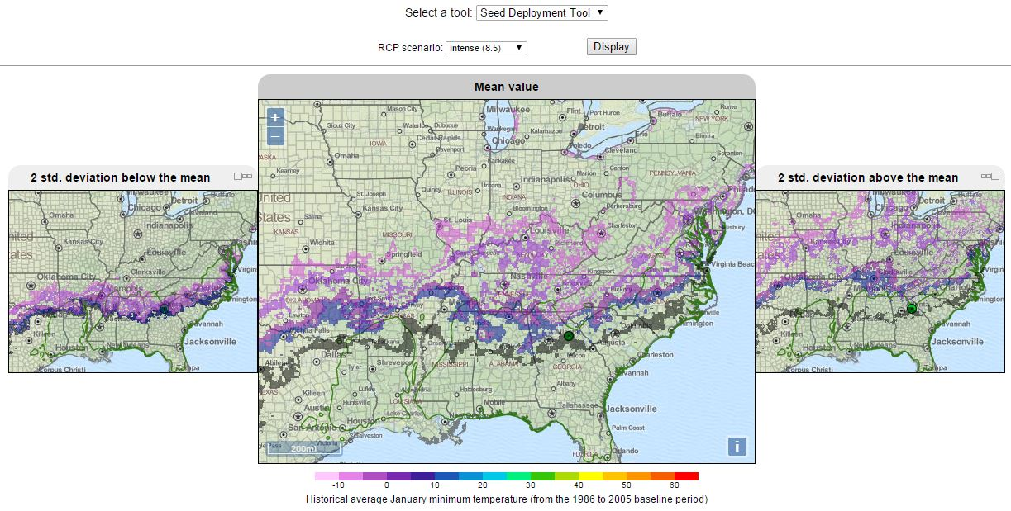
Prototype: Seed Deployment Tool Athens, GA RCP 8.5
Draft
Draft
Draft
Black: model baseline
Blue: 2020-2039
Purple: 2040-2059
Lt Purple: 2060-2079
Pink: 2080-2099

Slide 59
Next steps
Priority: MACA output for models
Set up MACA meeting(s) with modeling teams
DSS tools and beta testing – seed deployment
Beta testing team includes PINEMAP folks and external partners
Roll out DSS to target audiences (late Spring)

Slide 60
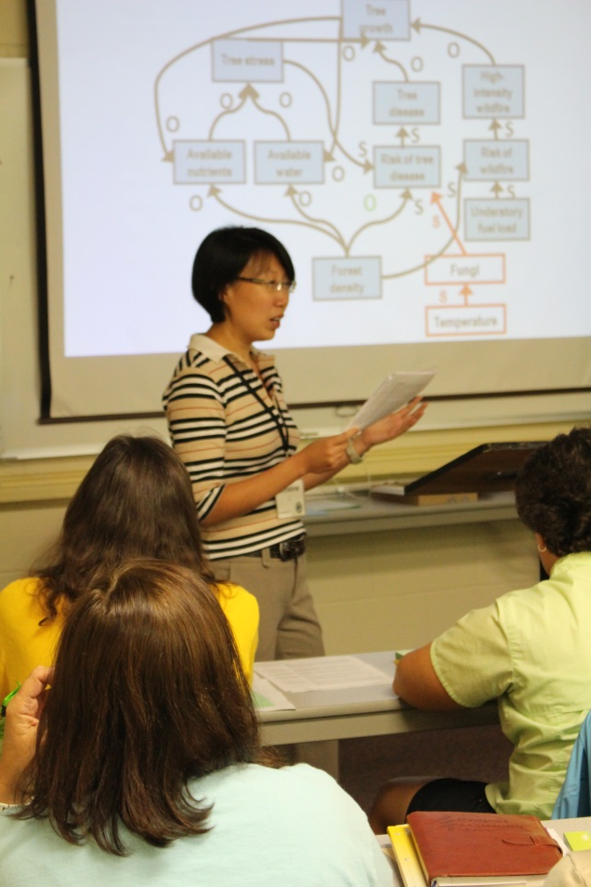
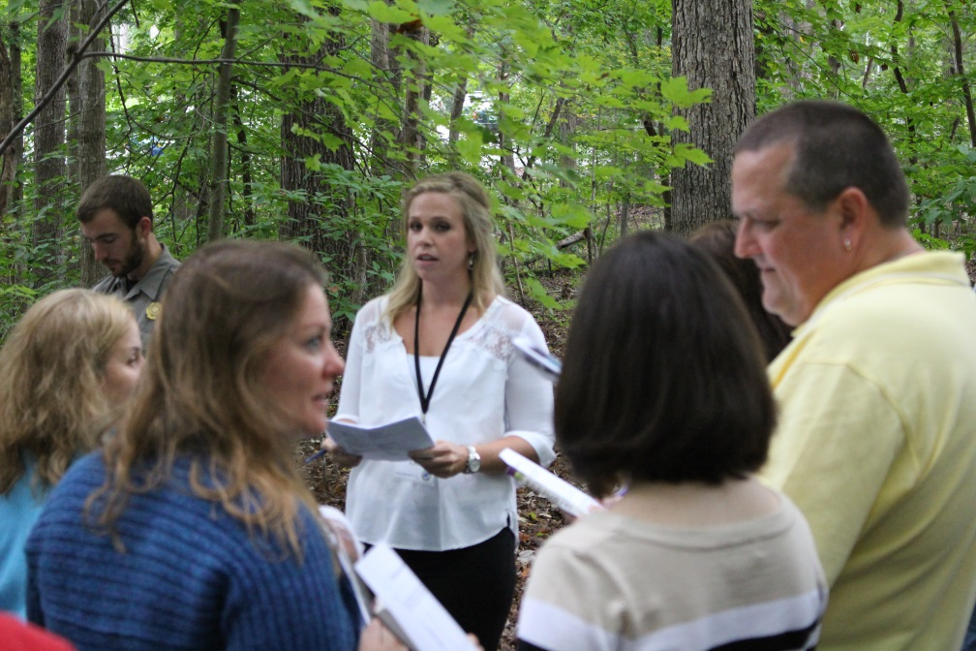
Report from the PINEMAP/PLT Secondary Module Integration Platform
Martha Monroe, Annie Oxarart, Christine Li, Tracey Ritchie, Kristen Kunkle, Kristy Burja

Slide 61

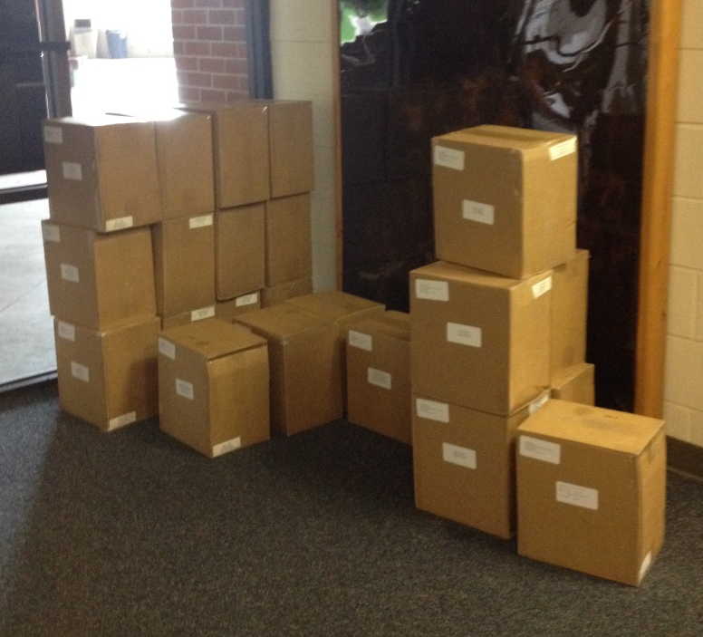
Southeastern Forests and Climate Change
Printed 2,777 copies September 2014
Mailed 365 copies to individual educators and PLT coordinators
Shipped 1,035 books to those who will conduct workshops

Slide 62
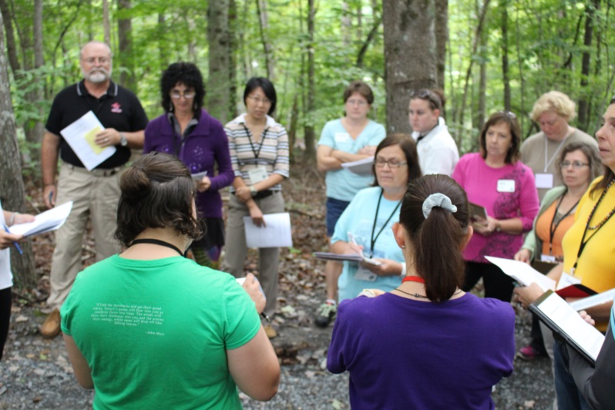
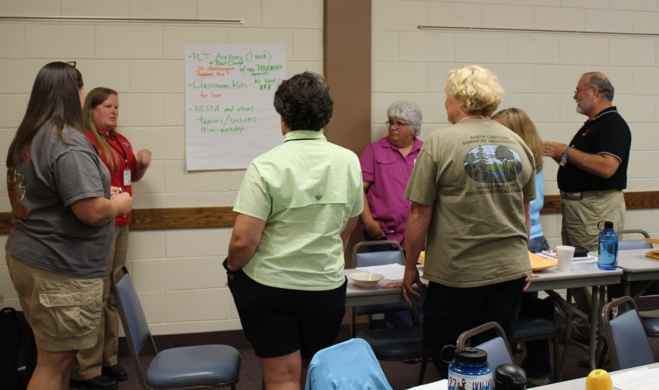
Training workshops
Conducted workshops to train PLT State Coordinators, facilitators, and educators to use the module
Asheboro NC September 19, 2014 39
Mark Megalos assisted
Little Rock AR November 13-15, 2014 22
Rod Will and Adam Maggard assisted
Jacksonville FL January 22-24, 2015 37

Slide 63
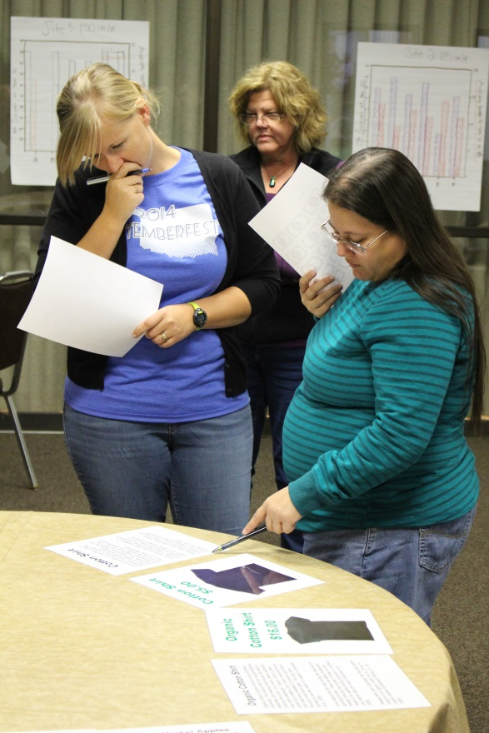
Regional reach of our workshops
State | State Coordinator | Facilitators | Educators
Alabama | 1
Arkansas | 1 | 3 | 3
Florida | 1 | 15 | 12
Georgia | 1 | 4
Kentucky | 1 | 4
Louisiana
Mississippi | 1 | 2
N. Carolina | 1 | 6 | 22
Oklahoma | 1 | 2
S. Carolina | 1 | 4
Tennessee | 1 | 2
Texas | 1 | 1
Virginia | 1 | 2

Slide 64
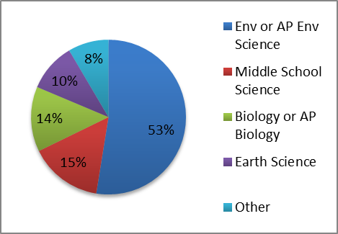
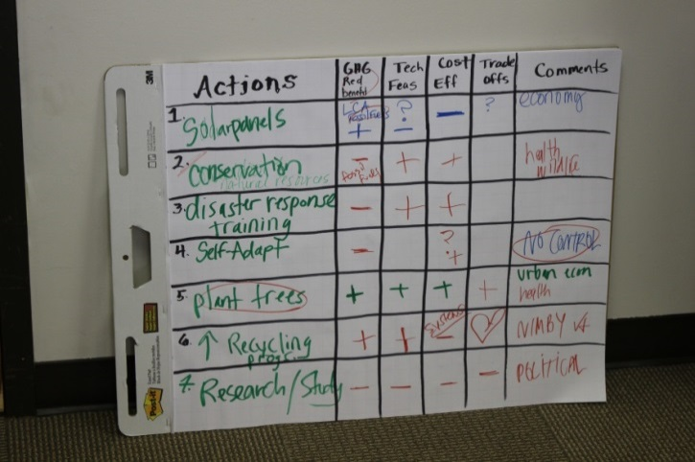
Formative evaluation
From the 123 applicants, we recruited 64 teachers to represent regional and grade-level diversity.
44 teachers completed their evaluation forms
924 students completed pre- and post-surveys

Slide 65
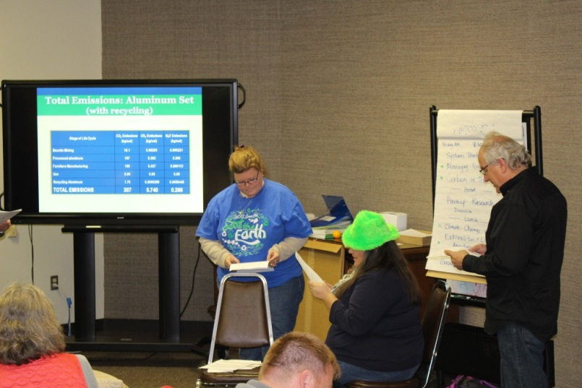
Summative evaluation
45 teachers were selected from 11 SE states (out of 170 who applied) to use 5 activities before June and return student data.
Those who have received the materials (workshop or website) will receive a survey asking how they used it and what they think.

Slide 66
Additional research in progress
Developing a reliable scale that measures hope about climate change​ for high school students
Understanding cultural cognition and how it affects educators’ intentions to support climate change education; identifying strategies to make materials attractive
Understanding how to measure systems thinking
Exploring teacher efficacy regarding teaching about climate change

Slide 67
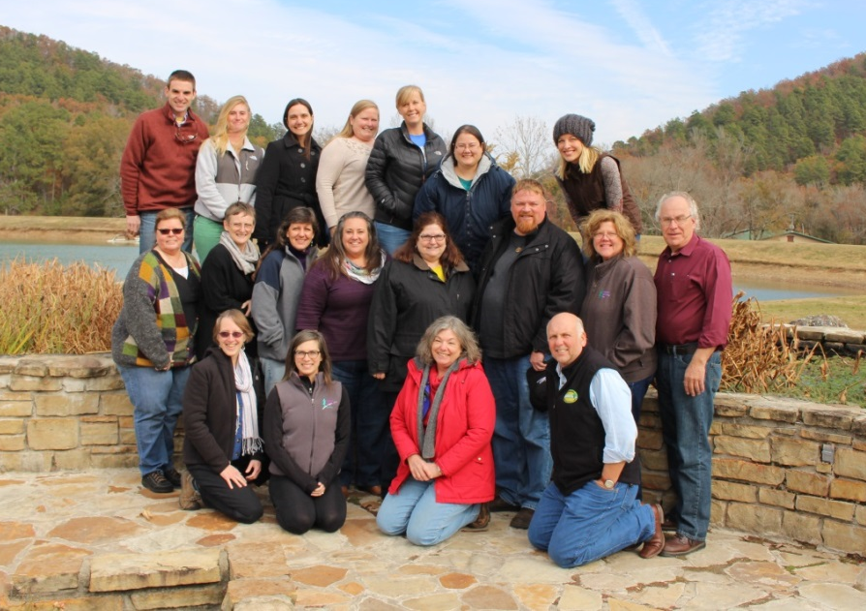
And…
Minigrants are available from National PLT to support state workshops in 2015.
Website homepage got 217,000 hits in 2014
106 have registered to download materials
Over 150 PDFs provide supplemental information

Slide 68
Plans for years 4-5
Complete summative evaluation
Make improvements to website and materials as needed
Support facilitators in their workshops
Conduct webinars to help educators
Work with National PLT on the future of the module, post PINEMAP

Slide 69
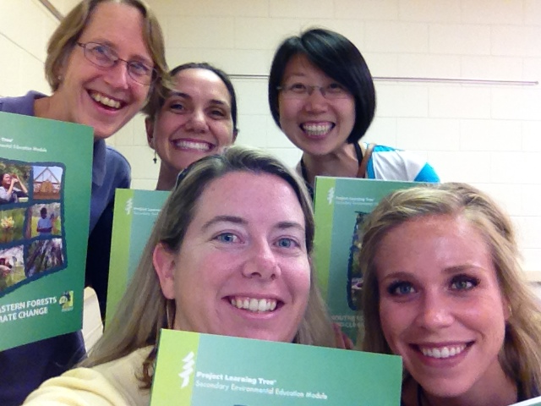
Unpacking the first box of books at our first workshop in NC generated
great happiness… and relief!

Slide 70
Undergraduate Fellowships: Program distribution 2012-2014

Slide 71
Outreach metrics 2012-2014
 | 2012 | 2013 | 2014* | Total
Fellowships completed | 5 | 12 | 9 | 26
Presentations delivered | 54 | 107 | 72 | 233
Schools visited | 14 | 25 | 23 | 62
Teachers visited | 29 | 40 | 28 | 97
Students reached | 1060 | 2629 | 1354 | 5043
* Incomplete data for 2014

Slide 72

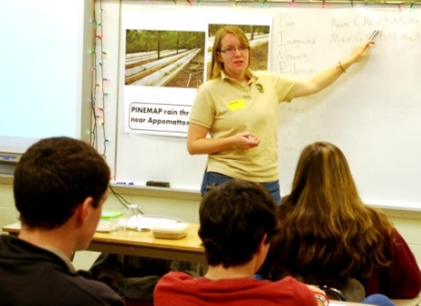
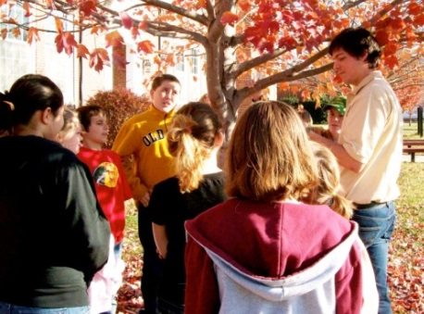


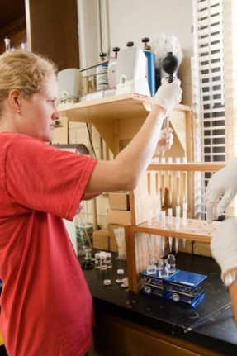
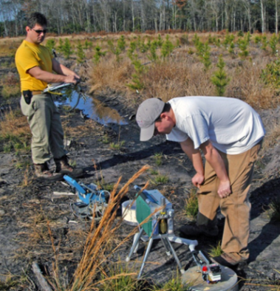
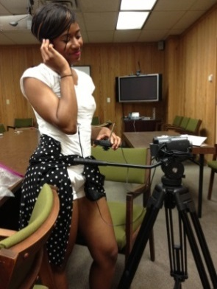
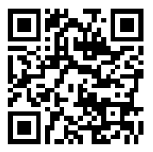

UNDERGRADUATE FELLOWSHIP 2015
Looking for Summer Research?
The PINEMAP Undergraduate Fellowship
Study climate change and natural resources
Full time, up to 12 weeks over summer
Work at a collaborating university
Be mentored by a graduate student
Earn up to $5,250/summer and $1,750/fall
This program includes a fall distance course
Independent study credits through your school
Learn about and improve communication skills
Develop an engaging lesson presented to nearby secondary school students
Produce scientific research communications
What are the Qualifications?
You are eligible if you:
Will have completed your freshman year
Are interested in natural resources
Agree to participate in both components
How Do I Apply?
Details and applications are online at:
www.pinemap.org/education/undergraduate/
Deadline is February 13, 2015
Awards in March, 2015
Contact:
John Kidd, coordinator
jbkidd@vt.edu
(540) 231-7744
The Pine Integrated Network: Education, Mitigation, and Adaptation project (PINEMAP) is a Coordinated Agricultural Project funded by the USDA National Institute of Food and Agriculture, Award #2011-68002-30185

Slide 73
Corporate Outreach Integration Platform Update

Slide 74
PINEMAP Corporate Landowner Outreach Plan
Coop-Based Outreach
Overview talk
Coop-specific PINEMAP work
Online Resources
Narrated PPTs from coop meetings
Trainings on PINEMAP tools and datasets
Conferences
Virtual and In-Person
Virtual conferences on focused science topics
Coop-specific feedback from stakeholders
1-2 page research summaries
Multi-topic virtual conference
Wrap-up meeting at end of project

Slide 75

Sustainable Forestry Initiative Certification and PINEMAP
Many PINEMAP corporate stakeholders are certified through the Sustainable Forestry Initiative (SFI) process.
There are a number of opportunities for PINEMAP to help these stakeholders fulfill climate-related requirements of SFRI
New program requirements are available, working with Aim 6 to integrate into corporate outreach

Slide 76
PINEMAP Extension Integration

Slide 77
AIM 6 Extension Integration
Workshops!
Growing Pines in Changing Times
Western Gulf Silvicultural Tech Meeting
Coop meeting
Publications
Carbon and pines
New publication series based on Webinars
Decision Support System
Collaboration with the Climate hubs

Slide 78
Wrap-up
Sap Flux Regional Analysis progress report
Updates from other Integration Platforms
Annual meeting ideas
Wrap up

