Slide 1

The PINEMAP Intern Program:
Integrating undergraduates into forest resource and climate change research, and education
John B Kidd¹, John R Seiler¹, Martha C Monroe², Shobha Sriharan³
¹ Virginia Tech, Dept. Forest Resources and Environmental Conservation;
² University of Florida, School of Forest Resources and Conservation;
³ Virginia State University, Dept. of Agriculture and Human Ecology

Slide 2
Justification
PIs
Mentors
Interns
Secondary
Students
Outreach
Integration

Slide 3
Program Goals
Engage undergraduate interns in research and teaching
Develop and deliver inquiry-based science lessons
Convey value and relevance of southern forests and climate change
Notes:
Mention recruitment of UGs into post-graduate research/grad school
Interest kids into college natural resources programs

Slide 4

Marketing
Two separate postings
Internship announcement
Call for proposals
Eligibility Criteria
Undergraduates
Graduate students
Distribution
Listservs, internal contacts, job boards
PINEMAP PI email
TO JOIN THE
INTERN PROGRAM

Slide 5
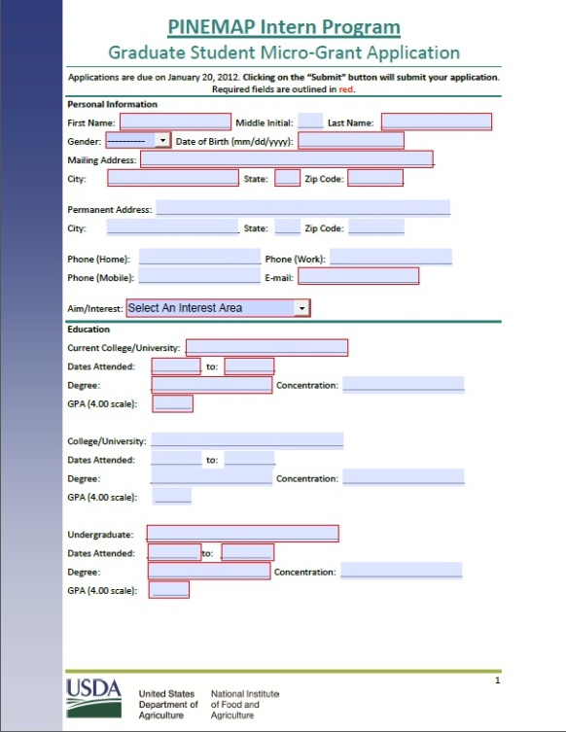
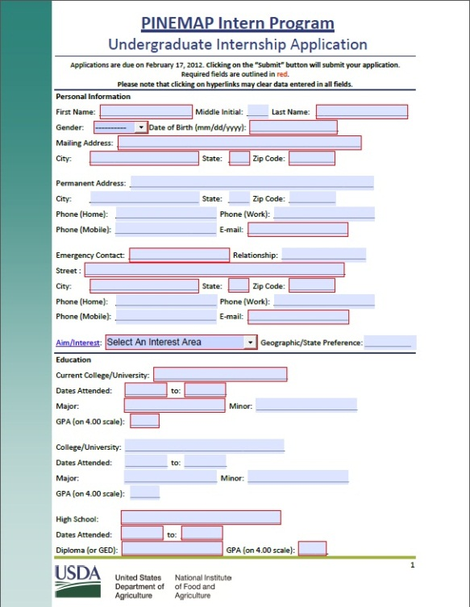
Application Process
Applying
Online only
Fillable form PDF
Application Data
Standard Resume Data
Interest Area
Personalized Data
Essay for interns
Proposal for mentors

Slide 6
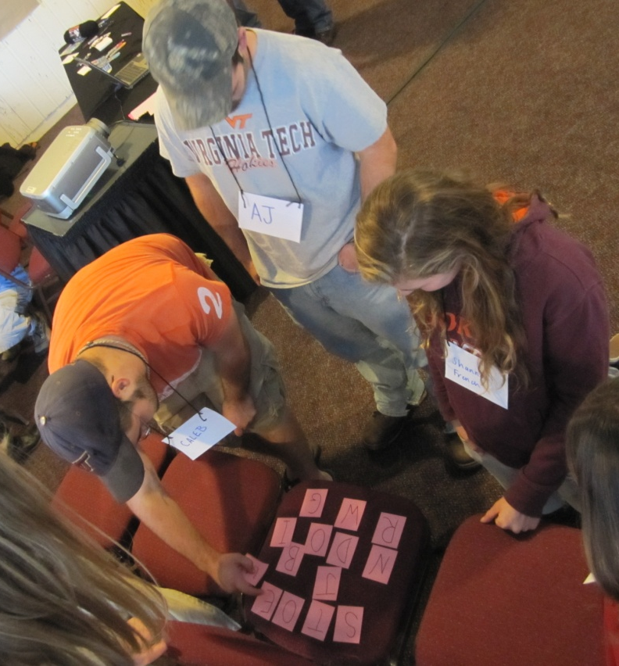
Selection Process
2012 year = 6 interns*
6 internships
6 micro-grants
Selection committee
Education Aim leaders
Program coordinator
PINEMAP PIs from other Aims
Courtesy: John R. Seiler
*Increases to 12, then 18 total in subsequent years
Notes:
Mention grad students get a subset to pick
Remind that this is pilot year

Slide 7
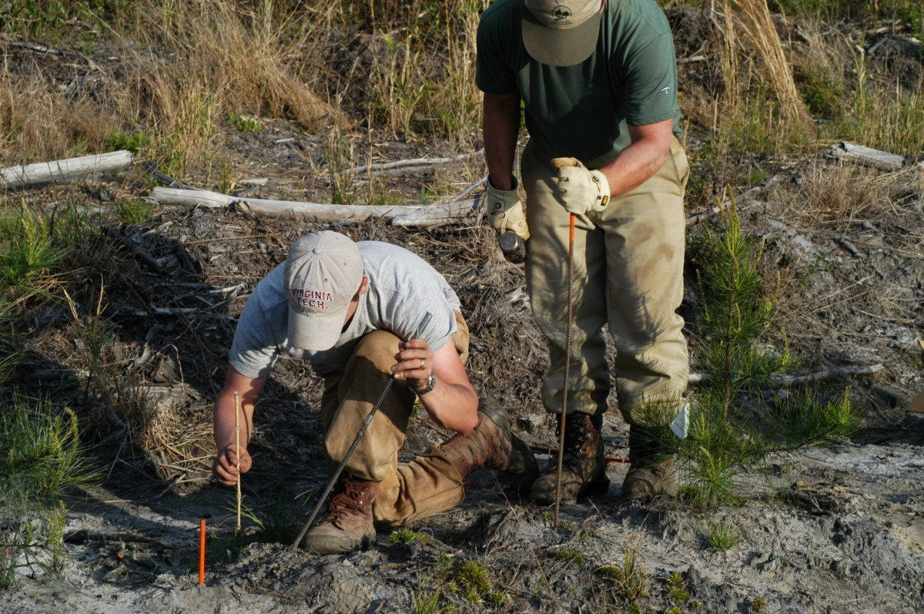
Program Awards
Undergraduate Interns
$7,000 stipend over 12 wks
Graduate Mentors
Micro-grant
Intern assistant
Courtesy: John R. Seiler
Notes:
Funding paid out through VT as wages. Interns will be emergency hires for summer field work.

Slide 8
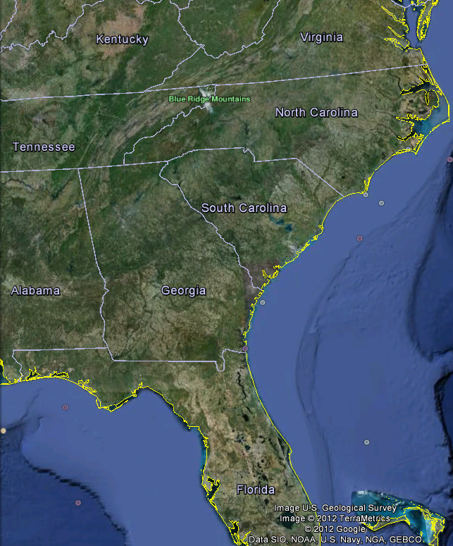
Internship Logistics
VT
VSU - Home
NCSU – Home, Host
AAMU - Home
UF - Host
Notes:
Need examples

Slide 9
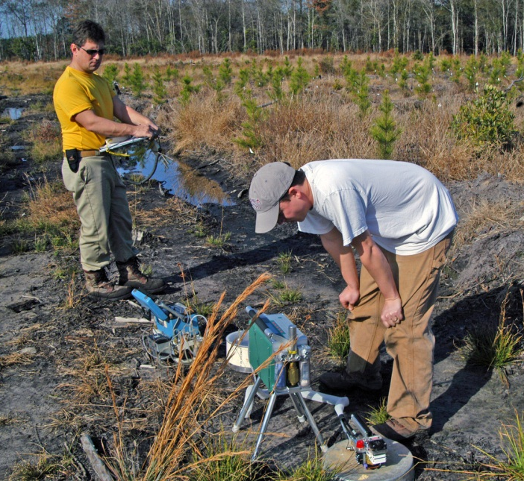
Summer Internship
Field work
Lab work
Attend lab meetings, etc.
Journaling
Intern program meetings
Courtesy: John R. Seiler
Notes:
Field work (hands-on, recording, etc.); soil moisture, gas exchange readings, collecting surveys
Lab work (data management, analysis); soil samples, N content, survey (Human Dimensions lab) data entry
-weekly(?) meetings w/ interns and mentors?

Slide 10
Internship Logistics
VT
VSU - Home
NCSU - Home
AAMU - Home
UF - Host
Notes:
Need examples

Slide 11
Distance Course
Distance-based Class
3 Credits, Fall 2012
Independent study
Synchronously delivered
Twice per week in evenings
3 units
Notes:
Independent study/UG research
Delivered using Adobe Connect or Google+ Hangouts

Slide 12
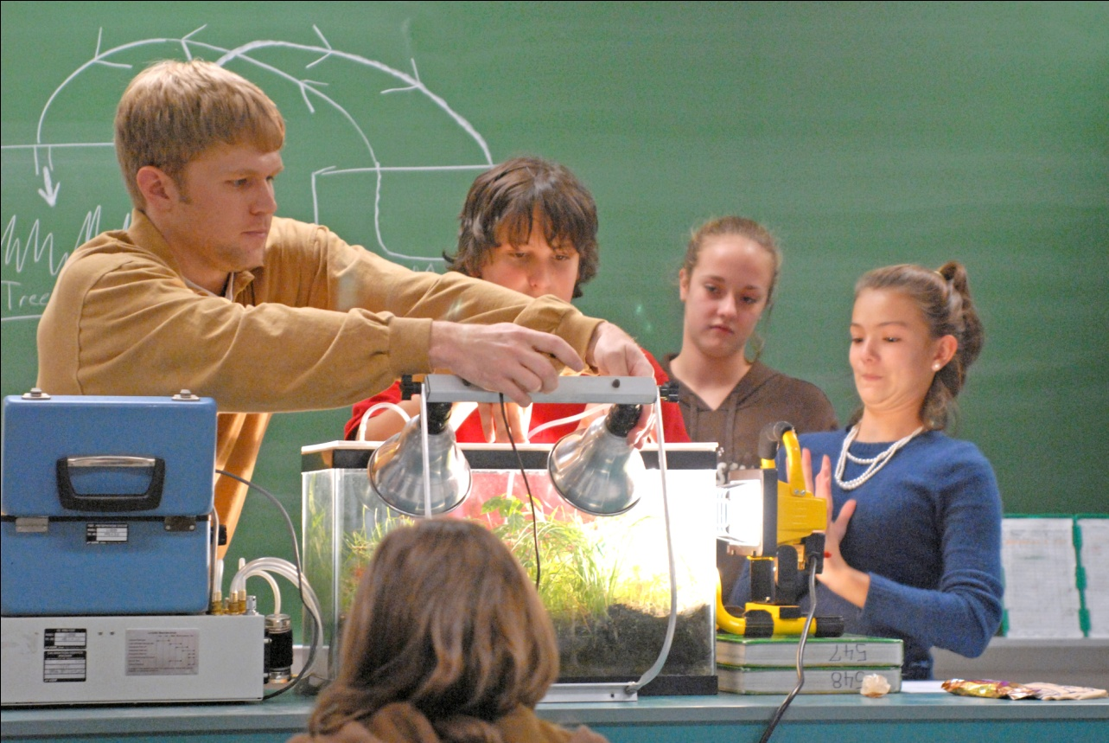
Distance Course
Communication Skills
Education
SOLs
Inquiry-based learning
Science ed. pedagogy
Journaling continued
Courtesy: John R. Seiler
Notes:
Oral and non-verbal skills

Slide 13
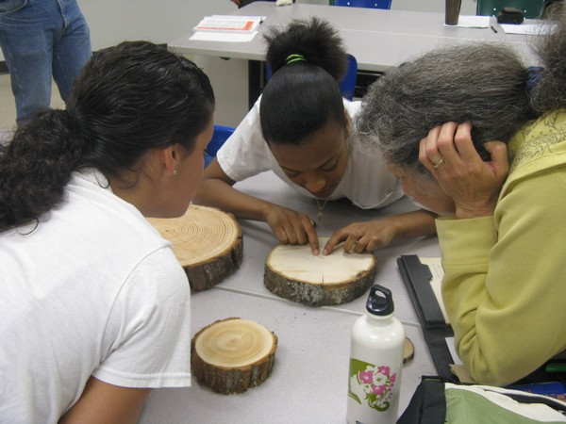
Distance Course
Developing Presentations
Learning experience for secondary students
Focus on internship project
Hands-on component
Preparation!
Mentors will help
Practice runs during class
Courtesy: Lindsey McConnell

Slide 14
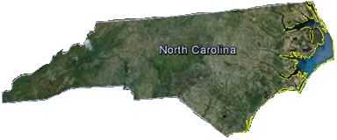
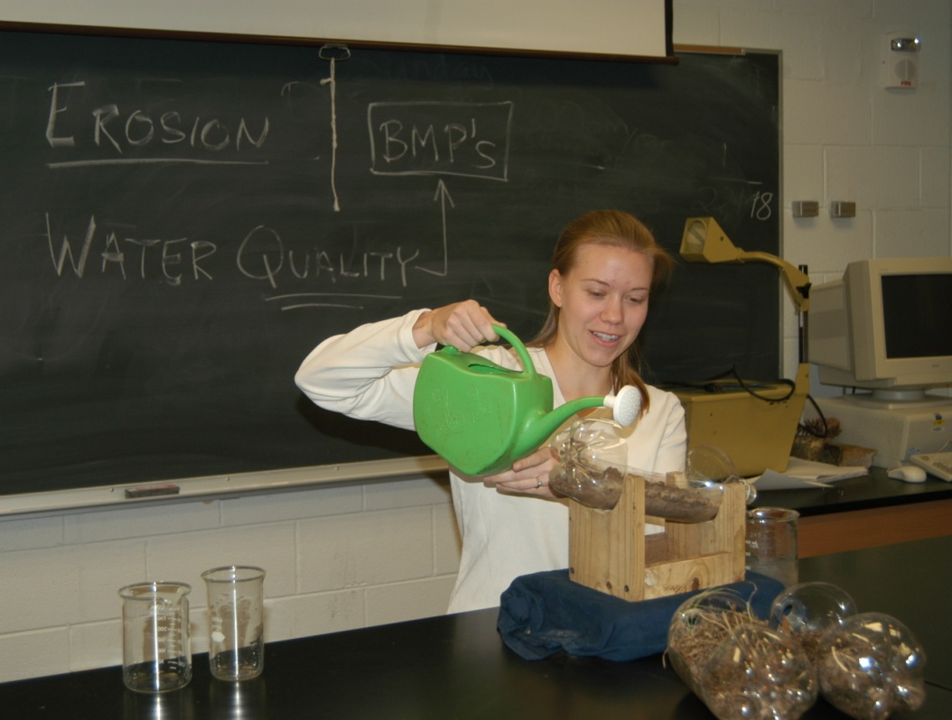
Distance Course
Presentation Deployment
Area public secondary schools
VT staff helps identify
Target Biology, Environmental Science
Multiple presentations
Presentation evaluations
Supervising teachers evaluate
Self evaluations
NCSU - Home
Courtesy: John R. Seiler

Slide 15
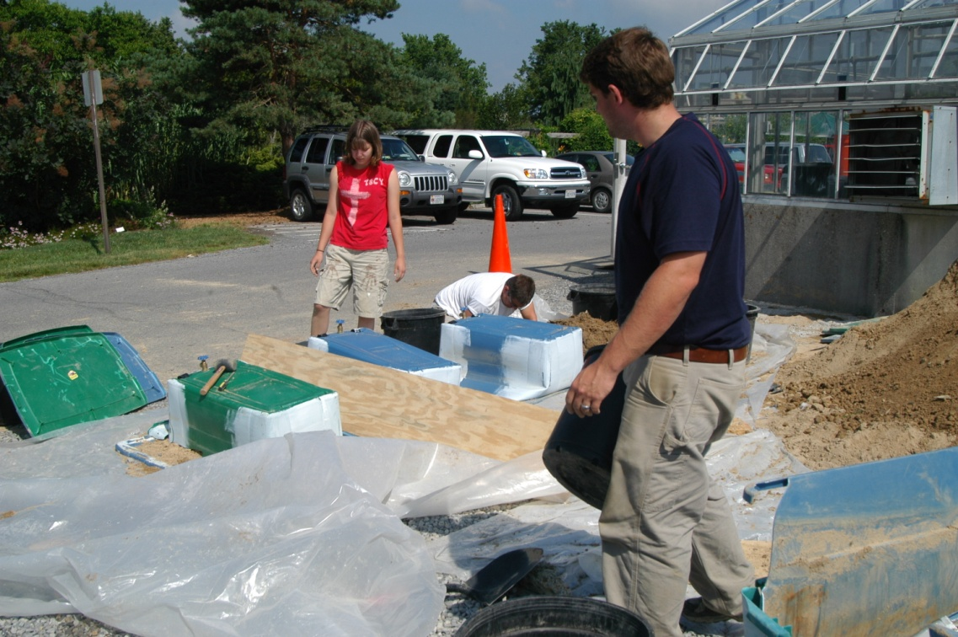
Initial Response
Underwhelming
6/25 graduate students applied
UG Responses
1 undergraduate application as of 1/27
2 as of 2/06
7 applicants total
Gosh,
I’m not so sure
about this…
Courtesy: John R. Seiler

Slide 16
Conclusions
Internship program for education/outreach
Recruit interns into graduate studies
Two components
Internship; focus on research
Distance class; focus on education
Low number of applicants in year 1
Evaluation to increase attractiveness and prospects

Slide 17

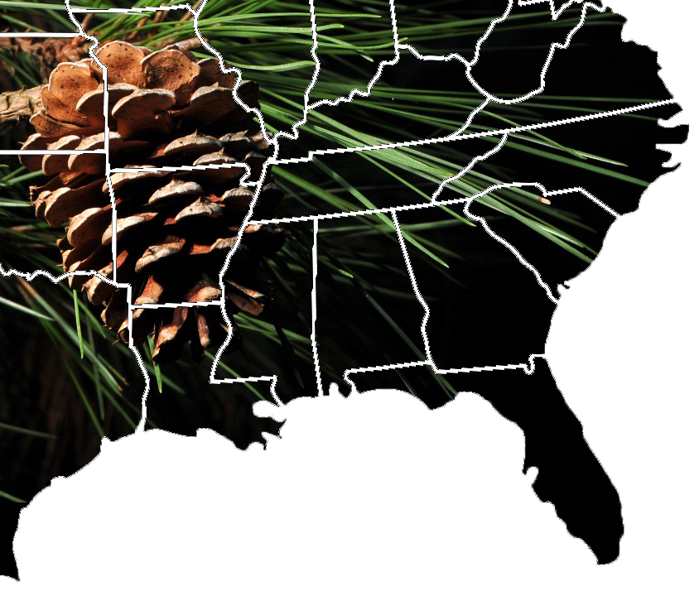


Questions

