Slide 1
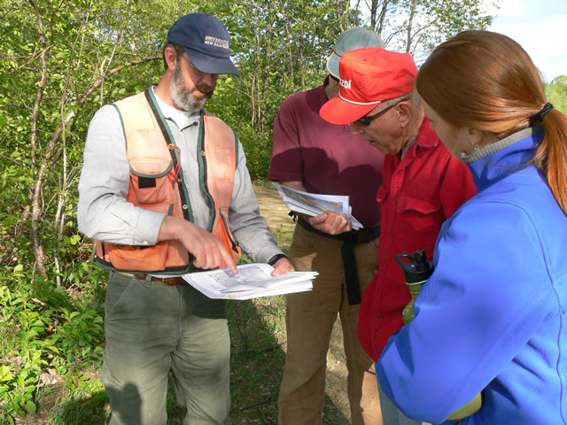
Aim 6 – Extension:
Accomplishing Project Objectives through Integration
Notes:
Timothy Fleury, Extension Educator UNH Cooperative Extension

Slide 2
Aim 6 Objectives
Inherently Include Integration :
Develop Extension programming and materials that combines regional expertise and forest management outreach.
To demonstrate and disseminate emerging knowledge, practices and decision support tools.
Notes:
Inherently Include Integration :
Develop Extension programming and materials that combines regional expertise and forest management outreach to deliver knowledge and state-of-the-art information, resources, and management decision support tools to forest landowners, resource managers, and policy makers.
To demonstrate and disseminate emerging knowledge, practices and decision support tools to enable corporate and non-corporate landowners to increase forest carbon sequestration, nitrogen fertilizer efficiency, and forest resilience under changing climate.

Slide 3
Research – Extension Interaction
Research
Extension

Slide 4
Overarching Strategies
Train and engage forest resource professionals on “climate smart” forest management.
Educate and inform current and potential pine plantation owners on “climate smart” forest management (corporate & noncorporate)
Collaborate with key influential educators who will share this information and perpetuate effort

Slide 5
Forestry Professional Activities:
Regional Workshops
  4 Proposed Regional Workshops in 2012-2013
Professionals Webinar Series and eLearning Courses
  Webinar portal - http://www.forestrywebinars.net
  CFEgroup - http://cfegroup.org
  eXtension
New Certificate Program
  Recognized by SAF and/or ESA
Website Development and DSS Development

Slide 6
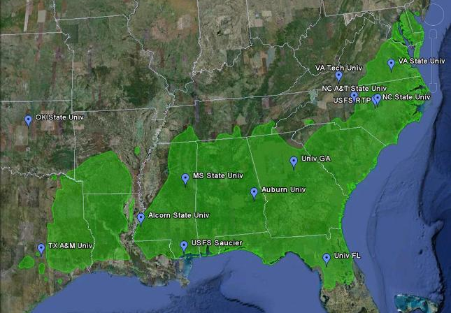
2012-2013 Regional PINEMAP Workshops
✪
✪
✪
✪

Slide 7
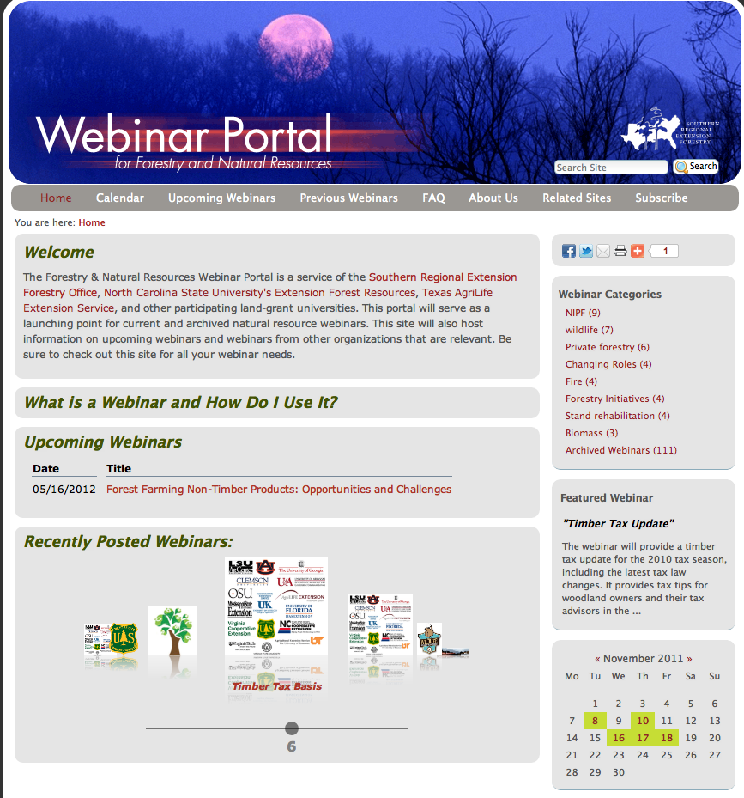
Forestry and Natural Resources Webinar Portal
Features
Live and Archived
Certificate of completion
CFE’s and CEU’s available
Pre and post session questions
Impact and reporting tools
Marketing tools
Over 50 archived webinars to date
http://forestrywebinars.net

Slide 8
Landowner Activities
“PINEMAP for Landowners” Webinar Series
  Utilize the http://www.forestrywebinars.net portal
Master Tree Farmer/Master Wildlifer Webinar Series
  Assist with this effort and ensure that the climate messages are interwoven with this major regional effort.
Workshops, association meetings and other venues
  PINEMAP Extension plans to pursue state forestry associations, agencies, Extension offices and others to hold sessions or events related to climate and weather influences on forest management.
Website Development (eXtension and PINEMAP Extension Site)
  Electronic and print content made available online for viewing or print-on-demand.

Slide 9
Needed Collaboration:
Topics & Agenda - Identifying best research nuggets to disseminate
Presentations - by PINEMAP and other climate science/forest management researchers
Publications - Identification and development of bulletins and factsheets that directly support workshop efforts
Demonstrations - Establishment/coordination of result demonstration sites for field tours
Review

Slide 10
Suggested Integration Protocols
Relevant research Aims will provide input to expedite integrated efforts
  Facilitate members to serve on the planning committees for Extension events and activities
  Facilitate members to participate as speakers at regional workshops and webinars
  Coordinate the review process for Extension publications and products utilized in activities
Notes:
Thing about how to include the graduate community

Slide 11
Suggested Integration Protocols
Climate science community will provide input to expedite integrated efforts where appropriate
  Facilitate members to serve on the planning committees for Extension events and activities
  Facilitate members to participate as speakers at regional workshops and webinars
  Coordinate the review process for Extension publications and products utilized in activities
PINEMAP Forest Cooperatives Extension liaisons will be invited to participate where appropriate.

Slide 12
Special Note on Evaluation/Impact and Integration
Need
Recognize the need to incorporate impact analysis and reporting across all 6 Aims
Proposed Protocol
One member from each Aim chosen to participate on an evaluation/impact committee
Responsibilities would be to outline the measurable deliverables proposed in the logic model(s) and develop an evaluation plan for measuring and reporting. Aim 6 will take the lead
Notes:
Establishing baselines of management activities

Slide 13
Questions

