Slide 1

Distance Graduate Course Spring 2012
Martha C. Monroe and Jessica Ireland
School of Forest Resources & Conservation, University of Florida
A project funded by USDA NIFA

Slide 2
Goals
Prepare students to address climate change mitigation and adaptation issues with southern pine forests
Facilitate greater levels of integration by supporting communication, cooperation, and collaboration between and within Aims and Research/Extension
Build transdisciplinary research, education, and outreach capacity

Slide 3
Planning Process
Committee formed at first annual meeting who helped shape syllabus (summer 2011)
Project Management Team continued to offer suggestions (fall 2011)
Volunteer presenters coordinated their topic with readings, webinar, discussion questions (December 2011)
Jessica held all the pieces together with weekly reminders for students and faculty

Slide 4
Parameters
Held during common weeks of spring term (3 week gap for spring break)
Synchronous 2 hour webinars most weeks
8 faculty gave 6 webinars; 1 faculty did narrated PowerPoint
2 guests gave 2 webinars
Weekly readings and online discussion supplemented information
9 faculty assignment group leaders
Students register for indep. study at home univ.

Slide 5
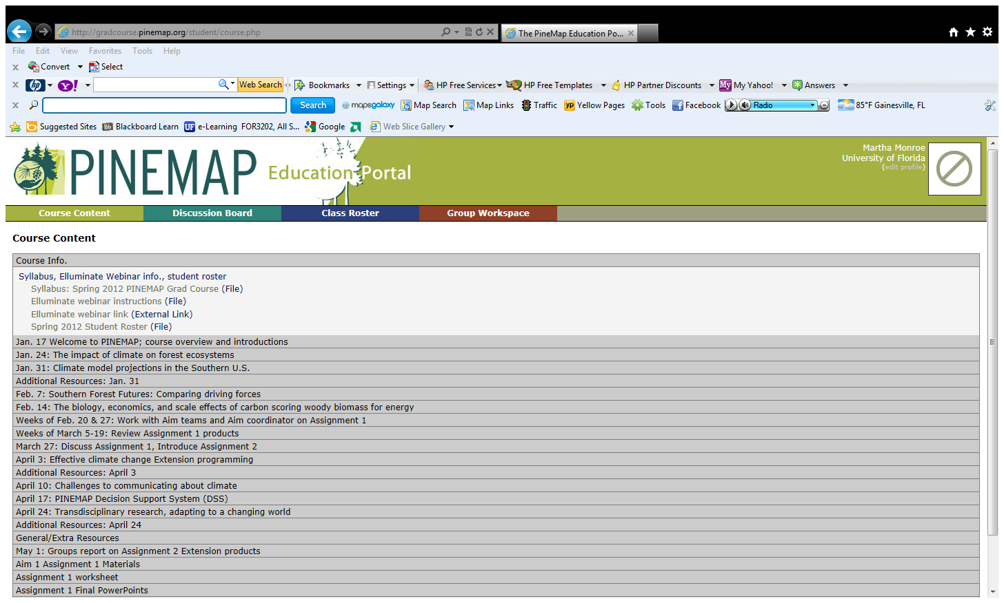
Web Portal for Course

Slide 6
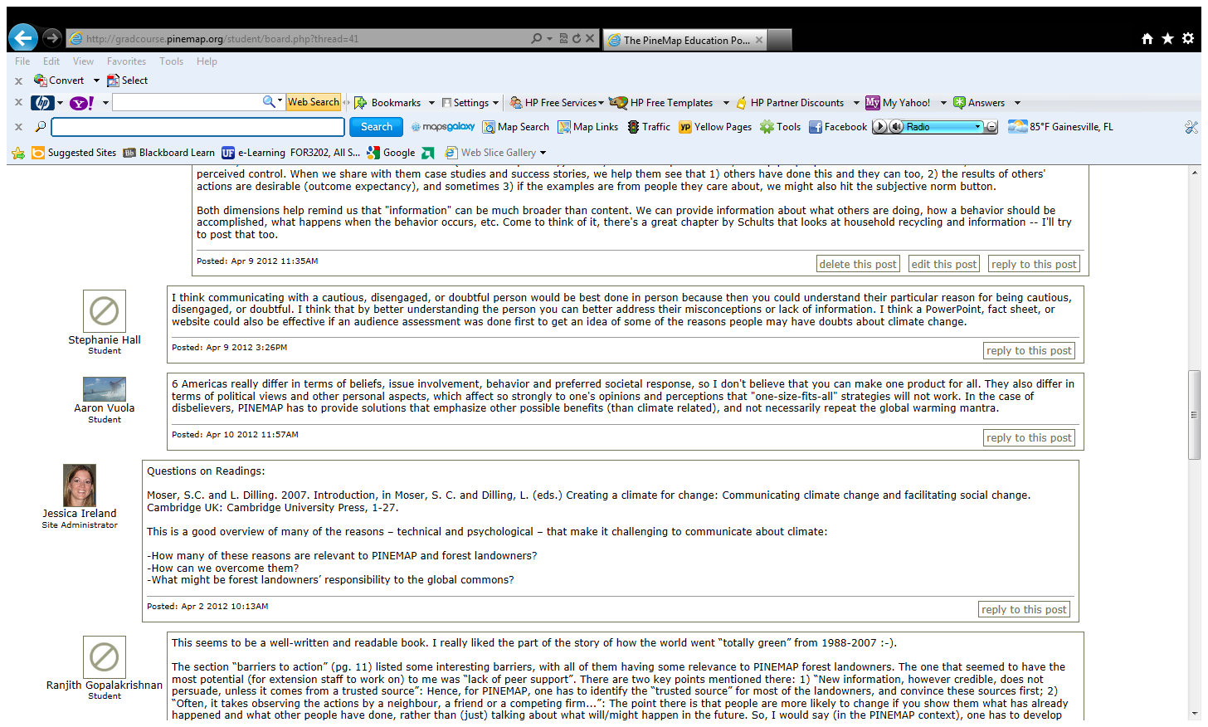

Slide 7
Assignments
1 – Work with Aim group to understand the research questions and role in PINEMAP; make a presentation to other students; respond to questions in discussion.
2 – Work in groups to create Extension Products for specific audience on forest management or vulnerability due to projected climate changes.

Slide 8
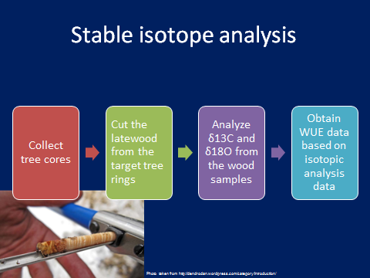
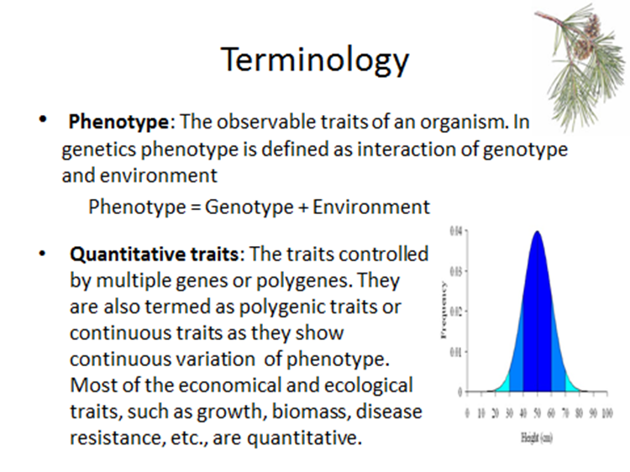
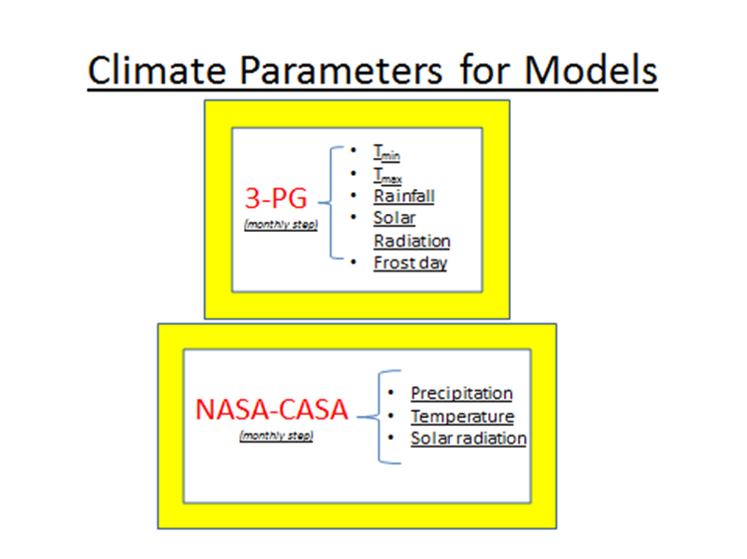
Assignment 1

Slide 9
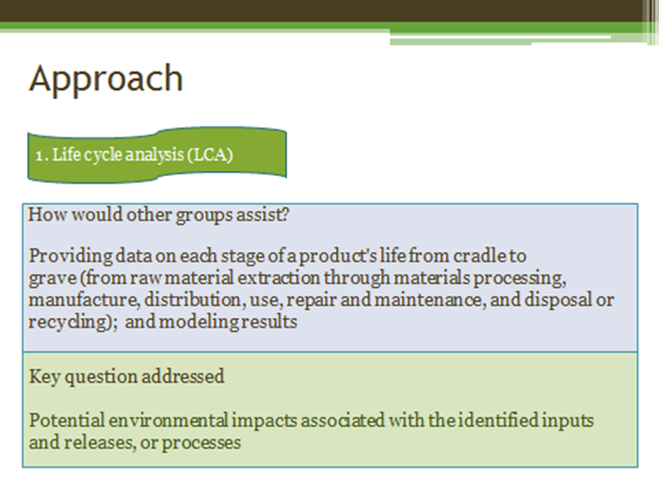
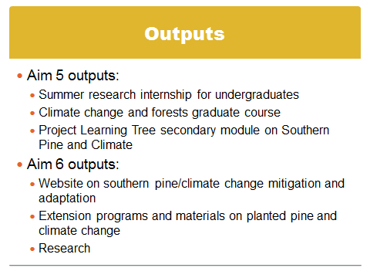
Assignment 1

Slide 10

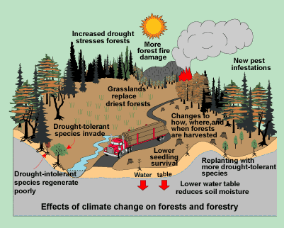
Assignment 2: Slide Presentation for Landowners

Slide 11
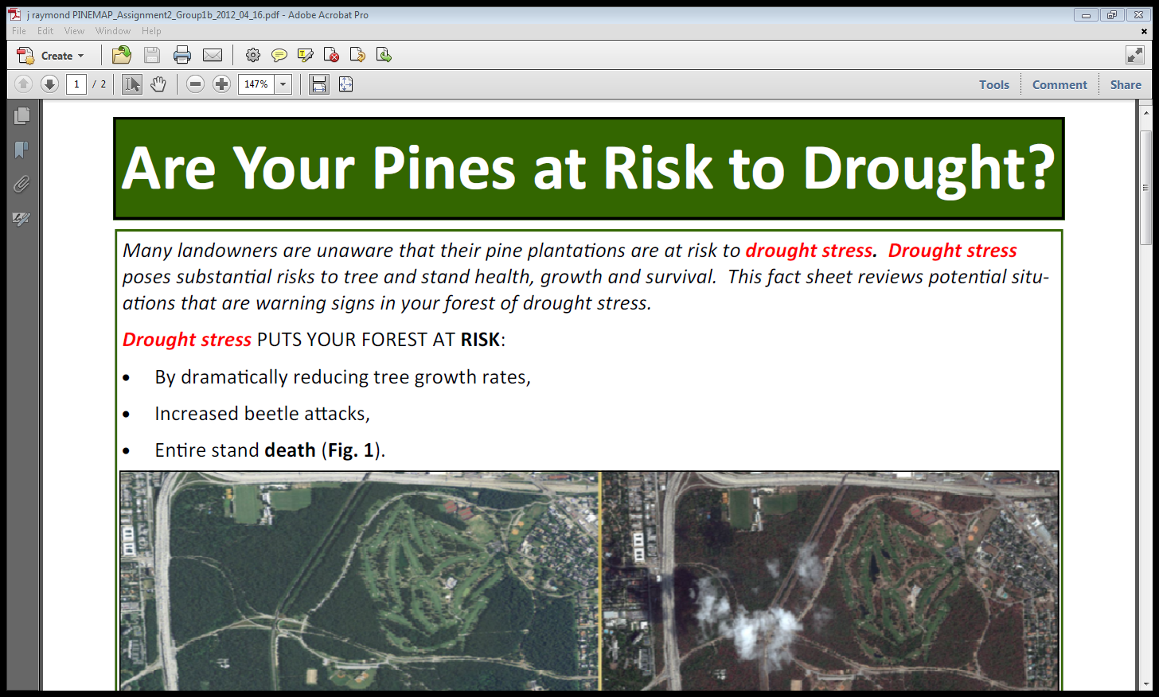
Assignment 2: Fact sheet for private landowner

Slide 12
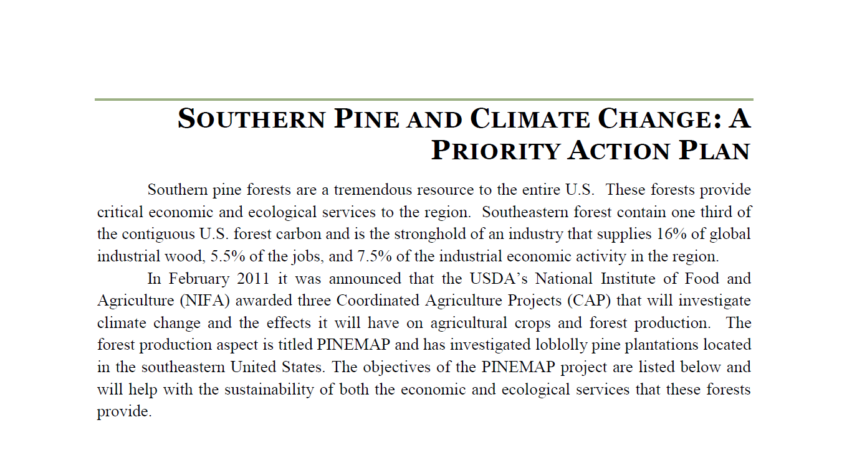
Assignment 2: Plan for State Agency

Slide 13
2012 Offering
6 PhD 1 MS Virginia Tech
1 MS Auburn
2 PhD 1 MS North Carolina St Univ
2 PhD 2 MS University of Florida
1 PhD Miss State University
2 PhD 1 MS Texas A&M University
1 PhD Oklahoma State University
2 PhD University of Georgia
Total: 16 6 8
And a few postdocs and staff

Slide 14
Course Evaluation
Online survey from students
20 respondents
14 questions (scale and open-ended)
Comments/feedback from students during final webinar
Anecdotal feedback from PINEMAP faculty

Slide 15
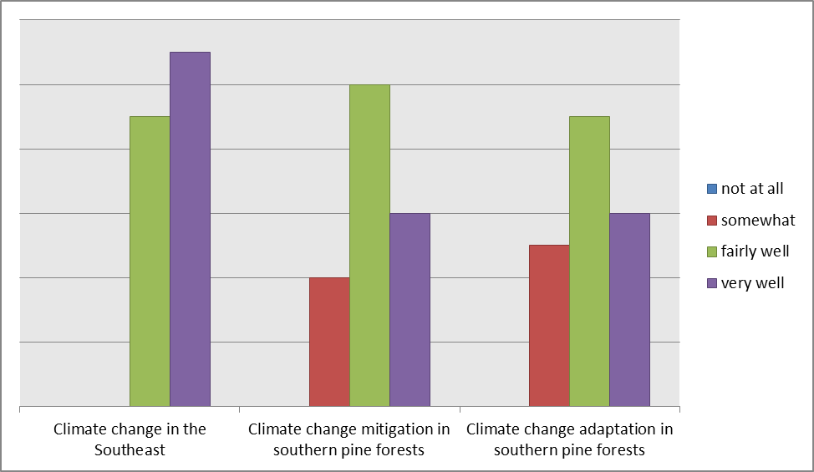
Student Responses
How well did the course facilitate learning about:

Slide 16
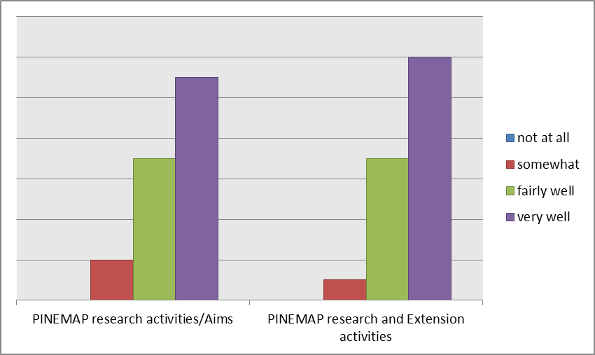
Student Responses
How well did the course help you better understand integration among:

Slide 17
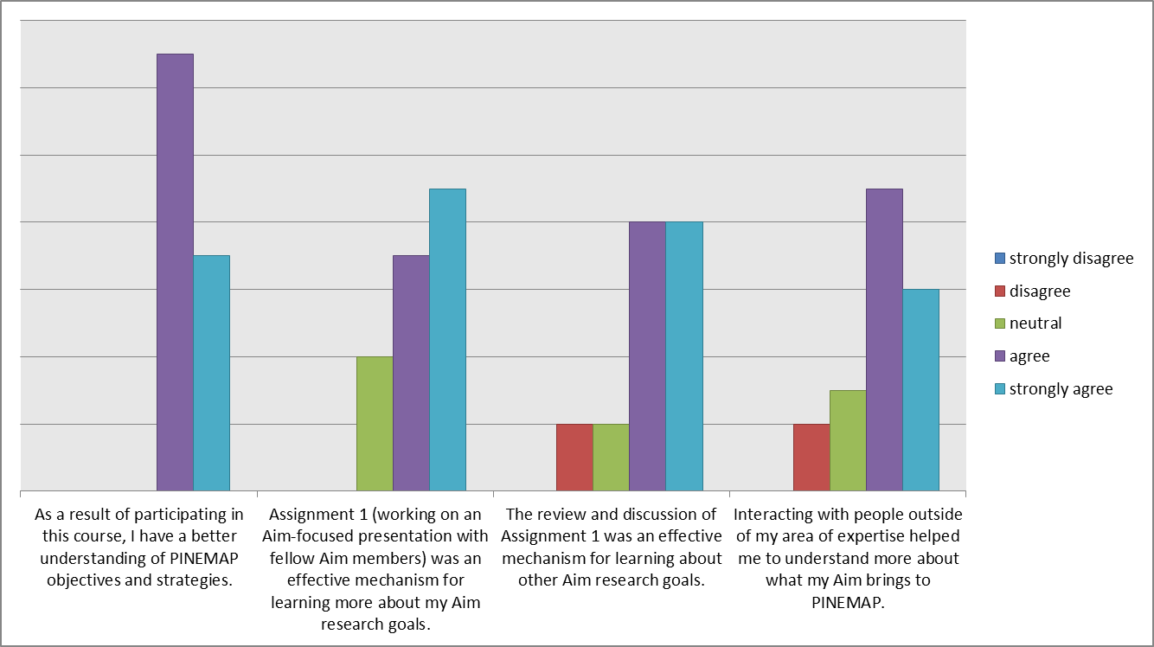
Student Responses

Slide 18
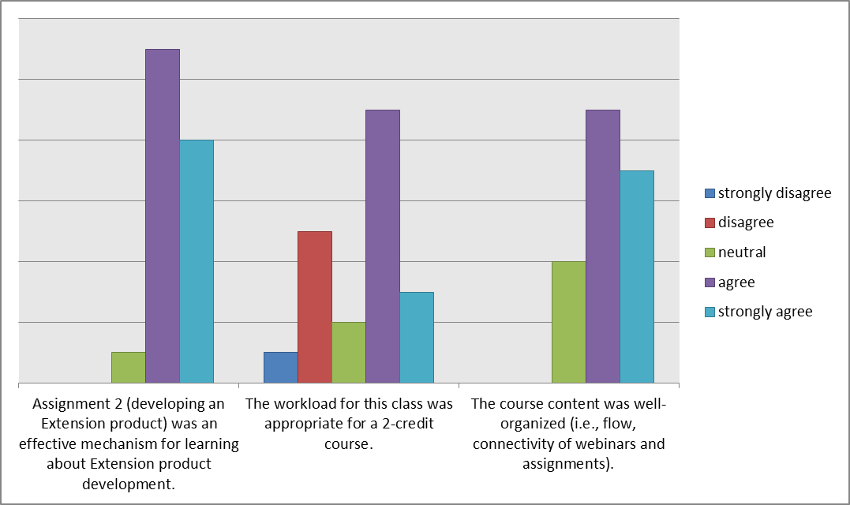
Student Responses

Slide 19
Student Feedback on Assignments
“Assignments 1 and 2 are good ways for us to communicate with each other and understand research aims and the needs of potential landowners”
“I thought the assignments were great and enjoyed the interaction among all parties”
“Team work is hard! Team work with all the people from different schools is even harder.”
“It was exceedingly tedious to work in groups over long distances.
“Working in a group via e-mail is sometimes not very effective. We should look for some more interactive way of doing it”

Slide 20
Course Structure/Interaction
“I enjoyed interacting with the other graduate students through the webinars and the assignments. I feel this is where I learned the most about what they are doing and how our aims fit together.”
“I think it is a great strategy for the course and would not change anything except grading. To get people to participate, you have to really make them…”
“People did not feel comfortable in participating in discussion after reading only 20-70% of the materials. Just too many readings. Less readings means more discussion! So, prioritize the readings then ask some nearly mandatory inputs from all”

Slide 21
Strengths/Weaknesses
“A strength of this course is definitely the amount of information and communication with other members of the PINEMAP network…Weakness…was communication among groups for assignments”
“Strengths –excellent, high-quality seminars from well-known individuals. Weaknesses – 2 hours is a long time to sit in front of a computer, and it’s difficult to communicate effectively during group projects”

Slide 22
Tweak to balance
Credits
Letter grade or pass/fail
Amount of reading
Discussion expectation; participation points
Assignments

Slide 23
Suggestions for future
Self-assessment questions for readings
Scheduled time for webinar interaction outside of main time (for those who can’t attend live webinars)
Less reading, more interactive discussion
Some individual assignments
Reduce amount of readings
Involve current grad students in future offerings (maybe assist with assignments?)

Slide 24
Faculty feedback
I believe it was very useful for our students.
Thanks for the useful assessment.
Hats off to all the instructors for putting together this fantastic learning opportunity.
My student enjoyed the class.
I commend [you] for organizing a good class with a delivery systems that, at least for some of us, is new and challenging.

Slide 25
Continued Interaction?
Seminars
Internal webinars
In person meetings
Blog or Twitter
Online discussion board
E-mail (grad student listserv)
Joint research project
Conferences

Slide 26
Some “Easy” Fixes
Synchronous time—not middle of the day or week
Specify grade calculation
Discussion questions too specific & intimidating
Students will be in the field and need to access Internet from rural locations – use narrated ppt
Page limits for readings
Include discussion points in grade
Pitch information and questions to better engage interdisciplinary groups!
Include current students in next class offering

Slide 27
Some Harder Fixes
Engage faculty more
Encouraging more student interaction on webinars AND online discussion board
Teamwork is difficult: distance group work across disciplines with strangers especially tedious, cumbersome
Too much work, material for a 2-credit P/F course? Increase commitment? Reduce expectation?
Better asynchronous activity to improve use of the gap across three weeks of spring break

Slide 28
How many more students?
Current students who plan to take this course later?
New students coming in by Spring 2013?
Additional students later?

Slide 29
Questions for Today
Introductory Course?
Again? Change? Keep? Expand? Who?
Future opportunities to engage current students
Another PINEMAP course? Seminar?
Existing webinars and Aim meetings?
Research questions and data analysis?

Slide 30
Let’s hear your best ideas:

