Slide 1

PINEMAP External Advisory
Board
PINEMAP Annual Meeting
Atlanta, GA, May 16, 2012

Slide 2
PINEMAP External Advisory Board (EAB) Mission
Provide guidance on program development, implementation, and evaluation from project stakeholders
Additional goals or duties developed by EAB

Slide 3
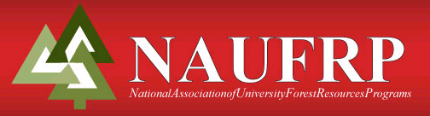

Janaki Alavalapati
Policy Committee Chair, National Association of University Forest Resources Programs
Professor and Department Head, Dept. of Forest Resources and Environmental Conservation, Virginia Tech University

Slide 4
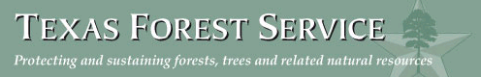
Tom Boggus
Director, Texas Forest Service

Slide 5
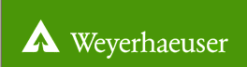
Christine Dean
Vice President, Timberlands Technology, Weyerhaeuser Company

Slide 6
Robert Purnell
Southern Tree Improvement Program Manager, Weyerhaeuser Company

Slide 7
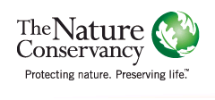
Troy Ettel
Director of Forest Conservation / Longleaf Integrated Landscape Director, The Nature Conservancy

Slide 8
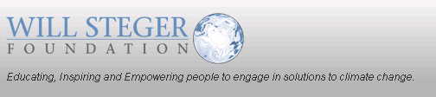
Kristen Iverson Poppleton
Director of Education, Will Steger Foundation

Slide 9
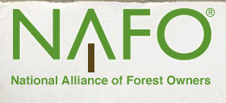
Dave Tenny
President and CEO, National Alliance of Forest Owners

Slide 10
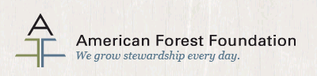
To Be Hired Soon
Director of Southern Sustainability, American Forest Foundation

