Slide 1

Delivering PINEMAP Outcomes
Tim Martin
Gary Peter
Tom Fox
Martha Monroe
PINEMAP Annual Meeting
Atlanta, GA, May 16, 2012

Slide 2
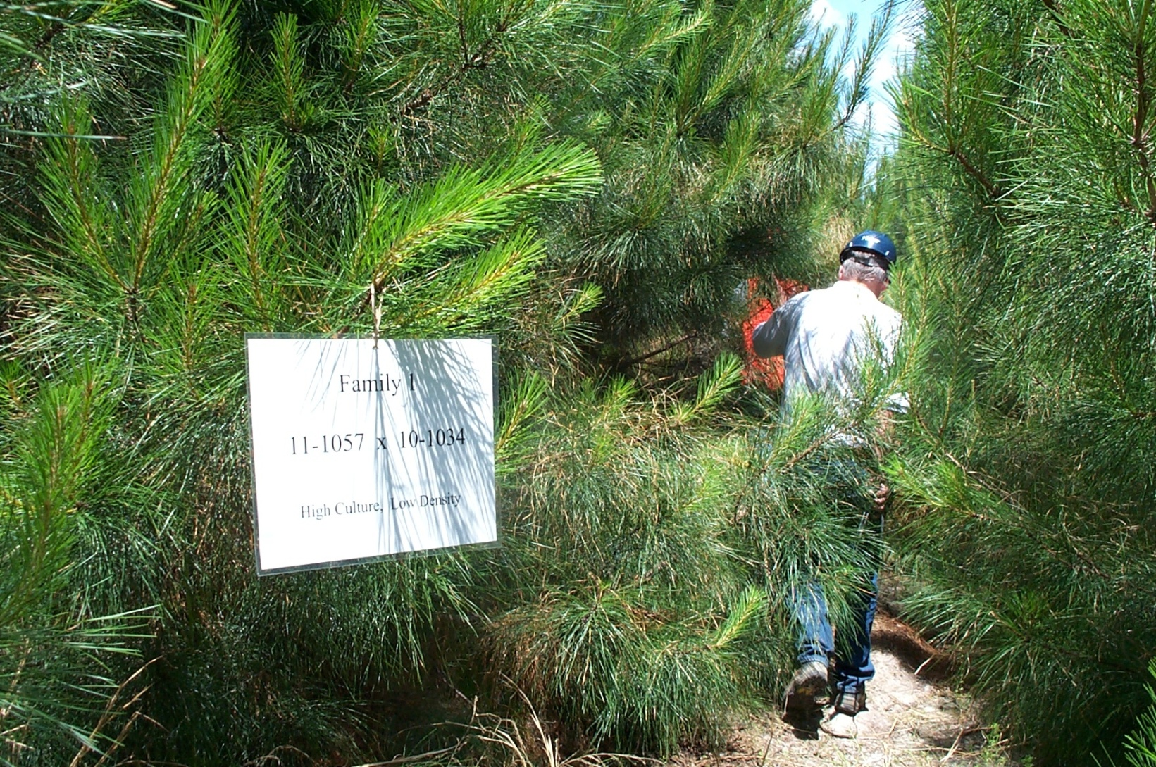
Welcome Back From the Weeds!

Slide 3
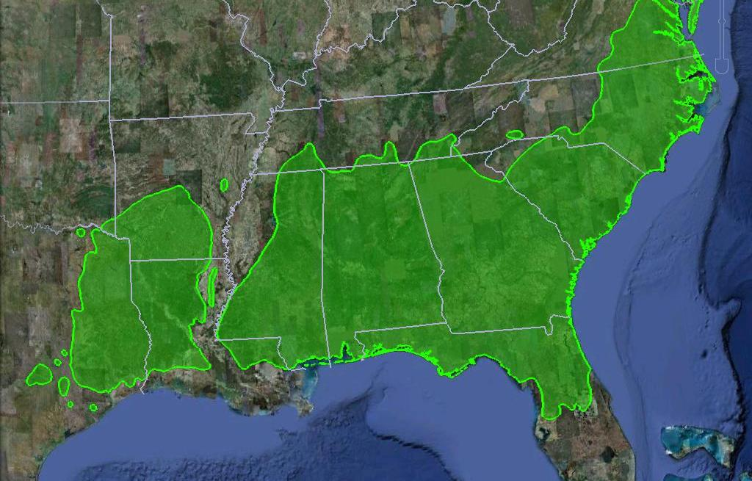


Slide 4
Long-Term Outcome of NIFA Climate Change Program: Reduce the use of energy, nitrogen fertilizer, and water by 10% and increase carbon sequestration by 15% through resilient forest production systems under changing climate by 2030
Provide New Management Methods
Mitigation – Reduce greenhouse gas emissions in forestry and maximize carbon sequestration
Adaptation – Maximize resiliency and reduce impact of climate change on productivity of forest systems and reduce carbon, nitrogen and water footprints under changing climate
Climate Education and Extension- Increase number of scientists, educators and extension professionals with skills to address climate change in forestry

Slide 5
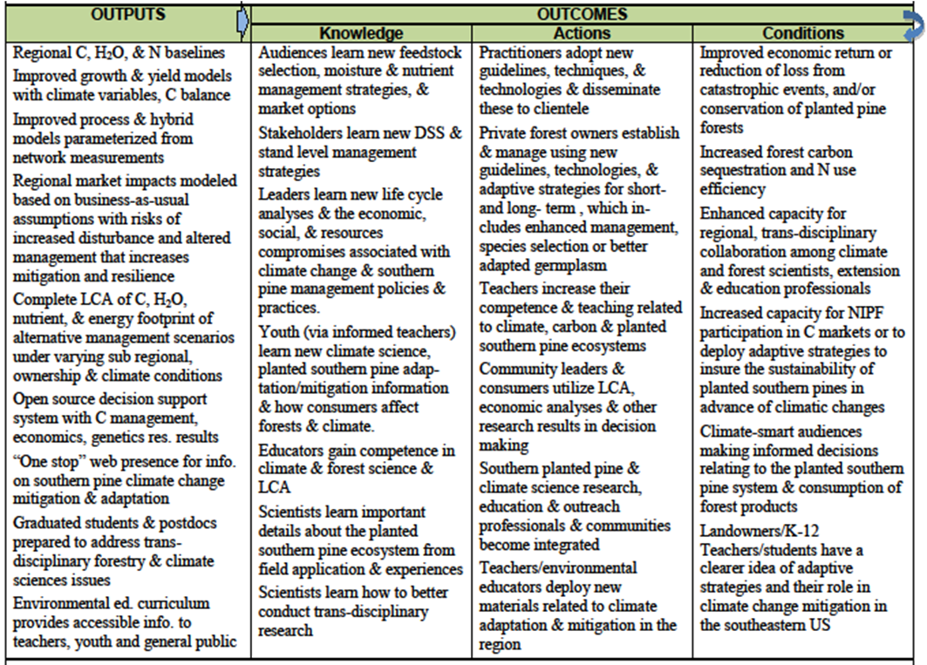
PINEMAP Logic Model

Slide 6
Key elements needed to produce PINEMAP outcomes
Baselines
Biophysical – regional carbon pools; quantification of resilience or “aggregate risk”?
Management activities – for demonstrating cause
Assessing management options
Including assessment of barriers to adoption
Delivery mechanisms
End-of-project assessment
Biophysical
Management
Bridges to the future

Slide 7
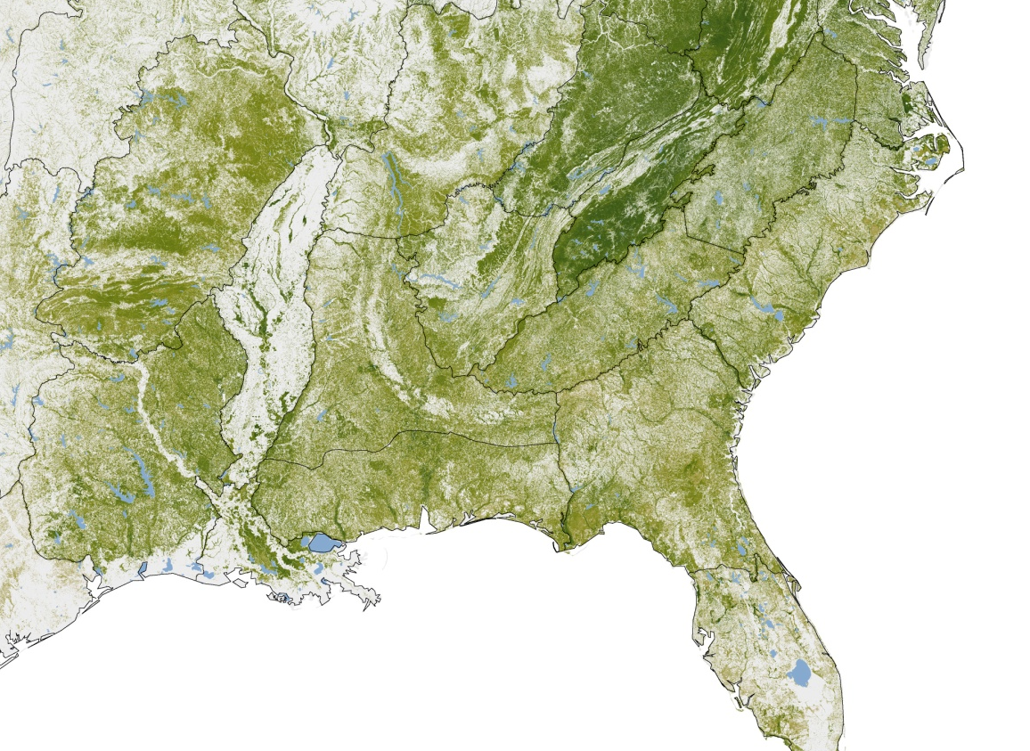
Baselines
Biophysical
Efforts will center in Aim 2
Early outputs critical for use as inputs for other analyses
Aboveground C Density – NASA Earth Observatory 2011
http://visibleearth.nasa.gov/view.php?id=76697

Slide 8
Baselines
Management
Corporate
Survey of all corporate landowners associated with PINEMAP coops – represent vast majority of SE corporate pine
Sensitive, but there is precedent, e.g. FPC annual fertilizer survey
Will be developed and implemented through Cooperative-Industrial Advisory Council
Non-Corporate
Aim 6 surveys and assessment of target landowners
Targeted audience will increase impact

Slide 9
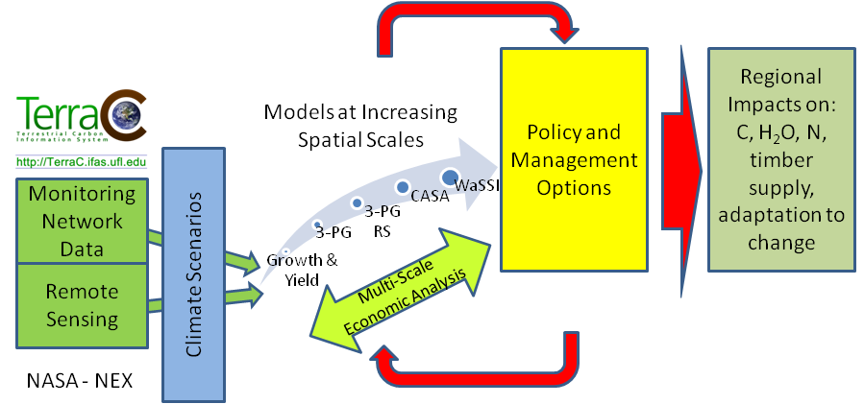
Assessing Management Options
Assessment of options will occur via models
Coordination with Aim 2 is essential
However, depending on accessibility of models, not all assessments will need to be done within Aim 2

Slide 10
Assessing Management Options
Development of silvicultural and genetic deployment options to test
Will include management, biophysical, economic, and policy factors
May require subcommittee or action team to focus on development of management scenarios or alternatives to be assessed

Slide 11
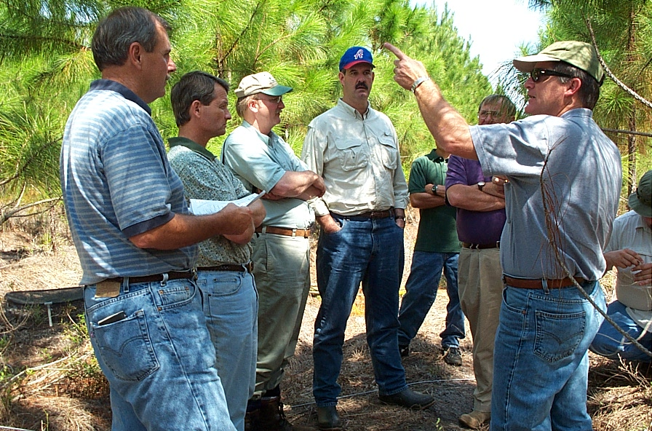
Delivery Mechanisms
PINEMAP Extension is a two-pronged effort with corporate and non-corporate audiences
As an outcomes-based project, involvement of all PIs in some aspect of Extension is key

Slide 12
End of Project Assessment
Repeat biophysical and management assessments to compare to baselines

Slide 13
Ambitious Outcomes will Require Implementation on Millions of Acres

Slide 14
Structure of PINEMAP Stakeholder Landholdings is an Advantage
Thousands of Acres
Smith et al. 2009
> 20 million acres managed by our industrial cooperators
> 95% of pine seedlings are produced by cooperators
Long-established record of successful tech transfer in cooperative framework
10% of NIPF owners manage 70% of acreage
Adoption of altered management by larger landowners will deliver largest impact

Slide 15
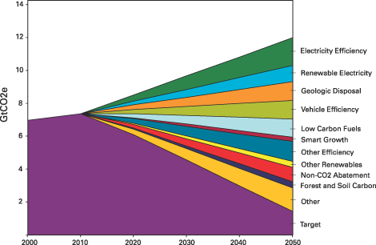
Stabilization Wedges (Pacala 2004)
http://www.nrdc.org/globalwarming/blueprint/methodology.asp

Slide 16
Mitigation Wedges Part 1 – Coop Tech Transfer is already a success story
Redrawn from: Fox, T.R., E.J. Jokela and H.L. Allen. 2007. The development of pine plantation silviculture in the southern United States. J. Forestry 105:337-347.

Slide 17
Mitigation Wedges Part 2 - PINEMAP
Increased fertilizer efficiency
Substitution effect
Regional Carbon Storage
Improved genetics
Increased resilience to disturbance
2010
2015
2020
2025
2030

Slide 18
Adaptation
Adaptation goals from RFP are less quantitative, but we still must show outcomes related to reduced risk and increased sustainability for our stakeholders
We must become the “go to” source of information on decreased risk and increased sustainability for planted pine forest management under changing climate

Slide 19
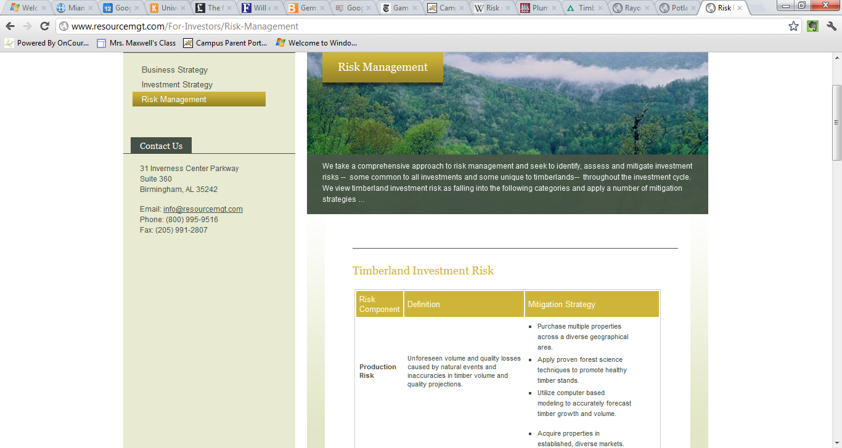
Adaptation: Immediate & Future Impacts
Risk modeling
Regional
Stand
Seed deployment
Stand health
Tier III
http://www.resourcemgt.com/For-Investors/Risk-Management

Slide 20
Bridges to the Future
Increased regional interdisciplinary forest science capacity
Enhanced and more highly integrated networks
New generation of managers, scientists and outreach professionals comfortable with integrated science / outreach work
Better informed citizenry prepared to address the interactions of climate and forest management

Slide 21
