Slide 1

Welcome!
PINEMAP 2012 Annual Meeting
PINEMAP Annual Meeting
Atlanta, GA, May 16, 2012

Slide 2
Year 1 Highlights
PINEMAP 2012 Annual Meeting
PINEMAP Annual Meeting
Atlanta, GA, May 16, 2012

Slide 3

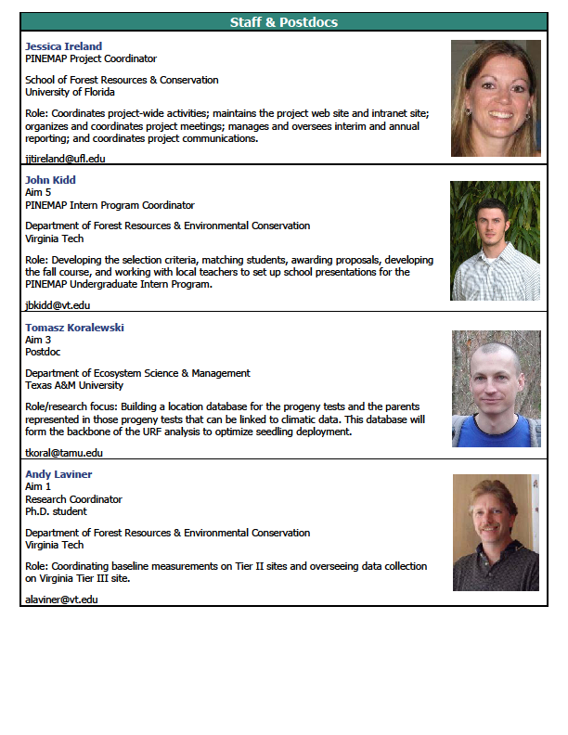
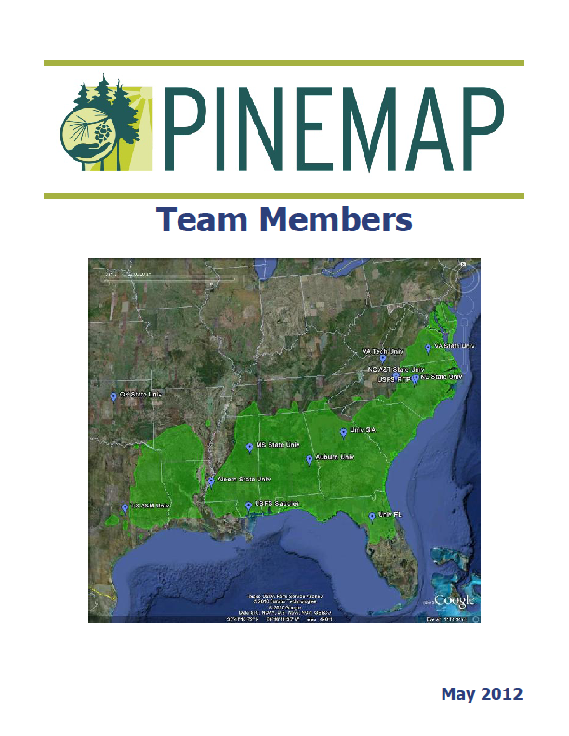
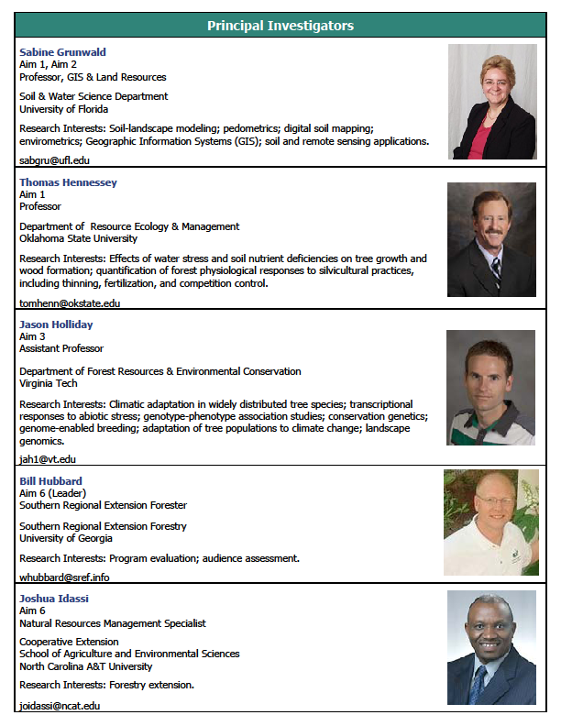
PINEMAP Project Team
53 PIs
23 Staff and Postdocs
28 Grad Students

Slide 4
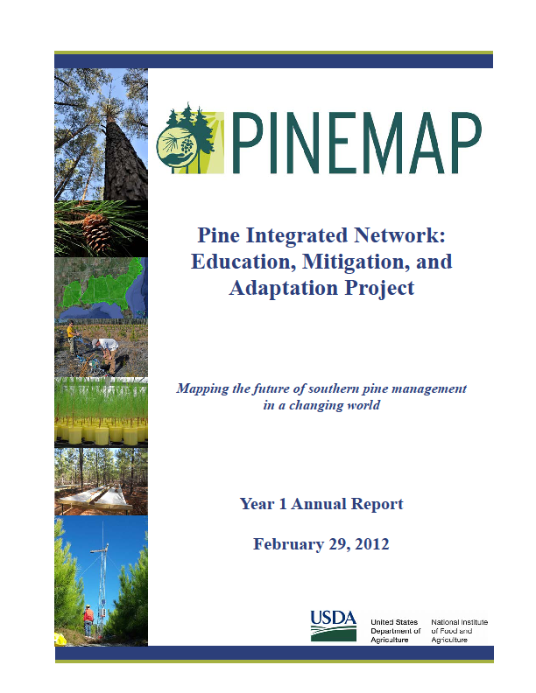
Annual Report

Slide 5
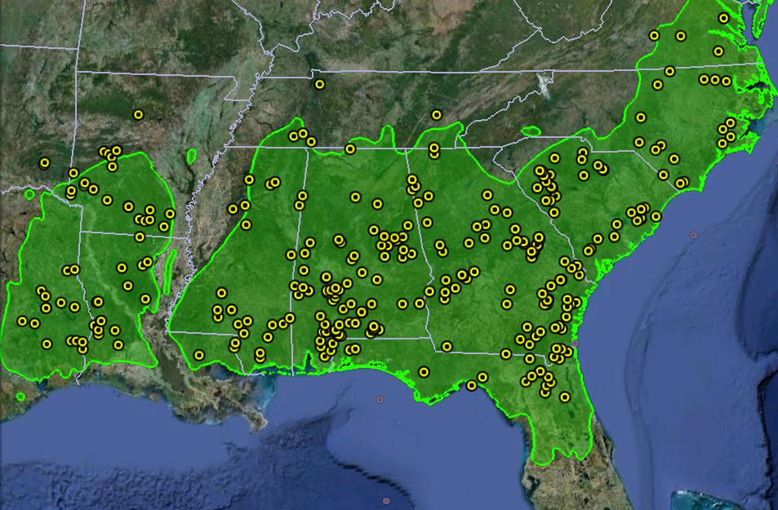
Tier 1 Network

Slide 6
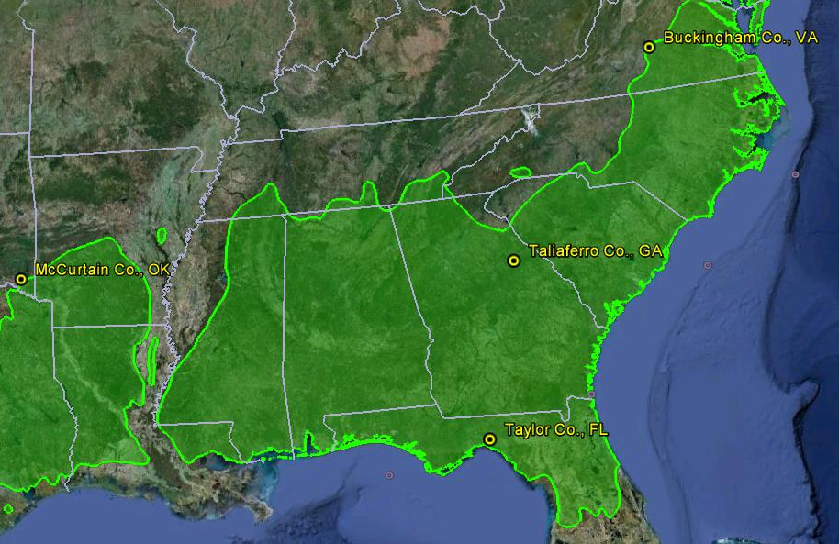
Tier 3 Network

Slide 7
Tier 3 Network
938 Miles
353 Miles
687 Miles
243 Miles

Slide 8
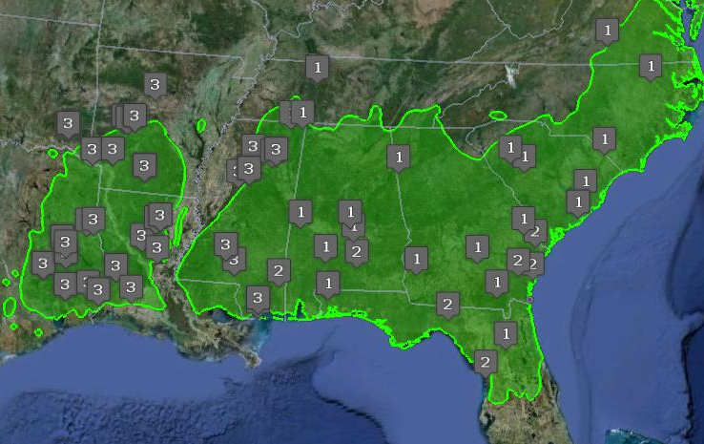
Aim 3 Uniform Response Function Network

Slide 9
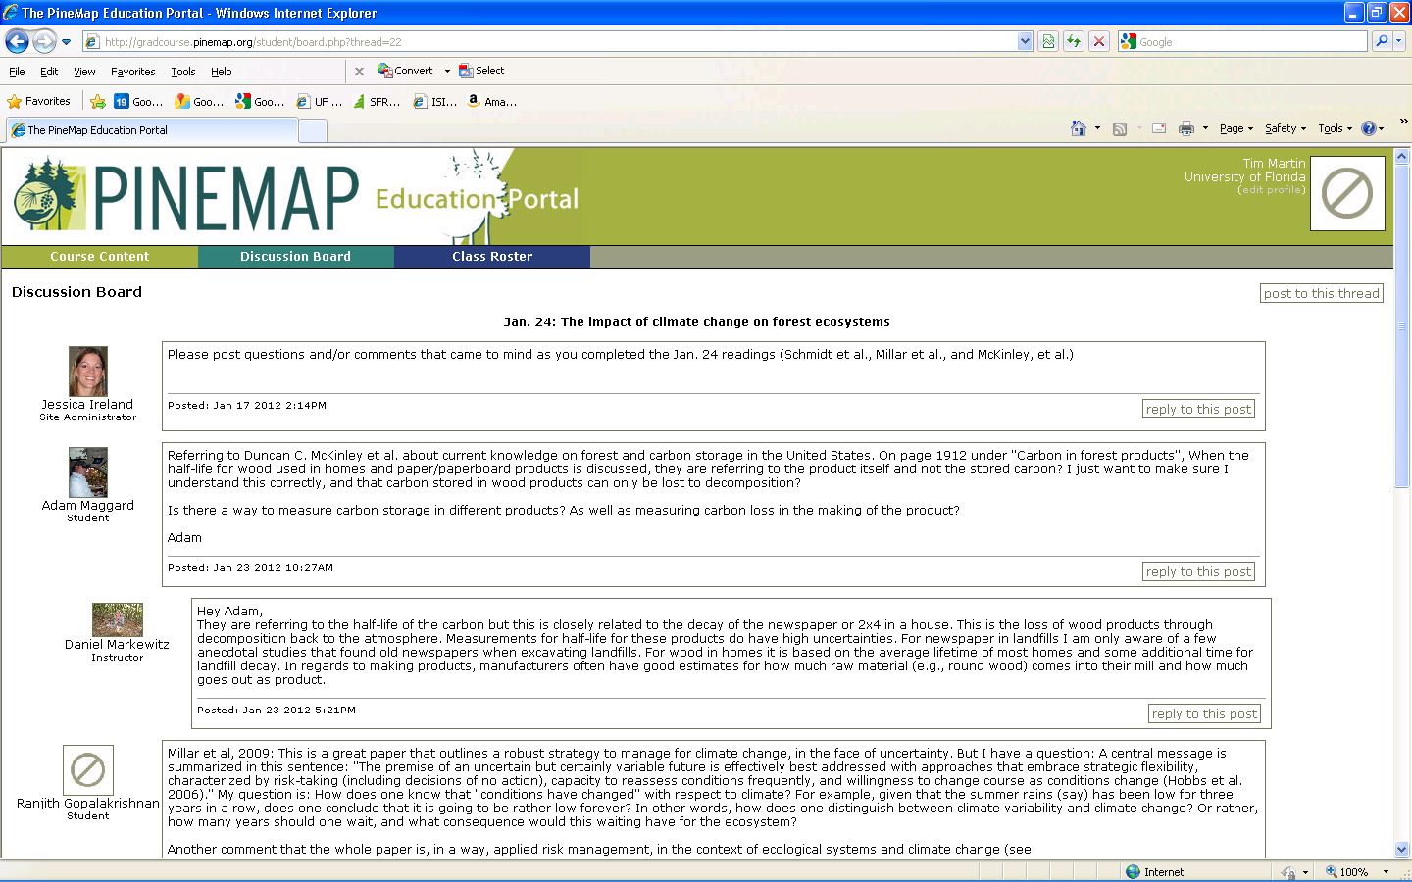
Graduate Online Course
Novel, online, intedisciplinary, integrated graduate education
22 graduate students from 8 universities

Slide 10
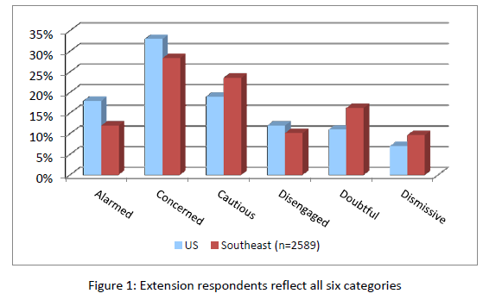
Survey of > 2,500 SE U.S. Extension Professionals Regarding Climate Change Attitudes

Slide 11
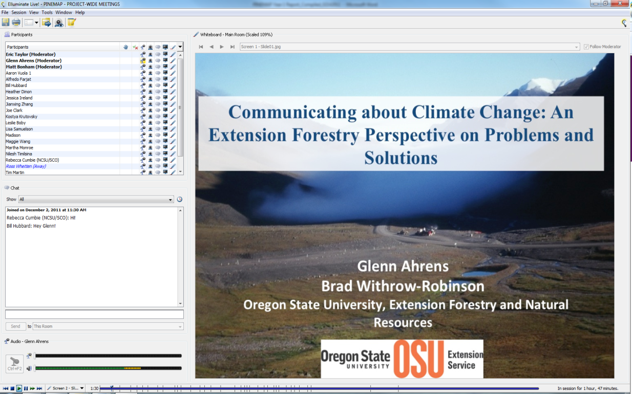
PINEMAP Webinars
Internal project orientation and education
Archived online
7 webinars
171 participants

Slide 12
Enormous amount of Aim-level Capacity Building
Tier 3 study installation
Field protocol development
Modeling environment development
Assembly of gridded historical and projected climate data
Genotyping protocol development
Literature reviews and assembly of data central to economics, policy, and risk analyses
Internship program spin-up
Extension program assessment and design

Slide 13
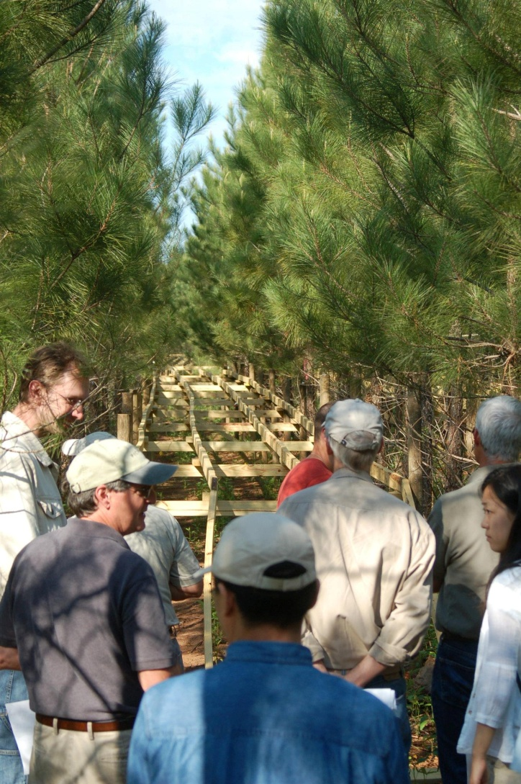
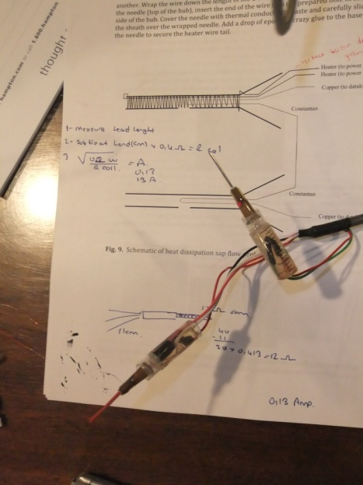
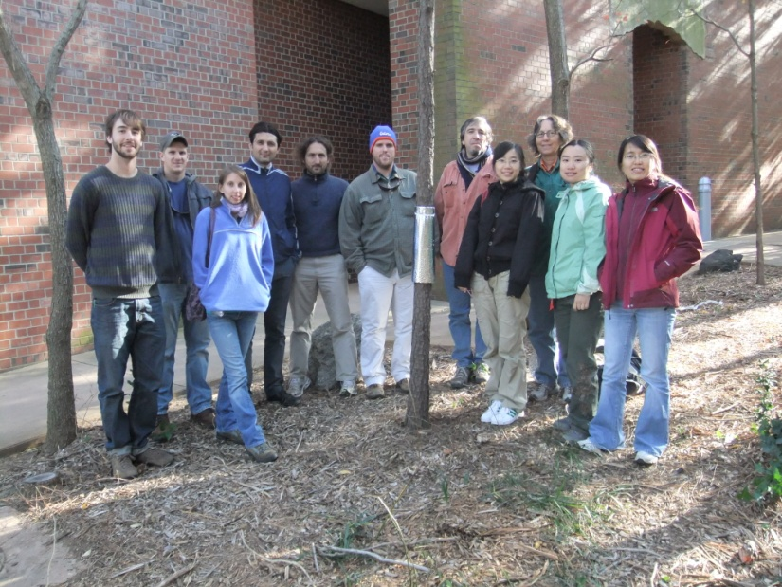
Enormous amount of Aim-level Capacity Building
Aim 2 Retreat in Charlotte, NC
Aim 1 sap flow workshop in Raleigh, NC
Aim 1 / Aim 2 Retreat in Athens, GA
Aim 6 Retreat in Atlanta, GA
Many, many telephone and Elluminate meetings

Slide 14
Year 2 Funding
In place
Uncut

Slide 15
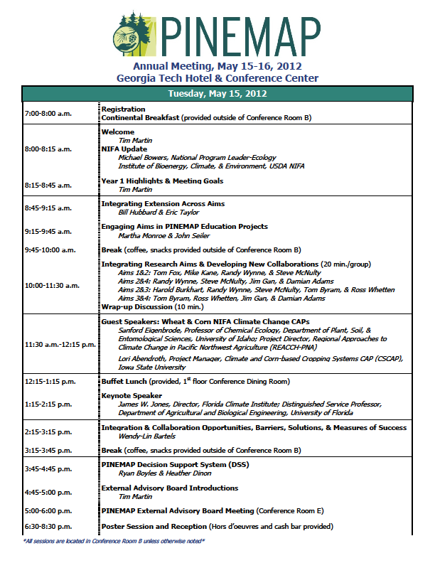
Agenda Highlights

Slide 16
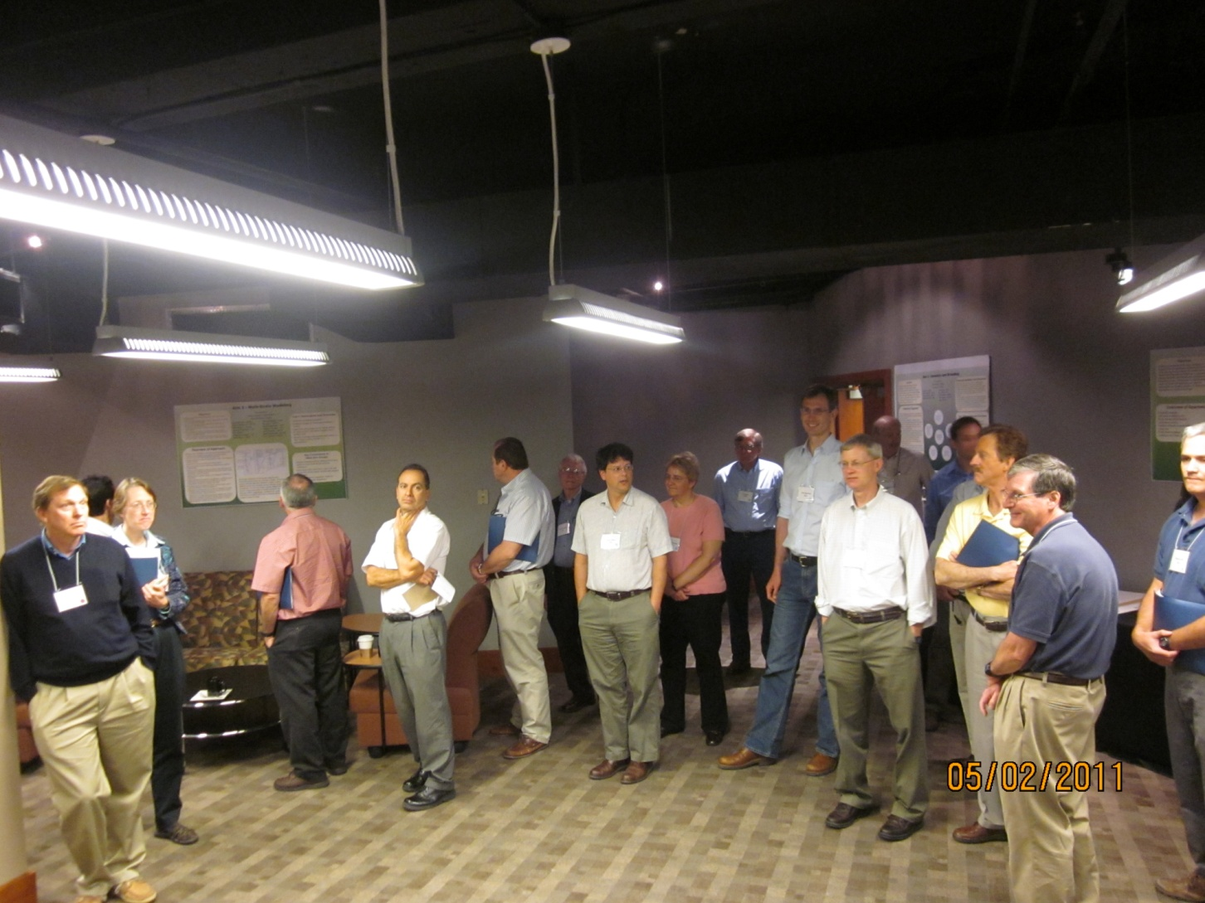
Foresters Standing Around Awkwardly, Worried about Icebreakers

Slide 17
Agenda Highlights
Integration presentations and discussions
Guest speakers
Integration and collaboration breakout groups
DSS workshop
Aim work sessions

