Slide 1


PINEMAP/PLT Module
An Aim 5 Integration Product

Slide 2

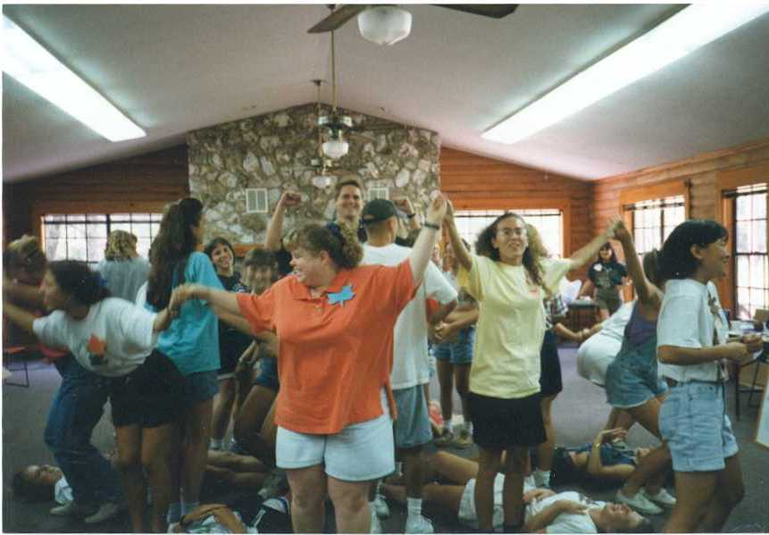
Project Learning Tree
National environmental education program
Forest industry support (AFF)
Distributed through state coordinators
Most famous for the PreK-8 Guide of 96 engaging activities

Slide 3
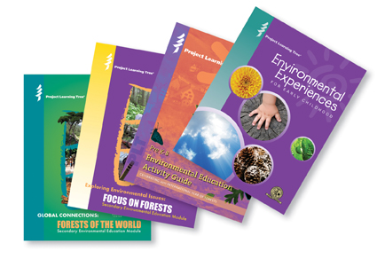
Secondary Modules
Grades 7-12
Issue focus
3-12 activities
A unit

Slide 4
Our project meets a need
Most climate education is part of Earth Science
Few states require an Earth Science class
Few educational resources apply climate change projections to ecosystems, social systems
We do!
Teachers are excited to use new materials in life science, agriculture, and environmental science courses

Slide 5
Our Module
The role of forests in climate change.
Climate and change, carbon cycle, and carbon sequestration.
Forest management can remove carbon dioxide from the atmosphere and improve resilience of southern pine forests.
Role of consumer choices in climate change mitigation through life cycle analysis and product comparisons.

Slide 6
It is a Process
Idea for activity
Concepts, data, exercise developed
Pilot test on UG students, 4-H’ers, science campers
Advisory Committee provides feedback
Expert review will happen
Formative evaluation in 2013
Online and in-person workshops

Slide 7
It is a Team
Staff – Annie Oxarart
MS Student – Stephanie Hall
PhD Student – Jie Li
PLT National – Al Stenstrup
Advisory Committee – 25 active engaged educators; Kristen also on External Adv Bd

Slide 8
It is a Team
Staff – Annie Oxarart
MS Student – Stephanie Hall
PhD Student – Jie Li
PLT National – Al Stenstrup
Advisory Committee – 25 active engaged educators; Kristen also on External Adv Bd
And YOU – for content

Slide 9
Aim Connections
Trees, carbon, sequestration
Forest management with climate uncertainty
Genetics and climate
Life cycle assessment
Communicating multiple perspectives on climate
Aim 1
Aims 1, 2, 6
Aim 3
Aim 4
Aim 6

Slide 10
Carbon on the Move
Students become carbon molecules and travel from station to station with a dice roll
Groups of students use their path to draw the carbon cycle
Pathway is the objective, not residence time or size of sink
Not so fun to be stuck; focus on bio-cycle

Slide 11
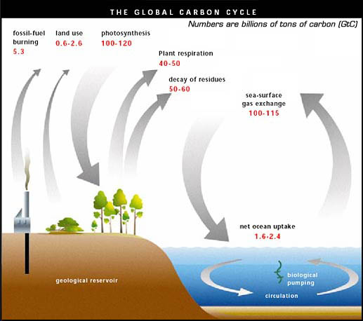
A simple carbon cycle includes:
Atmosphere
Plants
Ocean
Fossil fuels
Ours will also include:
Soil
Wood products
Animals

Slide 12
How can you be helpful?
Brainstorming ideas for activities
Answering questions, providing guidance
Reviewing for accuracy
Accommodating teacher feedback
Providing supplemental resources
Pilot test with students
Helping with local workshop

Slide 13
How can you be helpful?
Brainstorming ideas for activities
Answering questions, providing guidance
Reviewing for accuracy
Accommodating teacher feedback
Providing supplemental resources
Pilot test with students
Helping with local workshop
1 hr, 2x
1 hr, 2x
3 hrs
1 hr
6 hr?
4 hr
4 hr

Slide 14
Need Your Help
Brainstorm ideas
forest management
genetics
Help develop new activity ideas
Climate change perceptions
Review activities for accuracy
Carbon cycle and sequestration
Life cycle assessment and consumer choices

Slide 15
PINEMAP Integration
Part of our collective mission
To enhance K-12 education
Your names will be associated with the activities you develop or review
It will have a life beyond PINEMAP because it will be part of the PLT network in the Southeast
Building capacity of educators
Building awareness and knowledge of future landowners and voters

