Slide 1


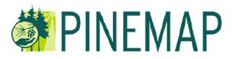
Pinemap and Terra C Data Management
Sabine Grunwald and Brandon Hoover
P
I
N
E
M
A
P

Slide 2

Aims of TerraC
Advance terrestrial carbon science and impact assessment of climate change through sharing of carbon and ancillary environmental data
Facilitate synthesis across geographic and thematic trajectories
Data management, archiving, and reporting
TerraC is an open database management system meaning that is not limited to the Pinemap project, but also stores other environmental project data
Initial funding
TerraC:
Notes:
Initially, TerraC was created to provide the data infrastructure for the carbon science community focused on ecosystems in Florida through a project funded by the Florida Energy Systems Consortium, FESC (2009-2012). The purpose of TerraC is three-fold: (i) advance terrestrial carbon science and impact assessment of climate change through sharing of carbon and ancillary environmental data; (ii) facilitate environmental synthesis across geographic and thematic trajectories; and (iii) enhance collaboration among researchers, scientists, extension specialists, Post-Docs, students, and others through shared resources.

Slide 3
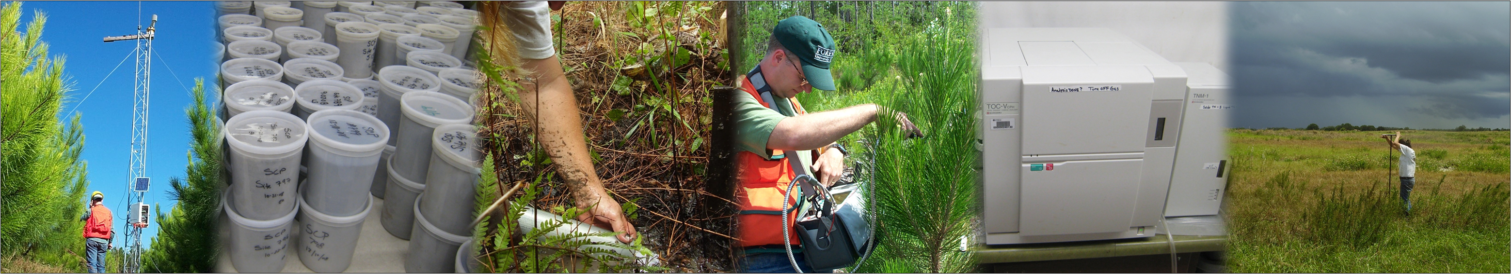
TerraC – Data Management Pinemap
TerraC provides a web-based accessible data system that allows
uploading, storing, managing, querying, displaying, reporting, and downloading of attribute data
characterizing soils, vegetation, atmosphere, water, and whole ecosystems
Notes:
TerraC provides a web-based accessible data system that allows uploading, storing, managing, querying, displaying, and downloading of attribute data characterizing soils, vegetation, atmosphere, water, and whole ecosystems. Data inputs are limited to site/plot-scale by characterizing the sampling point through geographic coordinates (latitude and longitude) using the World Geodetic System 1984 (WGS84). TerraC stores measurements/observations that are bound to a defined geographic point (with small sample support) for soil, vegetation, atmosphere, and water systems in a relational database format; except aggregated/average values that represent the whole ecosystem (e.g., a county). The measurements and field observations made at tier 1, 2, and 3 sites will be stored in TerraC in support of the PineMap project facilitating data sharing, managing, archiving, and reporting. Field protocols and base datasets identified by Aim 1 Group in conjunction with other Aim groups will be incorporated into TerraC.

Slide 4
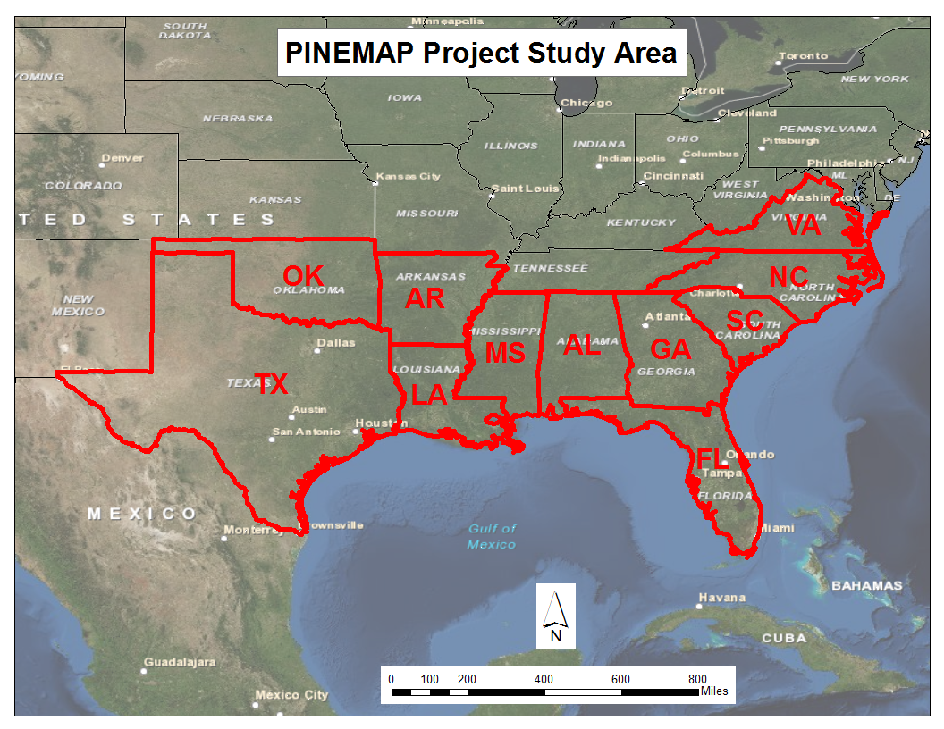
Pinemap Project Study Area
Tier
1, 2,
and
3 sites

Slide 5


Three-tiered Monitoring
Network & Data Structure
Process-level measurements
Temporal resolution
Data Pyramid
Tier 3 (4 sites)
Tier 2
Tier 1 (several hundreds)
Spatial dimension
Region-wide (SE U.S.)

Slide 6
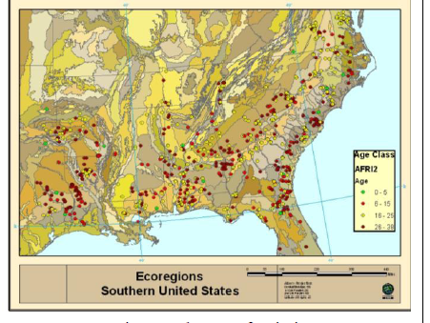
Measurements / Field Observations
Site-specific data (small sample support); “point”-specific data
Small plot data or
Aggregated/average values for map units (e.g., ecosystem type, county)
Pinemap base/field data protocols (meta data)
Geographic coordinates (latitude, longitude)
World Geodetic System 1984 (WGS84)

Slide 7
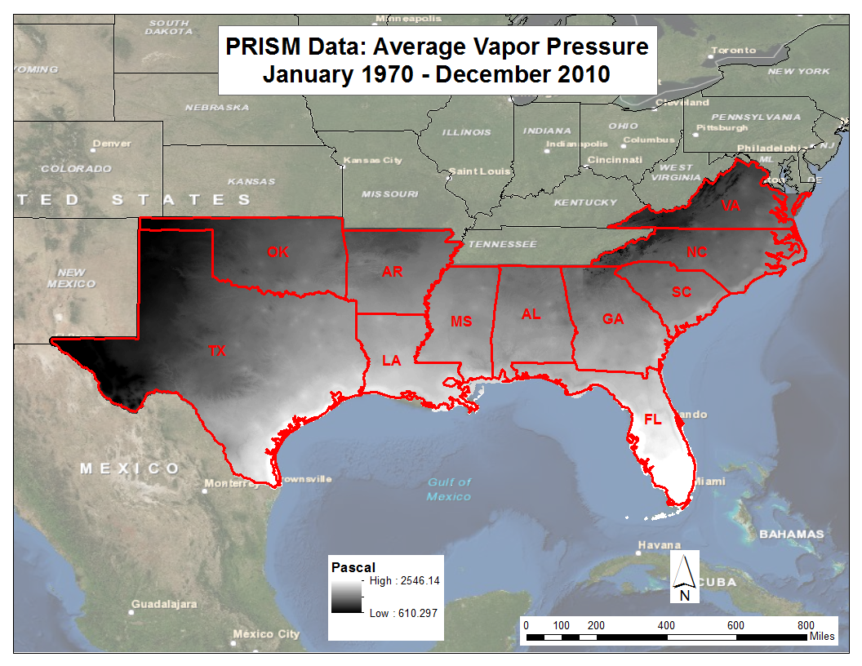
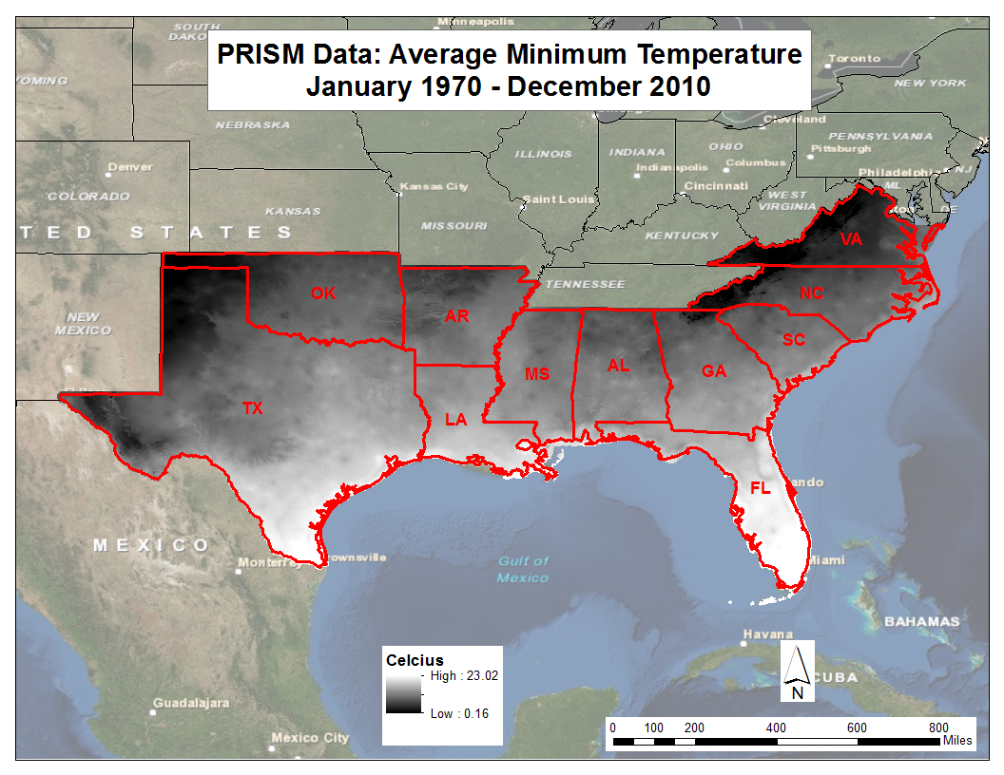
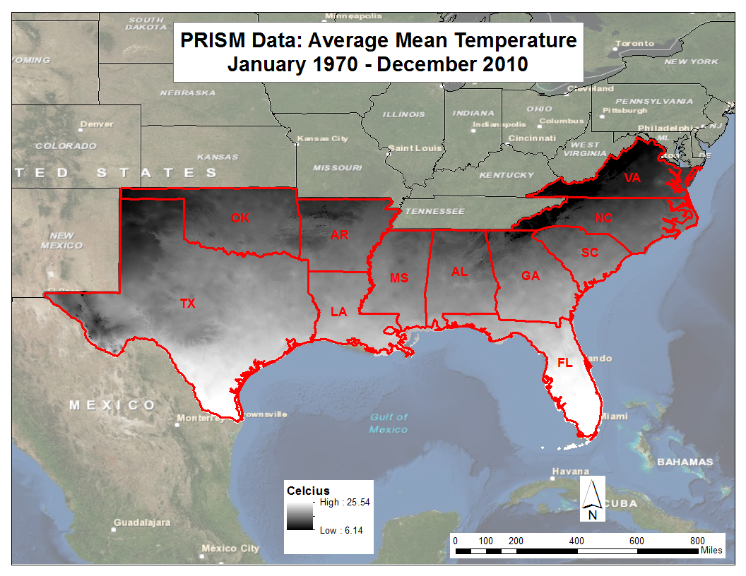
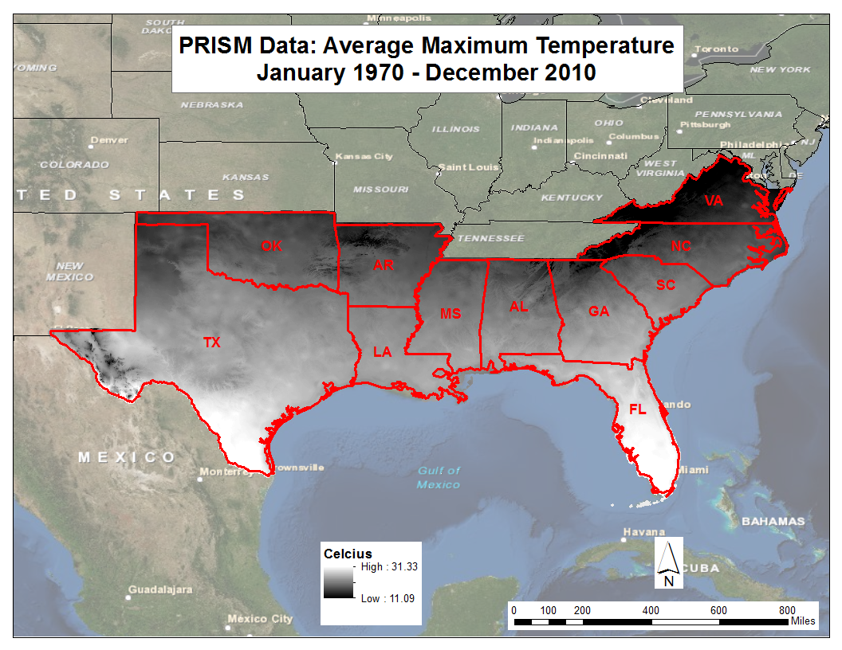
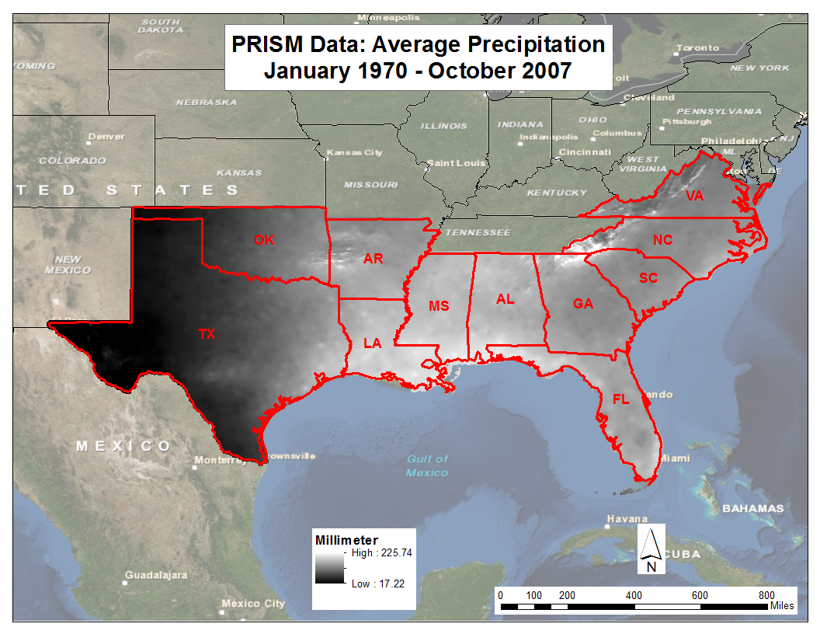
Point extractions of climate data
(GIS)
Extract Spatial Data to Tier Sites – Include in TerrC Pinemap Database

Slide 8
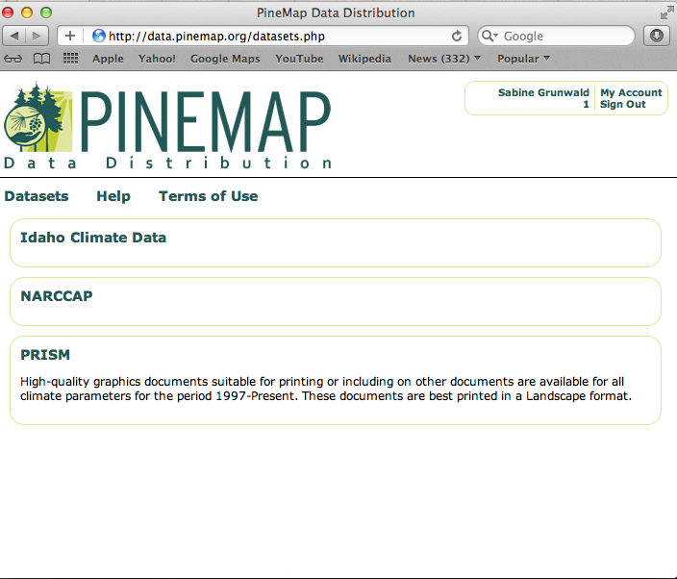
Pinemap Spatial Data Distribution http://data.pinemap.org

Slide 9
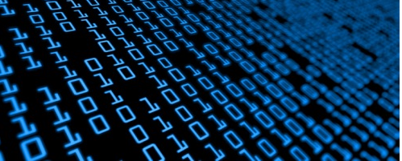
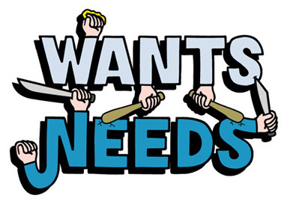
Life Story about Data
Everybody needs them – now
Notes:
Build a house metaphor

Slide 10
Data in TerraC
Standardized data and meta data
Disparate data types, units, and forms at different spatial and temporal scales
E.g., Carbon data - different forms (e.g., total, labile, active, mineralizable, or recalcitrant carbon) and units (e.g., concentrations, stocks, fluxes), at different spatial (e.g., site, plot/block or larger geographic unit such as a county, state, or watershed), and temporal scales (e.g., measured at a specific time or aggregated over time- an average value).
Similarly, other biogeochemical/environmental attributes can be stored in TerraC to complement carbon data sets

Slide 11
Data Structure and Organization
TerraC adopts a relational database management structure build on the Structured Query (SQL) programming language
Data are stored in form of project sets that characterize (i) soil, (ii) vegetation, (iii) atmosphere, (iv) water, and (v) whole ecosystems
Overall data structure:
Individual project datasets; umbrella projects (Pinemap)
Core/base (mandatory) data for each project
Attribute data
Meta data (XML)

Slide 12
Data Sharing Policy
PINEMAP Operating Principles and Guidelines
Sharing of data w/ project participants (facilitate collaboration)
Database w/ three access levels:
Level 1 – Public with read-only access
Level 2 – Private read/write access
Level 3 – Private read-only access
TerraC (public data): Creative Commons licensing scheme

Slide 13





Data Flow
Administrative Review
(quality check by Data Manager)
Data Submission
(Queue)
Data Submission (Data and meta data)
through web-application
(point/site/plot-specific data)
Subregion measurement teams: Four geographic sub-groups (1: VPI & NCSU; 2: UGA & Auburn; 3: FL; 4: OSU & TAMU) Tier II and III.
Data mining of cooperative research trials: Tier I
New data upload
New data upload
Administrative Tools
Core Database Server (SQL)
User Administration
Data Administration
(security and backup)
Query, Reporting & Graphics Tools
Data can be viewed, queried, and downloaded
…
Tier I
Tier II
Tier III
C flux data
(Ameriflux)
National
soil
data
Other
public & closed
env. data
Authenticated Users
Users in the appropriate groups have access to view and edit data in locked data tables. The owner can control access rights
Web Application (GoogleEarth)
Instant display of data/ measurements to provide geographic context and
browsing of data
KML
export
Pinemap – Spatial Database
(hosted at UF)
Extractions of spatial data, such as climate data (PRISM), to tier sites
Multi-scale Modeling / Synthesis
Empirical growth and yield models
Stand-level biophysical carbon balance models
Watershed to regional scale carbon and water models (supported by remote sensing)
Synthesis analysis
Meta analysis

Slide 14
Data to Model to Synthesis
TerraC facilitates to run queries across projects and integrate data into pooled sets facilitating synthesis across large areas (e.g., southeastern U.S.), ecological or climatic trajectories, and thematic foci (e.g., soil or terrestrial carbon)
The system provides in-build brushing, graphing, and visualization tools to support hypotheses development

Slide 15
Data extractions (downloads) will allow streamlining data into stochastic, deterministic, or mixed models that simulate interaction effects among measured properties, processes (mechanistic models), meta analysis, life cycle analysis, and more
TerraC facilitates to find answers to the key project questions posed in the Pinemap Regional project that requires synthesis of data, knowledge and findings
Data to Model to Synthesis

Slide 16
Discussion Items
Who will submit data (after QA/QC)? (tier 2 and 3)
Frequency data submission to TerraC
Timely data submission
Sharing of data for integrative analysis across the SE U.S. (statistical analysis, meta-analysis, synthesis, and modeling)

