Slide 1





Update
Sanford Eigenbrode, Project Director
Waterfront Center
May 15

Slide 2
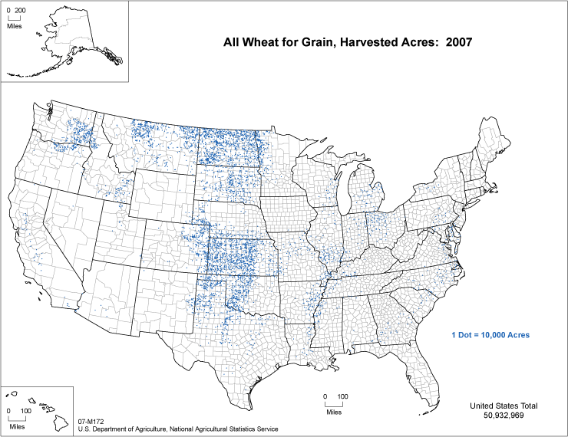
REACCH Domain

Slide 3
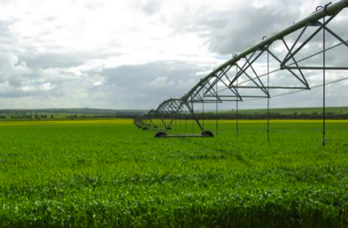
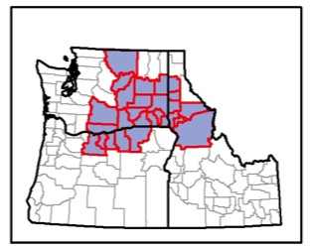
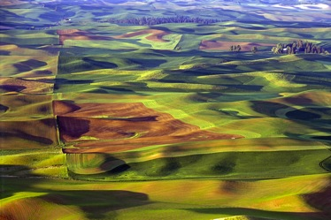
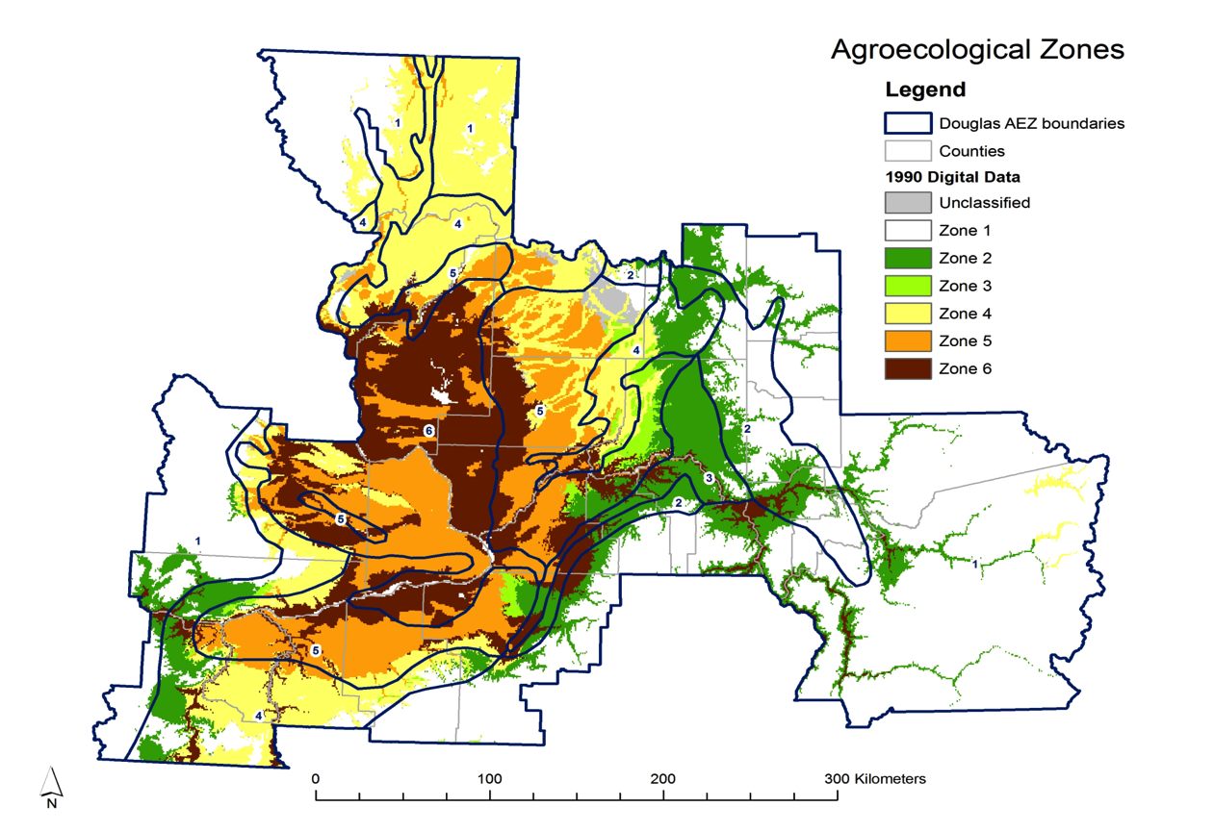
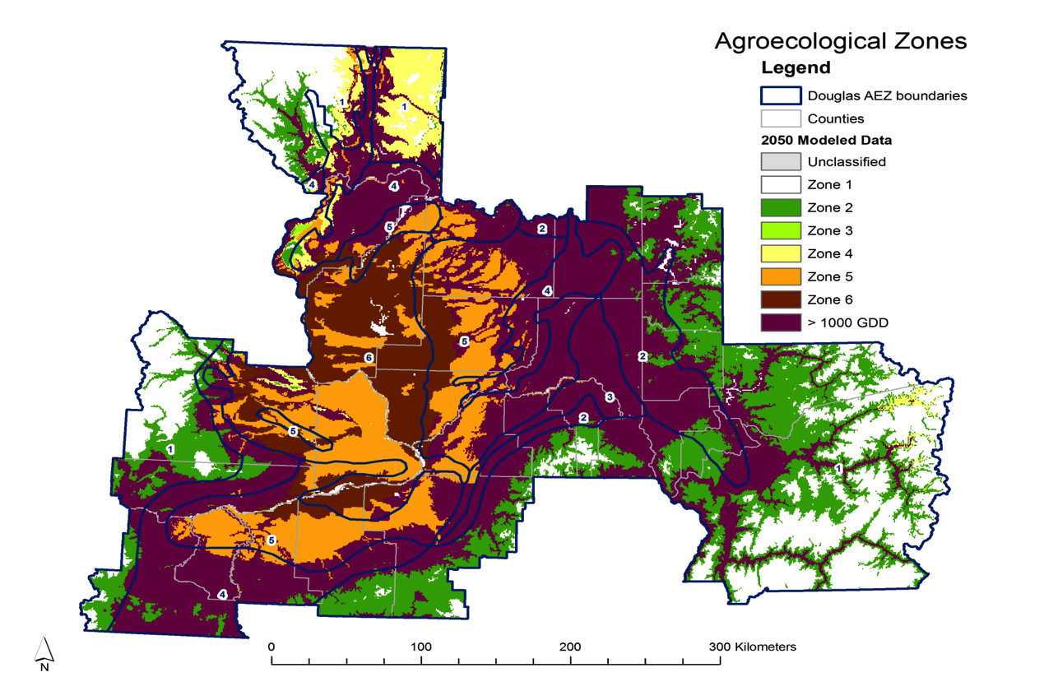
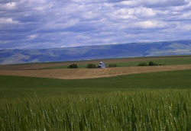
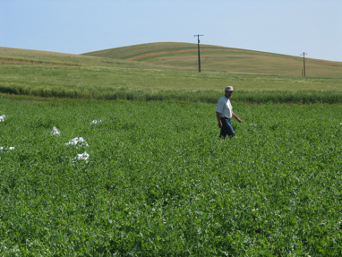
REACCH
2050
“Current”
Notes:
Potential climate Impact on inland PNW AEZ’s

Slide 4


Objectives
Objectives
Research
Create a modeling framework integrating climatic, biophysical and socioeconomic aspects of the system.
Establish a baselines and monitor soil carbon, erosion, nitrogen and GHG emissions from PNW cereal systems.
Compare current and alternative production practices for N and C use efficiency, GHG emissions and agronomics.
Determine social and economic factors influencing adoption of agricultural practices for climate change adaptation and mitigation.
Assess effects of climate change and alternative practices on crop protection and beneficial organisms.

Slide 5
Objectives, cont.
Objectives
Education and Extension
Introduce climate and agriculture themes into K-20, curricula; train grad students for integration.
Work closely with stakeholders in project design and execution. Ensure project findings are relevant and communicated effectively.
Capacity Building
Develop the regional capacity for continued, long-term research, education, and extension efforts to mitigate and adapt to climate change.

Slide 6
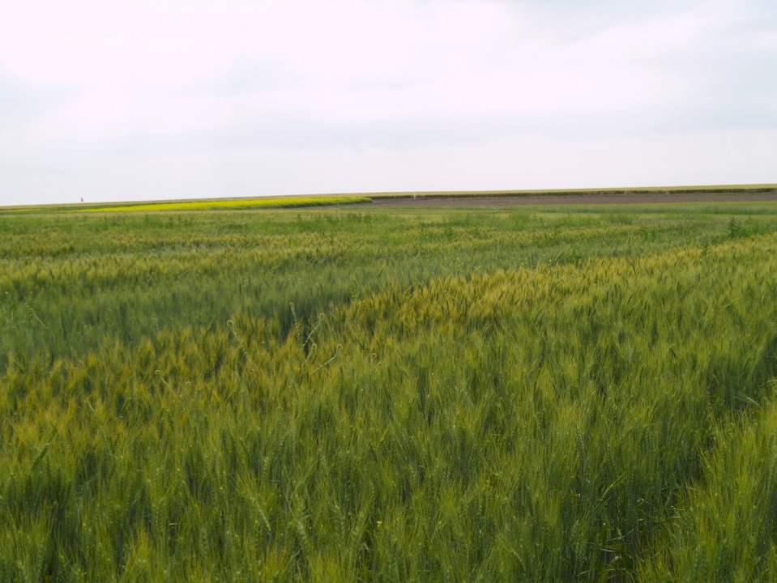
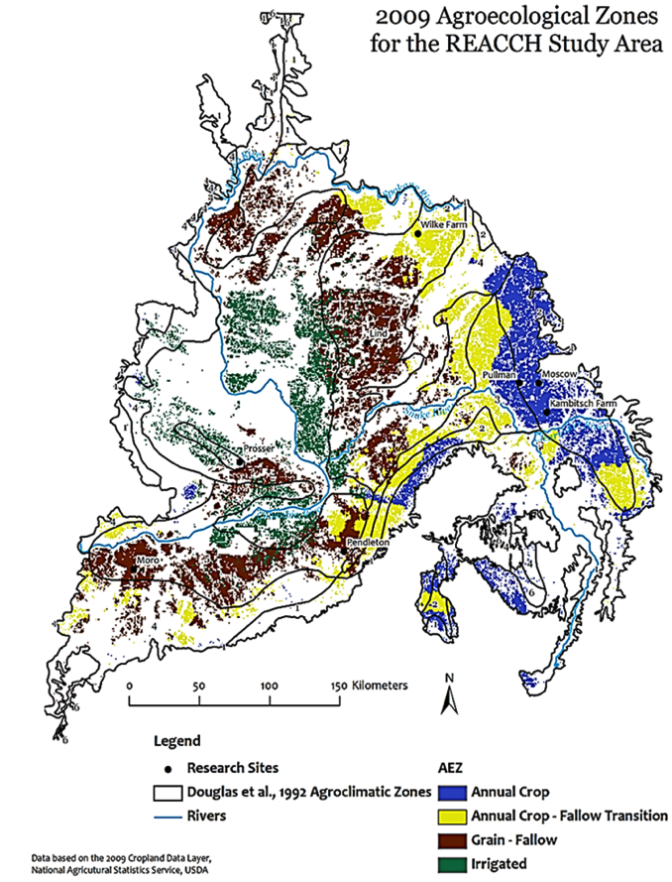
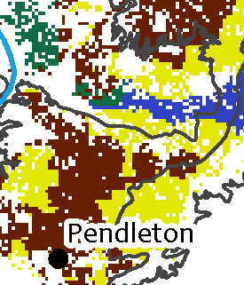
Highlights
Dynamic Agroecological Zones for the region
Concept Developed
First Outputs
MS in prep

Slide 7
Highlights
15 Experiments Established

Slide 8
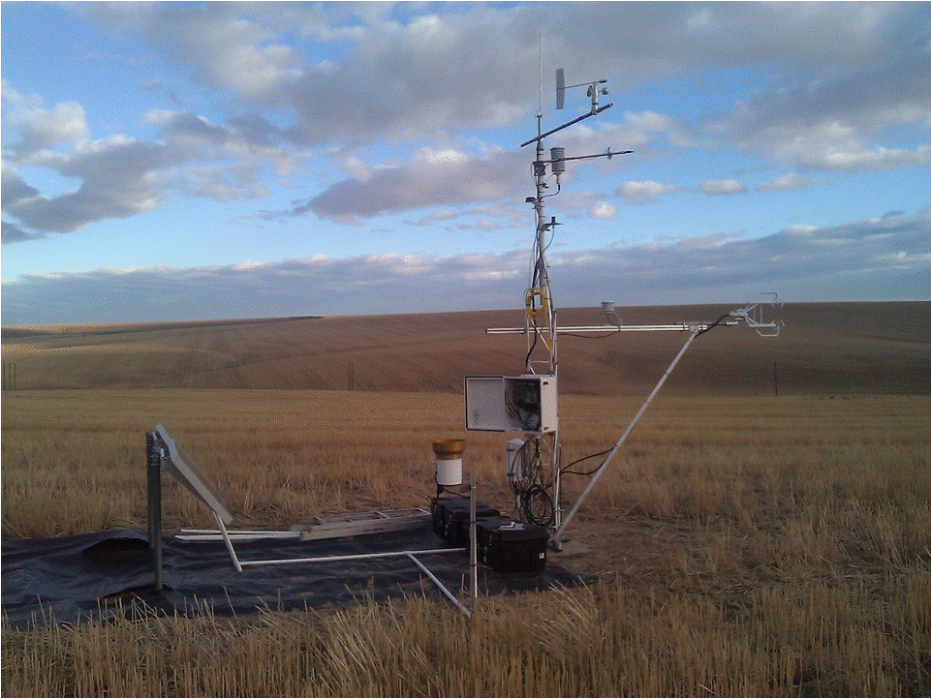
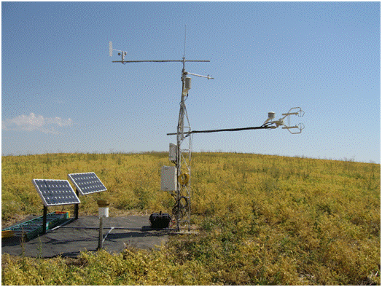
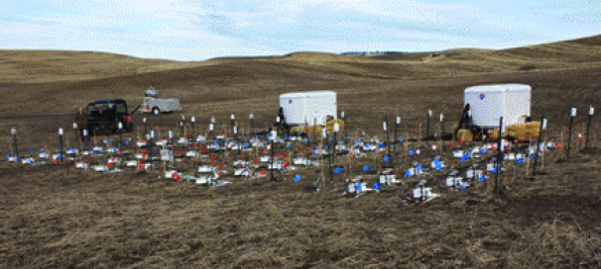
Highlights
Monitoring
Flux towers (2 of 7)
Chamber array

Slide 9
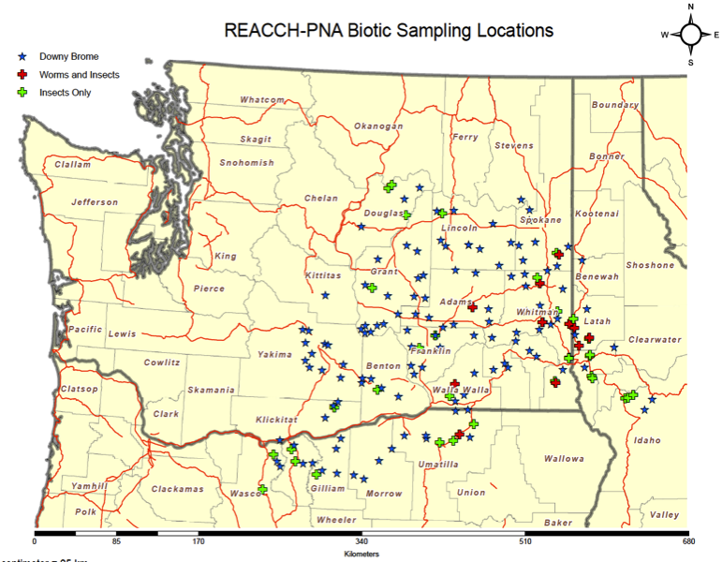
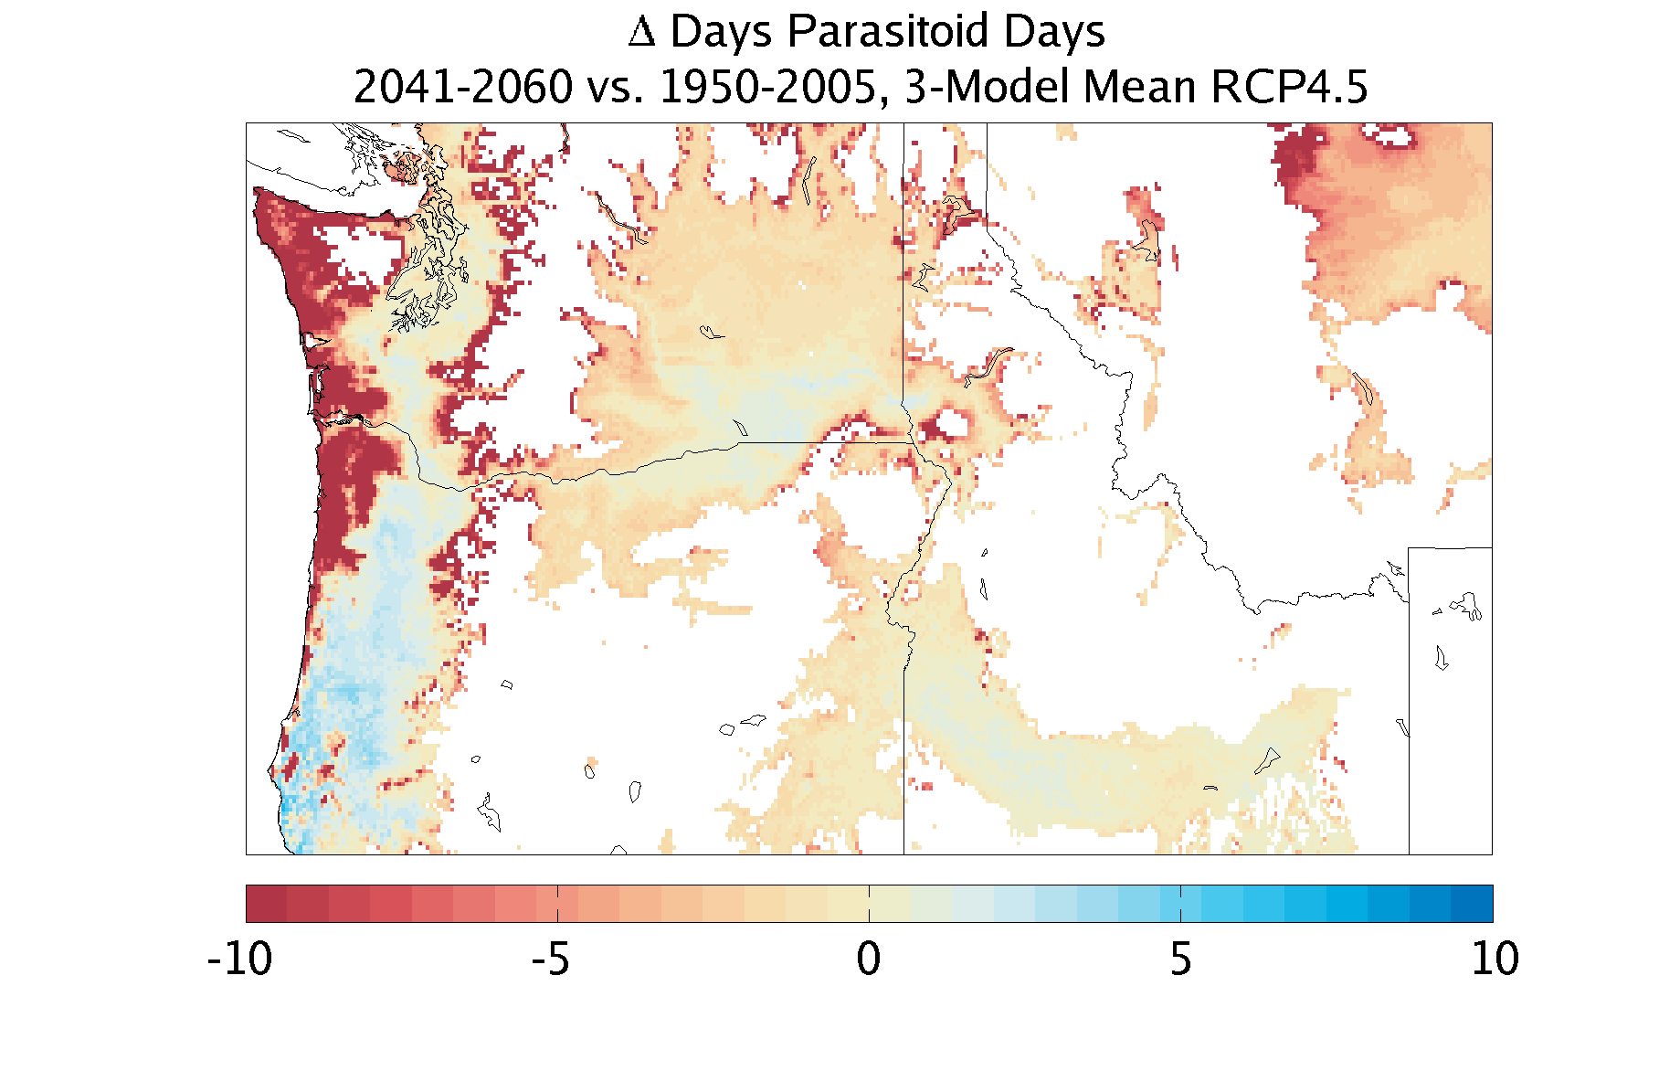
Highlights
Monitoring
Experiments
Grower cooperators
Modeling
Cereal leaf beetle
Downy Brome
Pests, Weeds, Pathogens
Model: Cereal Leaf Beetle Biological Control

Slide 10
Highlights
Education
K-12 Teacher Surveys Analyzed
Teacher Workshops June 19-21, Moscow and Oregon Teacher’s retreat
“REU” program, 14 in June – Aug. Cohort
Graduate Students recruited

Slide 11
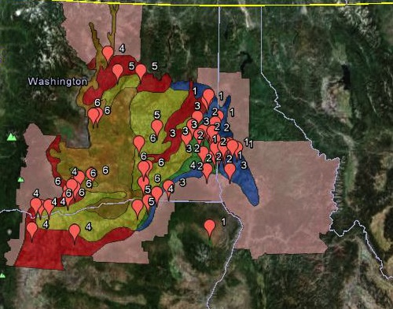
Highlights
Grower Surveys
Longitudinal surveys
Stratified
Farm scale
economic
agronomic

Slide 12
Highlights
Extension and Outreach
eXtension Community of Practice for Climate Change and Grain (partnering with Sustainable Corn CAP)
> 40 grower focused talks and field days
Stakeholder Advisory Committee participation in Launch Meeting and Annual Meeting

Slide 13
Highlights
Management
Biweekly Leadership Meetings
Regular Objective and Theme Team Meetings
Quarterly Executive Committee Meeting
Collaboration Software, Central Desktop

Slide 14
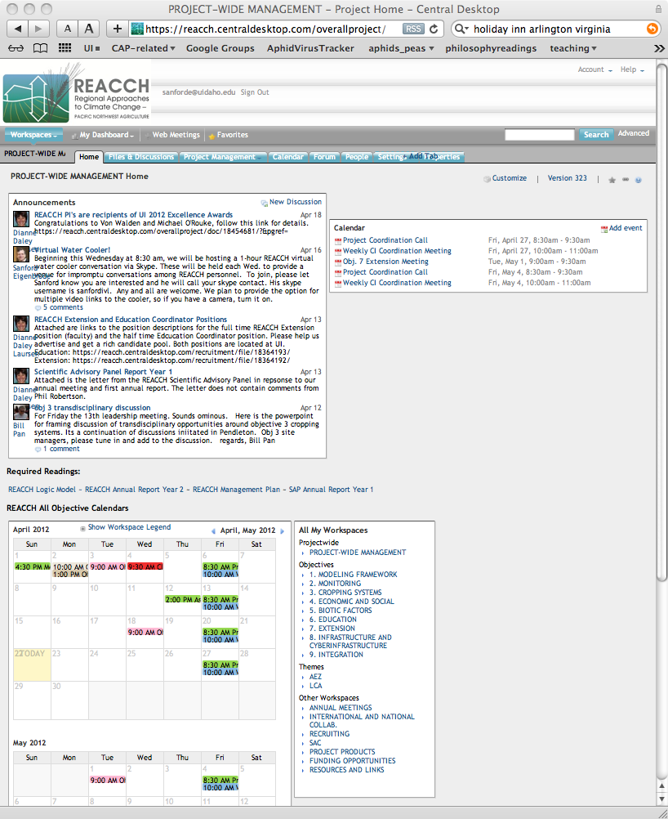
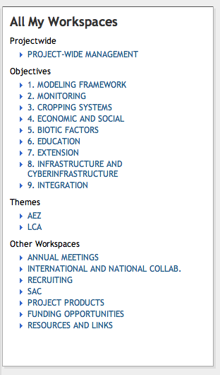
Central Desktop.com

Slide 15
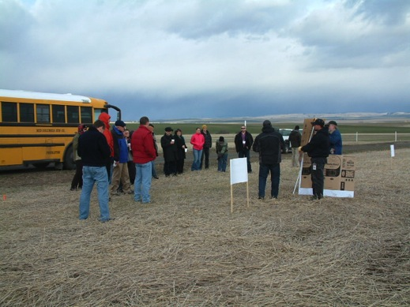
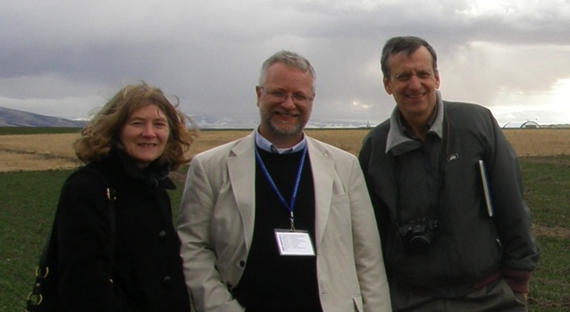
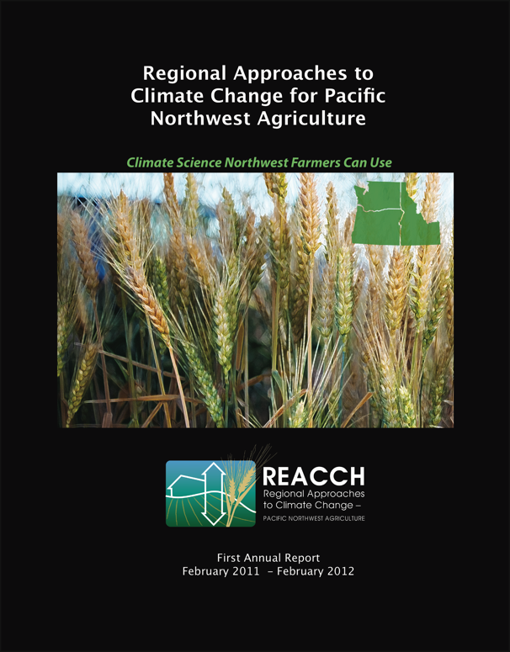
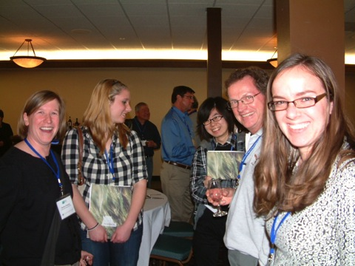
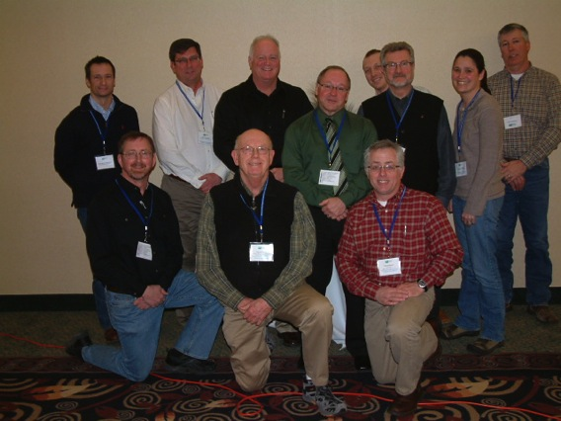
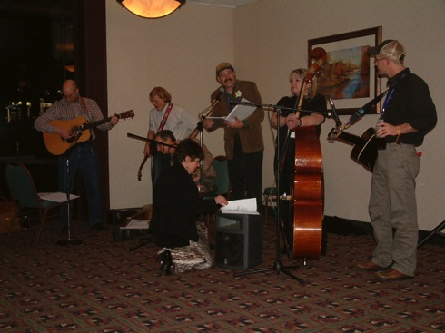
Highlights
Annual Meeting Feb. 29-March 2
Pendleton OR
Posters
Workshops on assessment
integration
Stakeholder Committee
Other Climate CAP leaders
Scientific Advisory Panel

Slide 16

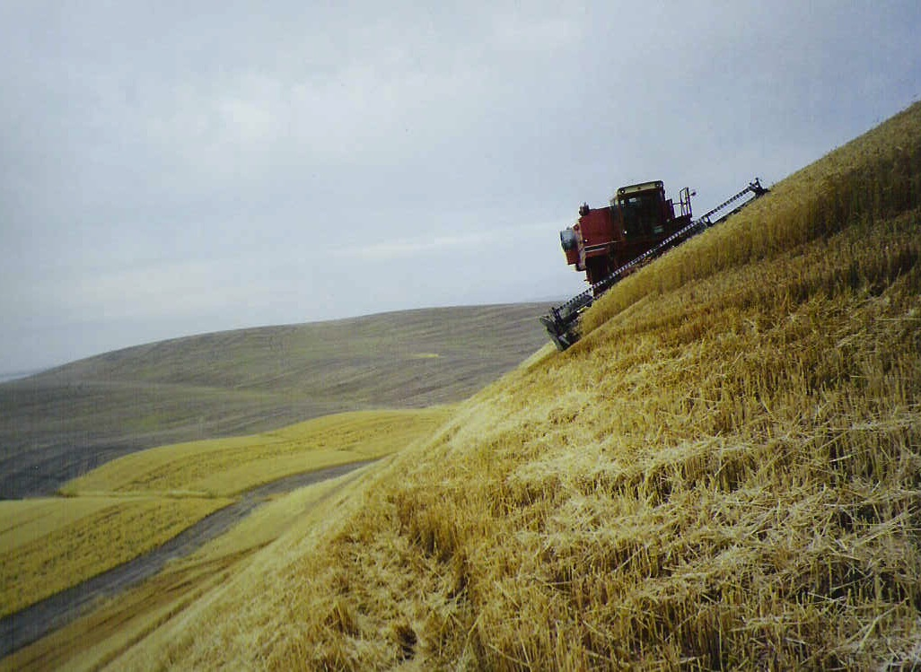
An interdisciplinary approach to climate change and cereal production in the Pacific Northwest: the REACCH PNA project
Year 2 Challenges
Sanford D. Eigenbrode
Entomology, University of Idaho
Director of REACCH-PNA
WSU Crop and Soil Science Seminar
Oct. 3, 2011
Improving Project-Wide Integration
Maintaining Esprit de Corps
Refining and Executing Integrative Modeling
Ramping Up Extension and Education
Building and Strengthening Networking
Improving Web Presence
Launching Data Portal
Building Partnerships

Slide 17
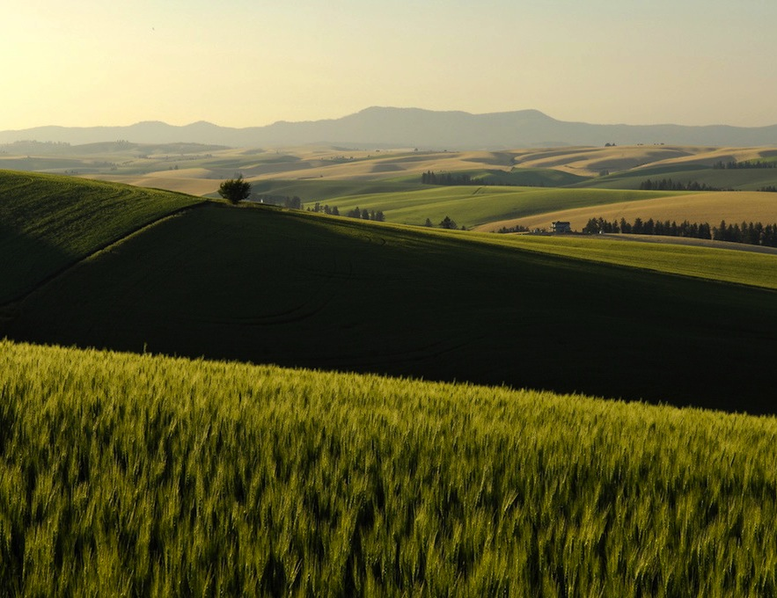
Meeting the Challenges
Improving Integration
Field Site Tour 2012
Virtual Water Cooler
Integration Fridays

Slide 18



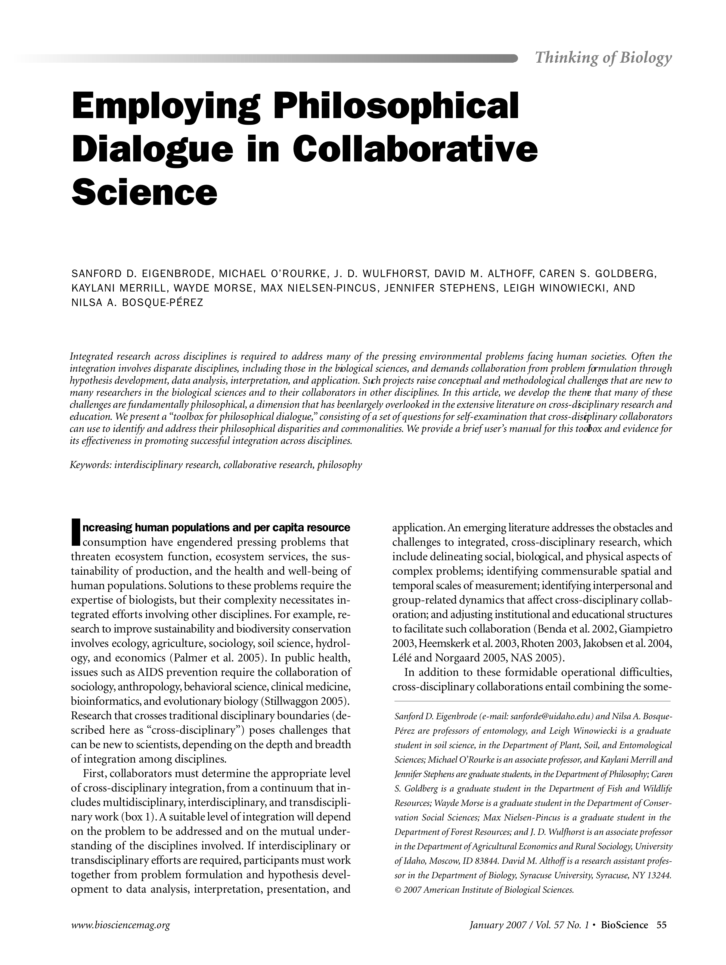
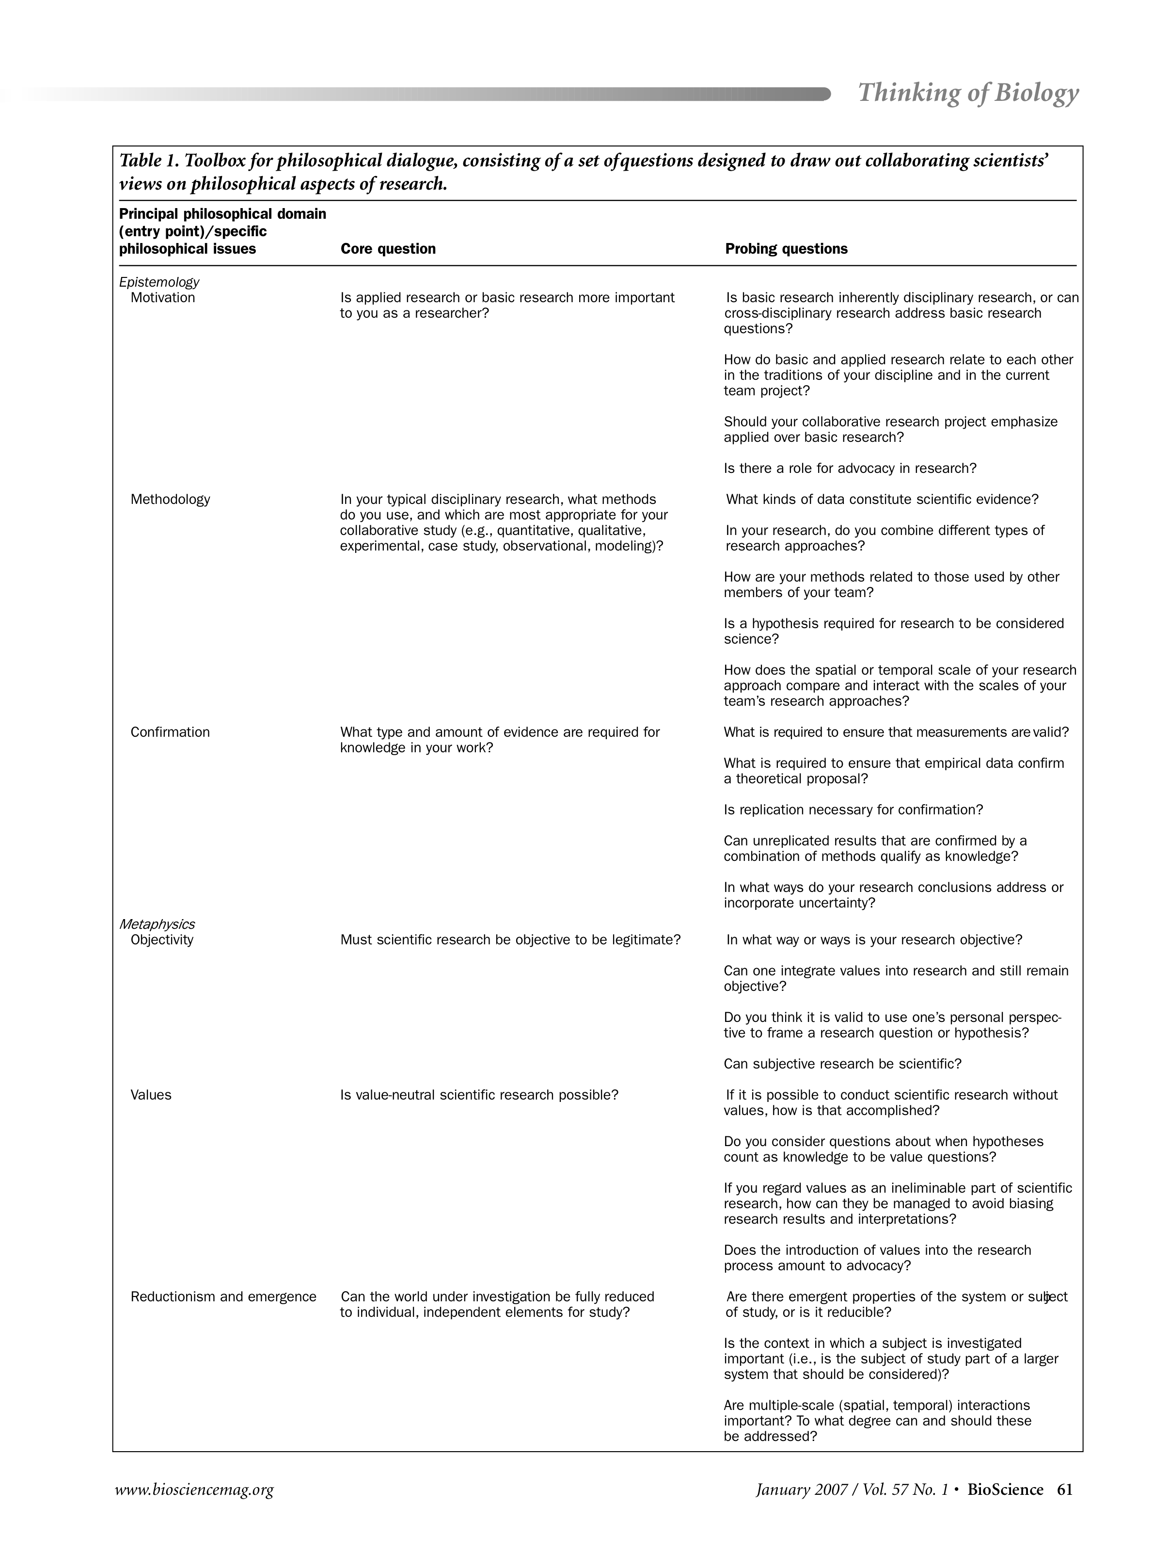
Toolbox Project Workshops
BioScience 57(1): 55-64 (2007)
Notes:
MO

Slide 19




Partnerships
UW
Climate Impacts Group (CIG)
IGERT
Projects
WSU- NSPIRE
UI - Ecological Resilience
Project
Pacific
NW Regional Climate Science Center
Idaho EPSCoR
Oregon Climate Change Research institute (OCCRI)
Climate Impacts Research Consortium (CIRC)
Kellogg Biological Station
UI –
Northwest
Knowledge
Network
Site Specific Climate Friendly Farming
WSU
ARS
GRACEnet
LTAR
PINEMAP
SustainableCorn.org
TCAPWheat (Davis)
Notes:
PNDSA thoughts
REACCH does not substitute for ongoing research in all aspects of farming in our region. It is large and integrative, but also seeks to maintain and work closely with other efforts ongoing and future.

Slide 20
Leveraging Partners
Sources
NOAA (Climate Impacts Research Consortium
NSF EPSCoR
USDA BioEarth project
STEEP
Idaho Regional Optical Network (IRON)
OFOOT (Organic Footprint Project)
Long-Term Agroecosystem Research (LTAR) site designation ARS
Life-cycle Assessment of Pacific Northwest
Two NSF-IGERT grants (UI and WSU)
Waste to Fuels Technology 2009-2011 (WA)
Columbia River Basin Water Supply Investment Plan
eXtension CoP for Climate Change and Grains (REACCH and Sustainable Corn)
AGMiP
Core Funding: $8M
Active Collaborations: $6M

Slide 21

Thank you for your attention!
http://reacchpna.uidaho.edu/reacchpna
reacch@uidaho.edu
Photo: David Barton

Slide 22
Highlights
Outputs
17 professional presentations
47 presentations at producer meetings and field days
14 refereed scientific articles
9 extension reports or bulletins
2 webinars and extension
1 video
Press
12 articles and press releases
http://reacch.nkn.uidaho.edu

Slide 23
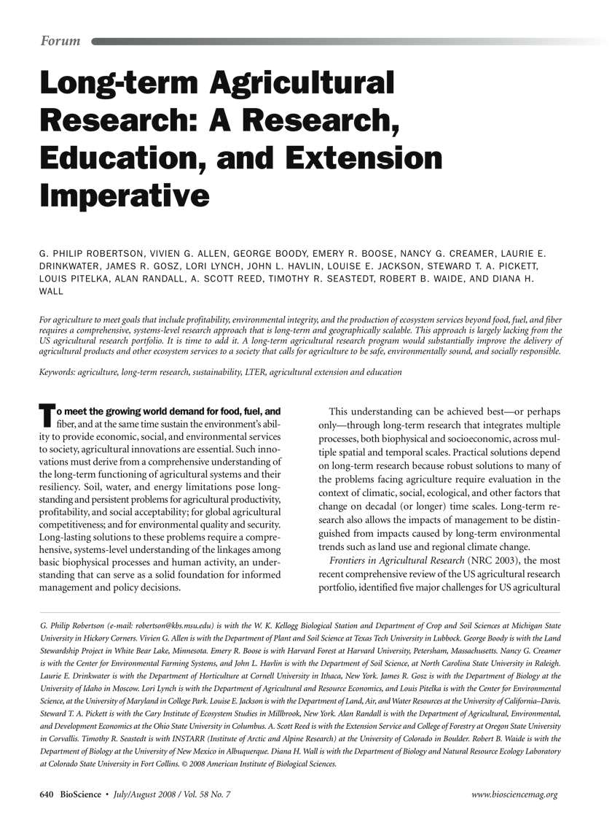
Vision for the PNW
Addressing the research imperative
Making REACCH part of the establishment of a region-wide Long Term, Distributed Research Project
Robertson et al. 2008
Notes:
This understanding can be achieved best—or perhaps
only—through long-term research that integrates multiple
processes, both biophysical and socioeconomic, acrossmultiple
spatial and temporal scales

Slide 24
Meeting the Challenges
Ramping Up
Extension
Hiring Extension Specialist
Responding to SAC feedback from annual meeting
Education
Hiring Education Coordinator
First Cohort Grad Retreat

Slide 25
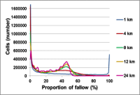
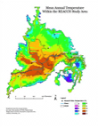
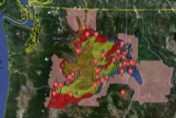
Cyberinfrastructure
Integrate
Analyze
Modeled data
and processes
REACCH Data
Discovery Server
Quantitative output
REACCH DB repository
Txt
Excel
Instrumental
Output
Research output
Data staging
transformation
REACCH staging
server
HTTP compliant data
streams
Legacy data,
Other data input
REACCH Confidential
Server
Metadata creation
and storage
Compiled tools
For research

Slide 26
Meeting the Challenges
Collaborations and Networking
ARS – LTAR network, GRACENet
AmeriFlux Network
NEON
Pacific Northwest Climate Science Center
UI-OSU-WSU Cyberinfrastructure
Genetics – TCAP and Limagrain
Other Climate CAPs

Slide 27
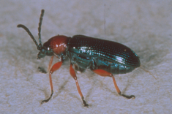
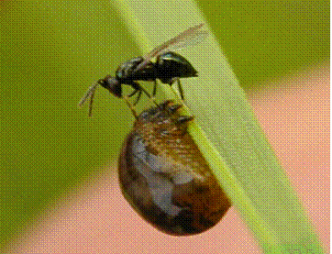
Highlights
Modeling
CLB
Biocontrol
Pests, Weeds, Pathogens
Mean annual Δ overlap (days) between CLB larvae and foraging Terastichus julis, 1950-2005 vs 2041-2060

Slide 28
Highlights
Assessment
David Meyer (BSU) leading
Surveys of all project personnel, stakeholder representatives to assess process and engagement
Tracking milestones and deliverables through Central Desktop
Assessment specialist participates in or monitors project meetings
Ethnographer studying transdisciplinary science within the project

Slide 29
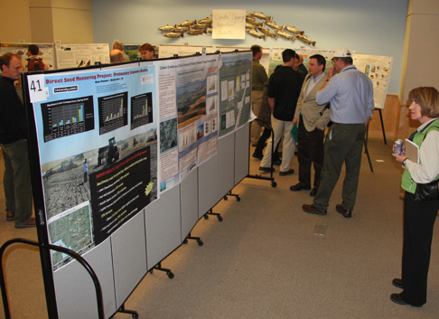
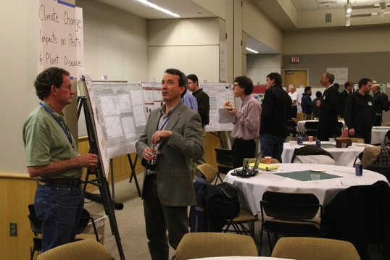
Highlights
Launch Meeting May 9-11
University of Idaho
> 60 posters
Workshops on improving communication in collaboration and communicating with the press
Michael Bowers in attendance
Stakeholder participation

Slide 30
This Presentation
Highlights of Year 1
Challenges in Year 2
Networking
Q & A

