Slide 1
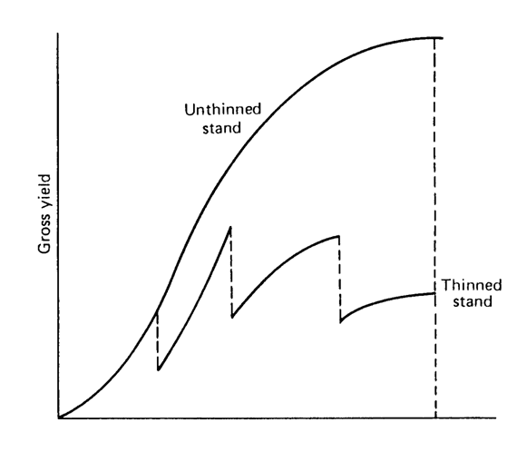
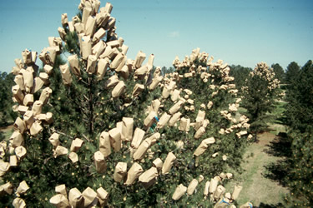
Integrating Research Aims 2 and 3
Modeling and Genetics

Slide 2
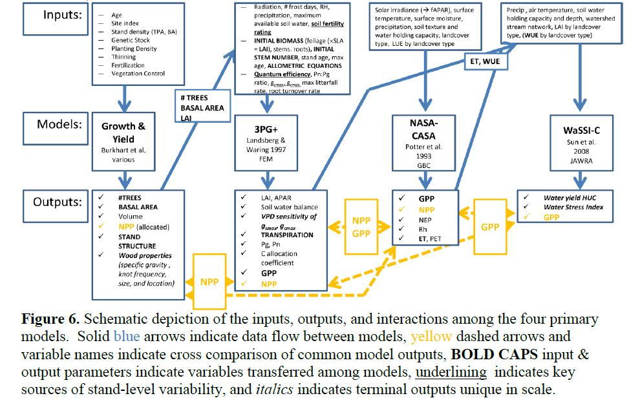
Overall Modeling Flow Chart

Slide 3
Interdependent Goals/Deliverables
Aims 2 and 3
Aim 2
Develop improved growth and yield models for evaluating tradeoffs among C seq., forest products, ecosystem services.
Incorporate response to genetic improvement silvicultural treatments, and climate.
Aim 3
Develop universal response functions to guide deployment of genetic material.
Identify alleles and genes associated, with growth, wood characteristics, disease resistance.

Slide 4
Two Major Components
For Implementing Aims 2 and 3
Develop improved methods for reflecting genetic improvement in models of forest growth and yield. To be carried out by Aim 2.
Develop Universal Response Functions to guide deployment strategy for varying genotypes and climate scenarios. To be carried out by Aim 3.

Slide 5
Past, Present, Planned
Work on Incorporating Genetic Effects on Growth and Yield of Loblolly Pine

Slide 6
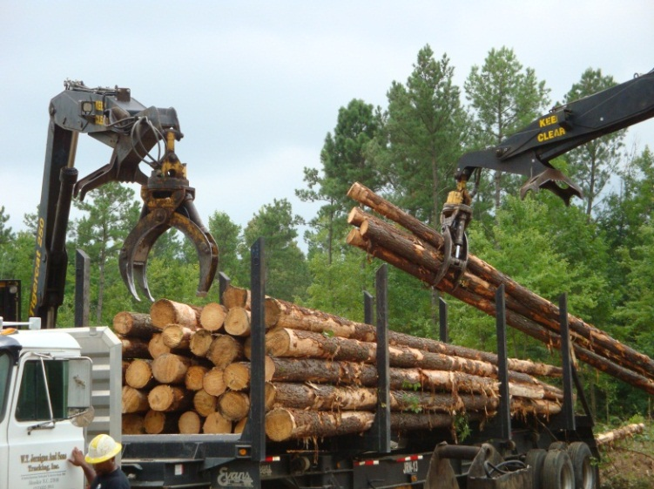
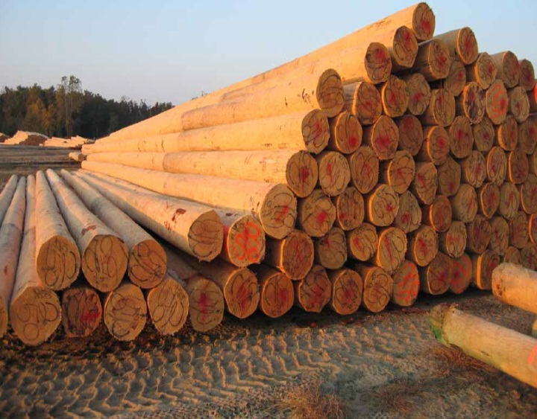
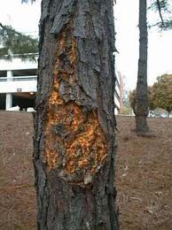
Genetic Improvement to Enhance
Growth Yield
Wood Quality
Disease/Pest Resistance

Slide 7
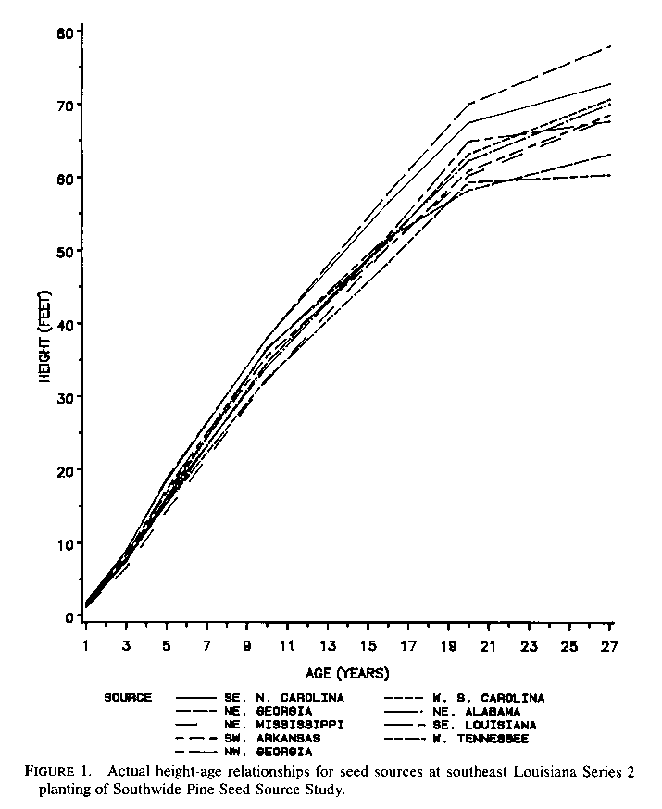
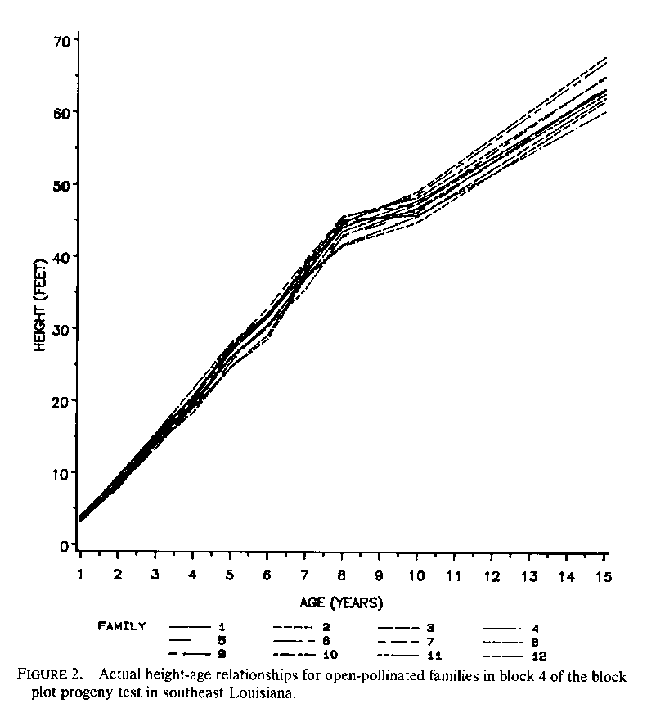
Study of Genetically Improved Loblolly Pine
Buford and Burkhart. 1987. Forest Science 33:707-724
Shape of height/age (site index) relationship related to site; level related to genetic stock
Seed source study
Open-pollinated families
Genetic effects not significant for other tree or stand variables.

Slide 8
Bottomline:
To predict growth and yield of plantations established with varying seed sources or open-pollinated families, it is necessary (and sufficient) to correctly specify site index.

Slide 9
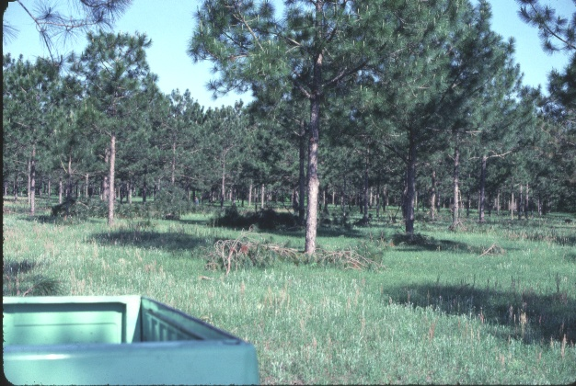
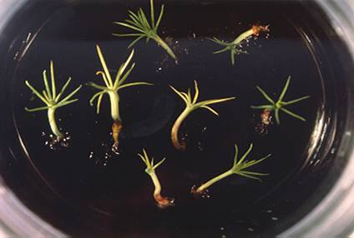
Mass Control Pollinated
Range of Genetically Improved Material Now Available
Genotypes
Open Pollinated
Clonal

Slide 10
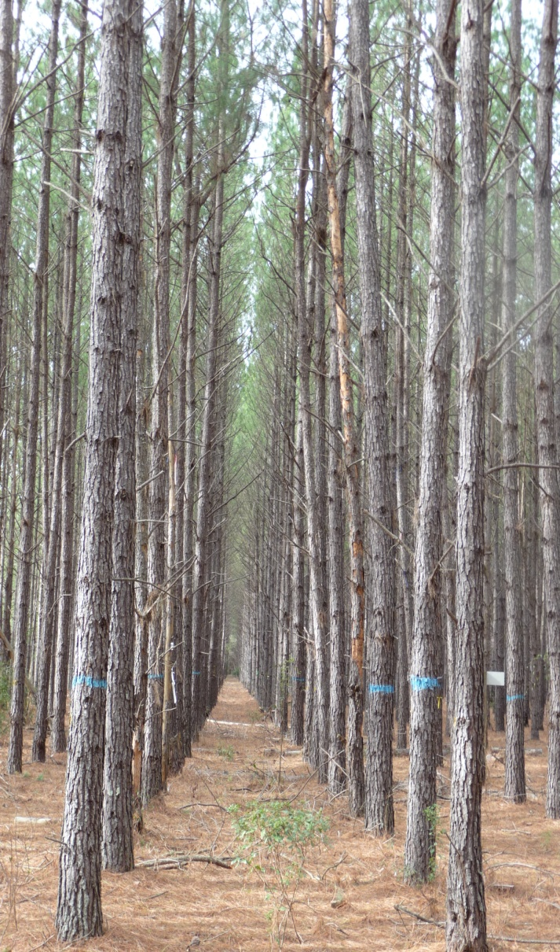
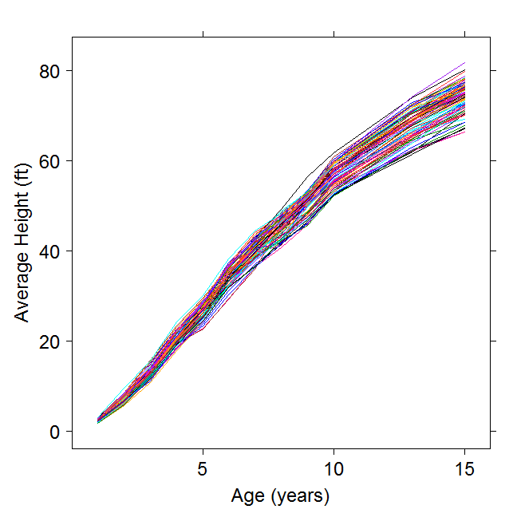
Height/Age
for loblolly pine in clonal screening trial
Notes:
10

Slide 11
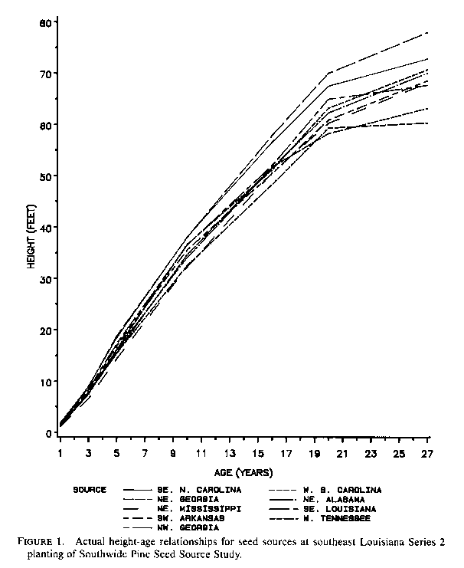

Seed source study
Height/Age
for Loblolly Pine
Clonal
Open-pollinated families

Slide 12
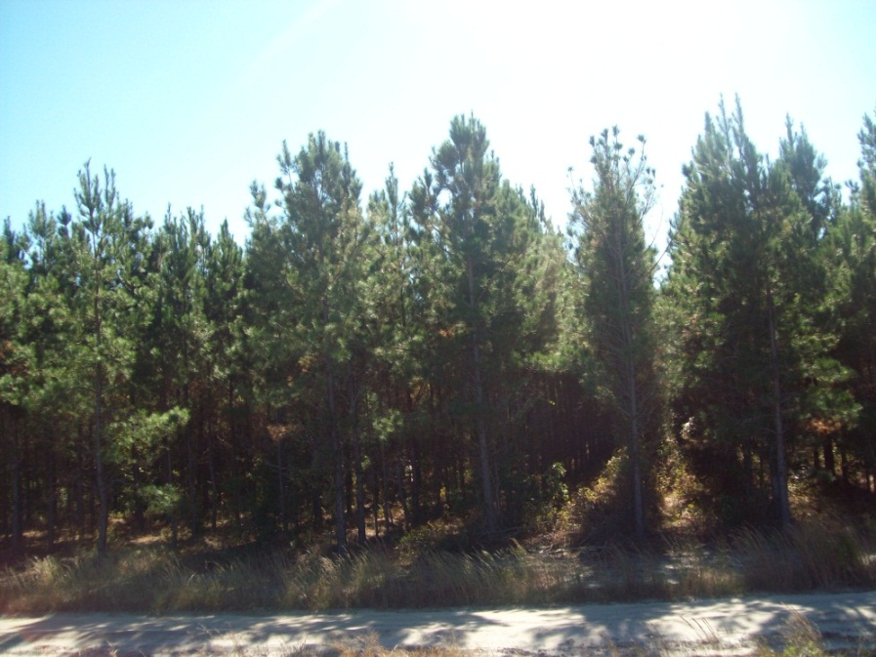
Plot Data
Height and dbh data from a genetic variety by density study
Plot size = 0.44 acre
CRD Experiment
Planted in 2002
Operational silviculture
Ages 8 and 9 data in
2009/10 and 2010/11
dormant seasons

Slide 13
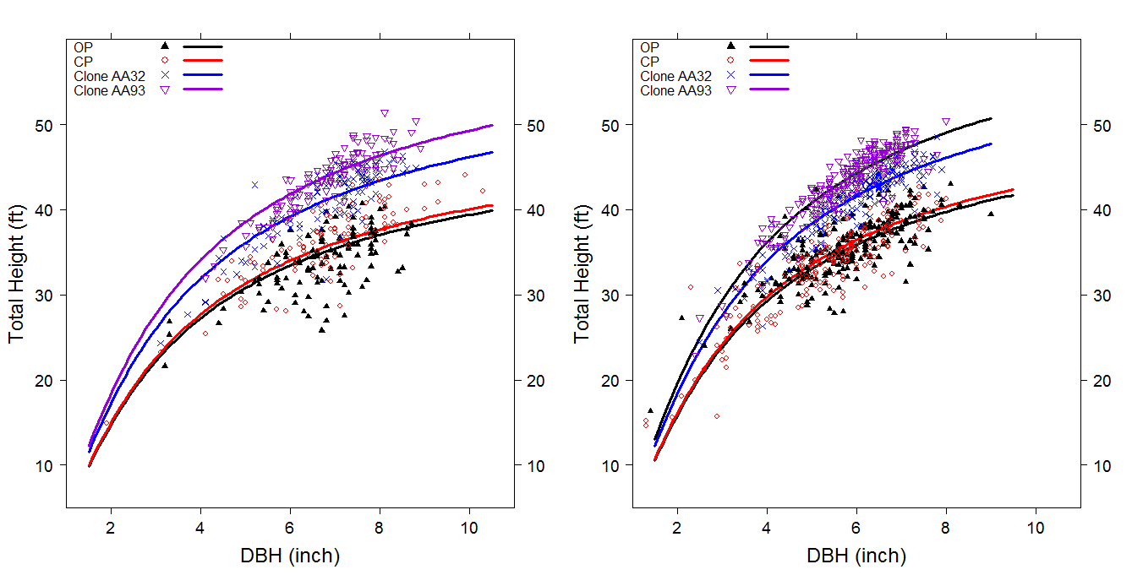
Height-Diameter Relationships
Two densities, Four genotypes

Slide 14
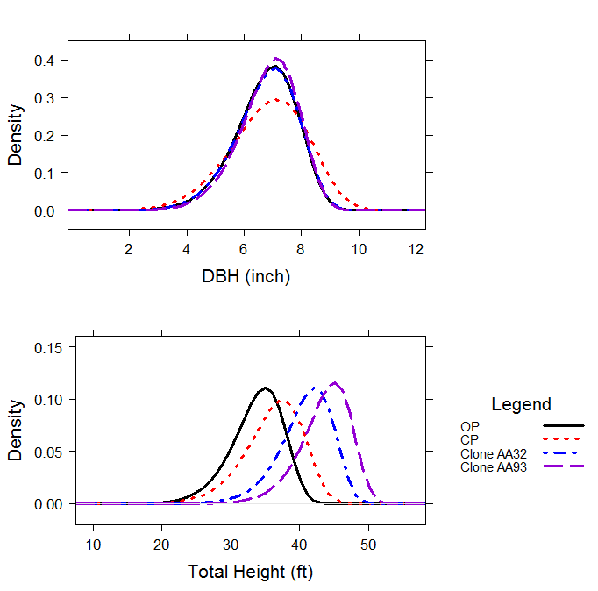
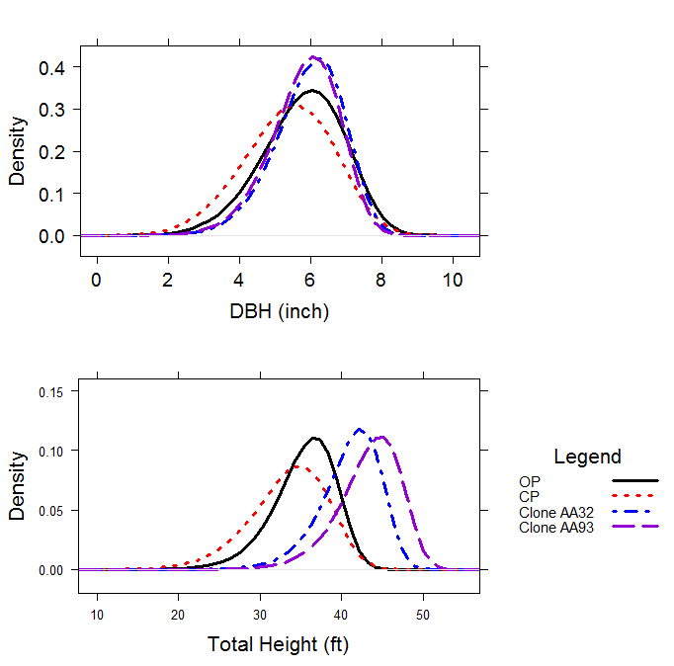
Diameter and height distributional changes
275 TPA
550 TPA

Slide 15
Allometry Can Vary For Clones
Clone 1
Clone 2

Slide 16
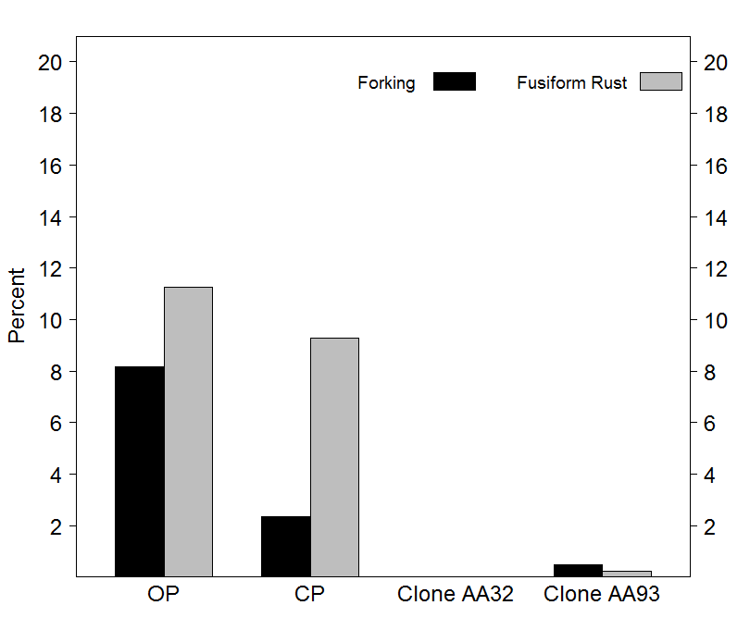
Stem Quality Characteristics
Fusiform Rust & Forking

Slide 17
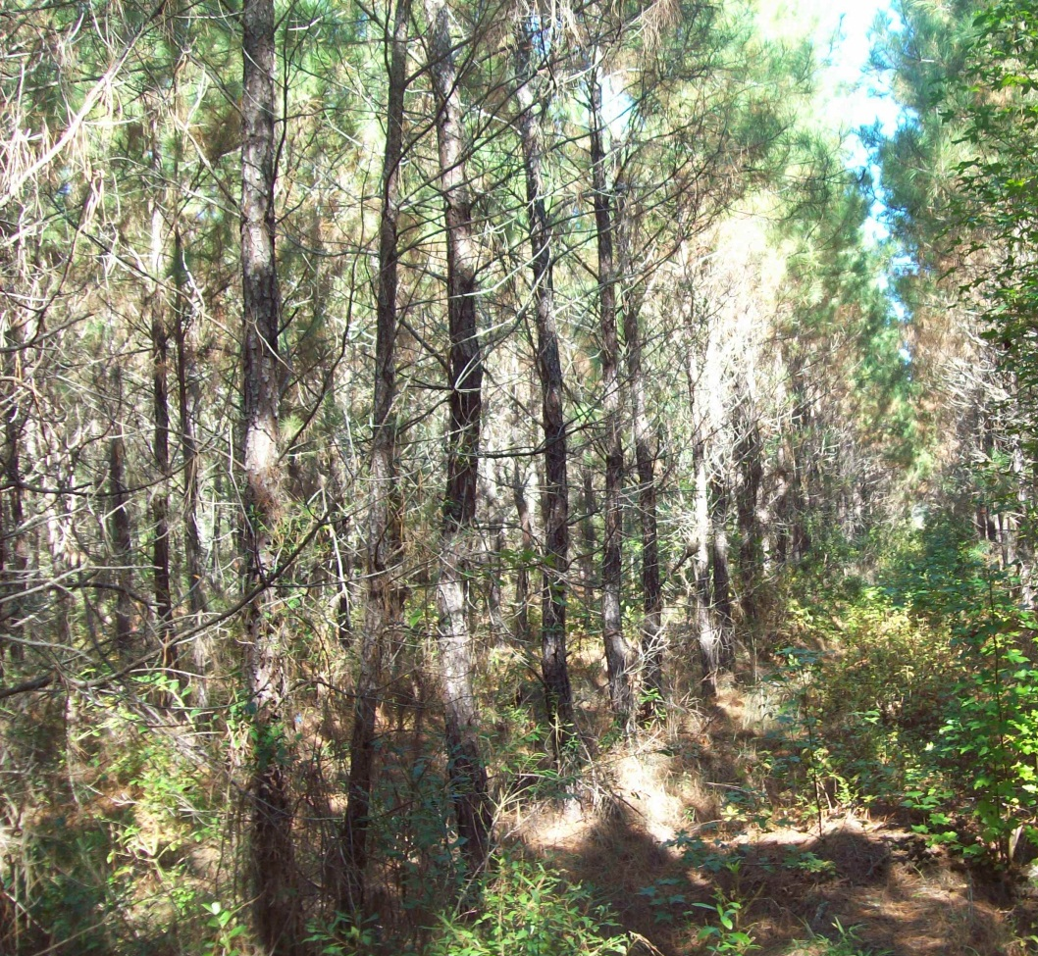
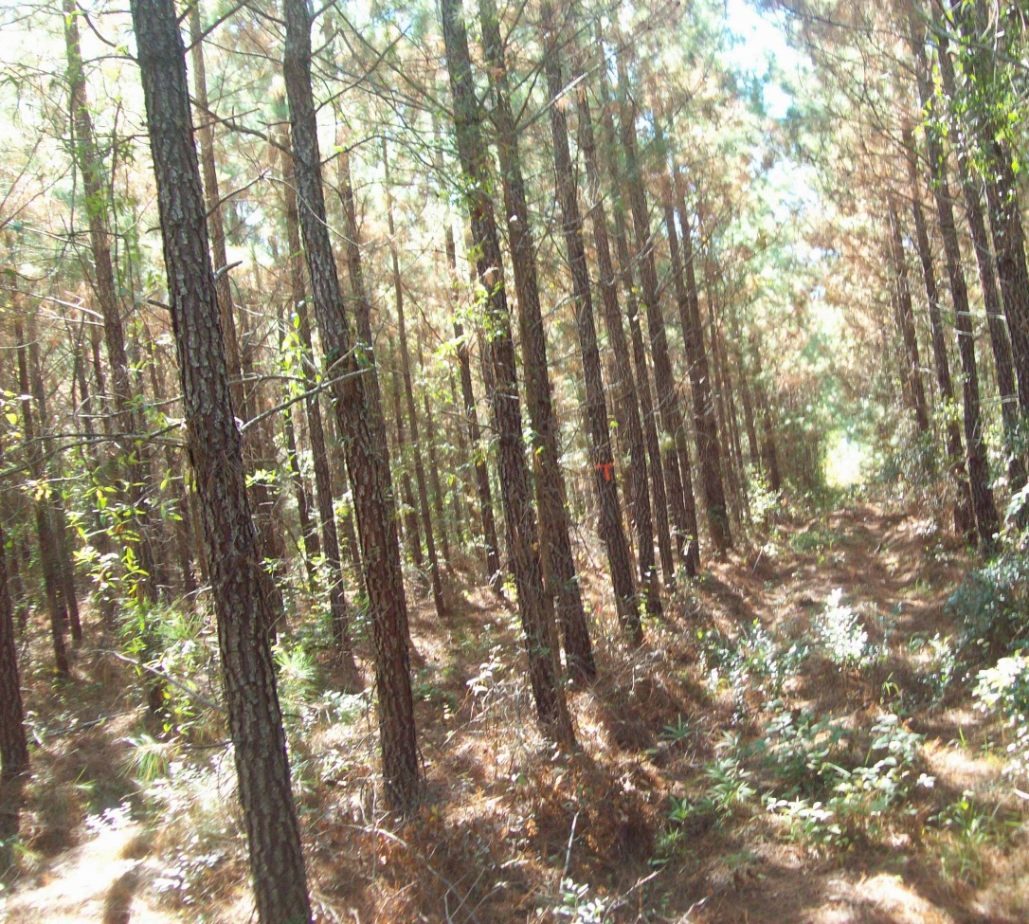
Stem Straightness & Branching
OP
Clone AA93

Slide 18
Properties of Models
Modelers of population biology strive to maximize simultaneously three desirable properties (Levins, 1966):
Generality
Reality
Precision

Slide 19
Strategy for incorporating genetic improvement effects in growth and yield models
Assemble data with varying levels of genetic selection (seed source, OP, clone) and analyze in a common framework for genetic effects on
  Height development
  Diameter development
  Tree stem quality
  Disease incidence
Incorporate impacts in model components
  Height growth
  Diameter growth
  Mortality estimation
  Product distributions by size classes
Structure a stand simulator to reflect the impact of changes in components on stand dynamics, growth and yield.

Slide 20
Strategy for developing
Universal Response Functions
Develop Version 1 with provenance trial data
Develop Version 2 with progeny data

