Slide 1
Integrated Team Science Discussion
Celebrate success and build on what works. Identify key enabling factors
Explore barriers and brainstorm solutions
How can we recognize and measure successful integration over time?

Slide 2
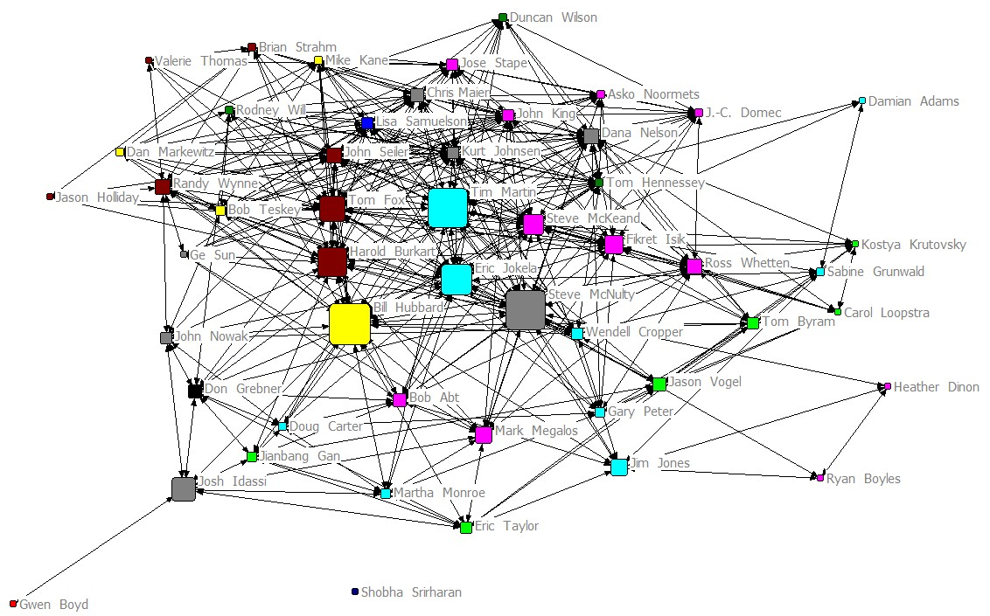

Slide 3
