Slide 1
Climate Change, Mitigation, and Adaptation in Corn-based Cropping Systems Coordinated Agricultural Project
Lori J. Abendroth, Project Manager
Lois Wright Morton, Project Director
Iowa State University

Slide 2











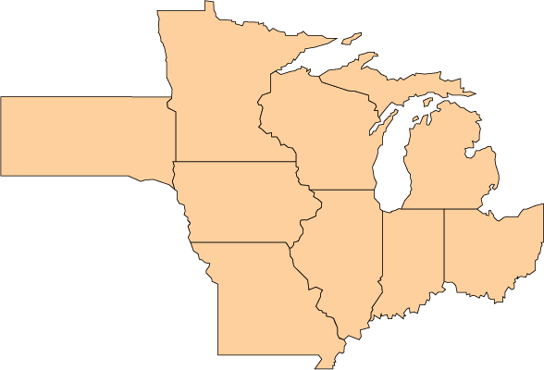

Slide 3
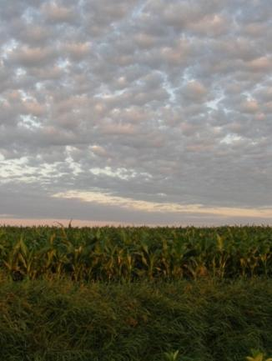
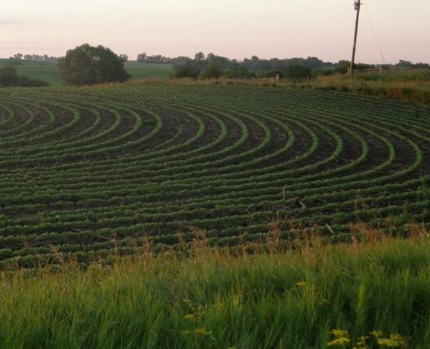
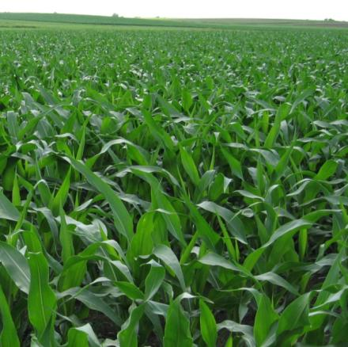
Importance of Corn
Major cereal crop in the United States
75% of world caloric intake from corn, rice, soybean and wheat
70% of U.S. corn crop produced in 9 CSCAP Midwest states

Slide 4
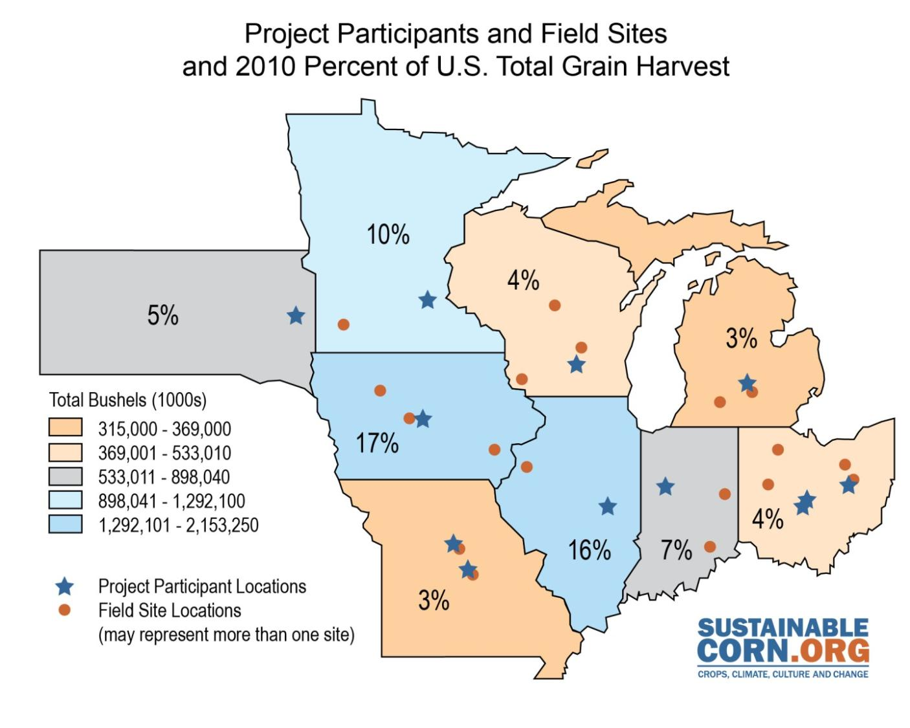

Slide 5
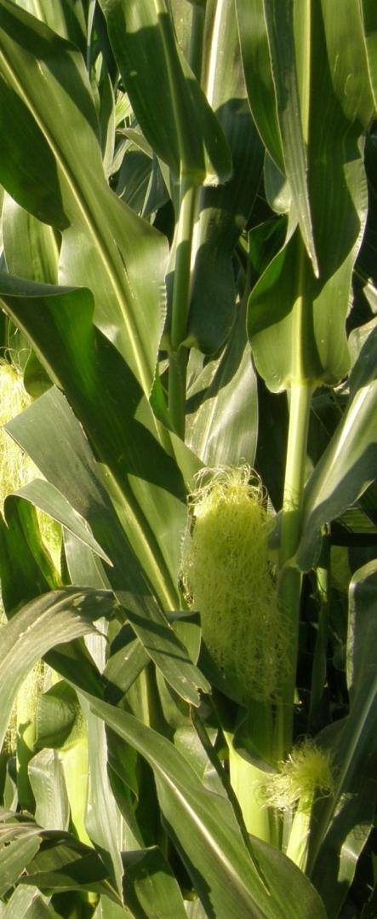
Agriculture and Climate
Climate scientists agree that long-term weather patterns will continue to change; however, there is great uncertainty and little research regarding how these global climate changes will impact local and regional cropping systems.

Slide 6
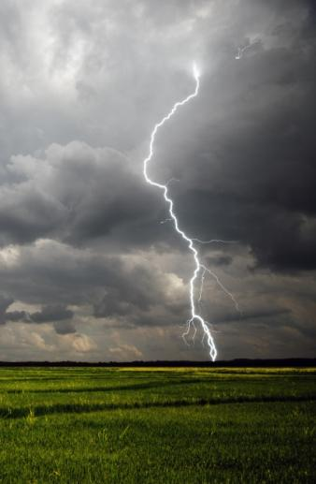
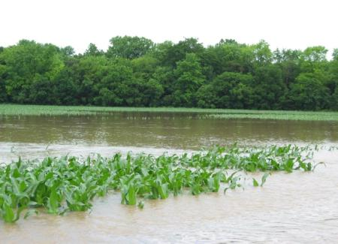
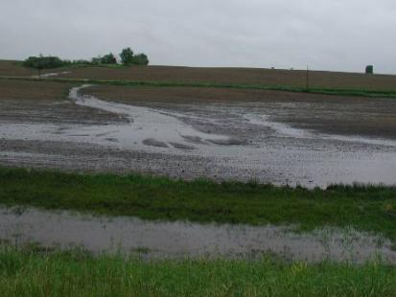
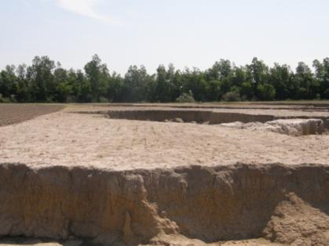
Climate and Agriculture in the Midwest
Longer growing season - shifted frost dates
Warmer winters
Warmer nights
More frequent severe precipitation events
Greater annual stream flows
Increased humidity within canopy

Slide 7
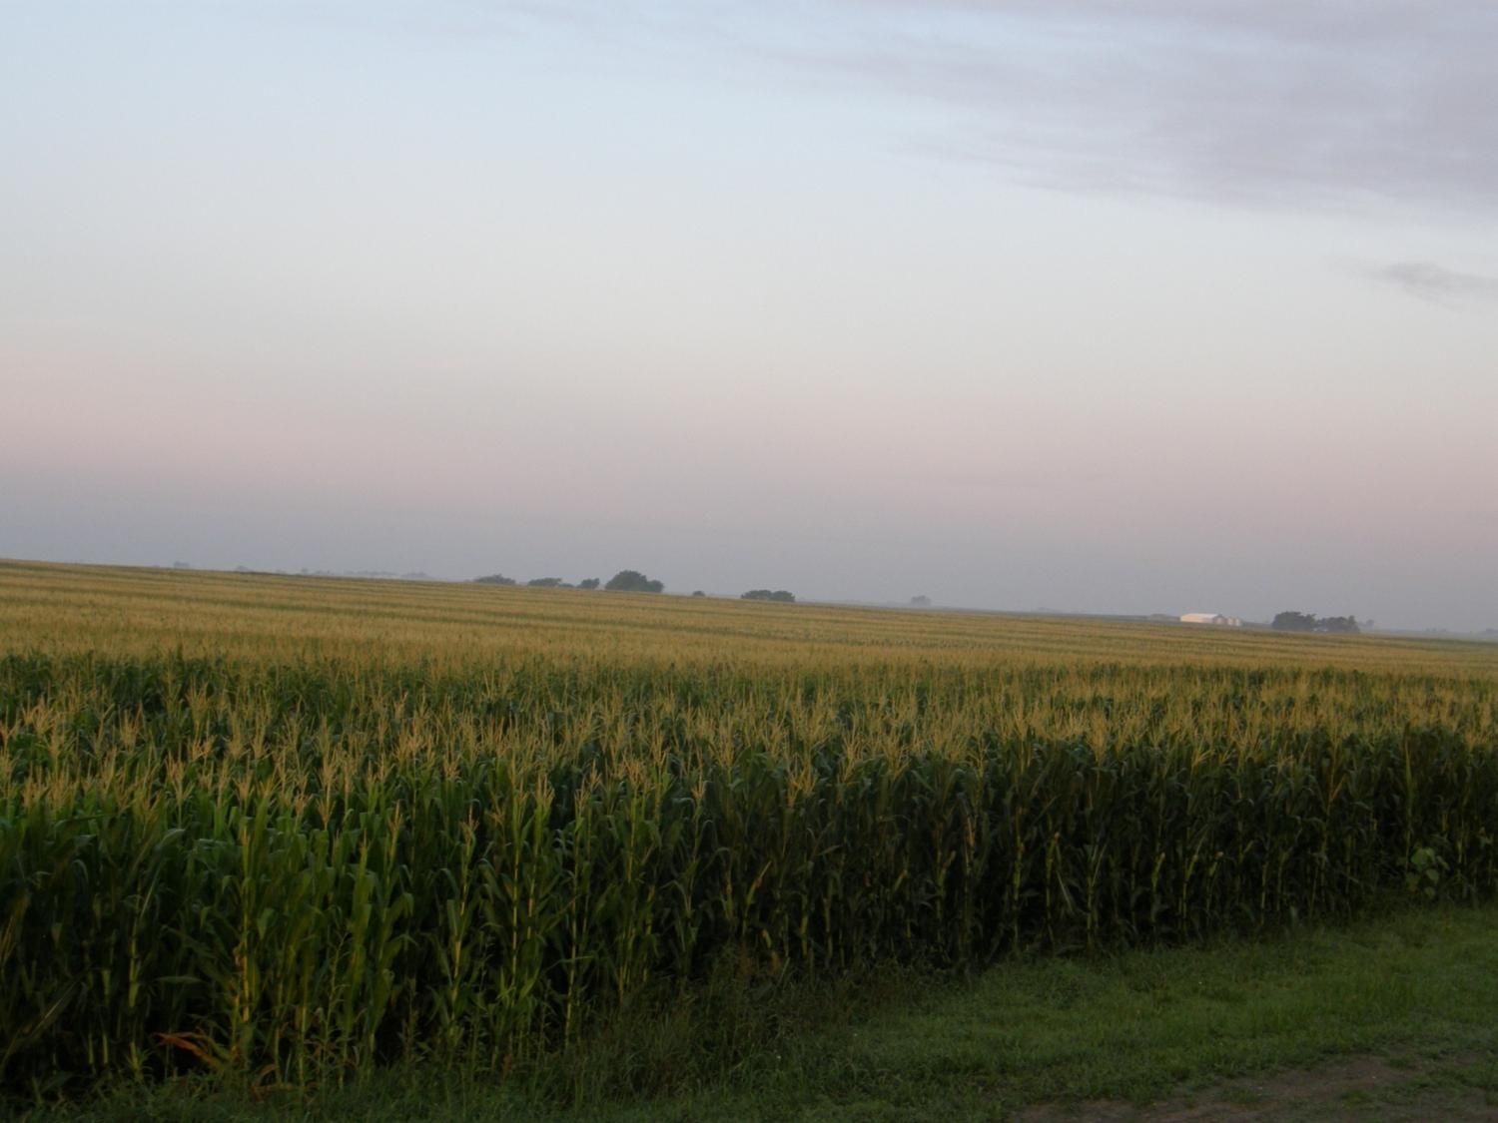
Climate & Corn-based Cropping Systems CAP Vision
To create new science and educational opportunities as a transdisciplinary team
To develop science-based knowledge that addresses climate mitigation and adaptation, informs policy development, and guides on-farm, watershed level and public decision making in corn-based cropping systems

Slide 8
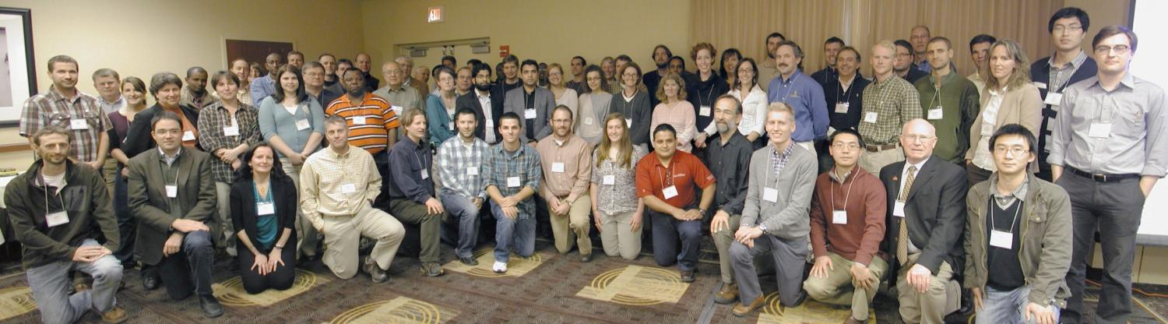
The CSCAP Team
A transdisciplinary project integrates the knowledge of many specializations to make a quantum leap beyond disciplinary sciences to create new collaborative knowledge, leading to new understanding of difficult and complex problems.
136-person team of scientists, graduate students and topic-based specialists
More than 19 disciplines
10 Land Grant Universities & USDA-ARS
35 field research sites in 8 states
20 dedicated extension educators
35 graduate students
20 advisory board members
Chicago 2011

Slide 9
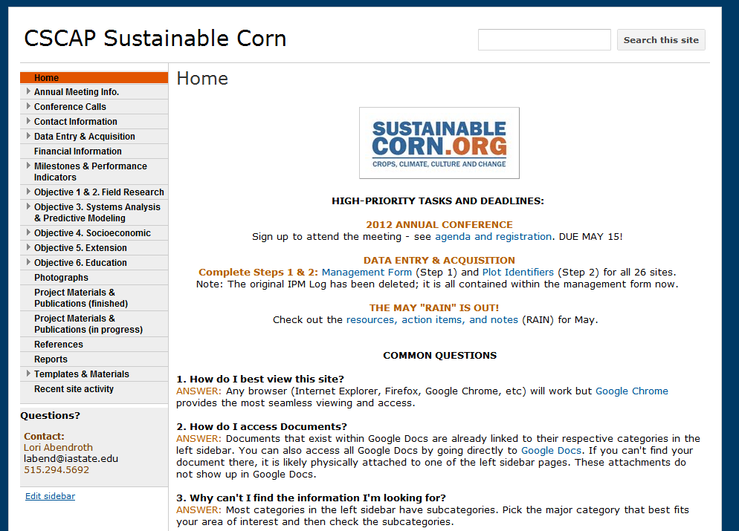
Team Management & Evaluation
CAP Collaboration
Project Management
Dianne Daley Laursen (REACCH)
Jessica Ireland (PINEMAP)
Lori Abendroth (CSCAP)
Evaluation
David Meyer (REACCH)
Wendy-Lin Bartels & Jessica Ireland (PINEMAP)
Kristi Lekies & Lori Abendroth (CSCAP)

Slide 10




Objectives
Develop standardized methodologies and perform baseline monitoring of carbon, nitrogen and water footprints at agricultural test sites across the Midwest.
Evaluate how crop management practices impact carbon, nitrogen and water footprints at test sites.
Apply models to research data and climate scenarios to identify impacts and outcomes that could affect the sustainability and economic vitality of corn-based cropping systems.
Gain knowledge of farmer beliefs and concerns about climate change, attitudes toward adaptative and mitigative strategies and practices, and decision support needs to inform the development of tools and practices that support long-term sustainability of crop production.
Promote extension, outreach and stakeholder learning and participation across all aspects of the program.
Train the next generation of scientists, develop science education curricula and promote learning opportunities for high school teachers and students.

Slide 11
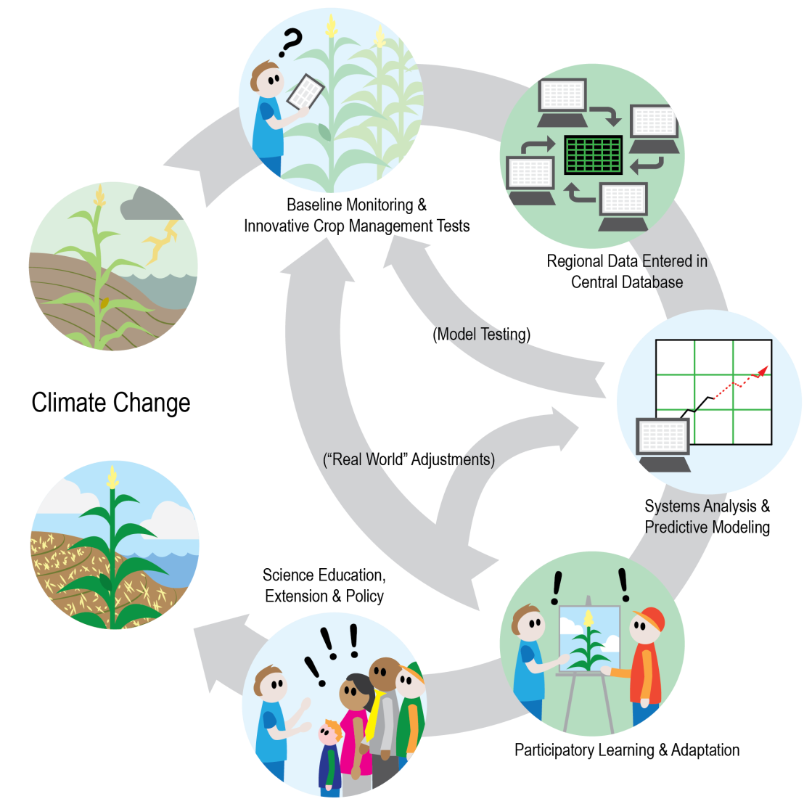

Slide 12
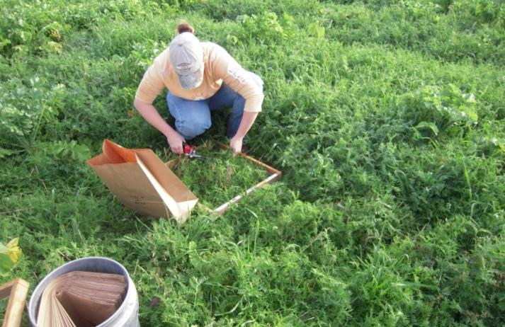
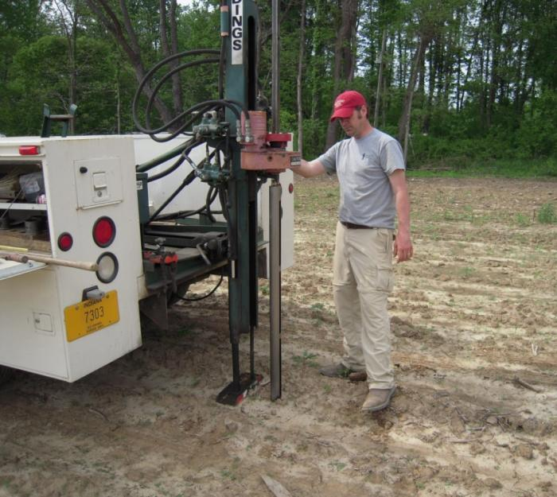
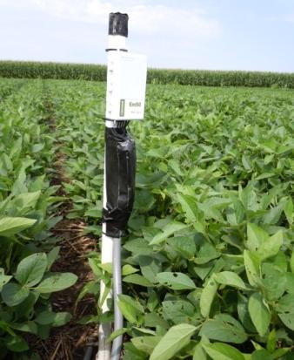
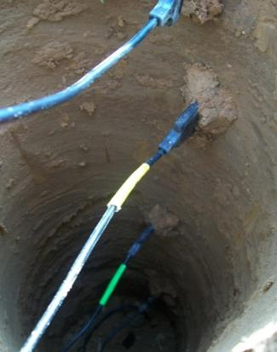
(1) Develop standardized methodologies and perform baseline monitoring of carbon, nitrogen and water footprints at agricultural test sites across the Midwest

Slide 13
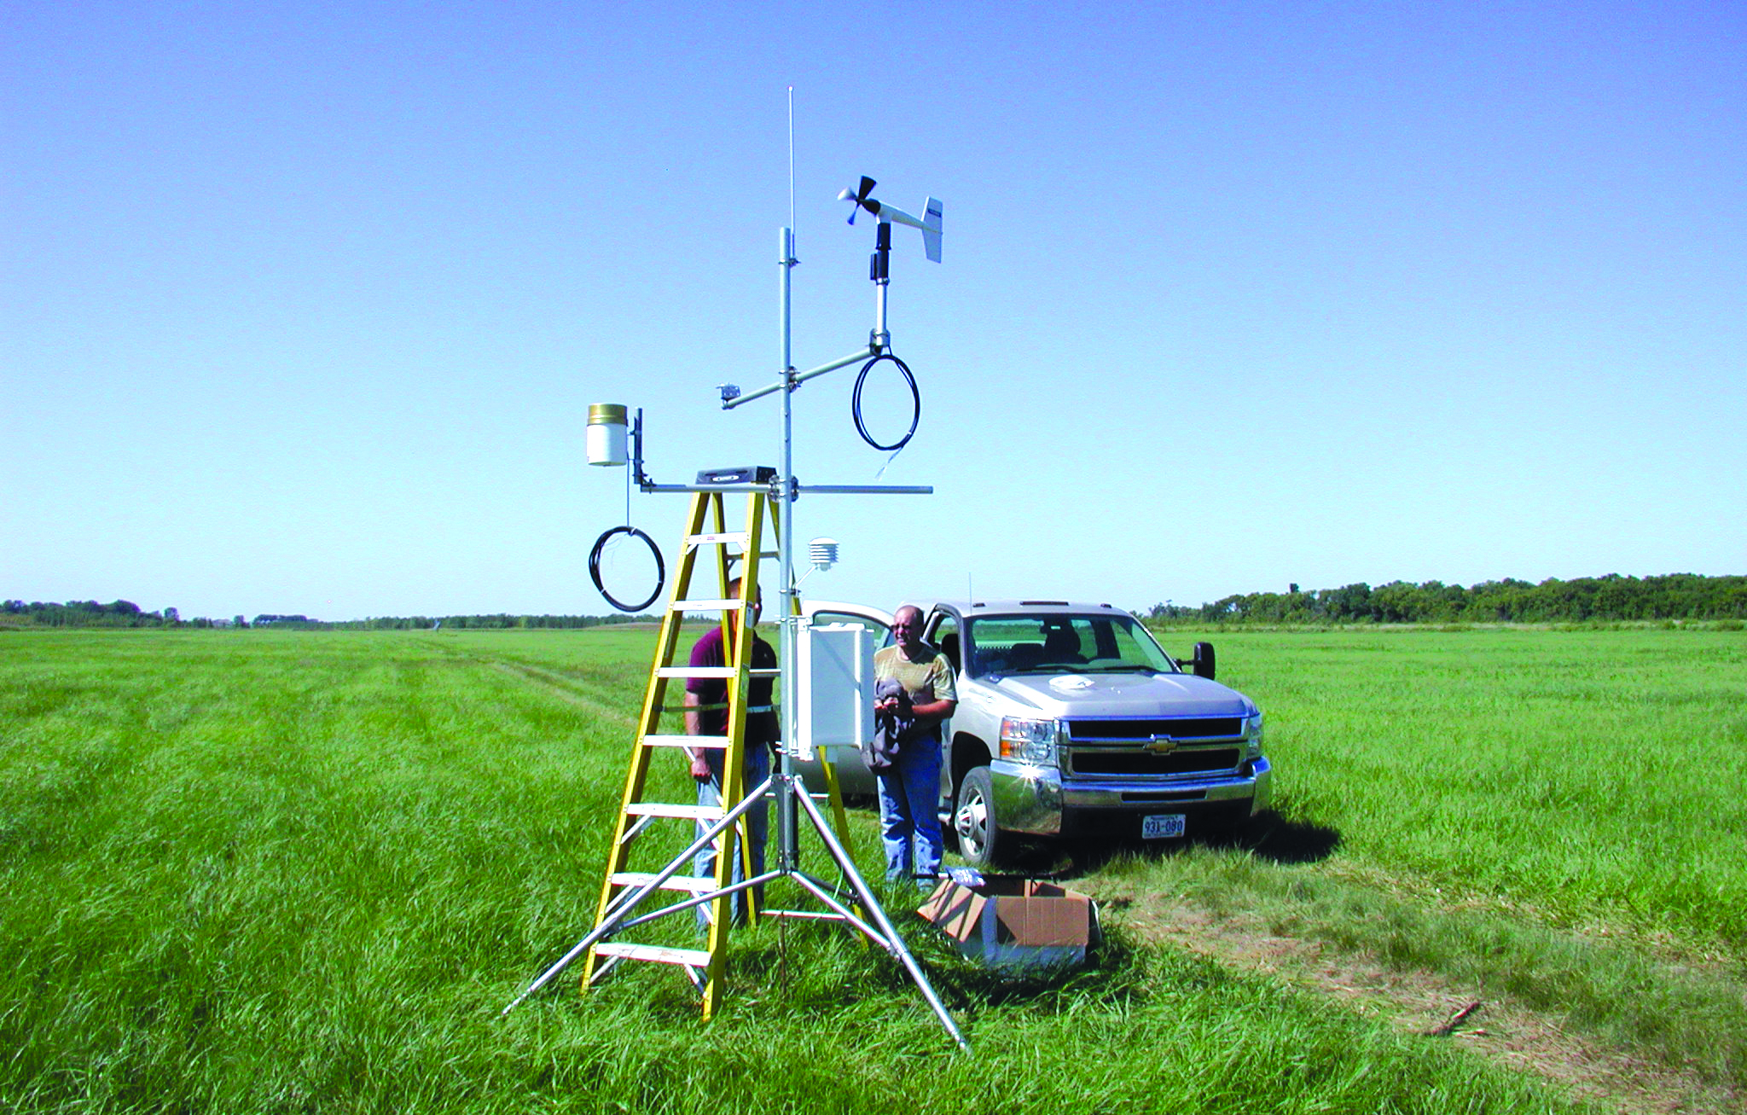
(2) Evaluate how crop management practices impact carbon, nitrogen and water footprints at test sites

Slide 14
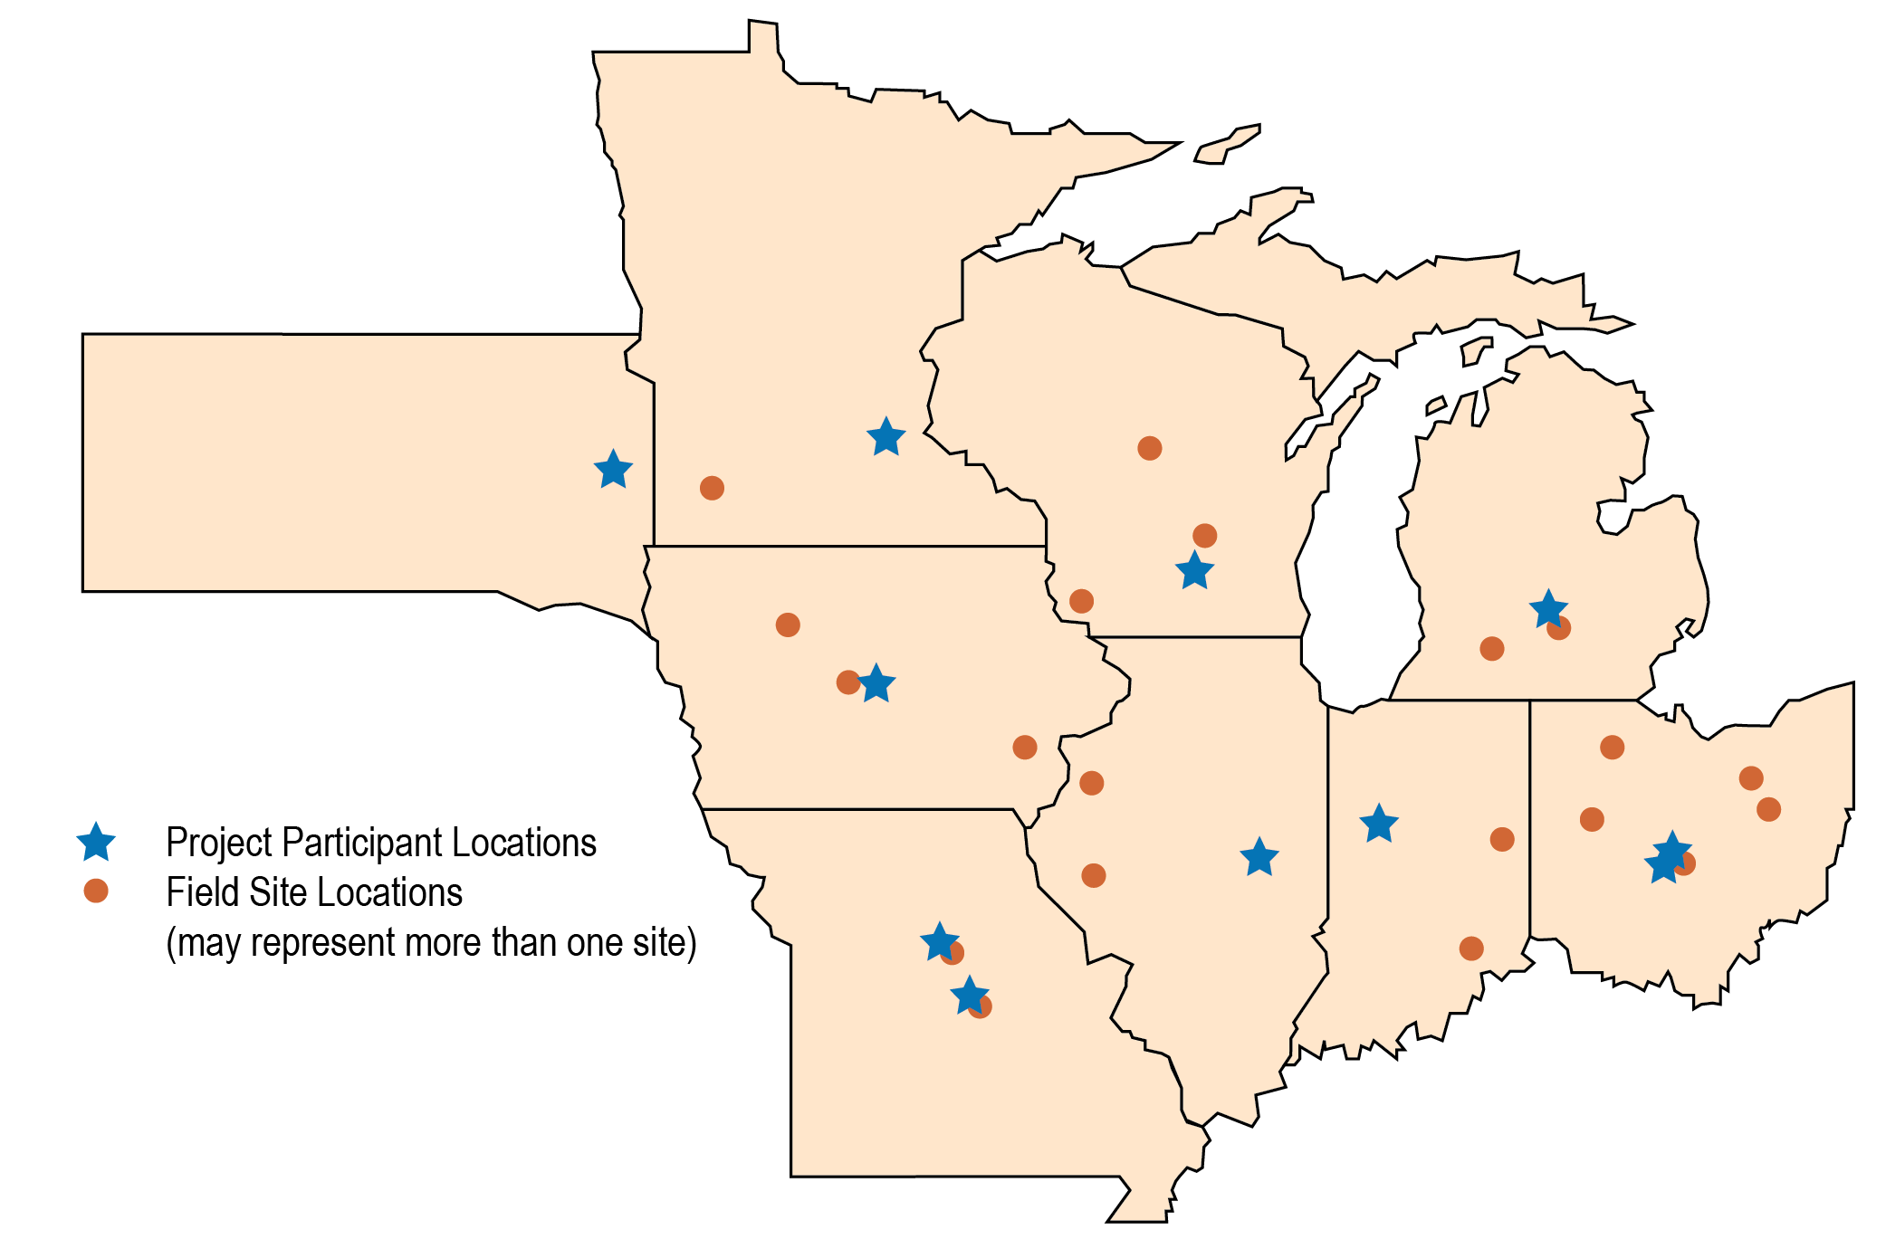
Field Research Network & Treatments
Corn-Soybean Rotation
Cover Crops within a Corn-Soybean Rotation
Extended Crop Rotations
Organic Cropping System
Drainage Water Management
Nitrogen Fertilizer Management
Tillage Management
Landscape Position

Slide 15
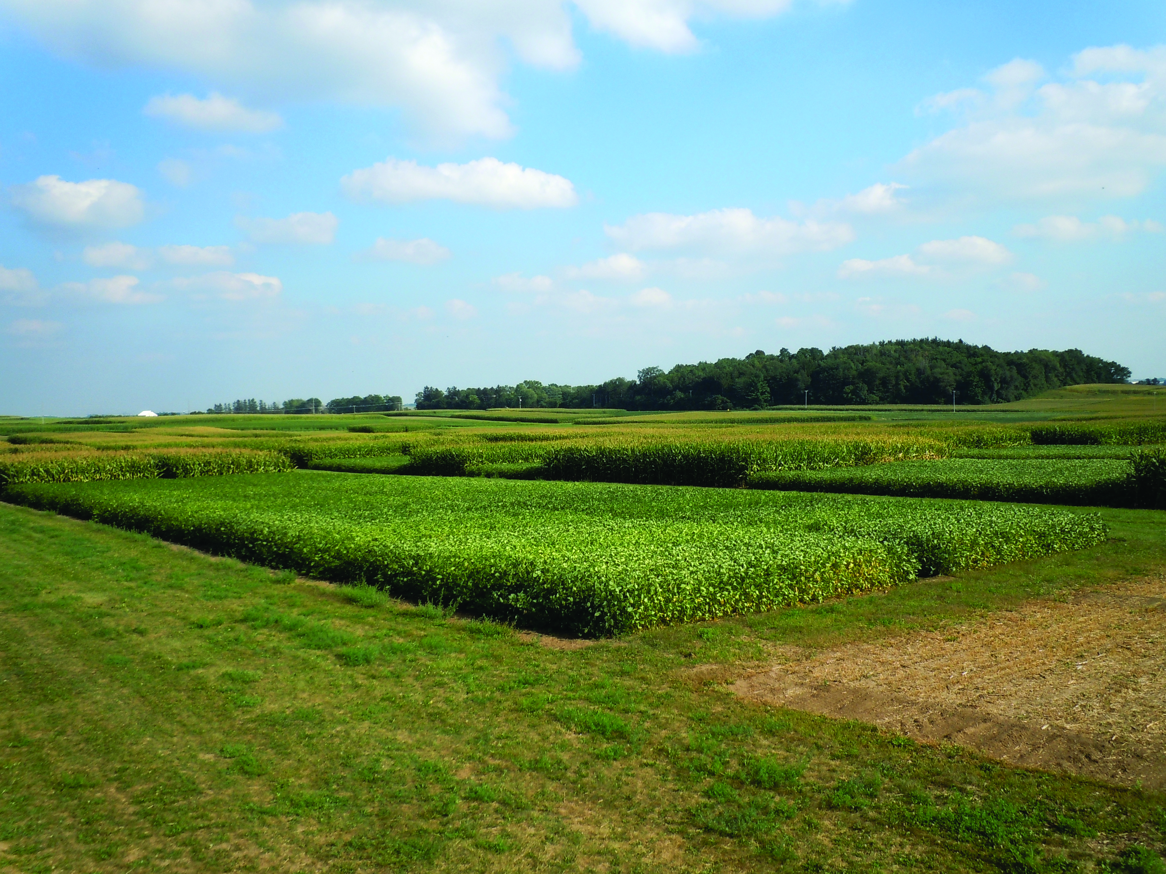

Slide 16
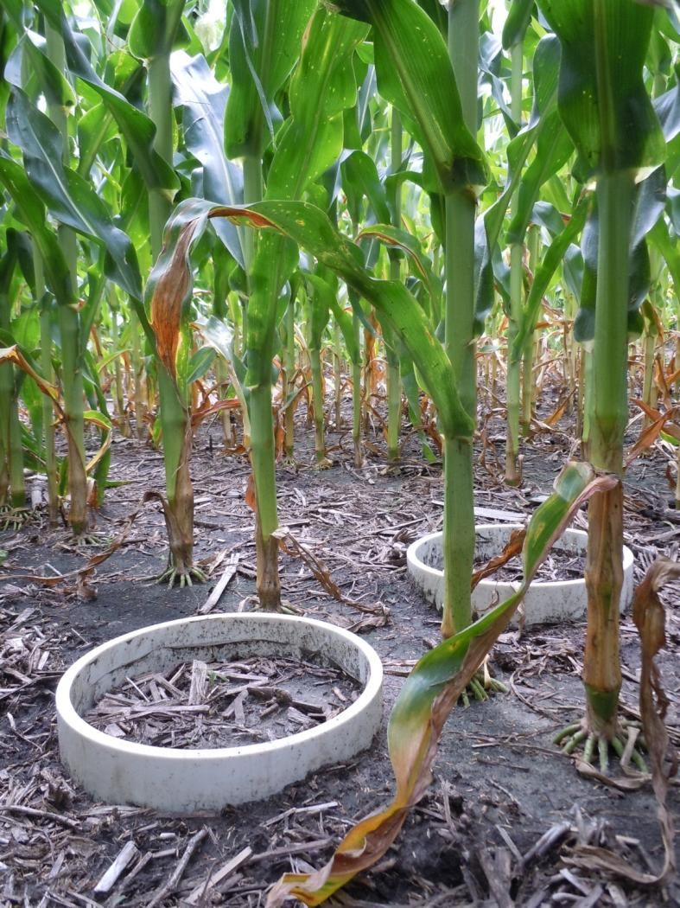
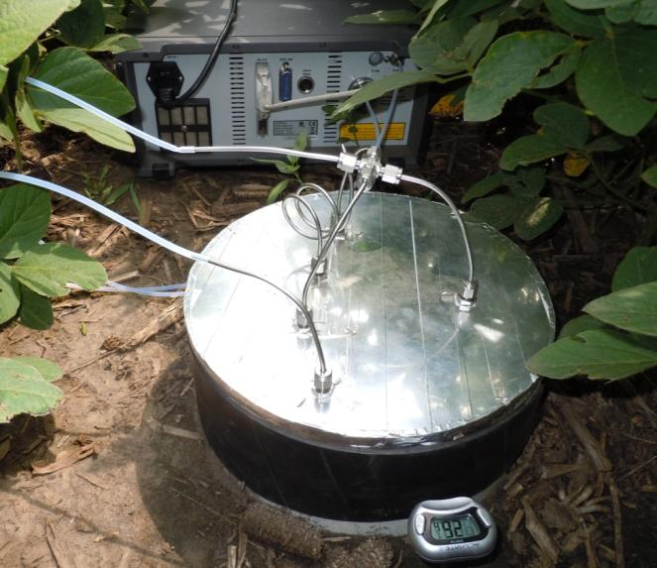

Slide 17
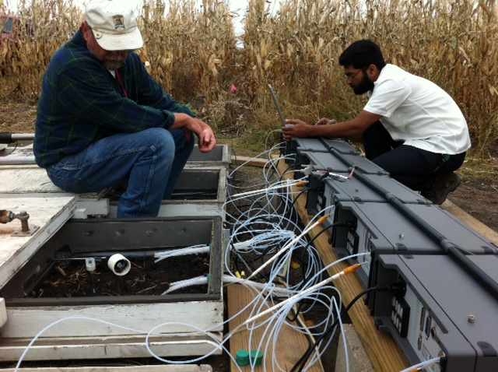

Slide 18
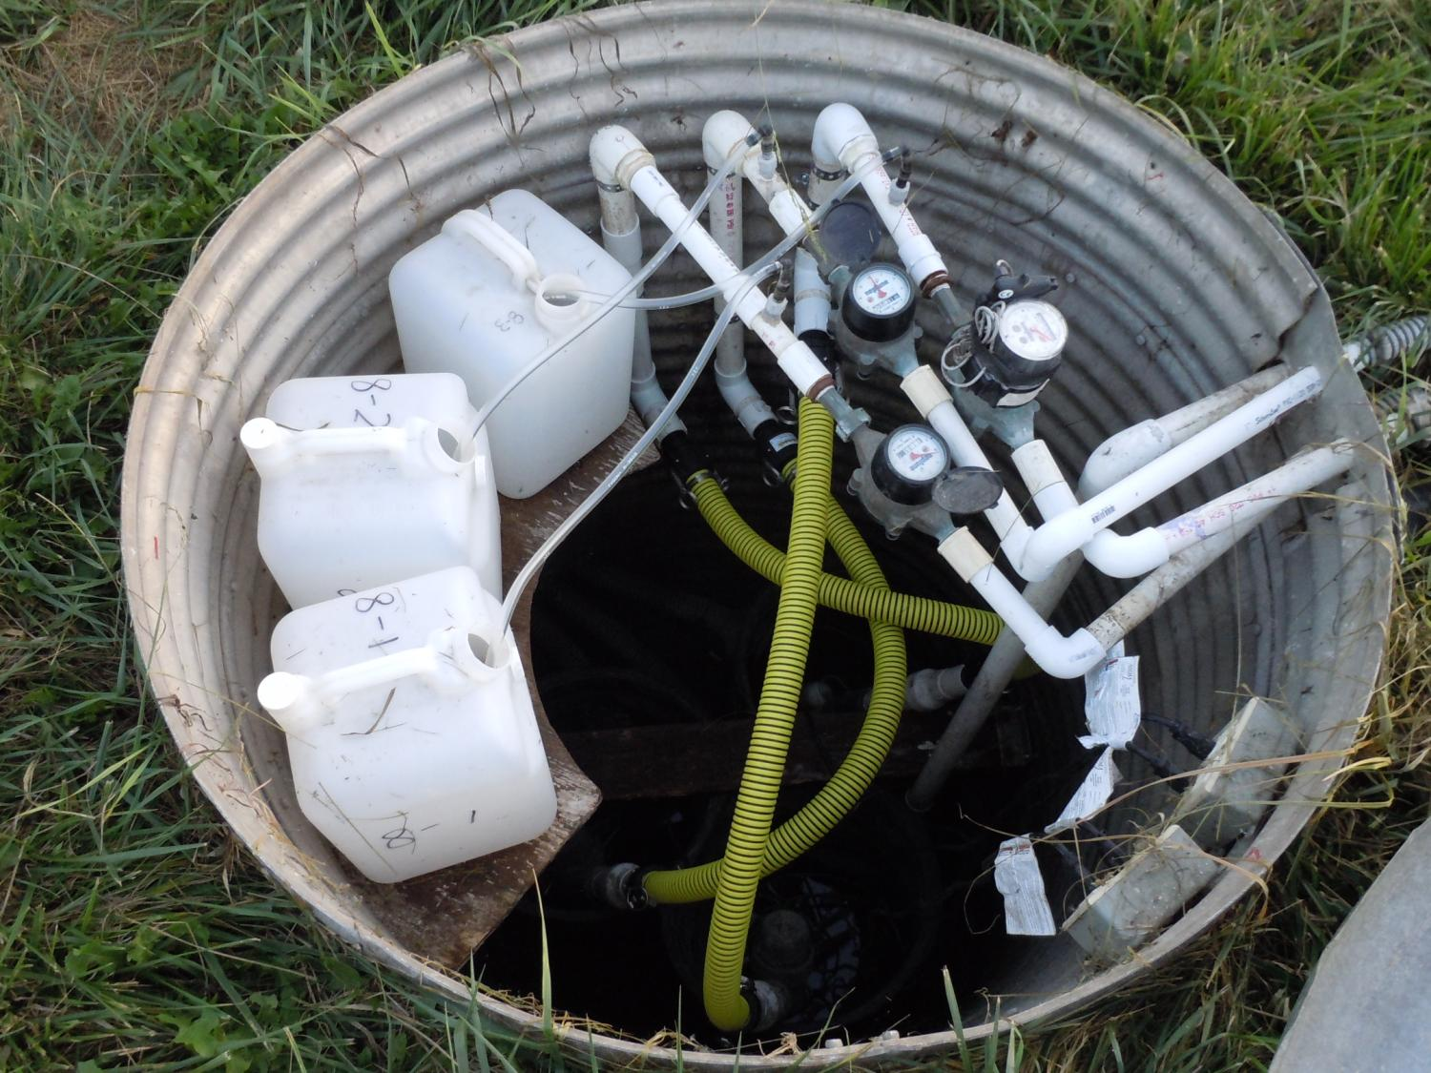

Slide 19
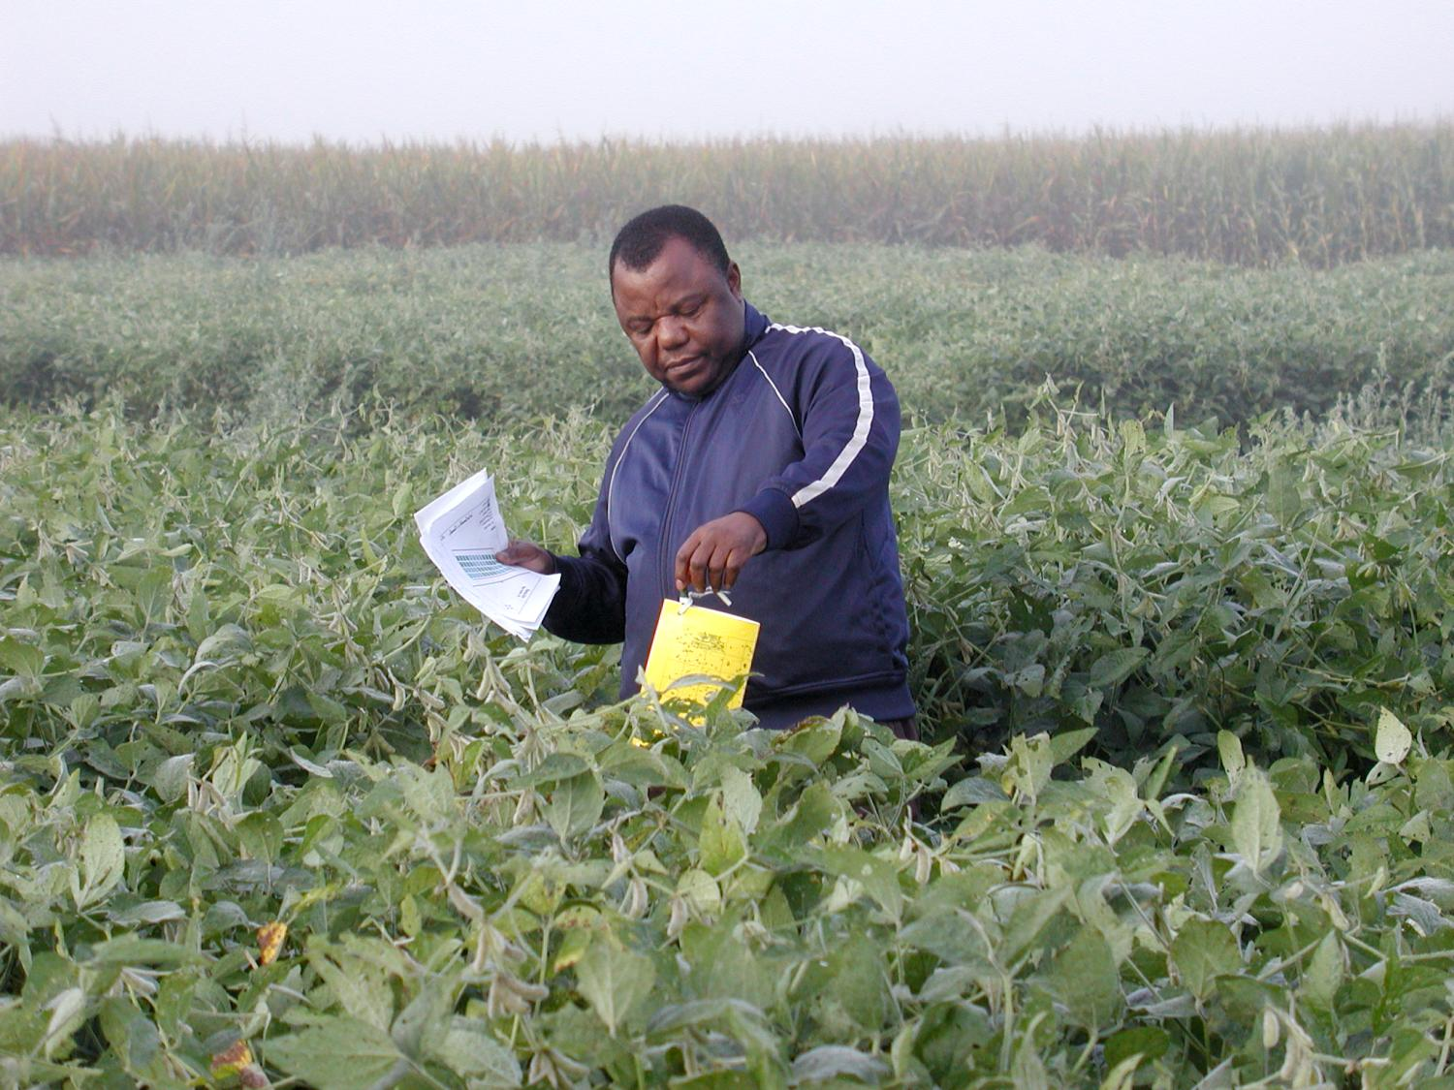

Slide 20
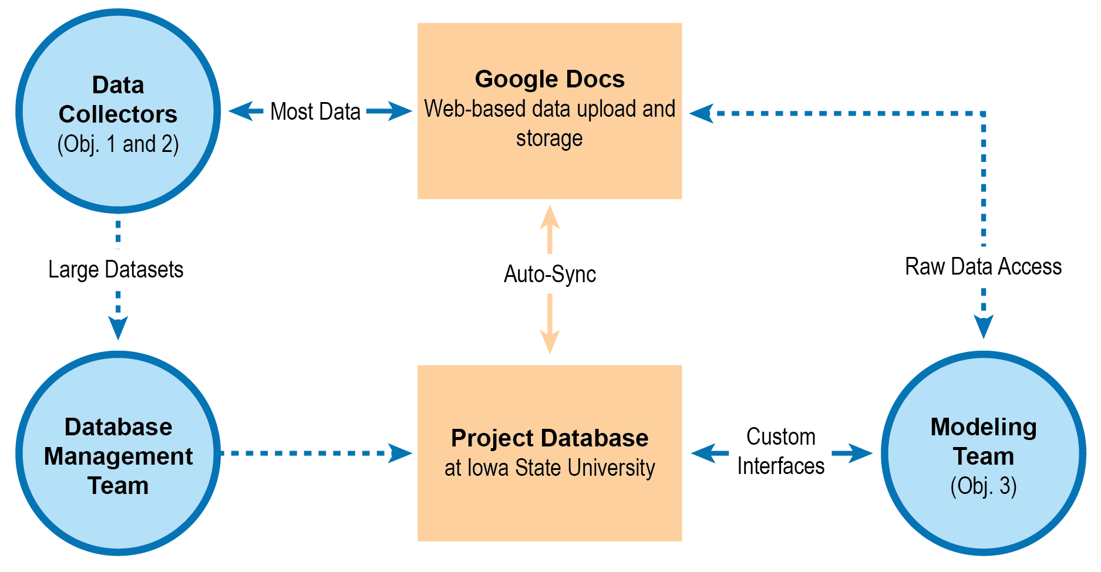
Central Database
CAP Collaboration:
Erich Seamon (REACCH)
Brandon Hoover (PINEMAP)
Daryl Herzmann & Lori Abendroth (CSCAP)
Field Research Trials
Watershed Based Survey Data
Farmer Interview Data

Slide 21
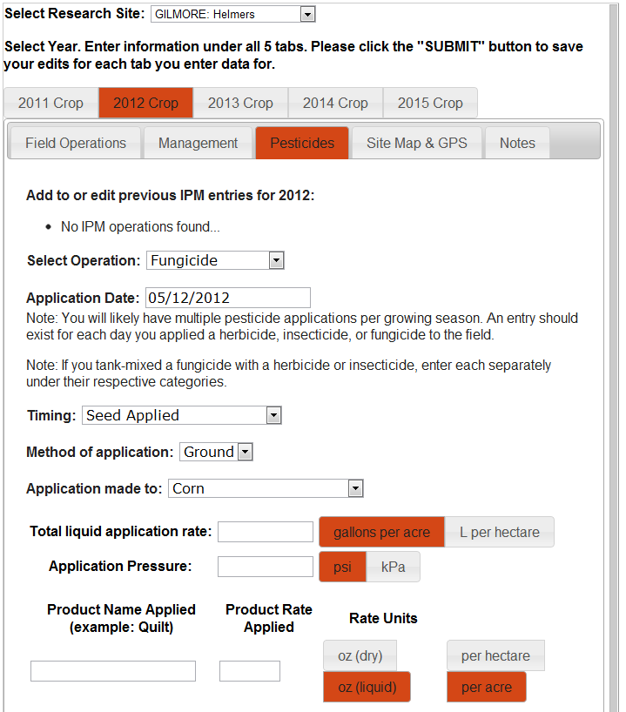
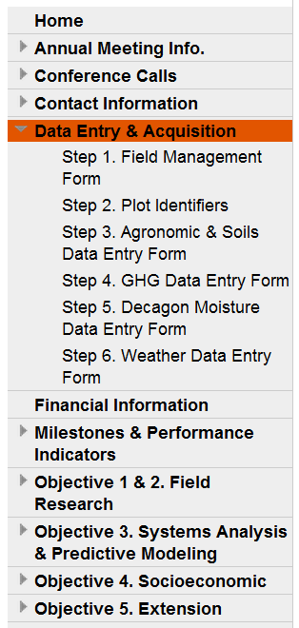

Slide 22
(3) Systems Analysis & Predictive Modeling
  Apply models to research data and climate scenarios to identify impacts and outcomes that could affect the sustainability and economic vitality of corn-based cropping systems.
  Determine the optimal targeting of cover crops, drainage management, and other conservation practices within a corn-based cropping system for a variety of possible environmental goals and under most likely future climate scenario.

Slide 23
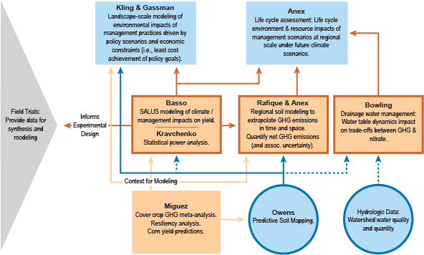
(3) Systems Analysis & Predictive Modeling

Slide 24
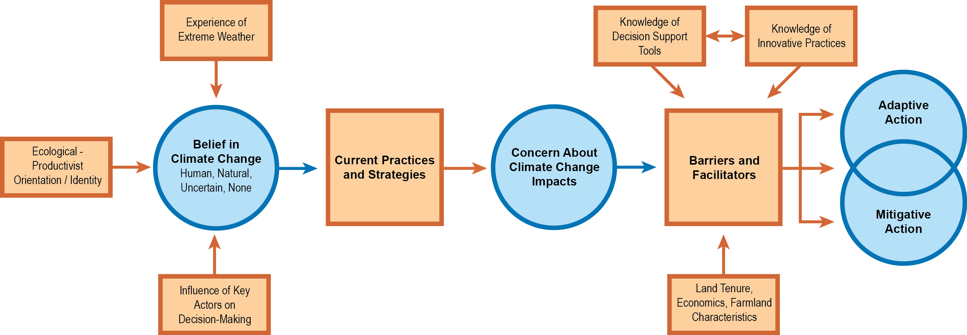
(4) Social & Economic Flowchart

Slide 25
(4) Social & Economic Research
Gain knowledge of farmer beliefs and concerns about climate change, attitudes toward adaptative and mitigative strategies and practices, and decision support needs to inform the development of tools and practices that support long-term sustainability of crop production.
Survey of nearly 20,000 farmers in top 22 corn-producing HUC6 watersheds in the upper Midwest.
Co-produced by CSCAP and U2U project

Slide 26
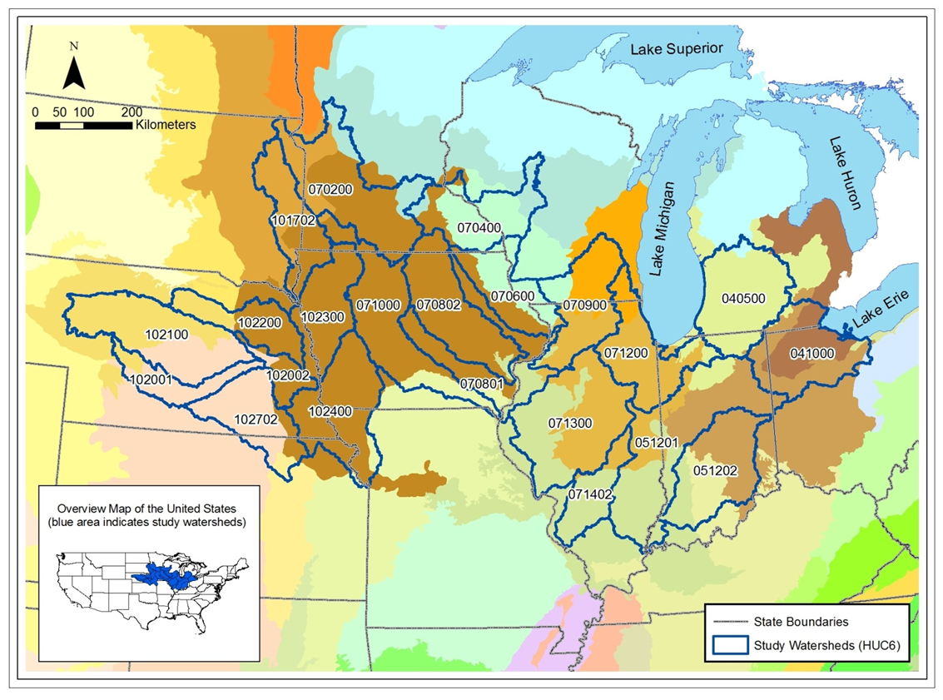

Slide 27
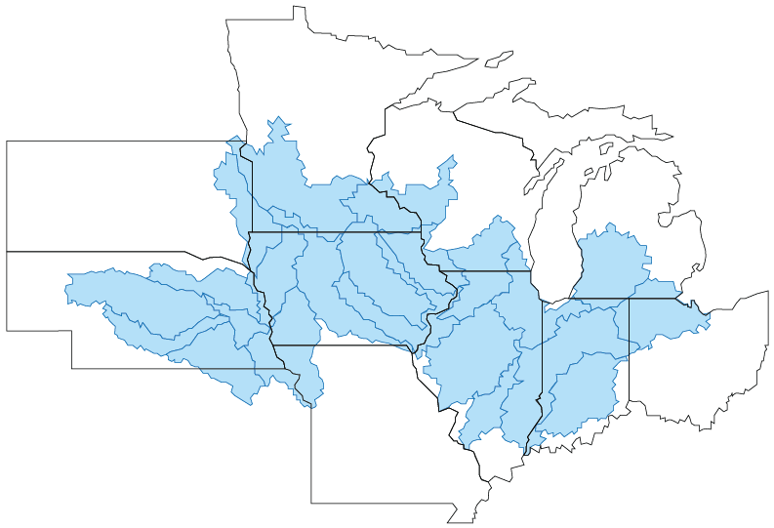

Slide 28
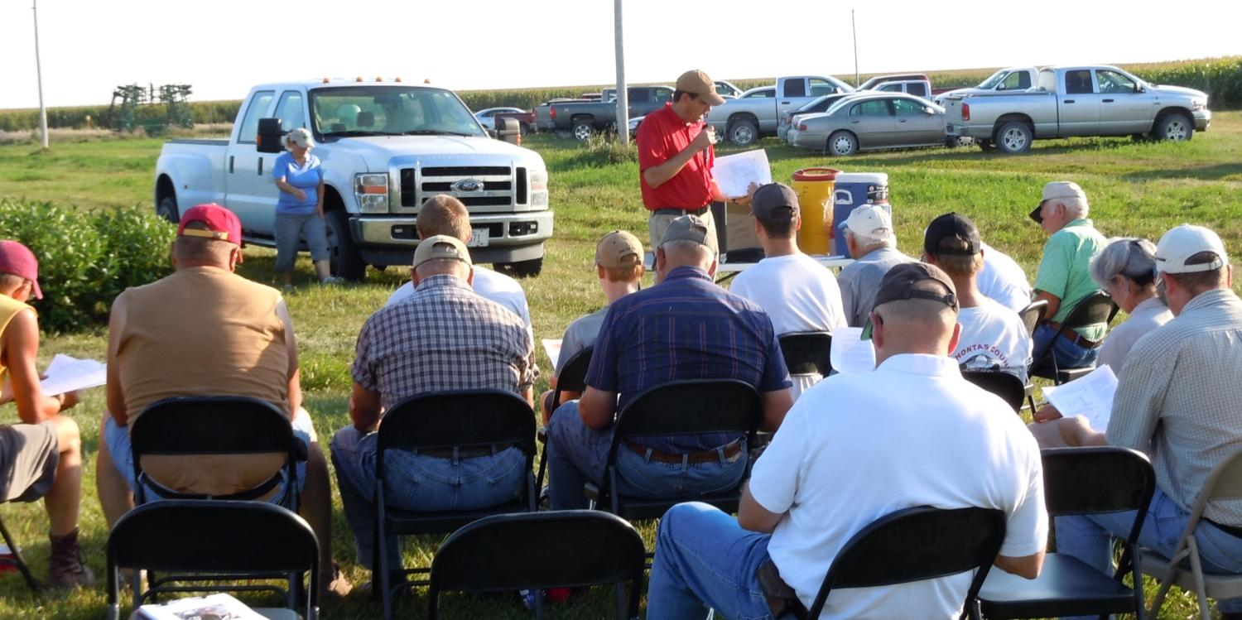
(5) Extension: Promote extension, outreach and stakeholder learning and participation across all aspects of the program

Slide 29
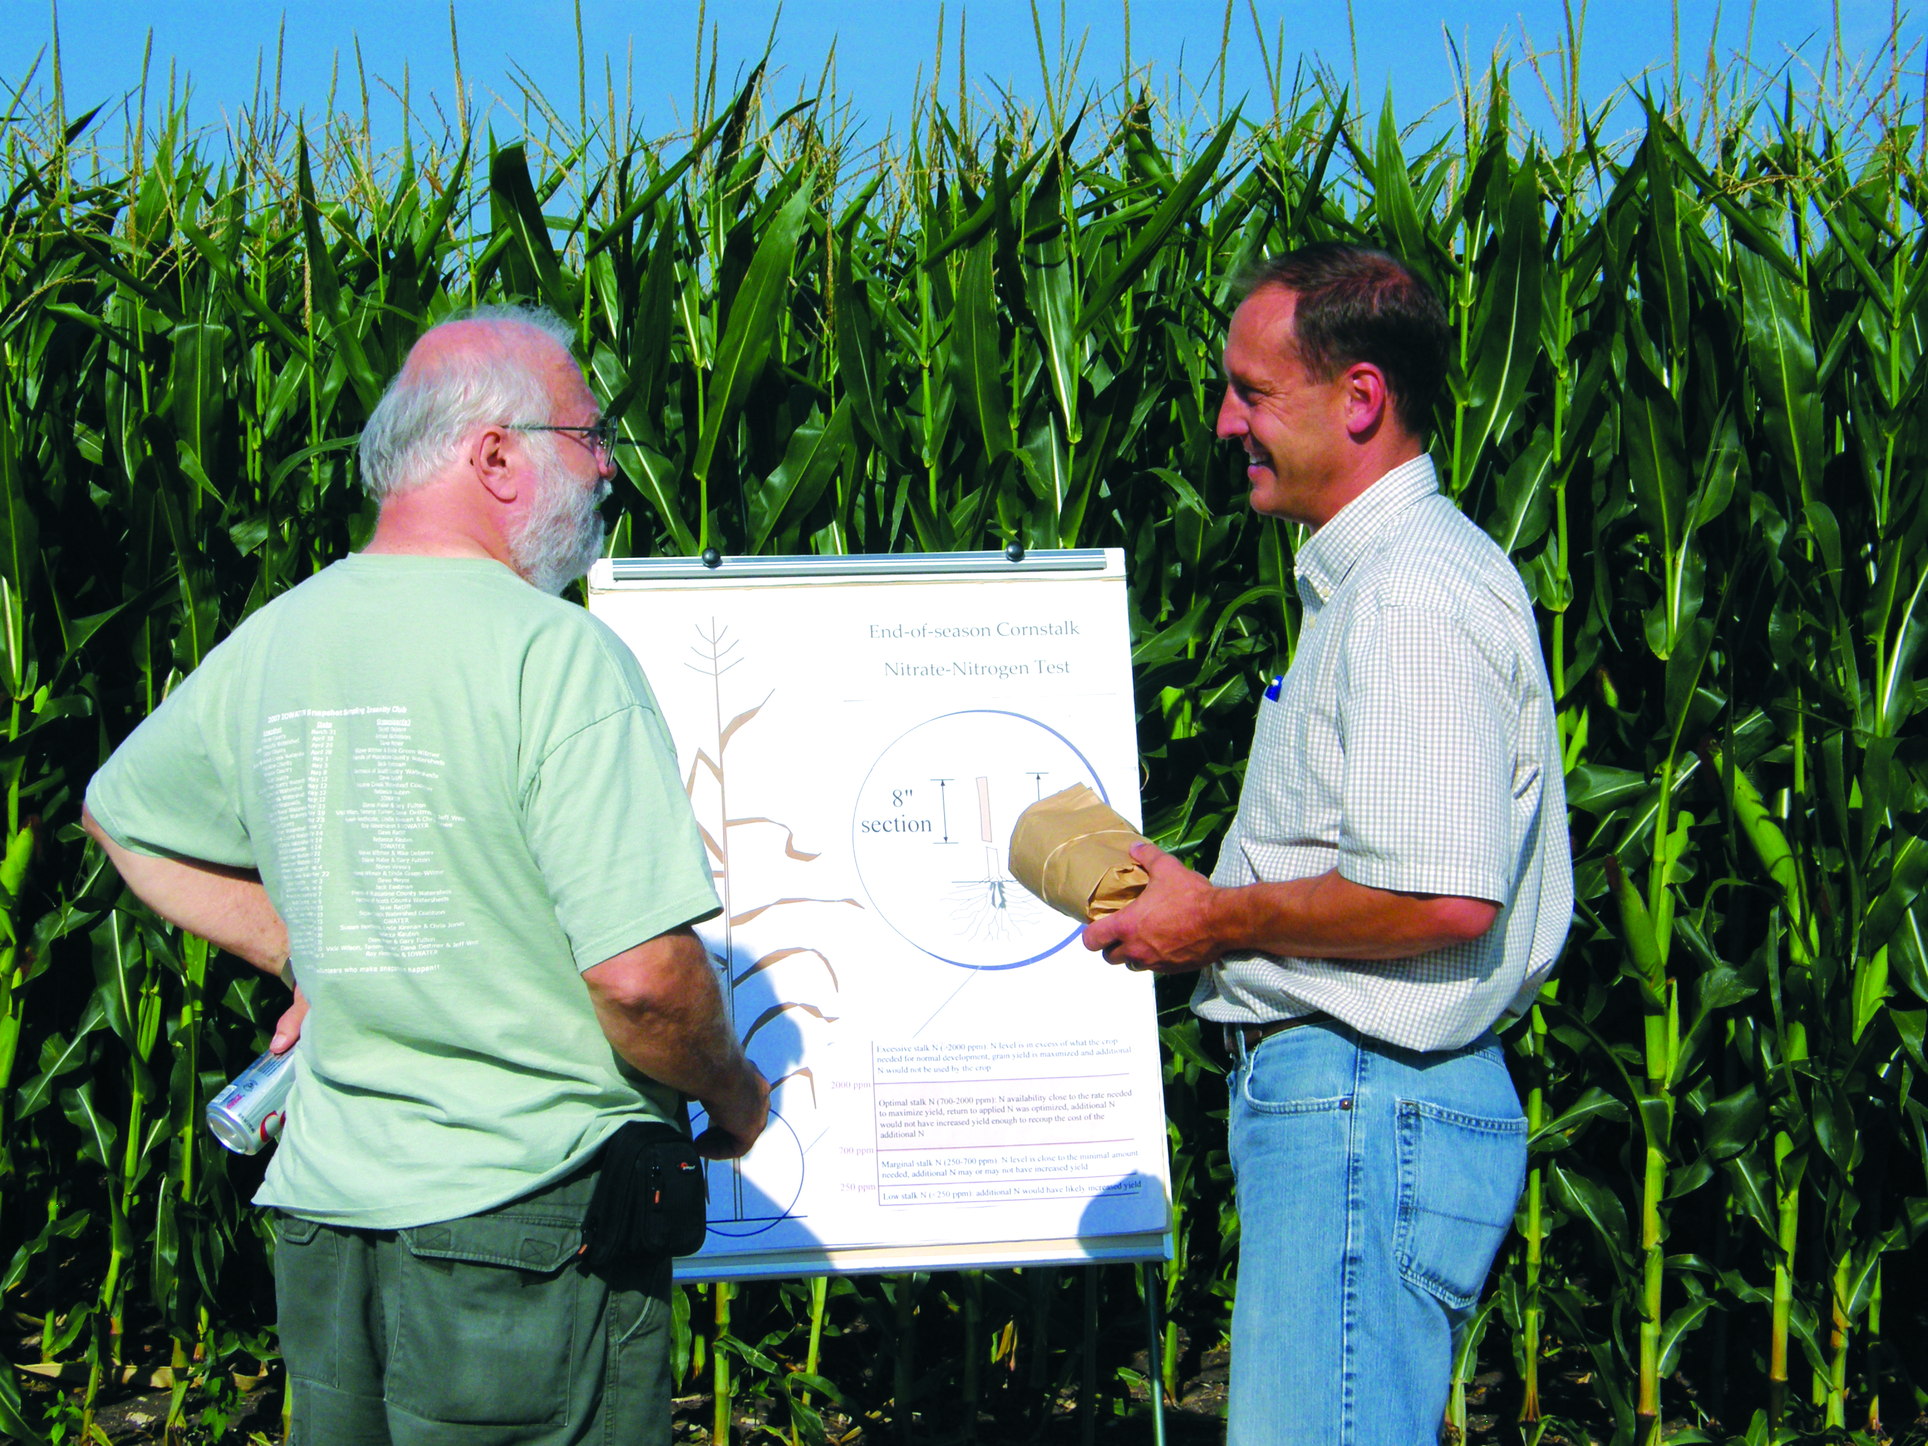

Slide 30
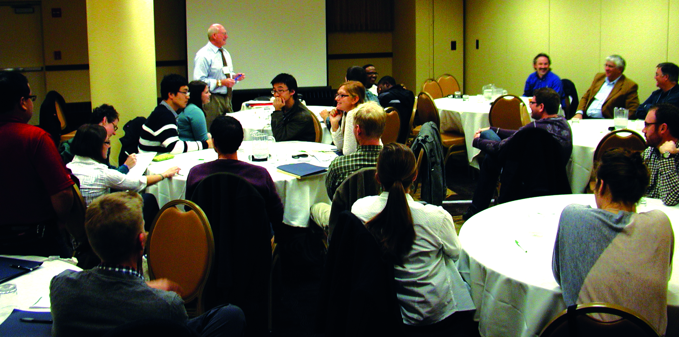
(6) Education: Train the next generation of scientists, develop science education curricula & promote learning opportunities for HS teachers & students

Slide 31
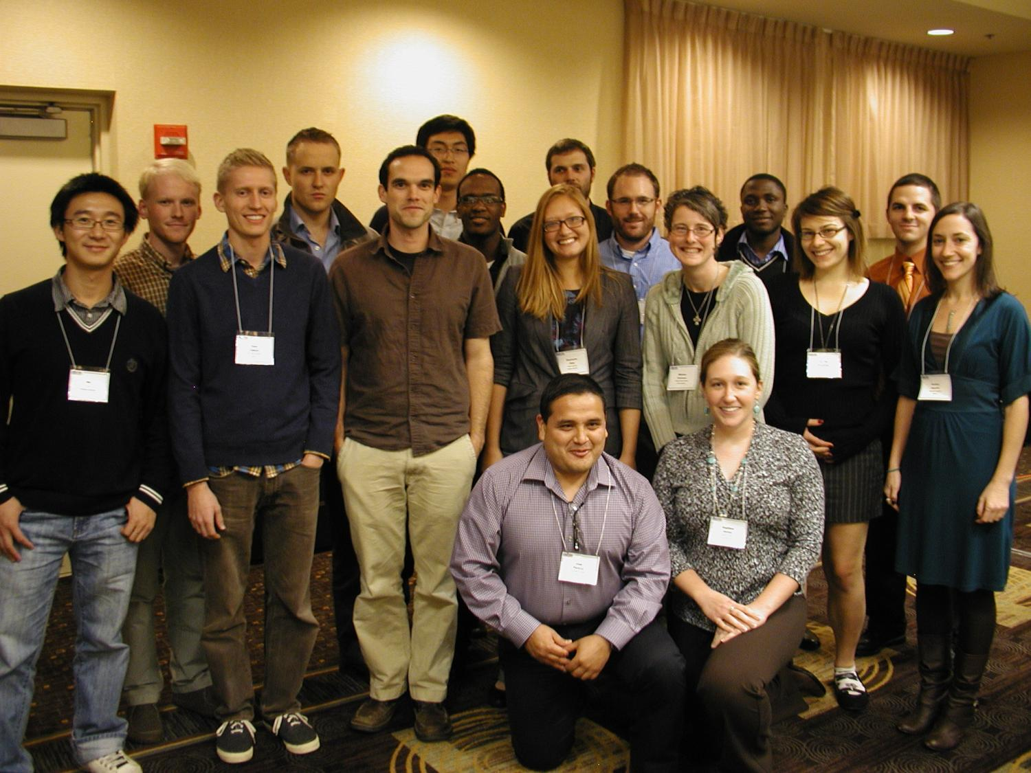

Slide 32
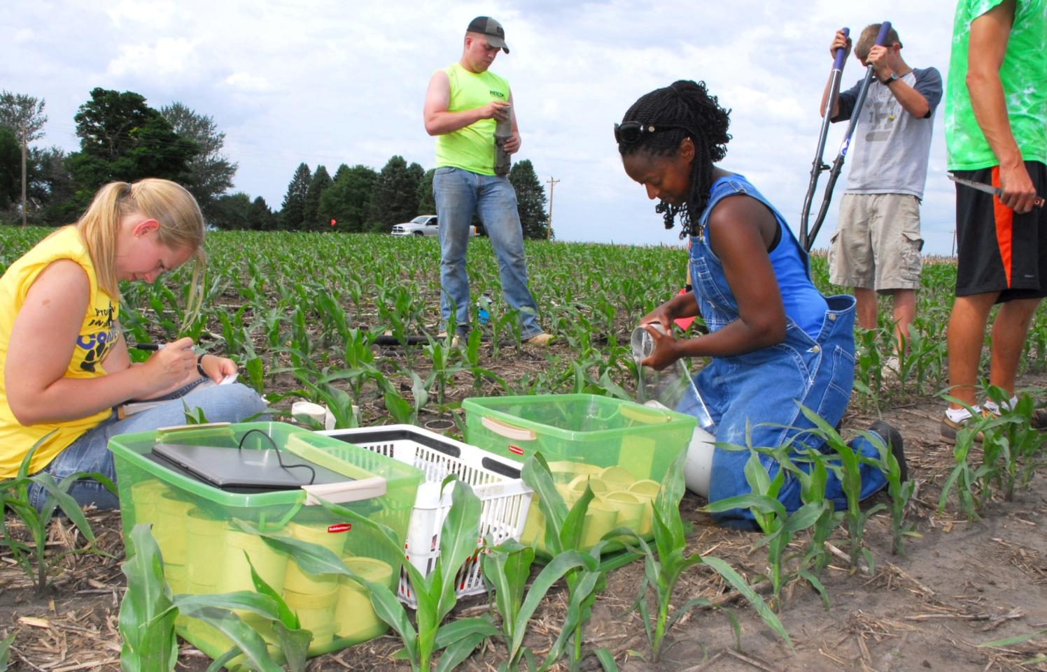
Undergraduate & Graduate Students

Slide 33
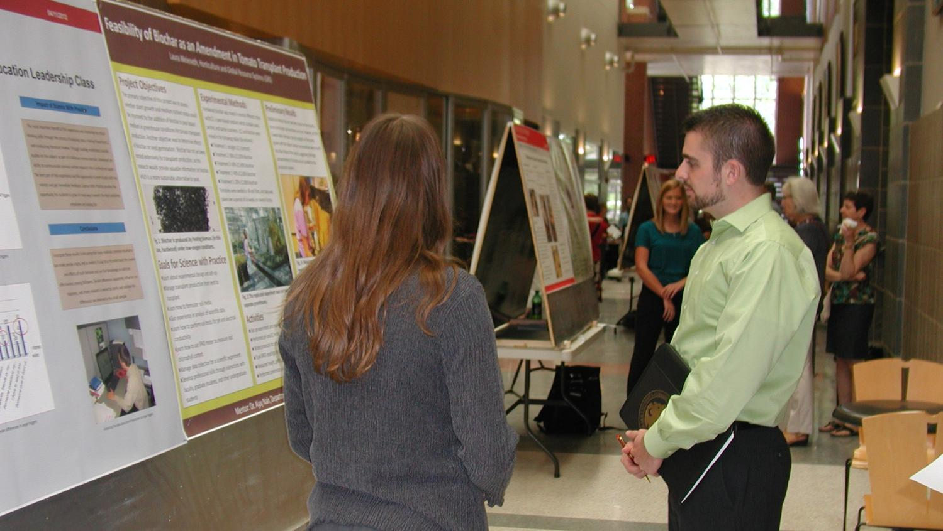
Undergraduate Students

Slide 34
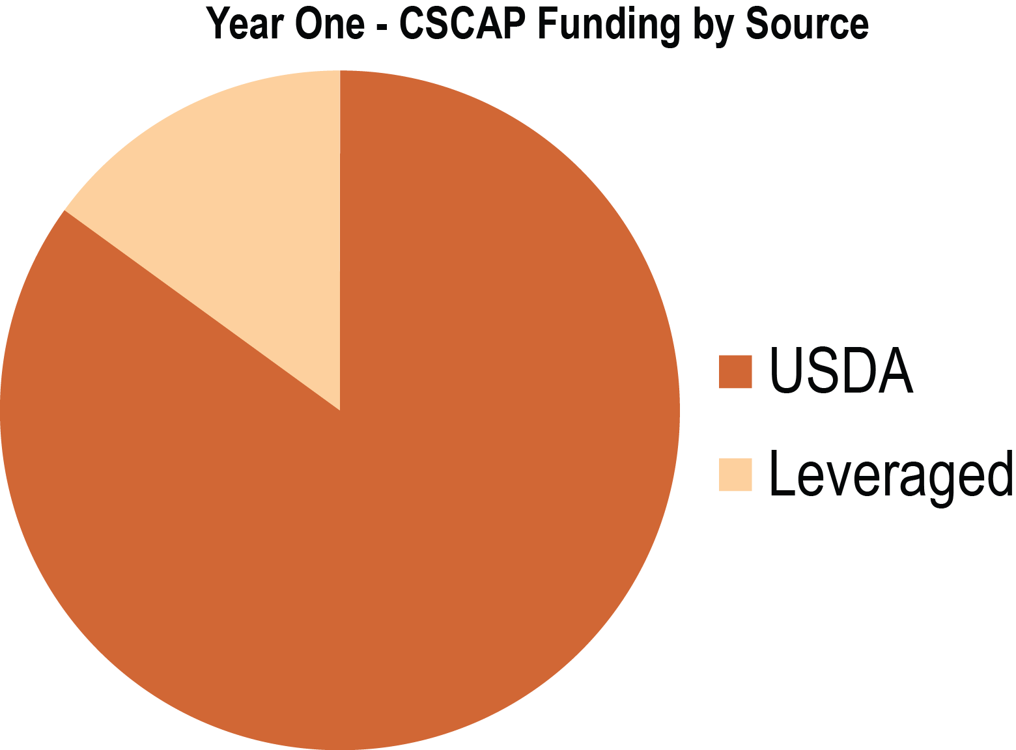
Leveraged Resources in Year One
$731,685 total in additional funds
Iowa NRCS $17,000
Iowa State Experiment Station $17,200
Purdue Agriculture $17,200
United Soybean Board $80,285
Supplemental institutional support more than $600,000

Slide 35
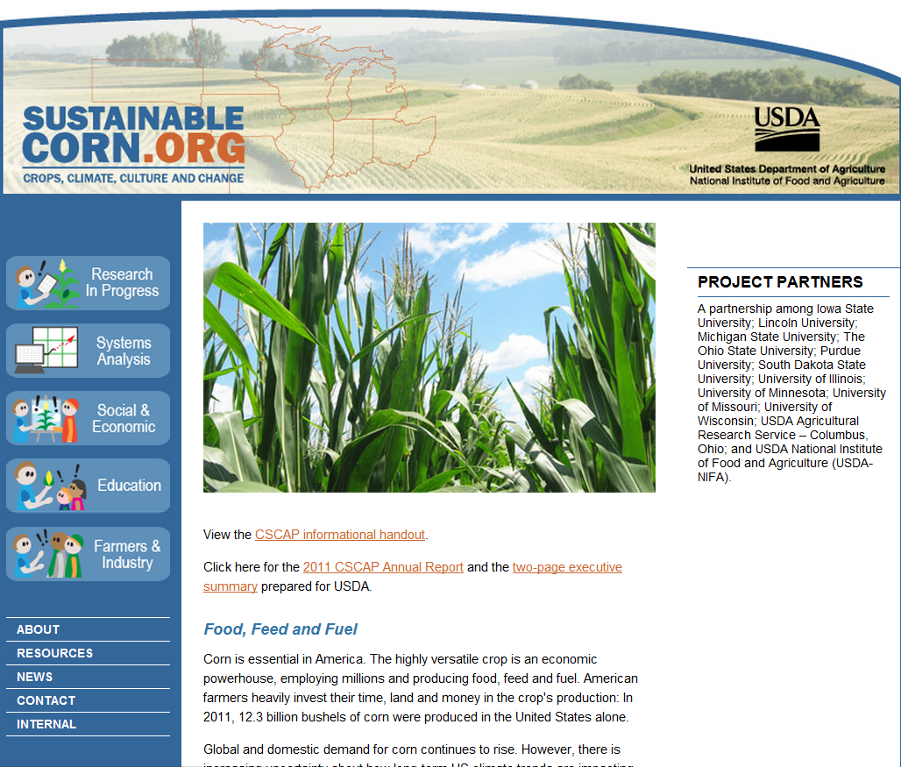
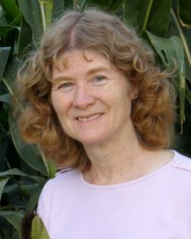
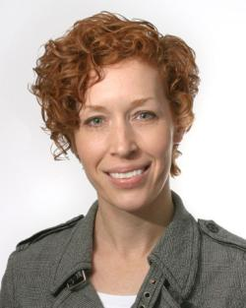
Thank You! Questions?
Lois Wright Morton
Project Director
515.294.2843 | lwmorton@iastate.edu
Lori Abendroth
Project Manager
515.294.5692 | labend@iastate.edu

