Slide 1

Clearing the Air
Examining the evidence
of climate change

Slide 2
You may have heard statements like…
“Most climate scientists agree.”
“Most scientists don’t agree.”
“Since we can’t predict the weather next week, we can’t know it will be warmer in 100 years.”
“Carbon is natural – what’s the problem?”
“Sea level has already risen and will continue in this century.”

Slide 3
Beliefs and Science
People believe many things to be true
  Beliefs are ideas for which we think are true
  They may be based on evidence, faith, or worldviews
Assumptions are underlying ideas, principles
  Used to connect evidence to conclusions
  May or may not be reasonable
Science is a process of understanding the natural world
  Helps us understand what is happening with evidence
  Assumptions are stated, tested, and reviewed
Notes:
This presentation will focus on the science, the interpretations of it, and what it means.
You can believe what you wish, but for today, understand the science.

Slide 4
Language of Science
Data: Observations and measurements, collected through standard methods
Evidence: Interpreted data that supports or challenges a scientific idea.
Theory: Well-established explanation for how or why a phenomenon happens
  Strongly supported by many different lines of evidence
Uncertainty: The range of values within which the true value is likely to fall.
  All measurements have some degree of uncertainty
  Doesn’t mean “unsure”
Notes:
Other definitions we may need / want:
Hypotheses: Proposed explanations for a narrow set of phenomena, based on prior experience, scientific background knowledge, preliminary observations, and logic.
Fact: Relatively simple statements known to be true. Facts stand the test of time and are found to be true in any context. Most used in common language, not science.
Uncertainty:
The nature of science
Science requires testing and retesting for accuracy
Without uncertainty and skepticism results would never be improved
Repeated experimentation makes observations become theories and theories become laws
Science is repeated, verified and confirmed by scientists in order to improve the evidence that supports a scientific hypothesis
Sources:
“Misconceptions about science, Vocabulary mix-ups.” Understanding Science. University of California Museum of Paleontology. http://undsci.berkeley.edu/teaching/misconceptions.php#a7
Michaels, Sarah, Shouse, Andrew W., and Schweingrube, Heidi A. 2007. Ready, Set, SCIENCE!: Putting Research to Work in K-8 Science Classrooms. National Research Council.
The National Academies Press
Schartz, Renee. 2007. What’s in a Word: How Word Choice Can Develop (Mis)conceptions About the Nature of Science. Science Scope, Vol. 31, No. 2, October 2007. http://undsci.berkeley.edu/teaching/schwartz_reprint.pdf

Slide 5
Weather
What we see or feel outside right now
Daily changes of temperature, rainfall, humidity, wind, and clouds.
Ranges from a few days to a few weeks
Example: today is sunny; the high temperature yesterday was 78F
Notes:
Weather and climate are two different things though they are based on similar variables.
A hot summer with no rain does not mean climate change.
A warm winter with little snow does not mean global warming.
A trend of hot summers or warm winters, however, over at least 10 years, suggests that climate is changing.

Slide 6
Weather Forecasting
Weather models take into account:
  Atmospheric processes
  Land surface
  Nearby oceans
Weather forecasting accuracy decreases over a few days
Tomorrow’s high temperature is weather forecasting
Notes:
Weather forecasting is what we see on the news. It is a short term projection of what will happen in the next few days to few weeks. Temperature, amount of clouds, humidity. But these factors are not projected for long periods of time.
Its accuracy has been improved over the years due to more satellites, more data and more knowledge of how meteorology works.

Slide 7
Climate
The long term averages and trends of weather patterns over a given period of time at a given location.
Climate changes cannot be seen annually.
Ranges from a few years, to centuries
Example: Normal monthly precipitation (30 yr average over 1971-2000) in April in Orlando is 2.7 inches
Notes:
Climate is the long term average of an area, region or the globe. It is dictated by climate forcings that change throughout time. Forcings are processes that dictate the extent of climate factors and the impacts of these factors on the environment.
Some forcings include:
solar activity
cloud coverage
greenhouse gases and their effect
and ocean chemistry.
Climate is typically measured in periods of time of at least 30 years if not hundreds to thousands.
Climate is not stable, it does fluctuate, but over long periods of time.

Slide 8
Climate Forecasting
Need to account for slow changing conditions:
  Amount of snow
  Type of land cover
Global climate models take into account:
  Atmospheric conditions and particulates
  Land surface
  Ocean and sea ice
  Vegetation
  Carbon cycling
Seasonal precipitation for 2013 or future climate in 2100 are examples of climate forecasting
Notes:
Climate forecasting has been a recent phenomena and its accuracy is increasing. Meaning, scientists are getting better at projecting future climate. As the science evolves and people see more change, the amount of variables included in the models increases. In the 1870’s scientists only used the atmosphere to predict climate! Now they use thousands of data sets with different types of climate forcings – land use, ocean content, GHG’s etc.

Slide 9
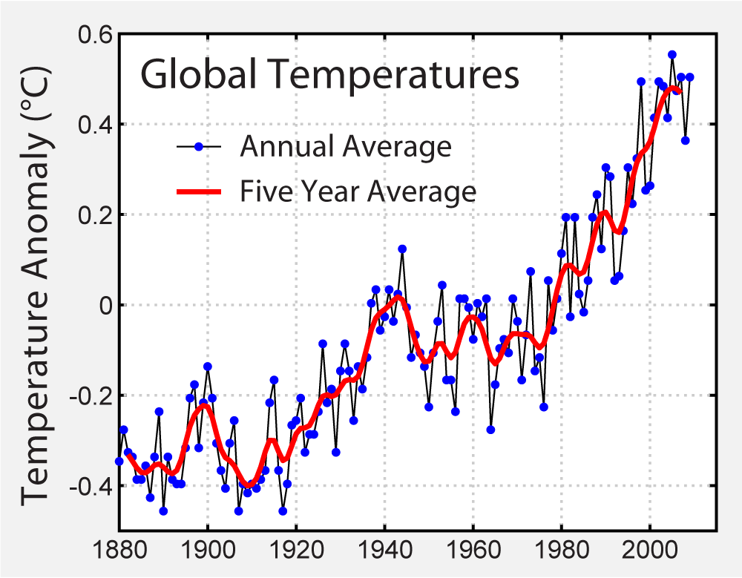
Global Warming
An average temperature increase of the Earth over time.
Hansen, James, Makiko Sato, Reto Ruedy, Ken Lo, David W. Lea, and Martin Medina-Elizade. "Global Temperature Change." Proceedings of the National Academy of Sciences 103.39 (2006): 14288-4293. Goddard Institute for Space Studies. National Aeronautics and Space Administration, 31 July 2006. Web. 2 July 2012.
Notes:
This usually refers to the recent increase over the last 130 years.
A change in average temperature can have big effects on natural processes. The average difference between Washington DC and Charleston SC is less than 1.4 degrees F, but different plants grow there.
The 0 point is the surface temperature anomalies relative to 1951–1980 from surface air measurements at meteorological stations and ship and satellite SST measurements.
Source: Hansen et al. 2006. Global Temperature Change, NASA.

Slide 10
Climate Change
Includes a variety of likely changes
  The effects will not be the same everywhere
Includes changes to:
  Temperature
  Precipitation
  Sea Ice
  Sea Level
  Extreme Weather Events
Notes:
Also, Climate change = a persistent and significant change in an area’s average conditions and its extremes
Global warming relates to the recent trend of warming in surface temperatures. Climate change refers to the total alteration of natural processes such as rainfall, temperature, hurricanes, sea ice and sea level

Slide 11
What is the EVIDENCE of chanGE?

Slide 12
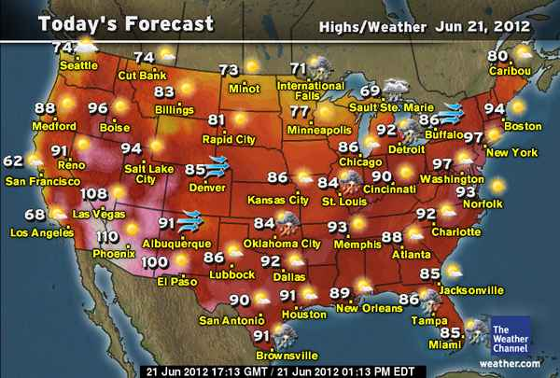
Temperature
Courtesy: The Weather Channel
Notes:
Weather.
This diagram shows a daily weather forecast for the United States
It is short term data that is based on current thermal readings and holds no data for future predictions for coming decades
Daytime is hotter than evening, some days are hotter than others. It does not tell us anything about climate.
The fact that summer is hotter than winter, however, is a seasonal, predictable trend that is CLIMATE.

Slide 13
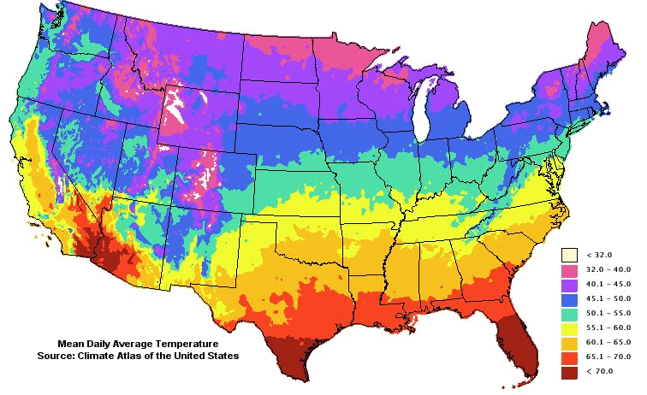
Average Temperature 1961-1990
McKenny, Dan, Megan Embrey, Amy Lee, Anantha Aiyyer, Bridget Lassiter, Ryan Boyles, Ashley Frazier, Sharon Schulze, and Heather Dinon. "Climate and Weather." Climate Education for Agriculture. NC State University, Web. 13 July 2012. <http://nc-climate.ncsu.edu/edu/ag/ClimateandWeather>.
Notes:
This graph shows the average annual temperature across the US from 1961 – 1990. This long term data over a specified area illustrates an example of the climate of a region, not its weather.
Source: NC state university, Climate change and agriculture

Slide 14
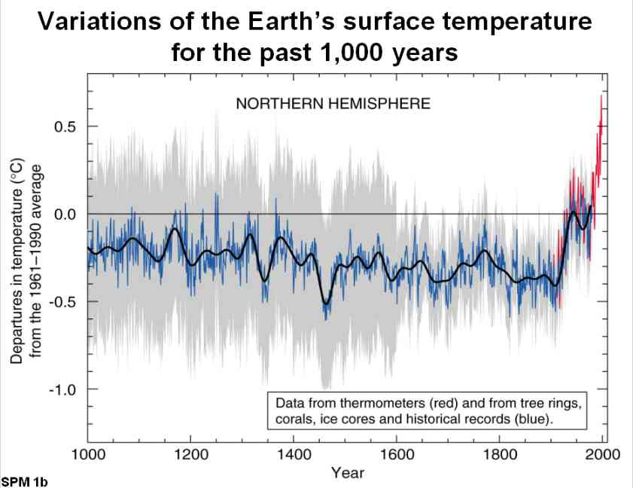
Temperature
IPCC, 2007: Summary for Policymakers. In: Climate Change 2007: The Physical Science Basis. Contribution of Working Group I to the Fourth Assessment Report of the Intergovernmental Panel on Climate Change [Solomon, S., D. Qin, M. Manning, Z. Chen, M. Marquis, K.B. Averyt, M.Tignor and H.L. Miller (eds.)]. Cambridge University Press, Cambridge, United Kingdom and New York, NY, USA.
Notes:
Climate.
This graph shows the increase in temperature for the globe. It shows 1000 years of data, so this is climate, not weather. Notice the increase in temperature in the last 50 years. This is what has people’s attention. They want to know whether this is normal or unusual, and what it will mean. Also notice that temperature does change over time. The trick is to project what will happen in the future.
Source: IPCC Summary for policy makers, 2007

Slide 15
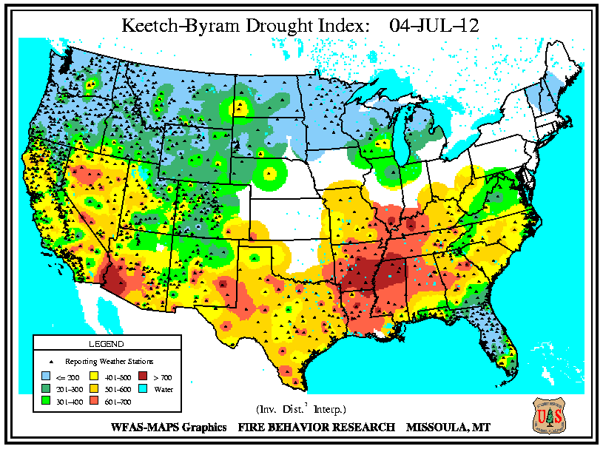
Precipitation
Notes:
Weather.
This graph shows an example of the “Keetch Byrum Drought Index” for the US. This shows the drought outlook for the July 4, 2012. This is an example of weather because it shows only one day of data. Climate graphs should be at least two or three decades before they can be considered climate.
http://www.wfas.net/index.php/search-archive-mainmenu-92
Wildland Fire Assessment System

Slide 16
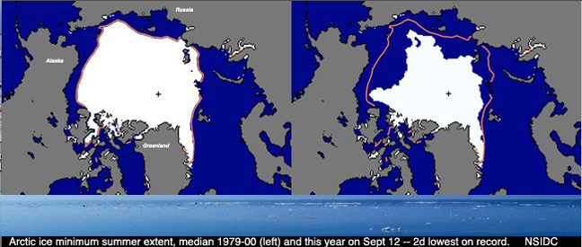
Arctic Sea Ice
1979 2009
Notes:
Weather.
But just because sea ice melts does not mean climate has changed. Sea ice actually melts every summer. That is a part of the natural seasonal climate. There can be warm summers and cool summers. This graph does not help us understand long term trends in climate.
---
This one is tough. Although the ice caps in the arctic are melting, it can be difficult to differentiate the change from weather or climate. Because these two images represent only one specific year, it is difficult to interpret an overall change or trend. You would need all of the years in between these two data points in order to make an argument for climate.
Because satellite imagery was only around since 1979, the historical extent of sea ice is difficult to extrapolate.

Slide 17
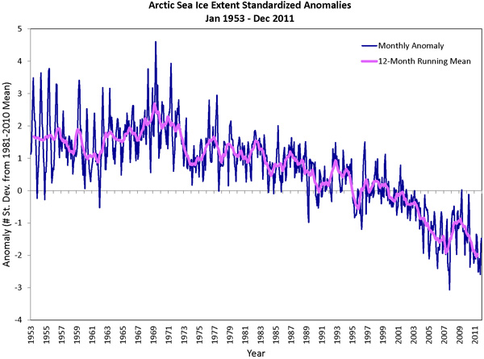
Sea Ice
Armstrong, Richard L. "Sea Ice." State of the Cryosphere. National Snow and Ice Data Center, 21 May 2012. Web. 13 July 2012. <http://nsidc.org/cryosphere/sotc/sea_ice.html>.
Notes:
Climate.
This graph displays long term averages of sea ice extent from 1953 to 2011. Sea Ice is the ice that covers the north pole and Arctic ocean. The recent trend – since 1950’s shows a decline in area. This is a reasonable outcome of global warming. Because this graph displays a long term trend, we can say that this is climate.
Because satellite imagery was only around since 1979, the historical extent of sea ice is difficult to extrapolate.
http://nsidc.org/cryosphere/sotc/sea_ice.html

Slide 18
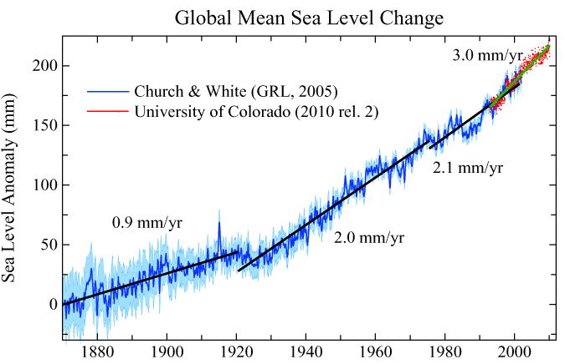
Sea Level
Hansen, James, and Makiko Sato. "Sea Level." Updating the Climate Science: What Path Is the Real World Following? Columbia University, 26 June 2012. Web. 13 July 2012. <http://www.columbia.edu/~mhs119/SeaLevel/>.
Notes:
Climate.
Sea level is also changing. This is another consequence of a warmer planet, since warmer water takes up more room than colder water and glaciers are melting. A warmer ocean means higher tides, bigger storm surges, and more coastal erosion. Sea level has risen over the last 150 years.
Melting of land ice is more concern for SLR than melting of sea ice. This website explains why: http://teachoceanscience.net/modulepopup/barrier_islands_and_sea_level_rise/melting_ice Also, the section on this website called “What causes the sea level to rise?” is a good resource: http://teachoceanscience.net/teaching_resources/education_modules/barrier_islands_and_sea_level_rise/learn/
Another good website: http://climate.nasa.gov/keyIndicators/
---
Sea level changes have been found in Earth’s past and they are often dictated by continental orientation, oceanic currents, ocean temperatures and sea floor spreading rates. This graph shows that the sea level as risen in two centuries and probably will continue to do so as sea ice is currently declining. This is an example of climate since it is data that covers a large area and over 200 years.
The smaller lines indicate the small fluctuations of sea level, but this graph shows an overall increasing trend.
Source: James Hansen, and Makiko Sato. 2010. Columbia University

Slide 19
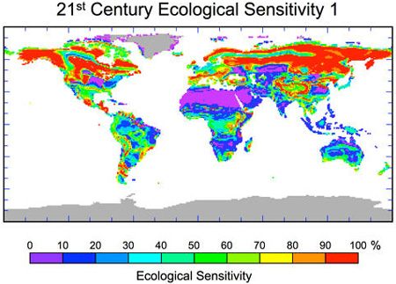
Ecosystem
Bergengren, Jon C., Duane E. Waliser, and Yuk L. Yung. "Ecological Sensitivity: A Biospheric View of Climate Change." Climate Change 107.3 (2011): 433-57. SpringerLink. Web. 22 June 2012.
Notes:
Climate.
Another consequence of a warmer world is changes in rainfall, and those two variables have the capacity to affect ecosystems. Some areas of the world are more sensitive to these changes than other areas. This map shows the sensitivity to change around the world – polar systems are likely to change more, and some parts of the world are not likely to change much at all.
---
As precipitation and temperature proceed to change as a result of climate change, habitat and ecosystem stability will be affected. This figure shows the sensitivity or ecological regions, which predict their relative resistance to change. Desert regions and areas of low biological diversity are less sensitive. Like the Saharan region in Africa. But colder regions like the Siberian region or the Alaskan area are very sensitive as these regions are the most susceptible to temperature change due to the lack of humidity and further decrease of glaciers and sea ice.
Bergengren, Jon C., Duane E. Waliser, and Yuk L. Yung. "Ecological Sensitivity: A Biospheric View of Climate Change." Climate Change 107.3 (2011): 433-57. SpringerLink. Web. 22 June 2012.

Slide 20
What does this all mean?
Scientists combine this evidence to draw conclusions:
  Earth’s climate is currently changing.
  Changes are not the same at all locations on Earth.
  Future changes may be more rapid than historical changes.
They look at evidence
  If these trends do not match historical averages or if they appear to be accelerated, then climate is changing differently than it has in the past.
Notes:
Evidence includes:
Long term changes
Multiple locations
Different types of data
Different sources of data
Feedback through peer review process
When climate changes, we can either adapt or mitigate

Slide 21
Why is climate changing?
Natural and Anthropogenic Changes
Notes:
To make projections about the future, it is important to know why change is happening. There are two major sources of climate change – natural changes and human-induced changes. Let’s look at each.

Slide 22
Climate is defined by several forces
Solar radiation
Ocean composition
Greenhouse effect
Albedo effect
Continental land arrangement
There have been natural fluctuations in these forces that have caused past climate change
  Are they causing current changes?
Notes:
The natural effects of climate change are always present. These natural forces have changed climate over millennia. Ice ages are due to these forces. Can these forces explain the changes we see today?
Solar energy coming to Earth, reflected off Earth, absorbed by atmosphere and planet…

Slide 23
The next three slides are to come.
There are some people who believe that the climate change we are seeing today is due to other natural forces, and not anthropogenic
  Changes in volcanic activity
  Changes in solar radiation
  Increased solar flares and sun spots
  Changes in Earth’s orbit around the sun

Slide 24
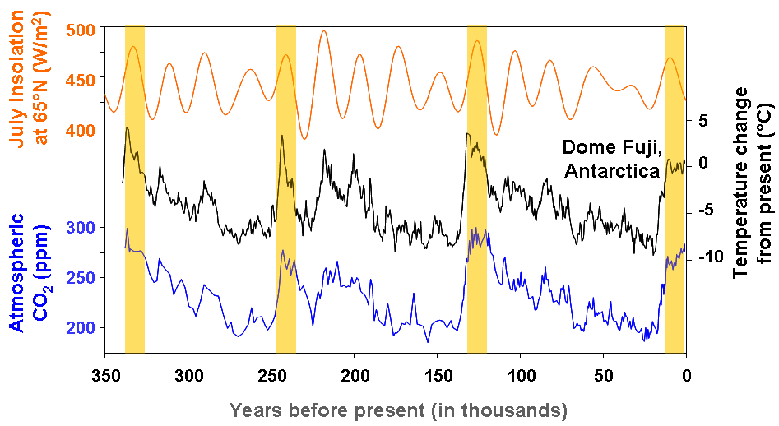
Solar Radiation
"Glacial-Interglacial Cycles." NOAA Paleoclimatology Program. USA.gov, 20 Aug. 2008. Web. 31 July 2012. <http://www.ncdc.noaa.gov/paleo/abrupt/data2.html>.

Slide 25
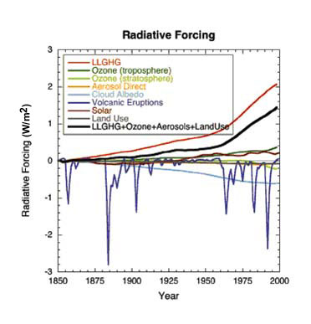
Volcanic Eruptions
"Frequently Asked Questions about the Science of Climate Change – 2008 Update." Environment Canada. N.p., 18 June 2012. Web. 31 July 2012. <http://www.ec.gc.ca/scitech/default.asp?lang=En>.

Slide 26
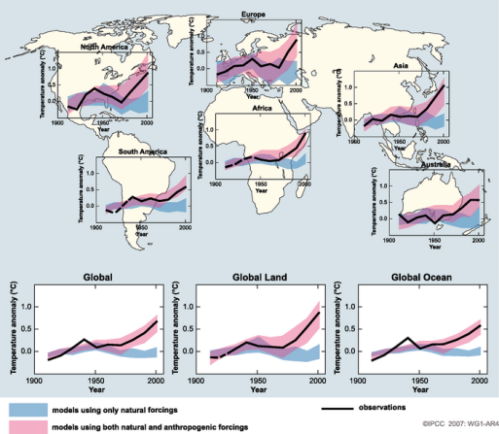
Global and continental temperature change
But natural forces alone do not explain the changes we have been seeing
Notes:
These graphs show two models – the blue lines are the expected temperature if natural forces alone were responsible for climate. The pink bands combine natural and human causes of climate change. The black line is what has really happened.
If climate models accurately represent the past observations, we have more confidence that they will be able to model future conditions at the global and continental spatial scale.
This is good, but the graphs are actually showing that in order to best replicate historical observations of global and continental average temperature (or what has happened in the past), climate models need to include both natural and human-induced forcings. If climate models accurately represent the past observations, we have more confidence that they will be able to model future conditions at the global and continental spatial scale.
---
Graphs of natural changes alone illustrate that the current warming is not dictated only by natural fluctuations. Therefore it is a combination of anthropogenic and natural fluxes.
http://www.ipcc.ch/publications_and_data/ar4/wg1/en/figure-spm-4.html

Slide 27
We have also altered the atmosphere
Carbon dioxide (CO₂)
  Currently 396 ppm; 35% rise since Industrial Revolution
Methane (CH₄)
  Currently 1800 ppb; from 700 ppb
Nitrous oxide (N₂O)
Chlorofluorocarbons (CFC’s)
Ozone (O₃)
Water Vapor (H₂O)
Notes:
These compounds act to insulate the Earth through the greenhouse effect. More of these compounds means warmer temperatures. Less of these compounds means cooler temperatures.

Slide 28
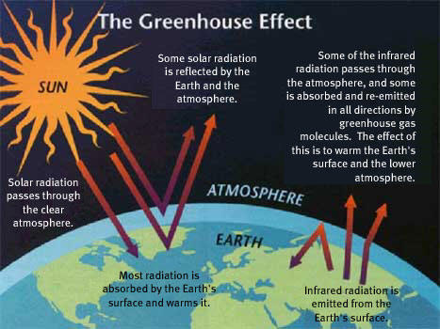
Notes:
The greenhouse effect is a natural process that supports life on Earth. It can be thought of as a blanket that warms the Earth. Energy from the Sun hits the Earth. Some of it is absorbed and some of it is reflected back. The energy that is reflected back either returns to space, or greenhouse gases “trap” or absorb the infrared radiation. Then, they re-emit the radiation which acts to warm Earth’s surface and the lower atmosphere. Therefore, the theory states that more greenhouse gases would lead to more warming.

Slide 29
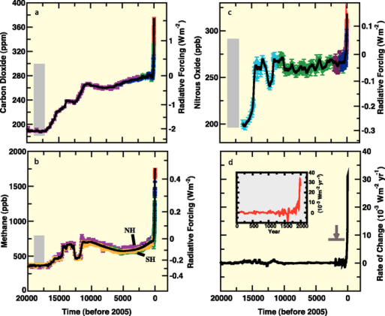
CO₂
N₂O
CH₄
Notes:
This shows the recent increase in GHGs over the past 20,000 years. The increase in the present is illustrating the GHG emissions from fossil fuels, pesticides and fertilizers as well as other human causes.
http://www.ipcc.ch/publications_and_data/ar4/wg1/en/figure-ts-2.html

Slide 30
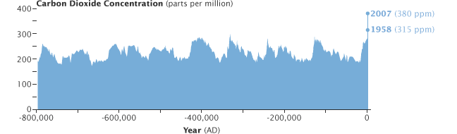

Human Forces
Humans have amplified the greenhouse effect by putting more greenhouse gases in the atmosphere at an accelerated rate
Notes:
There is a lot of attention on carbon dioxide. Why?
It has increased beyond the levels of the past 800,000 years – human civilization. This makes people believe that something we are doing now is very different from the past.
--
The graph shows historical CO2 concentration dating to 800,000 years ago. The recent increase is more drastic and exponential compared to past increases. This shows anthropogenic sources of CO2. The long-term carbon cycle is controlled by chemical weathering, volcanic and metamorphic degassing, and the burial of organic carbon. These historical CO2 levels are calculated using isotopic content of organic carbon (C 14) and using ice cores to measure CO2 in trapped air bubbles.
Over 500 million years ago, the atmospheric level of CO2 was about 7000 ppm. Today it is about 396. This past CO2 level was mainly due to the early formation of the Earth and its volcanic activity. There were also hardly any plants that photosynthesized, meaning this CO2 was never absorbed. Past atmospheres were not conducing to animal life due to the absence of ample oxygen and so life on the Earth was limited in those times.

Slide 31
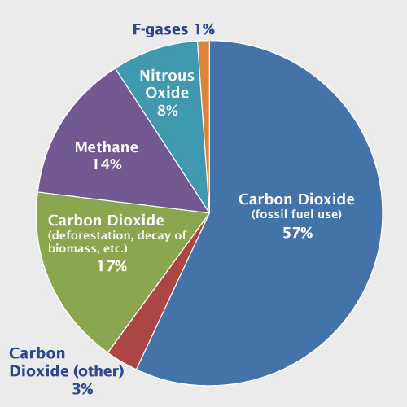
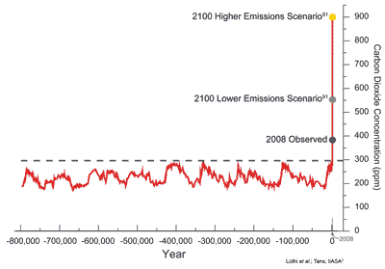
Focus on CO₂
People tend to focus on CO₂ because it is the one we have changed the most.
CO₂ is a greenhouse gas that scientists think has caused a lot of the warming to take place
Notes:
Here in the US, most of our GHG emissions are CO2. and most of that comes from fossil fuels. If we continue to burn fossil fuels as we currently are, we could see Co2 concentrations much higher than they are now in only 90 years.
Another way to describe why the focus is on CO2 is to discuss radiative forcing as depicted in IPCC AR4. This blog post is actually pretty good at explaining what radiative forcing means, if you’d like to learn more about it: http://atoc.colorado.edu/~seand/headinacloud/?p=204
---
This graph shows the emissions of greenhouse gases into the atmosphere in the United States. The 57% of CO2 emitted as a result of fossil fuel consumption illustrates the possible cause of the warming we see.
Source: IPCC (2007) based on global emissions from 2004. Details about the sources included in these estimates can be found in the Contribution of Working Group I to the Fourth Assessment Report of the Intergovernmental Panel on Climate Change .
Source: http://www.edf.org/climate/human-activity-causes-warming

Slide 32
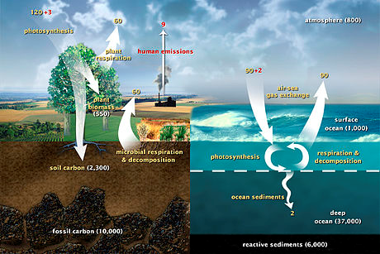
Carbon is Everywhere!
Notes:
Carbon is a critical element in all life forms – part of DNA. Also in coral reefs, ocean, soil, atmosphere. Vegetation photosynthesis converts CO2 to glucose, which can be converted to energy for plant, stored in cellulose, eaten by an animal…etc.
Biological carbon ½ in balance. Burning fossil fuel carbon in coal, oil, natural gas puts carbon in atmosphere, more than before.
Note the red digits in this figure illustrating the human emissions due to the combustion of fossil fuels and the sequestration of these emissions. There is a net 4 of the 9 emissions that are not sequestered.

Slide 33
Using Models to Project the Future
Notes:
we call them projections not predictions because they strongly depend on how humans will act. That component (human behavior with regards to amount of emissions) is unpredictable so it’s not called a prediction but a projection of what we think could happen based on different emission scenarios. It is almost like “what-if humans produced this many emissions then we would see these outcomes…”. Also, mention this is at a global spatial scale.

Slide 34
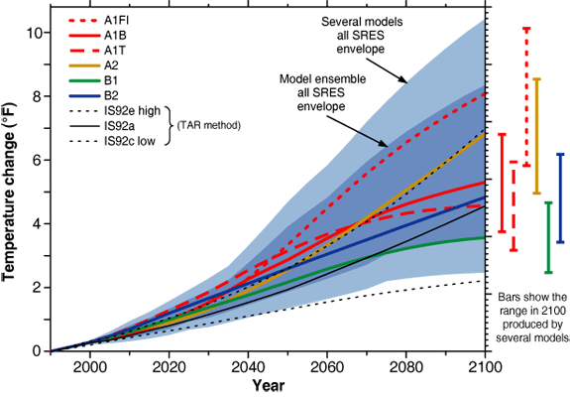
What Will Happen In the Future?
Scientists also use models to project temperature changes with different assumptions for emissions
"Temperature Projections." Consortium for Atlantic Regional Assessment. Global Change Research Program, US EPA, 23 Jan. 2006. Web. 13 July 2012. <http://www.cara.psu.edu/climate/emissionscenarios3.asp>.
Notes:
These projections and which track the Earth follows depends on the future dependence on fossil fuels, the economic growth of countries as well as the rate of usage of renewable energy. Depending on what policies are introduced, a certain track will follow.
Source: IPCC Third Assessment Report, 2001.

Slide 35
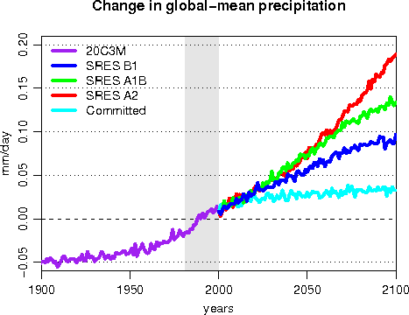
What Will Happen In the Future?
Scientists also use models to project precipitation changes
"Plots and Animantions." Climate Research Activities. Environment Canada, 19 Apr. 2010. Web. 13 July 2012. <http://www.cccma.ec.gc.ca/diagnostics/cgcm3-t47/plot_pcp_glb.shtml>.
Notes:
Precipitation will probably increase on average, because warmer temperatures will cause more evaporation of surface water, meaning more rain. But more evaporation means more water vapor in the atmosphere which leads to drought in some regions. Which means regions that are dry become drier and regions that are wet become wetter.
More water vapor due to more evaporation means more warming since water vapor is a GHG. Therefore more evaporation. This is positive feedback.
Source: Environment Canada. Showing a graph from the IPCC 20th century experiments.
check out this website under “Feedbacks” and “Precipitation” for a good explanation to supplement/edit the rest of what you have: http://climate.nasa.gov/uncertainties/

Slide 36
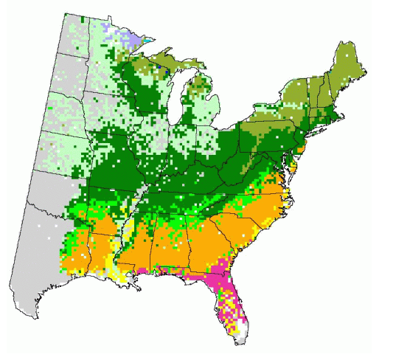
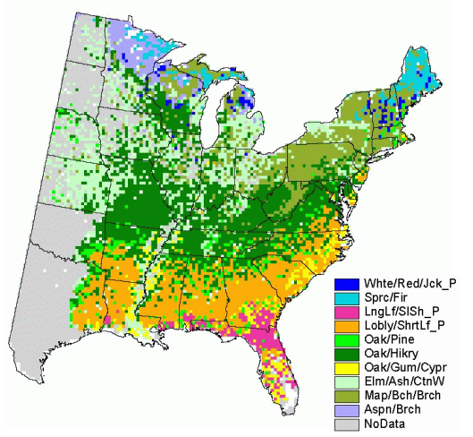
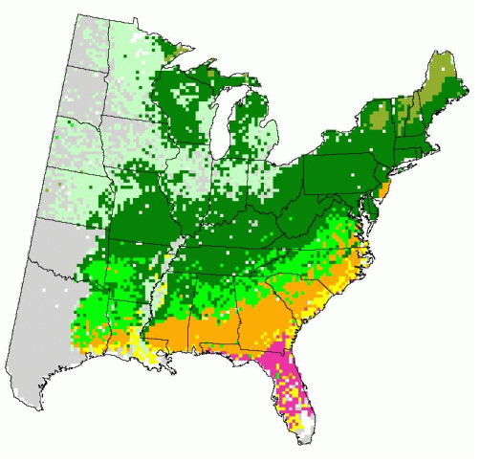
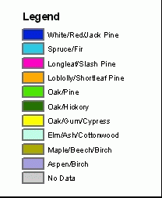
Ecosystem
Future Model – Low Emissions
Future Model – High Emissions
Current Modeled Forest
Courtesy: US Forest Service Tree Atlas
Notes:
Climate.
There is an animation. Click TWICE.
There are three images within this slide: Present, Lower emissions scenario and Higher emissions scenario.
Again, climate because the previous habitats of different forest types will begin to be lost due to temperature changes. The northern boreal forest will most likely disappear from the U.S. due to the warming, allowing the oak/hickory forest of the mid latitudes to take over as the dominant forest.
this map shows projected shifts in the range of species that can occur under low and high emission scenarios for the future.
Courtesy: US Forest Service Tree Atlas
36

Slide 37
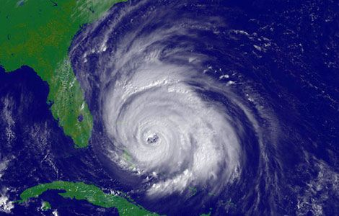
And what could happen here?
Florida’s climate is largely influenced by El Nino and La Nina
Sea level rise
  coastal erosion
  groundwater contamination
Warmer temperatures
  more invasive exotic organisms
  greater risk of wildfire
  Increased yield in some crops if water is plentiful
Less rain in the growing season
  harm crops, or change planting times

Slide 38
Why doesn’t everyone Agree?
Notes:
The peer reviewed literature and climate scientists agree. So why is this still considered a controversial issue?

Slide 39
It’s a Challenge
The science and the system are very complex
  Most of us are not climate scientists
  Feedback loops and delay, not linear cause/effect
Will not impact every region in the same way
Can not exactly predict the future – too many variables
Not just a scientific issue
  International, Political, Moral, Economic issue
Some changes are expensive
Changes are hard to see
My actions do not affect me
Notes:
Climate science is very difficult to understand. For some adults, it’s been a long time since they had a formal science course. Climate change does not affect people equally around the world. Some regions of the world will see little change, some will see a lot. It’s difficult to treat policies for climate change equally when not everyone will experience the same change.
Some solutions are expensive, and if we can’t afford to fix it, some people think it might be easier to say that there isn’t a problem in general.
Climate change is something that will happen in the future, and so it is difficult to project the exact outcomes because of the quantity of variables. Models help to project changes, but it cannot be certain what our future policies will look like.

Slide 40
Climate Change is Difficult to See
Changes take a while to detect because of short-term variations
Changes are often detected where people do not live
People spend less time in nature so changes may be more difficult to see
Delayed results mean people may not see how their behavior impacts the climate
Notes:
The polar ice caps are melting, but no one lives there. It’s hard to care about an area where you don’t live or ever see.
Climate change is not instant. It takes place over a period of time, and our actions have delayed effects.
When people can’t see an obvious change, they might not be inclined to change their actions.
40

Slide 41
But why disagreement?
People perceive and remember information that matches their existing mental model
  So it is hard to change someone’s opinions
People have partial information and leap to conclusions
  And it is hard to provide complete information
People listen to influential leaders
  rather than figuring it out for themselves

Slide 42
Skeptics and Deniers
Skeptics question data, interpretations, and recommendations
Skeptics are open to various ideas – with decent proof
Skeptics are valuable – they help to challenge the data!
Deniers repeat favored statements without questioning.
No amount of information will change a denier’s mind
Notes:
It’s good to have skeptics – they make us test our theories more. They help to improve the science.
Deniers are different. They are harder to talk to and are not open to evidence.
---
Opposes to climate scientists. There are different reasons why people deny climate change. Political values? Education? Religion?
It’s bad to have deniers because you can’t convince them otherwise.
42

Slide 43
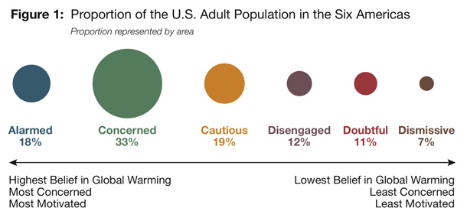
The U.S. Public Holds Different Beliefs about Climate Change
Notes:
Different people have different thoughts and opinions regarding climate change.

Slide 44
Homework
Use today’s information to evaluate statements about climate change.
  Underline the sentences supported by scientific data
  Circle the reasoning following the evidence.
  Star the final conclusion
If you think that the conclusion is false, or not supported well enough:
  Explain what information is lacking
  Rewrite the conclusion to make it more accurate

Slide 45


Example
The Earth’s orbit has been tracked and studied for hundreds of years though various astronomical research.
The shape of the Earth’s orbit is elliptical, not circular. Because of this shape, the Earth is farther from the Sun during part of the year than other times.
It is colder in the winter,
so the Earth must be farther from the Sun, receiving less solar energy, making it cold.
Therefore, the reason we see differences between winter and summer is because of Earth’s elliptical orbit and our distance from the Sun.
Notes:
There is an animation on this slide. Click 3 times total – once for underlined statement, 1 for circle, 1 for star.
Earth’s orbit does NOT dictate the seasons. It is actually due to the axial tilt of the Earth. The Earth is closer to the sun in January than it is in July, so this statement is false and the conclusion is not valid.

Slide 46
Questions?

Slide 47
What are Some Solutions?
Notes:
This will be a part B of the presentation to be done on the second day.

Slide 48
How to approach a problem?
Project future conditions
Assess the risks involved with various scenarios
  If the risks are acceptable – adapt to changes
    Find crops that grow in warmer, drier conditions
  If the risks are unacceptable – mitigate the change
    Many options at many scales: global, national, state, community
    Mostly around reducing emissions of GHG

Slide 49
Solutions to Climate Change
Lots of options; no “one” solution
Policies and actions implemented by
  Governments: international, national, state, local
  Industry and business
  Individuals – all of us!
One goal of these solutions is to limit the emissions of greenhouse gases
  Limiting emissions will decrease CO2 and some of the effects of climate change
Notes:
We can ADAPT to the change if the risks are acceptable to us. We can MITIGATE the change if the risks are greater than what we can handle.
We must explore the risks and costs of potential policies. There are different values and opinions as to what should be done, and this creates a challenge when making policies for climate change.

Slide 50



Reduce Emissions by Improving Efficiency
Fuel efficiency of vehicles
Building heating/cooling/lighting
  Residential and commercial
  Home appliances
Better ways to produce energy from fossil fuels
  Increase efficiency of energy generation
Notes:
Increasing efficiency in systems is the cheapest way to limit the carbon in the atmosphere. It would cost BILLIONS more to take carbon out of the atmosphere or to change our reliance on non-renewable energy to renewable energy. By making systems more efficient, less energy is wasted and therefore more net energy is available. This will decrease our reliance on energy inputs.

Slide 51


Reduce Emissions through Conservation
Improving transportation systems
  Bicycle, carpool, public transportation
Reducing fossil-fuel intensive systems
  Buy local
  Eat less meat
  Use fewer fertilizers
Conserving electricity
Reducing, reusing, recycling
Notes:
Driving less, eating less meat, and using less electricity all act to decrease emissions of CO2 and other GHGs. This then will decrease the warming effect that we are experiencing.

Slide 52
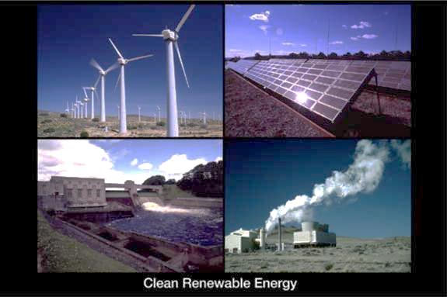
Use Carbon Neutral Energy Sources
Renewable Energy
  Solar
  Biomass
  Wind
  Geothermal
  Hydropower
  Hydrogen
Nuclear
Notes:
Renewable energy is a clean alternative to non-renewable energy that emit CO2 into the atmosphere. These energies are being researched and developed which will lower their cost in the future. As their cost decreases, more people will use these energies in private or public industrial system as a replacement to non-renewable fossil fuels.

Slide 53
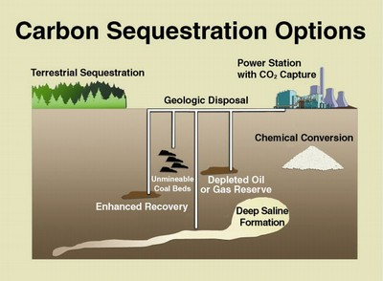
Remove Carbon from Atmosphere
Decrease rates of deforestation
Increase rates of reforestation
Manage forests for carbon sequestration
Manage agricultural crops and soils for carbon sequestration
Use carbon capture
Substitute wood
Notes:
Carbon sinks are areas in which carbon is stored. If these sinks are managed, more carbon can be stored on the surface of the Earth instead of in the atmosphere as a GHG. Deforestation decreases the carbon sequestration that takes place, which then limits how much carbon is stored separately from the atmosphere.
Carbon capture is a new technology in which carbon emissions are taken from power plants and transported and then inserted into the ground as carbon storage. Instead of letting these emissions escape to the atmosphere, engineers and scientists have developed ways to take this carbon and store it in the ground instead. This method is expensive and many people view it to be dangerous.

Slide 54
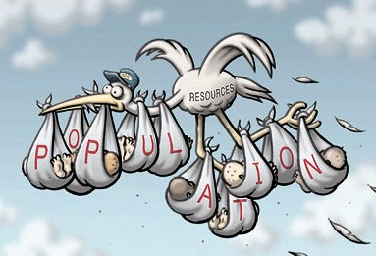
The Bigger Picture
Implement carbon taxes
International agreements – Kyoto Protocol
Manage the global population
Notes:
Slowing population growth will slow our use of fossil fuels and our emissions. Less land development will be needed if population decreases, thereby allowing more land area to be used for carbon storage, i.e. FORESTS.

Slide 55
Case study Examples

Slide 56

Kansas City Power and Light
  Company is committed to sound environmental practices that maintain and preserve the integrity of the planet
  Pioneering efforts to reduce environmental impact of electric generation
  Spearville Wind Generation Facility provides 100.5 megawatts of renewable energy
Notes:
http://www.kcpl.com/
“We pledge to participate in – and contribute to – efforts that recognize and promote responsible environmental stewardship; to continually seek to understand and address concerns about the environment; and to strive to improve, protect and conserve beyond the law’s requirements.” - Bill Downey, KCP&L President and CEO

Slide 57

Canary Initiative
Aspen, Colorado
Created in 2005 to address climate challenge
Goal to decrease local GHG emissions by 30% by 2020 and 80% by 2050
Notes:
http://aspenpitkin.com/Living-in-the-Valley/Green-Initiatives/Canary-Initiative
The City of Aspen’s Canary Initiative was created in 2005 to address the climate challenge and provide leadership in reducing greenhouse gas emissions locally. Through policy, research, education and community engagement, the Canary Initiative is helping Aspen transform itself from a carbon-intensive community to one that is sustainable and environmentally responsible.

Slide 58

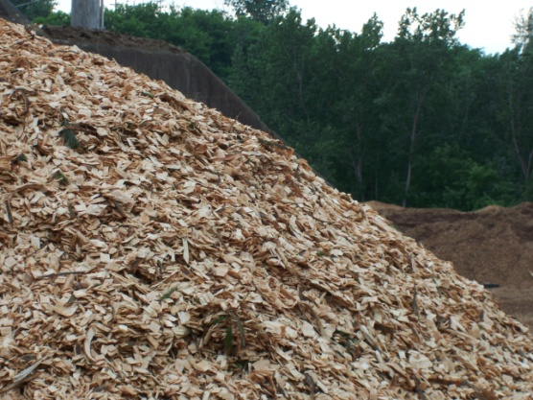
McNeil Biomass Plant
Burlington, Vermont
  Began operation in 1984
  50 megawatts net electrical generation
  Burns 76 tons of wood per hour
  Uses 70% produced from low-quality trees and logging waste
  25% produced from residues (chips and bark from local sawmills)
  5% comes from clean recycled wood

Slide 59

The 10% Challenge
  Group of local, regional, and state-level professionals dedicated to the reduction and education of greenhouse gas emissions and climate change
  Mission is to help reduce emissions in households by at least 5% and a total reduction of 25% by 2012.
Notes:
http://www.10percentchallenge.org/

