Slide 1
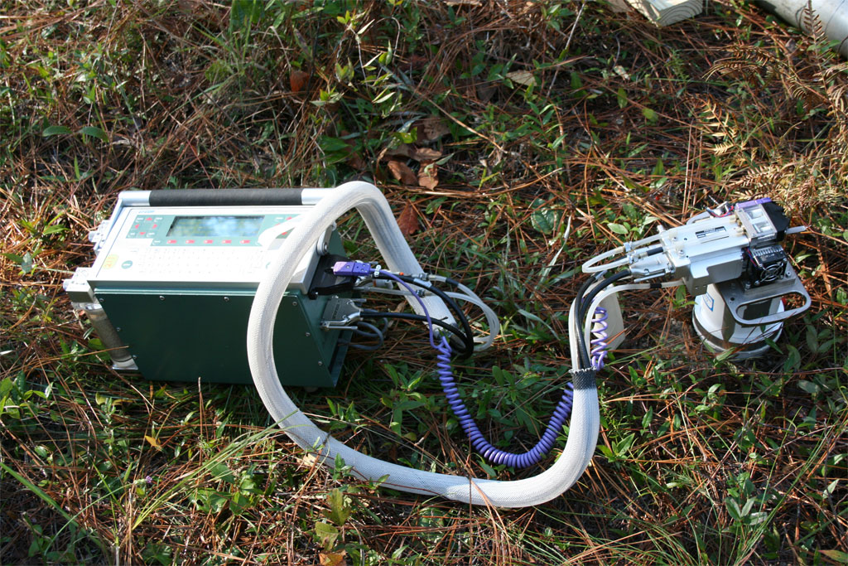
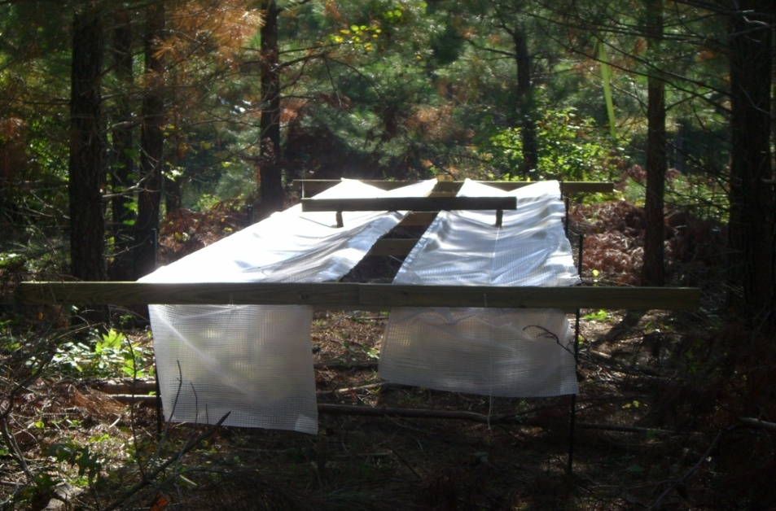

Aim 1: Silviculture and Ecophysiology

Slide 2
Graduate Students
Joe Clark- MS, Auburn
Brett Heim- MS, Virginia Tech
Andy Laviner- PhD, Virginia Tech
Wen Lin- PhD, North Carolina State
Cody Luedtke- PhD, Georgia
Adam Maggard- PhD, Oklahoma State
Jay Raymond- PhD, Virginia Tech
Maxwel Wightman- MS, Florida
Lu Zhai- MS, Texas A&M

Slide 3
Outline
Introduction
Monitoring network
Carbon – Research proposed and justification
Nitrogen – Research proposed and justification
Water – Research proposed and justification
Conclusion

Slide 4
Fundamental goal
The fundamental goal of PINEMAP is to develop knowledge, technology, approaches and tools essential to
increase C sequestration by 15% and
reduce energy, N fertilization, and water use by 10%
through resilient southern conifer forest production systems under changing climates by 2030 relative to 2010 baselines
Notes:
I am not sure how to revise this slide since there are some doubts over the water use. Maybe we can discuss with Dr. Kane.

Slide 5
Deliverables from Aim 1
Establish a regionwide three-tiered monitoring network
Existing cooperative field trials will be the backbone of the three-tiered monitoring network
Standardized methods will be developed to quantify :
C, water, and nutrient storage
Flux baselines
Responses to climate and management

Slide 6
Deliverables from AIM 1
Initial quantification of cross-region fertility rating and stomatal response functions
Relative index of soil nutrient availability
Stomatal response functions critical to C assimilation
δ¹⁸O and δ¹³C from Tier II wood samples
Use measurements of these wood stable isotopes to quantify amount of biomass produced per unit of water
Notes:
3 methods for testing fertility (soil attributes of A horizon) (Early stand height, up to five years) and (soil chemical structural and or biological properties)

Slide 7
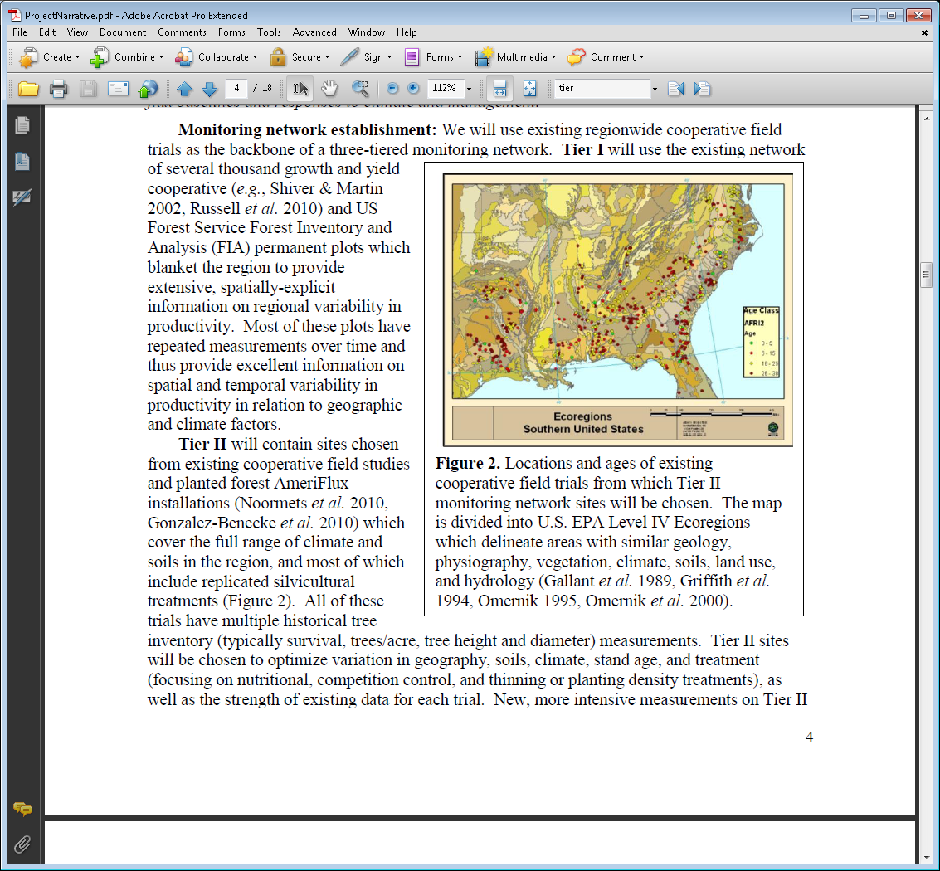
Monitoring Network
Aim 1 will establish a three-tiered monitoring network to quantify carbon, water, nutrient storage and flux baselines
This information will be used to assess responses to climate and management
Existing region wide cooperative field
trials will be used as a backbone for the monitoring network

Slide 8
Tier 1
Goal: To measure regional variation in pine productivity
Includes existing growth and yield monitoring sites:
Several hundred sites included
Includes sites and data from research cooperative experiments representing a 50+ year, multimillion dollar investment by universities, state and federal agencies and forest industry
Includes US Forest Service Forest Inventory and Analysis (FIA) permanent plots
Data includes information on:
Site characterization (soils & climate)
Establishment date, study design, and original spacing
Information on silvicultural treatments
Individual tree height, DBH, and tree condition
Growth and yield data
Notes:
Most of these plots have repeated measurements over time and thus provide excellent information on spatial and temporal variability in productivity in relation to geographic and climate factors.

Slide 9
Tier 2
Goal: Measure effects of management actions on carbon, nutrient, and water cycles
Contain sites chosen from existing cooperative field studies and planted forest AmeriFlux installations (~140 Sites)
Cover the full range of climate and soils in the region
Include replicated silvicultural treatments focusing on: fertilization, competition control, thinning, and planting density
Trials have multiple historical tree inventory measurements

Slide 10
Tier III
Goals:
Test loblolly pine plantation response to nutrition and artificial drought around the fringe of the natural range of the species
Create a platform where ecophysiological measurements can be made that will aid process model parameterization
Determine C, N & H2O fluxes and pools under drought conditions that could exist in the future
Provide educational opportunities for graduate education
Test loblolly pine resilience under extreme conditions

Slide 11
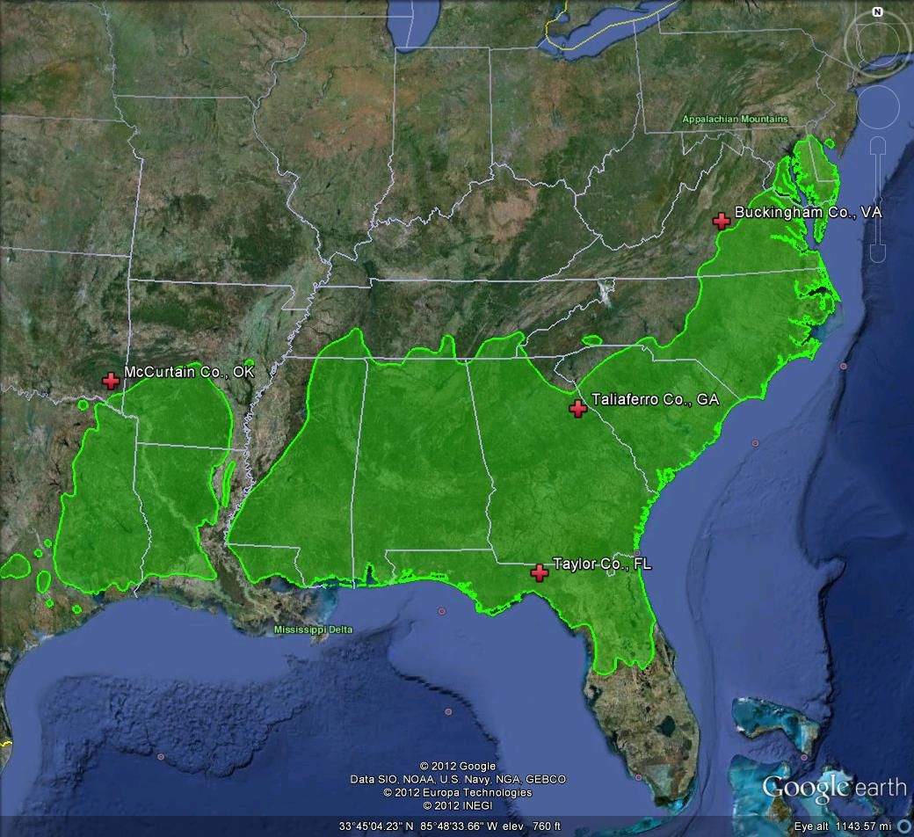
Tier III
Four new installations across productivity gradients around the fringe of the loblolly pine range
Stands at or near crown closure
Open pollinated seed orchard mix

Slide 12
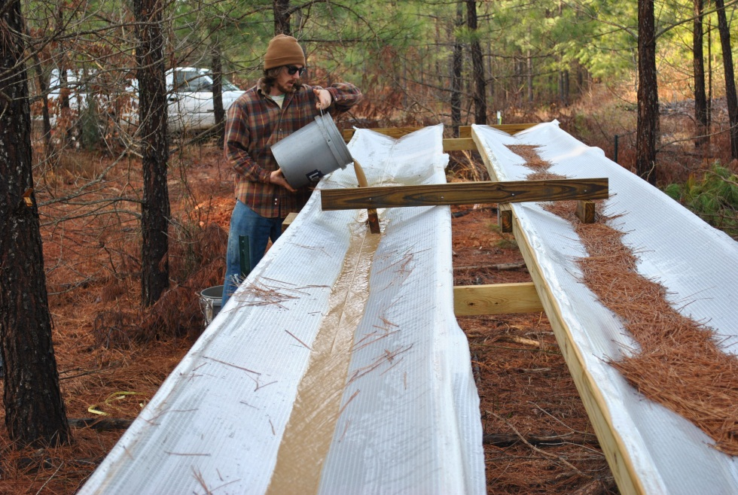
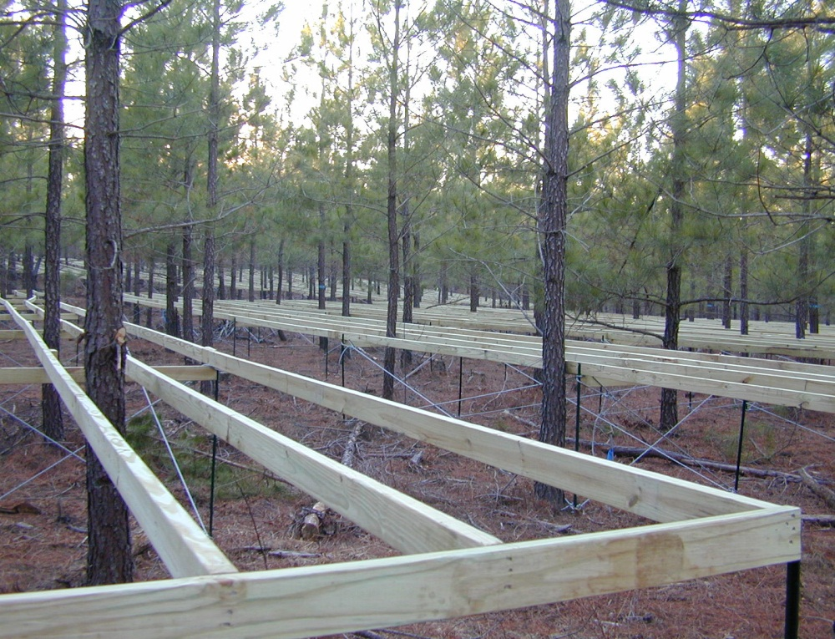
Tier III
2X2 Factorial of fertilization and throughfall exclusion
Control (no treatment)
Fertilized - one time balanced application (N, P, K, B, S, Zn, Mn, Cu)
Drought (30% throughfall exclusion)
Fertilized and Drought

Slide 13
Aim 1 - Carbon: PINEMAP Research Proposed and Justification

Slide 14
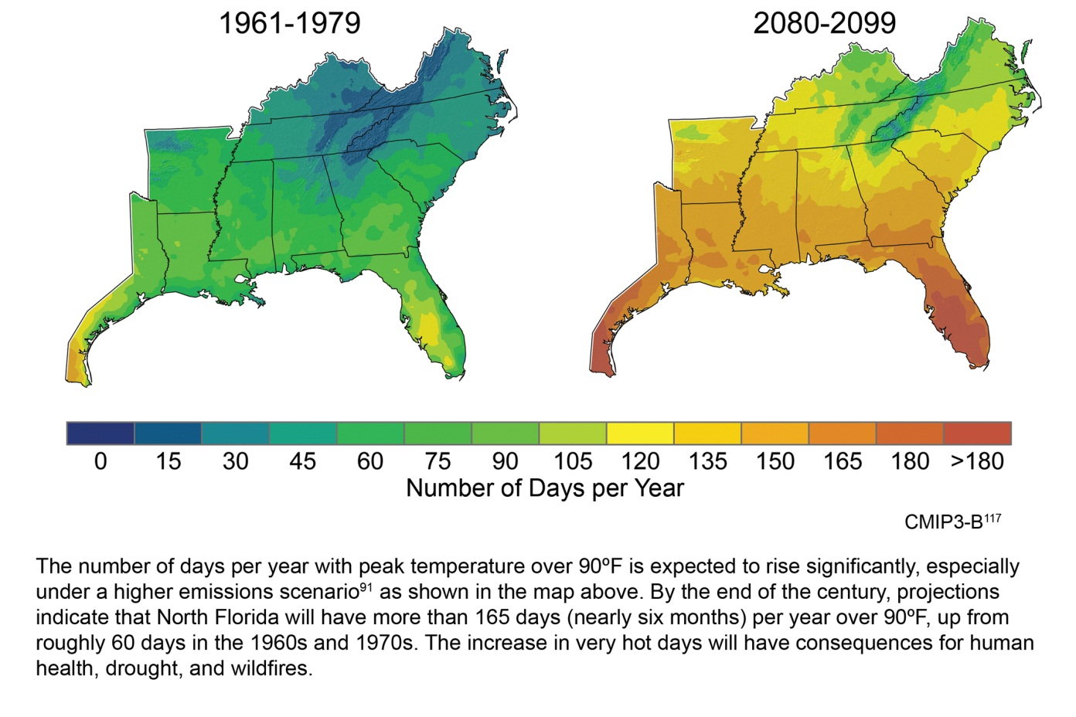
Justification
• Planted pine systems in the Southeastern US will be impacted by climate change.
• Increases in temperature, with summer precipitation rates declining by 10 to 30%
• These changes will increase vapor pressure deficits, changing soil water deficits and impacting C sequestration in Southern pines
• Warming oceans are expected to increase hurricane intensity, thus wind damage, leading to a potentially large impact on regional C balance
USGCRP 2010

Slide 15
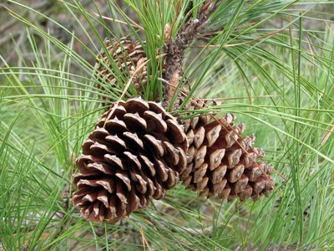
Justification
• Southern forests contain 36% (12 Pg) of sequestered forest C in the contiguous United States
• Forests sequester 13% (76 Tg) of regional C emissions
• Can sequester more through reforestation, afforestation, and improved forest management
• PINEMAP goal is to enable landowners to mitigate rising atmospheric CO₂ through research and extension

Slide 16
Experimental Sites: 3-tiered approach
Tier I sites (several thousand)
• Will provide spatial and temporal variability of productivity in relation to geography and climate
Tier II sites (~140)
• Quantification of C pools and fluxes – soil heterotrophic respiration
• Vegetation and soil C sampling
Tier III Sites (4)
• Manipulative treatments will be done to test interactions of genetics, fertilization and precipitation
• Soil CO2 efflux measured and vegetation and soil C sampling

Slide 17
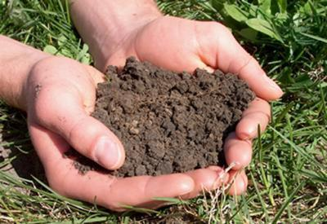
Vegetation and Soil Sampling
Following international protocol for C accounting
Measurements of standing live and dead trees, understory vegetation, coarse and fine woody detritus, forest floor, and soil organic matter, roots, and chemical and physical properties collected at 0-5, 5-10, and 10-20 cm depths
Sieved, air dried soils archived according to USDA supported National Soil Carbon Network methods

Slide 18
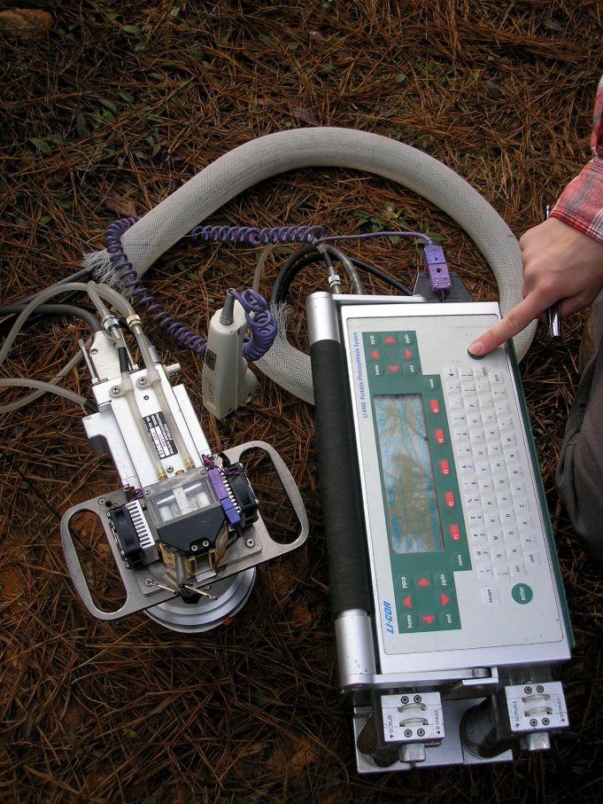
Ecophysiological Measurements
Parameterize inputs for Physiological Principles in Predicting Growth (3-PG) model (IPAR_{max})
Stomatal conductance, WUE
Linked to C assimilation
Soil CO₂ efflux on Tier II and III sites
Heterotrophic separated from autotrophic by root exclusion tells us
Quantify NEP or C storage
Minimum GPP allocated to support root development
Rate of decay of old soil carbon
Data shared in a centralized C information system
Measuring soil CO₂ efflux at the GA Tier III site with the LI 6400 Portable Photosynthesis System and Soil CO₂ Flux Chamber

Slide 19
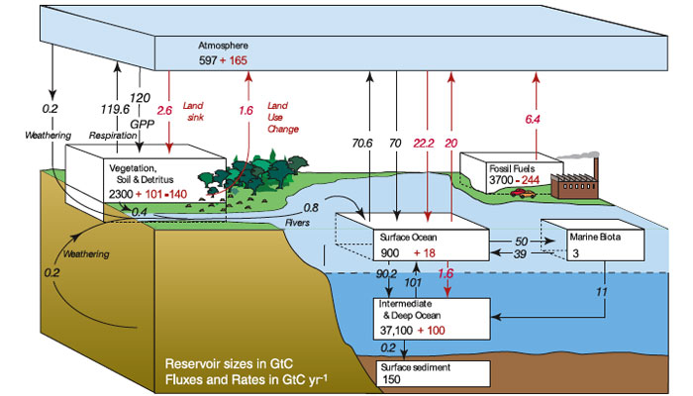
Soil Respiration
Soils are the largest terrestrial C pool (Schlesinger, 1977)
Soil respiration is the second largest flux in the C cycle (Raich and Schlesinger, 1992)
Management can decrease the time it takes for forests to go from a C source to a C sink (Sampson et al., 2006)
The predicted shift in productivity of intensively managed forests due to climate change could negatively impact the forests ability to sequester C
However the goals of PINEMAP to mitigate these climate effects on pine production will aim to increase resilience of pines
© Climate Change 2007: The Physical Scientific Basis, Intergovernmental Panel on Climate Change.

Slide 20
Soil Respiration
Measuring Soil respiration will elucidate
Net ecosystem productivity (NEP), or C storage, from estimates of net primary productivity (NPP) requires the separation of heterotrophic, microbial respiration (R_{H}) from autotrophic, root-derived respiration (R_{A})
Separating RH from RA will yield estimates of NEP. The difference between NPP and RH estimates NEP and thus the carbon balance of the system
Separating these components under experimental manipulations (Tier III) will inform models of how these treatments might affect the C storage under various management scenarios

Slide 21
AIM 1 - Nitrogen: PINEMAP Research Proposed and Justification

Slide 22
Nitrogen & PINEMAP - Project Goal 1
Establish a three-tiered monitoring network based on existing cooperative research trials, and develop standardized methods to quantify C, water and nutrient storage (Nitrogen = N) and flux baselines and response to climate and management

Slide 23
Nitrogen & Productivity
Productivity of loblolly pine plantations in the SE USA commonly limited by low soil nutrient availability (Fox et al. 2007)
Important stages for fertilization:
Stand establishment – N availability > N demand
High decomposition & mineralization rates
Seedlings smaller size
Rapid expansion of foliage that occurs at this period (Blazer et al. 2006)
• Canopy closure – N availability < N demand (Piatekand Allen 1999, 2001)
Plant available nutrient supply decreases in soil
Nutrient use increases for plant
• N availability limits leaf area production and plant growth

Slide 24
N Relationships in Loblolly Pine Stands
Fox et al. 2007

Slide 25
Solving N Limitations in Stands
Nutrient amendments (fertilization) aimed at increasing leaf area and stemwood production are common (Albaugh et al. 2007)
Most field trials (~85%) for SE USA stands (>5–10 yrs. old) displayed strong growth responses following N fertilization (Martin et al. 1999, Amateis et al. 2000, Fox et al. 2007)

Slide 26
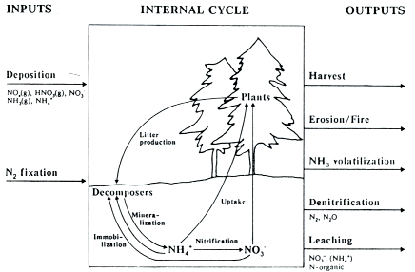
Where Does Fertilizer N Go?
10-25% in trees (Mead and Pritchett 1975, Blazier et al. 2006, Mead et al. 2008)
75-90% Other pathways
Understory (hardwood, vine, herbaceous species)
NH3 volatilization
leaching
denitrifcation
harvest
fire
erosion

Slide 27
Decisions for N Fertilization
Magnitude of growth response
Product mix in the stand
Stumpage prices
Cost of fertilization
Length of time before harvest

Slide 28
Efficient N Fertilization
Developing an integrated silvicultural program (Fox et al. 2007)
Genotypes
Site preparation
Hardwood herbaceous control
Thinning
Additional nutrients (Fox et al. 2007, Timothy et al. 2007)
Understanding N volatilization (Zerpa and Fox 2010)
Site specific concerns
Forest floor moisture
Forest floor vs. open mineral soil
Urea formulation

Slide 29
PINEMAP N Efficiency - Management Alterations
Increase acreage fertilized due to lower fertilization cost associated with improved N efficiency fertilizers
Use of enhanced efficiency N fertilizer to reduce amount of N applied per acre
Use of enhanced efficiency N fertilizer to reduce C cost associated with N fertilizer manufacture
Martin et al., Southern Conifer Climate Change CAP

Slide 30
PINEMAP N Efficiency – Potential Impacts for Stands
15% increase in in situ + ex situ C stocks
Industrial = 10 million ac.
NIPF = 500,000 ac.
50% reduction of N fertilizer application
Industrial = 50% reduction in N fertilizer acres /500,000 ac/yr
50% of fertilized acres /50,000 ac/yr
Martin et al., Southern Conifer Climate Change CAP

Slide 31
Conclusion
N is essential nutrient for plant growth and N limitation reduces loblolly pine plantation productivity
Plantation management decisions based on inefficient N fertilization can be costly and environmentally problematic
PINEMAP is integrating existing and current research on enhanced N fertilization, silviculture, and genetics to increase N efficiency, reduce N fertilizer application, and increase productivity in SE USA loblolly pine plantations

Slide 32
AIM 1 - Water: PINEMAP Research Proposed and Justification

Slide 33
Contents
Precipitation manipulation
in Tier III sites
Ecophysiological measurements
in Tier II and III sites
Sap flow measurements
Stable isotope analysis

Slide 34
10% Reduction in Water Use
How to reach this goal:
Water Use Efficiency
Increase carbon gain per unit of transpiration
Genetic selection
Stand level reduction in transpiration
Competition control
Stand density management

Slide 35
Precipitation manipulation
Conducted at 4 Tier III sites at the edges of the loblolly pine range
Imposed by installing fiberglass throughfall diversion panels in the forest understory

Slide 36
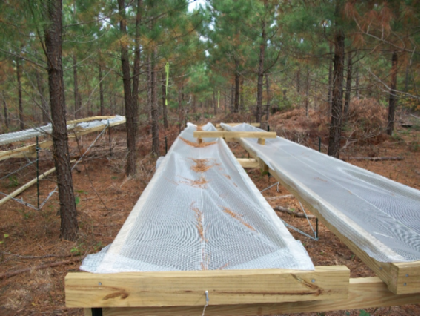
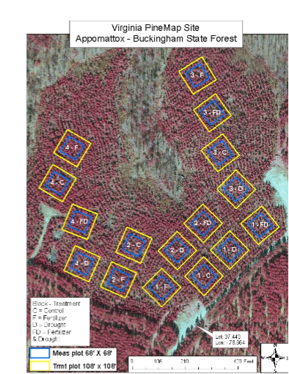
Precipitation manipulation at Virginia site
Factorial design with precipitation as a factor
Two levels: control, 30% reduced

Slide 37
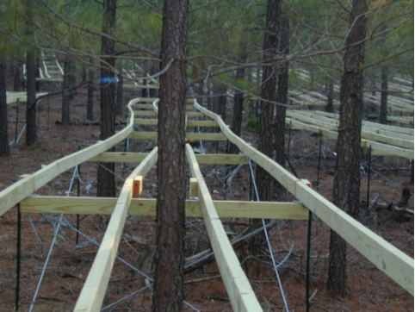
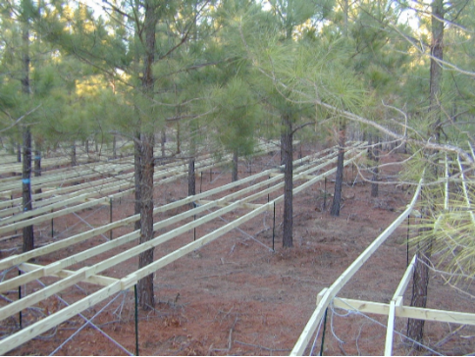
Precipitation manipulation at Virginia site

Slide 38
Ecophysiological measurements
Sap flow measurements for tree level water use
Stable isotope (δ13C and δ18O) analysis for water use efficiency

Slide 39
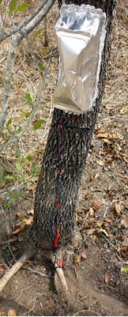
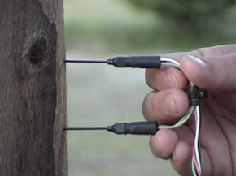
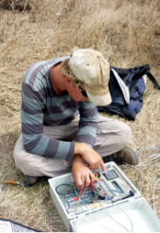
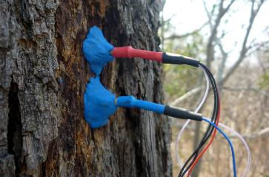
Sap flow measurements
Photos taken from: http://www.ictinternational.com.au/tdp.htm, http://hannes-hachmann.blogspot.com/2010/10/sap-is-finally-flowing-under.html

Slide 40
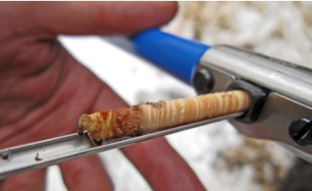
Stable isotope analysis
Collect tree cores
Cut the latewood from the target tree rings
Analyze δ13C and δ18O from the wood samples
Obtain WUE data based on isotopic analysis data
Photo taken from http://dendrodan.wordpress.com/category/introduction/

Slide 41
Ecophysiological measurements
For model parameterization (Aim 2)
Tree level transpiration estimates
Link transpiration rates to soil water availability and vapor pressure deficits

Slide 42
Ecophysiological measurements
Attribute water stress to physiological or environmental constraints
Characterize variation in tree WUE by genotype, tree age, and region
Provide a physiological understanding of underlying mechanisms for the relationship between regions and genotype under climatic change scenario

Slide 43
Aim 1 Conclusions:
Deliverables:
Standardize methods for estimating C, N, H₂0 pools and fluxes
Quantification of cross-regional fertility rating and stomatal response functions
Regional C, N, H₂0, Soil CO₂ evolution baselines and responses to silvicultural treatments

Slide 44
Aim 1 Conclusions:
Collaborate with other Aim Groups
Data to Aim 2 for modeling
Silviculture by Genetics interactions (Aim 3)
Data to Aim 4 for LCA and management responses
Graduate educational opportunities and support to (Aim 5)
Disseminate findings through Coops and support (Aim 6)

