Slide 1
PINEMAP Aims 5 & 6 Education & Extension
Aaron Vuola
Stephanie Hall
Martha Monroe

Slide 2
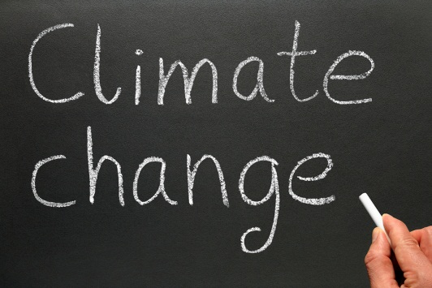
Objectives
Aim 5 objectives:
Create inquiry-based educational resources that convey the relationship of southern pine forests and climate change
Engage undergraduates in research and teaching activities
Prepare graduate students to address climate change adaptation and mitigation issues
Picture: http://greenplanetethics.com/wordpress/climate-change-denial-curriculum-moving-into-public-school-science-classrooms/

Slide 3
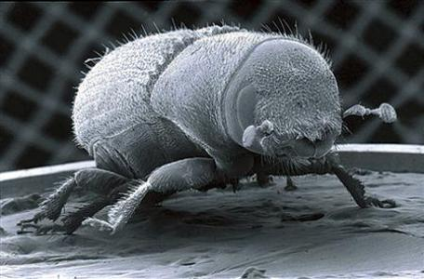
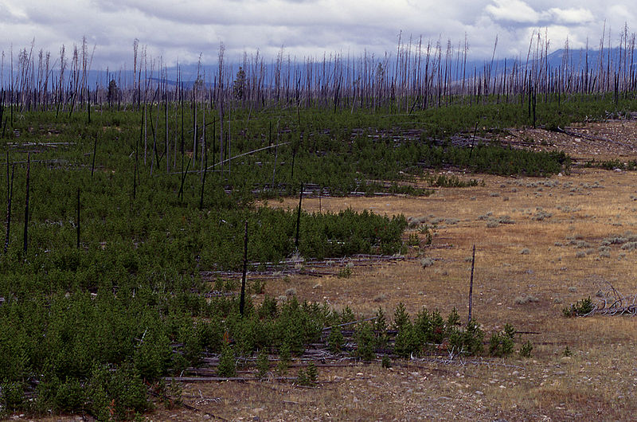
Objectives
Aim 6 objectives:
Develop extension programming that delivers climate and forest management knowledge, resources, and management decision support tools to forest landowners, policy makers, and resource managers
Pictures: http://blogs.reuters.com/environment/2010/12/09/cancun-talks-ignore-intrusive-aspect-of-climate-change/
http://carbon-based-ghg.blogspot.com/2011/03/climate-change-killing-lodgepole-pines.html

Slide 4
Outputs
Aim 5 outputs:
Summer research internship for undergraduates
Climate change and forests graduate course
Project Learning Tree secondary module on Southern Pine and Climate
Aim 6 outputs:
Website on southern pine/climate change mitigation and adaptation
Extension programs and materials on planted pine and climate change
Research

Slide 5
Relation to PINEMAP Goals
By informing the public and the next generation about the relationship between climate change and southern pine forests, we can change behavior to increase climate change adaptation and mitigation
These aims integrate the information from the other (research) aims and deliver it to the public

Slide 6

Science behind the Aims
Theory of Planned Behavior
Diffusion of Innovations
Picture: http://lookatmyhappyrainbow.blogspot.com/2011/04/thinking.html

Slide 7
Theory of planned behavior
“Since people’s beliefs represent the information (be it correct or incorrect) they have about their world, it follows that their behavior is ultimately determined by this information.” (Ajzen 1985)
“The success of an attempt to execute the behavior plan depends not only on the effort invested (the strength of the attempt) but also on the person’s control over other factors, such as requisite information, skills, and abilities, including possession of a workable plan, willpower, presence of mind, time, opportunity, and so forth.” (Azjen 1985)

Slide 8
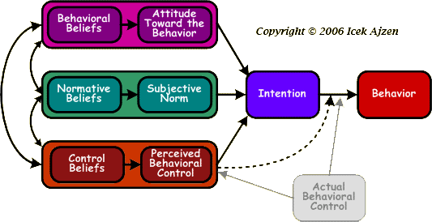
Science behind the Aims
Theory of planned behavior
Figure: http://people.umass.edu/aizen/tpb.diag.html

Slide 9
Diffusion of Innovations
Extension agents work as “change agents”
“Individuals who attempts to influence clients’ innovation-decisions in a direction that is deemed desirable by a change agency” (Rogers 1995).
Agricultural Extension in the US is stated to be the word’s most successful change agency

Slide 10
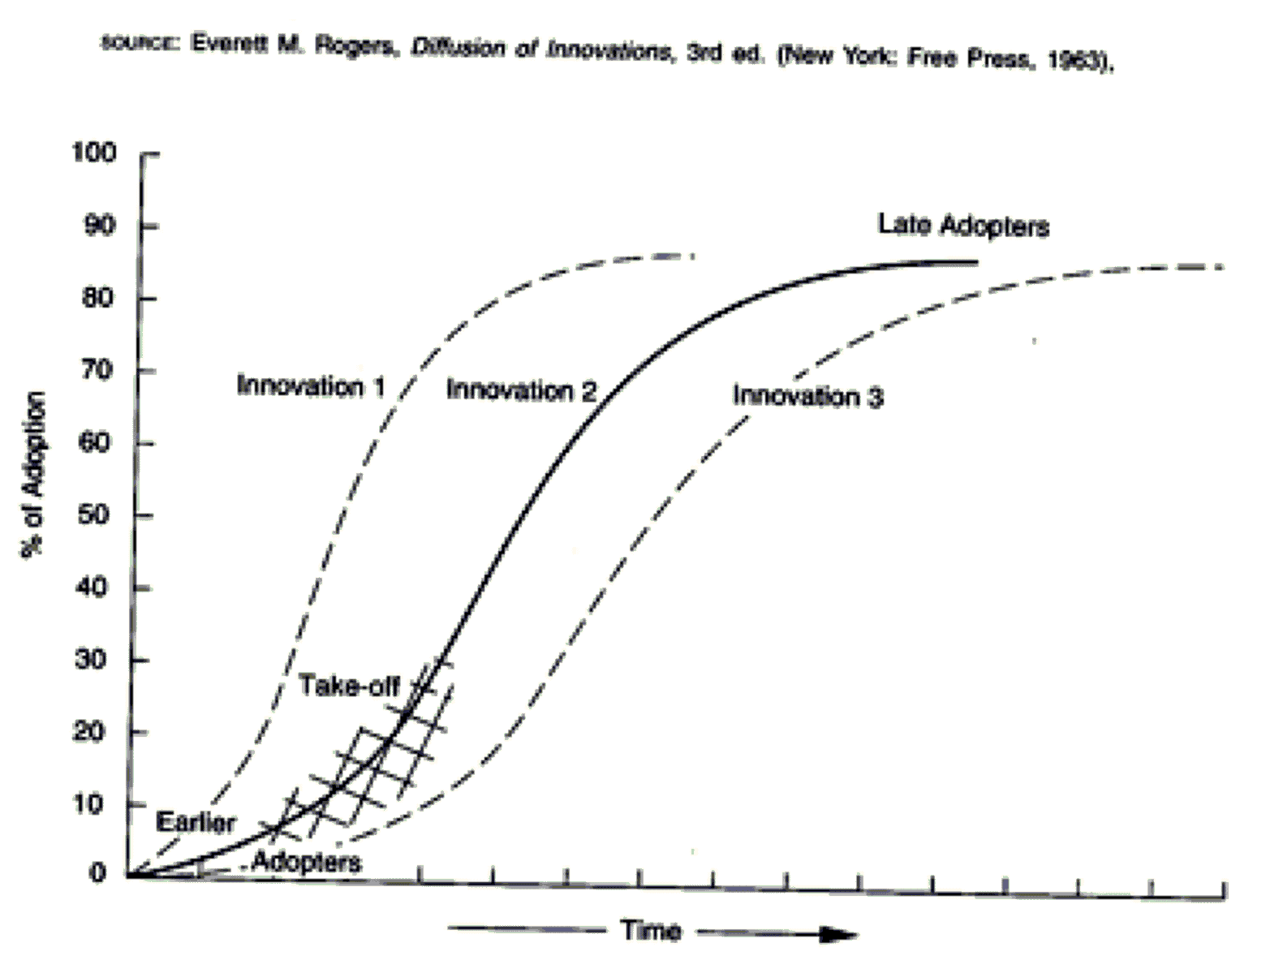
Science behind the Aims
Diffusion of Innovations
Figure: http://theory.isthereason.com/?p=35

Slide 11
Research
Aim 5: High school students and climate change education: How do students’ perceptions of their parents opinions about climate change affect their own opinion about climate change? How do different lesson formats affect students’ tendency to anchor to their original conceptions of climate change?

Slide 12
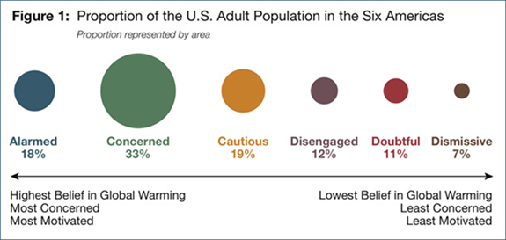
Research
Aim6: Extension Perceptions and the Six Americas of Climate Change: How do Extension personnel/agents engage themselves with the issue of global warming and how they differ form public perceptions in the US. How does it affect Climate Programming?
Source: Leiserowiz et al. (2008)

Slide 13

Suggested Readings
Theory of planned behavior (Azjen 1985)
Diffusion of innovations (Rogers 1995)
Chapters 1 and 10
Global Warming’s Six Americas (2009)

Slide 14
Discussion Questions
How will your research be important to the program development?
For which audience will your research be the most helpful?
What information from your aim will be the most important to share through the educational and extension programs?

Slide 15

Thank You!

