Slide 1
Aim 4 : Economics and Policy

Slide 2
Aim 4 Members
Robert Abt, Faculty, NCSU
Damian Adams, Faculty, UF
Douglas Carter, Faculty, UF
Don Grebner, Faculty, MSU
Jianbang Gan, Faculty, TAMU
Gary Peter, Faculty, UF
Mike Kane, Faculty, UGA
Tom Fox, Faculty, VT
Francisco Escobedo, Faculty, UF
Wendell Cropper, Faculty, UF
Puskar Khanal , Student , MSU
Soyoung Lee , Student , TAMU

Slide 3
Objectives
Objectives
Comprehensive life cycle
analyses of regional forest
management systems
Multi-scale policy and economic analysis of market and
non-market forest benefits and
services
Evaluate regional tradeoffs and interactions among policy,
climate scenarios, carbon/water/nutrient/energy footprints,
forest management, and genetic deployment
Assess adoption of
alternative approaches by
private landowners.

Slide 4
Key linkage to Other Aim Groups
Aim 4
Conducts economic
and Policy studies
Aim 1
Aim 5/6
Aim 3
Aim 2
  Provides field-level data to support LCA and regional modeling
  Provides data and forest growth/yield modeling results, and carbon dynamics to support LCA and regional modeling
  Extension, Interaction with research efforts for collaborative working relation and partnership
  Provides findings on the impact of selected genotypes on productivity and resistance to disturbances to support LCA and regional modeling

Slide 5
Relation to PINEMAP goals
Aim 1: Provide field-level data to support LCA and regional
modeling
Aim 2: provide data and modeling results on forest growth/yield and carbon dynamics
Increase C sequestration by 15 % by 2030;
Increase efficiency of practices by 10% by 2030;
Increase forest resilience and sustainability under variable climates
Aim3: Provide results on the Impact of selected genotypes on forest productivity and resistance to disturbances
Aim 4: Conduct LCA analysis, optimization studies, financial and policy analysis ,and landowner studies
Aim 5/6: Create educational resources and training materials, deliver state-of –art information to landowners, resource managers and policy makers
Notes:
All these aim group findings will collectively help to achieve those targets.

Slide 6
Approach
Broader approaches to look at aim 4 objectives:
1. Life cycle analysis (LCA)
2. Financial and policy analysis
Aim 4 approaches
3. Scenario analysis and modeling
4. Landowner studies
Notes:
The objectives of the aim group 4 fall into one of these categories. This is the general categorization of the objectives.

Slide 7
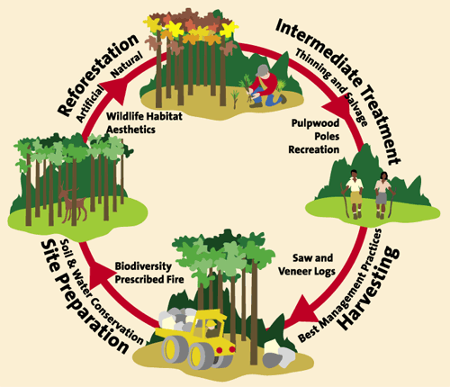
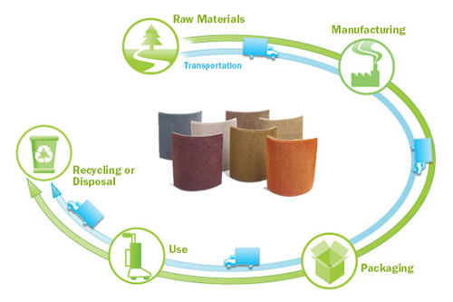
Approach/method
1. Life cycle analysis (LCA)
  Is a “cradle-to-grave” approach for assessing industrial systems.
forest products
forestry operations
Notes:
“life cycle” refers to the major activities in the course of the product’s life-span from its manufacture, use, and maintenance, to its final disposal, including the raw material acquisition required to manufacture the product
LCA provides a comprehensive view of the environmental aspects of the product or process and a more accurate picture of the true environmental trade-offs in product and process selection

Slide 8
How would other groups assist?
Providing data on each stage of a product's life from cradle to grave (from raw material extraction through materials processing, manufacture, distribution, use, repair and maintenance, and disposal or recycling); and modeling results
Approach
1. Life cycle analysis (LCA)
Key question addressed
Potential environmental impacts associated with the identified inputs
and releases, or processes

Slide 9
Approach
2. Financial/economic and policy analysis
Major financial analysis tools
Net present value analysis, Faustmann formula, Hartman formula, discounted cash flow analysis
Policy review and analysis
tax policy, subsidies effect analysis
    These tools are employed for determining the optimum use of scarce resources, involving comparison of two or more alternatives in achieving a specific objective under the given assumptions and constraints

Slide 10
Approach
2. Financial/economic and policy analysis
How would other aim groups assist?
Providing data about the adoption practices (aim group 5 & 6) of the
selected genotypes (aim group 3) predicted to provide certain growth and yield (aim group 3) under varied climactic conditions (aim group 1)
Key question answered
Potential financial returns from the alternatives
Expected economic and policy environment to make the practice
acceptable to the landowners

Slide 11
Approach
3. Scenario analysis and modeling
The major approaches for scenario modeling and analysis
    Options analysis coupled with dynamic optimization under risk
    Panel data modeling
    Sub regional Timber Supply (SRTS) modeling

Slide 12
Approach
3. Scenario analysis and modeling
Dynamic modeling/optimization
Represents a technique for the systematic determination of optimal combinations of decisions
Is a method for numerically solving a dynamic system of equations
Can work iteratively through the sequence of decisions in forward or backward flowing fashion
Is used to maximize biological potential and economic returns related to a stand of trees

Slide 13
Approach
3. Scenario analysis and modeling
Panel data modeling
Panel data refers to pooled cross-section and time series, longitudinal, or repeated measurements
Panel data model could reveal,
Impact of climate change on the risk of the disturbances
Contributions of adaptations to mitigating the risk under climate change
Economic losses in terms of timber and carbon values based on timber and carbon prices and projected future forest areas in the South under climate change.

Slide 14
Approach
3. Scenario analysis and modeling
SubRegional Timber Supply (SRTS) modeling
SRTS uses FIA data to project timber supply trends based on current conditions and the economic responses in timber markets
It models regional product market and carbon consequences of business-as-usual and
potential new silvicultural management regimes
It uses the empirical product supply and demand relationships to project changes in inventory characteristics (forest type, age class structure, product inventories, harvest, and growth)

Slide 15
Approach
3. Scenario analysis and modeling
How would other aim groups assist?
Providing data on projected management scenarios on different climatic conditions
( aim 1), their genome and productivity characteristics ( aim 3), their growth and yield models ( aim 2), and the landowner level feedback about optimum practices (aim 5 & 6)
Key questions answered
Optimum management scenarios with given biological potential and expected economic return
Economic analysis, risks involved, and climate change impact
Projected demand and supply situations under different climactic conditions and timber management scenarios

Slide 16
Approach
4. Landowner studies
The major tools used in landowner studies are
Survey tools
Landowner socio-economic studies, decision making, and willingness studies
Their Behavior modeling and econometric analysis
Key questions answered
Landowner characteristics, forestry behaviors and preferences
Their willingness to adopt optimum management scenarios, and predicted forestry practices, and policy environment desired for adoption of new regimes

Slide 17
Thank you !!

