Slide 1




Pinemap Graduate Course Assignment 1
(Genetics of Adaptation)
Rajesh K Bawa
Alfredo E. Farjat
Mengmeng Lu
Jianxing Zhang

Slide 2
Outline
Background
Objectives and Goals
Basic terms and Jargons
Why’s and Why not’s
Methods
Benefits and Applications

Slide 3
Background
Genetic improvements in forestry dramatically increase the productivity of planted pine in the southeast US.
Climate is a key environmental factor affecting the phenotypes and genotypes of trees.
How can forestry adapt to changes in climate and climate variability?

Slide 4
Objectives and Goals
Analyze genetics of breeding and natural populations to discover alleles in genes controlling important adaptation and mitigation traits that enable future tree breeding strategies
Deliver deployment guidelines for genotypes suited for varied climatic conditions to maximize resiliency and reduce adverse impacts of climate change on productivity.

Slide 5
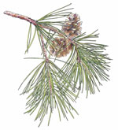
Terminology
Basic terms and jargons
Genes: The basic unit of inheritance, which is transmitted from parents to offspring.
Alleles: Alternate forms of a gene (more than 1) or genetic locus.
Genotype: Genetic constitution of an individual.

Slide 6
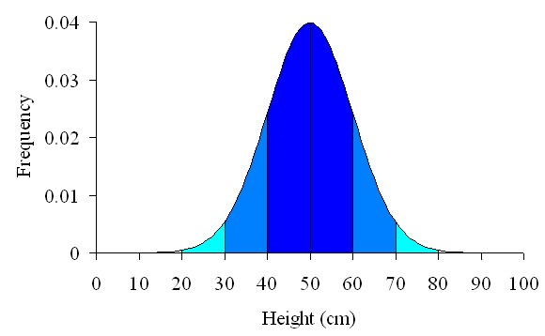
Terminology
Phenotype: The observable traits of an organism. In genetics phenotype is defined as interaction of genotype and environment
Phenotype = Genotype + Environment
Quantitative traits: The traits controlled by multiple genes or polygenes. They are also termed as polygenic traits or continuous traits as they show continuous variation of phenotype. Most of the economical and ecological traits, such as growth, biomass, disease resistance, etc., are quantitative.

Slide 7
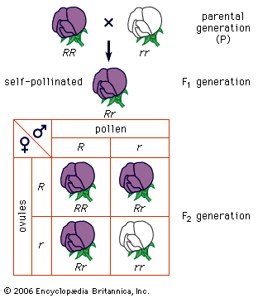
Terminology
Explanation
In the given example, the gene being looked at is controlling flower color
R and r are two allelic forms of the same gene controlling color, where R presence leads to purple and r presence leads to white color.
RR, rr and Rr are genotypes of individuals, having same or different allelic pairs
R is dominant over r, so in heterozygous state (Rr), we see purple color

Slide 8
Terminology
Quantitative trait Loci : A region of DNA that is associated with a particular phenotypic trait. The QTLs are often found on different chromosomes.
Phenology: Seasonal life cycle events, like bud set, bud flush, flowering and the timing of these events along the growing season.
Seed zones: Areas where seeds of similar population genetics have been determined by scientists as being genetically similar and adapted through evolutionary processes for fitness.

Slide 9
Why Genetics ?
Why is Genetics important on climate change?
Observable traits are product of genes and their interaction with environment. The economical and ecologically relevant traits are function of expression of group of genes that regulate a specific phenotype.
Some of the variation in these genes is functionally relevant both to the expression of the phenotype and geography or local climate of that area, thus is important for local adaptation

Slide 10
Why focus on quantitative traits?
The traits related to fitness of the tree, and the ones which are agronomicaly relevant are all complex traits
These traits fall into four categories: growth and biomass, apical bud phenology, resistance to biotic and abiotic stress and wood properties.
So the variation we see in these traits is sum of small variations in large number of genes controlling that trait.

Slide 11
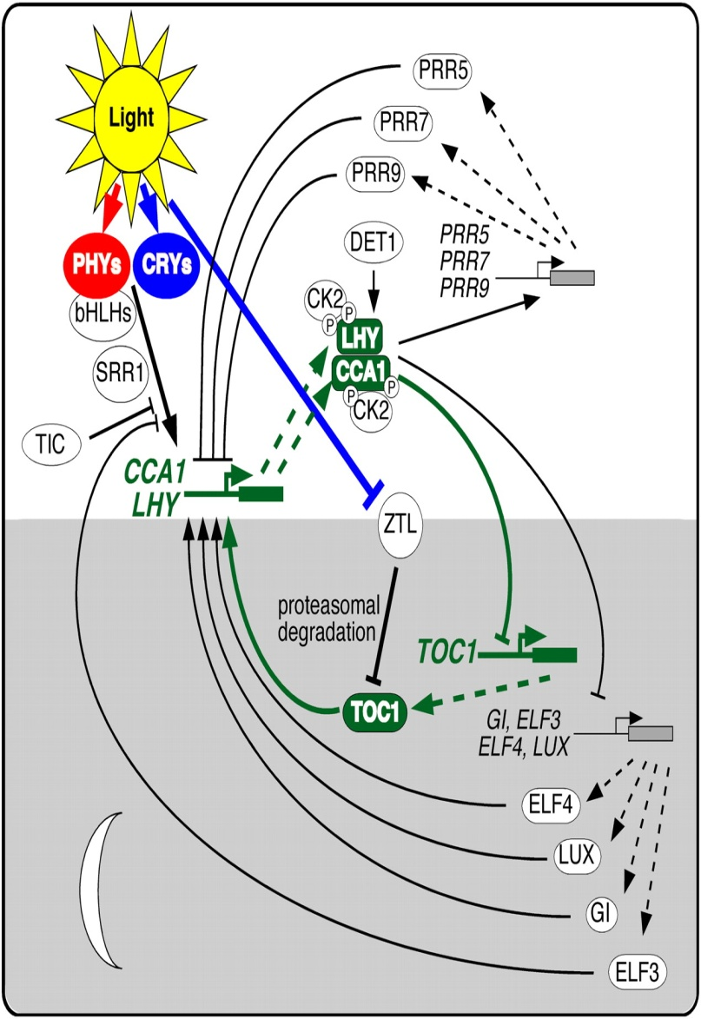
Why focus on quantitative traits?
This quantitative trait variation is attributable to few genes with large effect (major genes) and large number of genes with small effect (minor genes).
Figure on the right shows genes involved in flowering in Arabidopsis. Genes highlighted in green are major genes.

Slide 12
Why phenotyping?
Timing of phenological traits like bud set, bud flush are related to local climate ( mostly temperature and light) conditions
Common garden experiments have shown that same species from different locations have different timings for these traits, demonstrating local adaptation
Genetic variation found has to be associated to specific traits measured (at specific location and time) to find functional relevance of that variation, termed as marker-trait associations

Slide 13
Methods
Genetic studies will be conducted in 3 populations:
Plantations selection seed source study (PSSSS)
Comparing clonal lines on experimental sites (CCLONES)
Allele discovery of economic pine traits 2 (ADEPT2)

Slide 14
Methods
Complete δ¹³ studies on ADEPT2 populations
Water use efficiency (WUE) correlates to CO₂ uptake, and isotopic composition of plant tissues can provide index for measuring WUE.
In δ¹³ studies ratio of amount of ¹³C to ¹²C is measured in sample and compared to standard isotopic composition
This will be used for finding drought adaptation or WUE related QTLs in Loblolly pine

Slide 15
Methods
2. Determine appropriate genome reduction methods
Conifers genome size is extremely large, ranging b/w 20-40 Gbp, which is 7 fold larger than humans and 300 folds larger than Arabidopsis.
Genome is filled with repetitive sequences, which complicate structural and functional genomic studies
Since sequencing entire genomes is still rather expensive, and most functional variants are probably in or near genes, we would like to enrich for those and not waste our efforts and $ on intergenic regions

Slide 16
Methods
2. Determine appropriate genome reduction methods
the methods used will be:
Target Gene Sequence Capture: Solution hybridization capture and sequencing of specific gene sequences (Agilent SureSelect Target Enrichment system).
Restriction Enzyme-based reduced representation libraries: use restriction enzymes to create reduced DNA libraries of entire genome. This helps to reduce genomic complexity and increase sequence efficiency and coverage

Slide 17
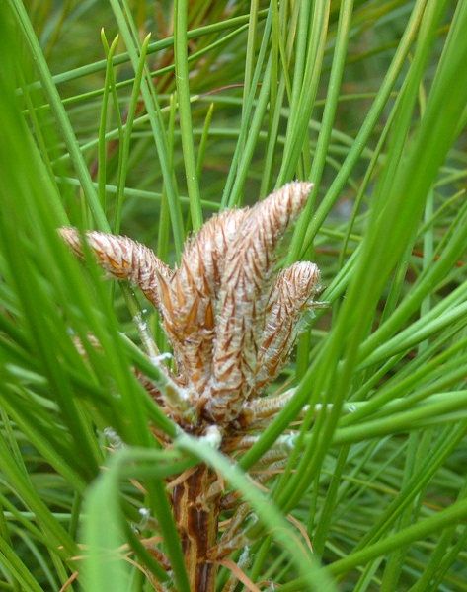
Methods
Flowchart for genome reduction and allele discovery
Loblolly pine gene enrichment using Agilent SureSelect Target Enrichment System using oligonucleotide probes based on 35,550 unigene sequences, then sequence the captured genomic DNA
Design the oligonucleotide probes
Build the sequencing library
Capture the target sequences
Sequence
Assemble the sequences into contigs and map them to the unigenes or reference genome, if it would become available
SNP discovery
Identify alleles in adaptive trait related genes that could be involved in response to climate change via association mapping

Slide 18
Methods
3. Development of suitable Climate Models
The hypothesis underlying the development of climate models is that variation in the climate occurs geographically, and, therefore, elements of the climate can be predicted from geographic descriptors.
Spatial regression models using data from climatic stations are fitted to make predictions about the climate in the region under study. Models of the following form are used:
Where Yi is a climatic variable specific to station i, β’s are regression coefficients, X’s are geographical variables, and e is the residual.
The geographical variables are generally combinations of Latitude, Longitude and/or Elevation.

Slide 19

Methods
4. Develop uniform response functions (URF) with provenance and progeny trial data
Population Response Functions
In order to develop functions that predict specific traits of a population, such as height or survival rate, in relation to environmental gradients, the results from the climate models are used to describe the climate at the test sites.
A common approach is to fit a quadratic regression model to fit each climatic variable to the observed traits, such as height or survival, to the populations. The model can be written as follows:
Where Yij is the mean of the observed trait of population i at planting site j; β’s are the Regression coefficients; and Xj is a predicted environmental variable for planting site j.
Notice that this approach assumes that climate is the primary factor controlling the measured response.

Slide 20
Methods
4. Develop uniform response functions (URF) with provenance and progeny trial data
Transfer Functions
The response functions pertain to specific populations.
Transfer functions are developed to assess whether or not populations
occupy their optimal environments to achieve optimal growth and
productivity of the species as a whole.
This functions take into account the distance that the native population
should be transferred along an environmental gradient to attain its maximum.
A common approach is to fit a quadratic regression model with observations
of some populations as response variable and some measure of the transferred distance along the environmental gradient.

Slide 21
Methods
5. Genetic deployment tool (GDT) based on uniform response functions (URFs) after extensive provenance, progeny and clone trials
deployment of planting stock based on the performance (growth and survival data) and genetic tests (i.e. presence of certain alleles or variants of the ‘adaptive genes’) to ensure suitability of stock not only to yield, but also to be resilient to climatic changes

Slide 22
Methods
5. Genetic deployment tool (GDT) based on extensive provenance, progeny and clone trials
this will require extensive phenotyping of provenance and progeny trials in different physiographic conditions
and finding presence of specific markers (genotyping) after marker-trait associations are found from mapping studies
use uniform response functions and climate models to predict traits such as height and survival rate of populations under different climate scenarios

Slide 23
Methods
6. Discover alleles and genes related to productivity and adaptive traits in 3 populations.
Common garden experiments have shown that different local populations of same species are genetically differentiated and show varying phenological responses, thus showing local adaptation
in order to explore the molecular component of adaptive variation following steps will be performed

Slide 24
Methods
after next gen sequencing of all plants in three populations (ADEPT2, PSSSS, CCLONES), the same gene fragments in different populations will be compared to find single nucleotide polymorphisms (SNPs).
The SNPs found will be used based on presence in the gene (functionally linked) or outside the genes (neutral) to decipher various population genetics and evolutionary processes acting on the populations
Neutral markers will be used to find various demographic signatures (population expansion or bottleneck),population structure, gene flow and genetic drift acting in populations.

Slide 25
Methods
Patterns of allelic diversity in the genes will be used to find adaptation relevant variation
for this various nucleotide diversity statistics (θ_{w} , π , dn/ds ratio and others) will be used to find outliers (either showing low or high variation than expected)
the putative SNPs found will be statistically associated to phenotype or geographical location, showing its relevance to expression of that phenotype and local adaptation.

Slide 26
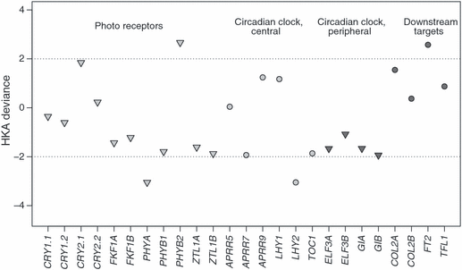
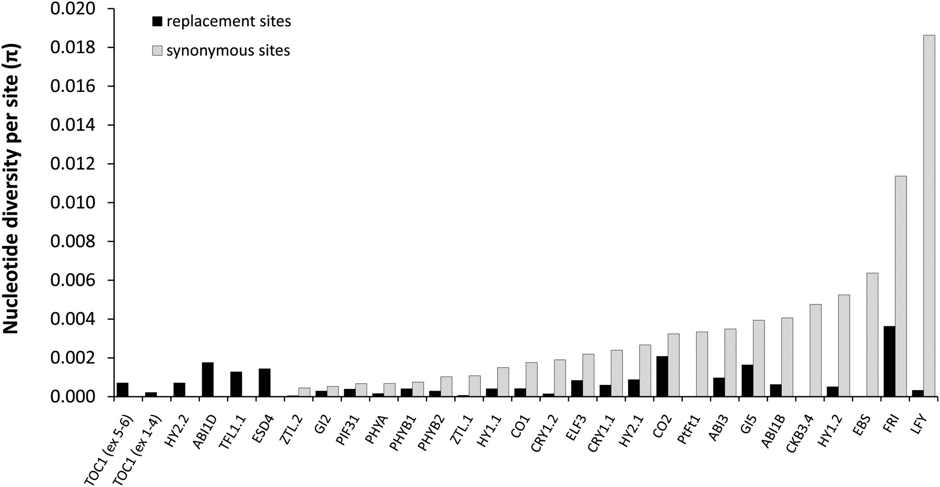
Methods
INGVARSSON et al 2011
Keller S R et al. Genetics 2011
These are figures of latest studies on local adaptation in Populus sp. The figure on the left shows outliers/genes showing high or low variation (using HKA test), and the figure on right shows frequencies of synonymous and nonsynonymous mutations in different genes.

Slide 27
Benefits and Applications
Find regions in the genome related to drought tolerance and water use efficiency
Find genes and alleles important for local and general adaptation
Discover QTLs related to more wood production, disease resistance and better yield
Develop genome reduction protocols for future gymnosperms research

Slide 28
Benefits and Applications
Genetic deployment tool and uniform response functions to allot correct planting stock for better productivity and reduce adverse effects of climate
Develop response functions and general transfer functions which will be suitable tool for estimating the effects of changing climates on forest growth and survival rate of different populations
Southern pine landowners could use the results of the research to adapt their forest management approaches to increase resilience in the face of changing climate.

Slide 29
References
Aitken, S.N., et al., Adaptation, migration or extirpation: climate change outcomes for tree populations. Evolutionary Applications, 2008. 1(1): p. 95-111.
Eckert, A.J., et al., Back to nature: ecological genomics of loblolly pine (Pinus taeda, Pinaceae). Molecular Ecology, 2010. 19(17): p. 3789-3805.
Gnirke, A., et al., Solution hybrid selection with ultra-long oligonucleotides for massively parallel targeted sequencing. Nat Biotech, 2009. 27(2): p. 182-189.
González-Martínez, S.C., K.V. Krutovsky, and D.B. Neale, Forest-tree population genomics and adaptive evolution. New Phytologist, 2006. 170(2): p. 227-238.
Neale, D.B. and A. Kremer, Forest tree genomics: growing resources and applications. Nat Rev Genet, 2011. 12(2): p. 111-122.

Slide 30
References
Neale, D.B. and P.K. Ingvarsson, Population, quantitative and comparative genomics of adaptation in forest trees. Current Opinion in Plant Biology, 2008. 11(2): p. 149-155.
Rehfeldt, G.E., et al., Genetic Responses to Climate in Pinus contorta: Niche Breadth, Climate Change, and Reforestation. Ecological Monographs, 1999. 69(3): p. 375-407.
Schmidtling, Ronald C.; Robison, T.L.; McKeand, S.E.; Rousseau, R.J.; Allen, H.L.; Goldfarb, B. The role of genetics and tree improvement in southern forest productivity. In: Gen. Tech. Rep. SRS75. Asheville, NC: U.S. Department of Agriculture, Forest Service, Southern Research Station, 2004. Chapter 10. p. 97-108
Wang, T., G.A. O'Neill, and S.N. Aitken, Integrating environmental and genetic effects to predict responses of tree populations to climate. Ecological Applications, 2010. 20(1): p. 153-163.

Slide 31
Thank You for Your Attention!
Questions or Comments?
Enjoy the Other Presentations!

