Slide 1
Aim 2 Modeling
C. Wade Ross
Nabin Gyawali
Ranjith Gopalakrishnan
Ying (Maggie) Wang
Beth Stein

Slide 2
Model Types
Models can be grouped into two categories:
Empirical: based entirely on collected data. Capable of describing real life behavior and can be highly accurate. However, empirical models require extensive data collection, often long term and expensive.
Mechanistic (Process based):Physiological process’ and interactions are expressed in mathematical equations. May not be as accurate as empirical anaylsis.

Slide 3
Growth and Yield Model
G&Y is a theory influenced, semi empirical, whole stand growth model.
Based on the purpose, model could be developed at stand or Individual tree level.
It is capable of modeling four variables (top height, tress per hectare, basal area and measure of stand closure) that can describe the stand at any point in time.
Forest growth is simulated based on important and readily available variables and modifying factors, well suited for situations where limited data is available.
Growth and yield model can provide high degree of accuracy in estimating stand volume or biomass when compared to process-based model.

Slide 4
Size, distance and number of neighboring trees
GROWTH
&
YIELD MODEL
Site Index
DBH
DBH Growth
Competit-ion
Thinning
Crown Ratio
Feritili
zation
Height Growth
Hardwood competition level
Mortality
Mathematical
relationship
Feedback path
Total height
TREE GROWTH COMPONENT
STAND LEVEL COMPONENT
Figures 1: A Schematic diagram of typical Growth and Yield model (Reproduced from Burkhart et al. 1987)

Slide 5
3-PG (Physiological Principle in Prediction Growth)
3PG is a generalized forest carbon allocation model that uses readily available data for inputs; such as species growth tables, latitude, aspect, weather, stand age and stand density to derive monthly estimates of GPP. Recent revisions allow the use of remotely-sensed estimates of leaf area index and basic soil information.
3-PG is hybrid model based on physiological processes and statistical growth and yield models.
Major physiological processes involved that govern the growth are interception of solar energy, it's conversion to biomass, and the distribution of biomass to tree components.
Model utilizes easily obtained weather and site condition data along with the biology of species and can be used to simulate growth and yield of forest stands and the effects of environment factors.

Slide 6
3-PG
Rainfall
Radiation energy
VPD
Canopy interception
Foliage/leaf area
Litter fall
Stomatal conductance
Canopy quantum efficiency
Nutrition
Transpiration
Primary (carbohydrate)
production
Soil water
Carbohydrate partitioning
Stems
Root mass, root turnover
Figure 2: Schematic diagram general 3-PG model based on Landsberg and Waring .

Slide 7
NASA-CASA (Carnegie-Ames-Stanford approach)
A global model that runs on a monthly time interval to simulate seasonal patterns in net plant carbon fixation, biomass and nutrient allocation, litter fall, soil nitrogen mineralization and CO2 production.
model includes both climatic and edaphic control factors and mostly used for climate change analysis of ecosystem productivity.
It relies heavily on satellite data and mechanistic plant, soil moisture and soil C:N submodels to simulate the carbon cycle flow.

Slide 8
NASA-CASA
AVHRR
SOLAR
RADIATION
TEMPERATURE
PRECIPITATION
SOIL MOISTURE
NET PRIMARY PRODUCTIVITY SUBMODEL
SOIL TEXTURE
LITTERFALL
N UPTAKE
SOIL CARBON- NITORGEN SUBMODEL
NET ECOSYSTEM PRODUCTION
DECOMPOSITION
RESPIRATION
Figure 3: Schematic diagram of NASA-CACA model (Potter et al. 1993).

Slide 9
WaSSI-C (Water-Centric monthly scale Simulation model)
This model also operates at a monthly temporal scale and simulate full monthly water and carbon balances, including evapotranspiration (ET), soil moisture content, water yield, gross ecosystem productivity (GEP), ecosystem respiration etc. and aggregate the fluxes to the entire water basin.
Model is used to study the relation between regional water and carbon resources under a changing environment.

Slide 10
WaSSI-C (Water-Centric monthly scale Simulation model)
WaSSI-C is a regional scale model used to simulate both spatial and temporal watershed stress and carbon flow in an area of interest by using empirical measurements of water and carbon fluxes. WaSSI-C was developed to be used as a tool for land and resource managers to examine tradeoffs between regional water and carbon resources under changing environmental conditions.
Operates at a monthly temporal scale and simulates full monthly water and carbon balances, including evapotranspiration (ET), soil moisture content, water yield, gross ecosystem productivity (GEP), ecosystem respiration etc. and aggregate the fluxes to the entire water basin.

Slide 11
ET = f(PET,P,LAI,S)
GEP = f(ET)
WaSSI-C
P
Re = f(Ta, or ET, or GEP)
WATERSHED WITH MIXED LAND COVER
P = Precipitation
ET = Evapotranspiration
PET = Potential evapotranspiration
LAI = Leave area Index
S= ground water storage
GEP = gross ecosystem productivity
Re = ecosystem respiration
Ta = temperature
NEE = Net ecosystem exchange and NEE = -NEP, where NEP is Net ecosystem productivity
Q = historic runoff
Q = f(P,ET,S)
Water balance Carbon Balance
ΔS = P-Q-ET NEE = -(GEP -Re)
Figure 4: Sketch of conceptual framework of WaSSI-C model (Sun et al. 2011).

Slide 12
Parameters Linking Models
# of Trees, Basal Area, LAI
(G&Y output)
ET
(NASA-CASA output)
WaSSI-C
input
3-PG Model
input
LAI
(3-PG output)
Notes:
Those parameters that linked the aim2’s models

Slide 13
Climate Parameters for Models
T_{min}
T_{max}
Rainfall
Solar Radiation
Frost day
3-PG
(monthly step)
NASA-CASA
(monthly step)
Precipitation
Temperature
Solar radiation

Slide 14
Climate Parameters for Models
G&Y
WaSSI-C
(monthly step)
No need of climate data input
But can be interfaced to additional climate data
Precipitation
Mean air Temperature

Slide 15
Differing Model Uses of LAI and fPAR
Model | LAI | fPAR
Growth & Yield | Resource capture from thinning
3PG+ |  | Calculate total fixed C (gross primary production) by controlling fPAR for soil drought, atmospheric vapor pressure, and age of stand
NASA-CASA |  | Calculate amount of plant biomass produced through an equation that takes into account temperature and soil moisture
WaSSI-C | Calculate the ET (for water balance equation) along with PET and precipitation (P) | Used by MODIS ET algorithm for model validation
Future climatic scenario to calculate fPAR:

Slide 16
Future Climatic Scenarios to Calculate fPAR
Space/time substitution: If climate expected to be hotter/wetter by the models, then substitute a current location of a similar climate for desired location in the future (e.g. substitute fPAR values for Raleigh, NC in 2000 for Blacksburg, VA in 2050)
Use G&Y models to get LAI, then derive fPAR from LAI
3PG gives LAI and APAR, which can be used to calculate fPAR
With CASSA: Calculate the trend in NDVI changes over a historical timeframe from the AVHRR imagery (since fPAR is linearly correlated with NDVI), then follow that trajectory to specific dates in the future, assuming a consistent trend

Slide 17


Model Sensitivity Analysis
Helps understanding model better
Identifies important parameters
Builds confidence in using the model
Esprey et al. 2004

Slide 18
Model Sensitivity Analysis
HOW?
Full Factorial Design
Random Sampling
Fractional Factorial Design (Taguchi Method)
Clemson et al., 1995, p.45
Latin Hypercube Sampling
Change the value of one parameter while all other parameters are held constant

Slide 19
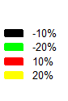
3-PG Sensitivity Analysis
1
1
2
3
4
(Wang et al., unpublished data)
Notes:
For example, graph4, by changing the parameter StemConst by -20% (from the original StemConst), the prediction of basal area will change more than 300% (by comparing with the original basal area), which means the “Basal area” is very sensitive to the parameter “StemConst”. Alpha is the canopy quantum efficiency, fN0 is a fertility effect parameter. FR is fertility rating, stemconst is a constant in the stem mass to diameter relationship, There are also some other parameters that the output are sensitive to, too. But because of the limited space, there are only 4 graphs showing here.

Slide 20
Sensitivity Analysis
NASA-CASA:
IPAR
soil N pool
WaSSI-C:
Precipitation
G&Y:
Stand density

Slide 21
Assessing potential impact of fire and disease/pests
Forest fires
Have been increasing in size in west US
In US, 2003 fires caused $337 m. loss (Marlon et al 2012)
Around 2.9% of total US forest area insect damaged annually
Many efforts to model the effects of temp., prec., and CO₂ inc. (easier)
Really important (and hard): Modeling Fires, Insect/Pathogens, extreme Events
Needed: Development of integrated dynamic vegetation models that simulate
the composition of deciduous/ evergreen trees
forest biomass and production
water and nutrient cycling
the effects of fires, insect outbreaks, and extreme events
Notes:
21
“Forest fires…”: A very good and authoritative study of the trend in forest fires have been done in the paper, “Warming and Earlier Spring Increase Western U.S. Forest Wildfire Activity”, Science, 2006. They have a good graph that shows how there is an increasing trend in the wildfire frequency.
“Many efforts…”: The point is that there is much more modelling required to study the important effects of fires, insects/pathogens and extreme events
Extreme events: Droughts and floods
21

Slide 22
Modeling of future fire regimes in PINEMAP
Fire regimes product of complex interactions between: climate, vegetation, topography, human activities
So, best may be to fit in a statistical model
In Marlon el al (PNAS, 2012), they have:
Charcoal data for the past 3000 years => biomass burnt
Temperature, DAI (drought area index) also collected
They fitted a stat. model where biomass_burnt = f(temp, DAI)
These two explain most of variation (R²=0.85; p < 0.001)
For PINEMAP: Create fire season severity forecast from future climate data (esp. ENSO, see chen. et al 2011 and Jin et al 2008)
Notes:
22
“Fire regimes are a product of climate, vegetation...”: Topographhy (slope especially) is important, as fires go faster uphill. Human activities such as road development of a region (that can help in managing and controlling fires) are also important
“For PINEMAP: …”. We propose that 1) We identify climate models that best predict ENSO; 2) Prediction of temp and prec is also important
Chen et al 2011: “Forecasting Fire Season Severity in South America Using Sea Surface Temperature Anomalies “, Science 2011. About how ENSO has been used to forecast fire season severity.
Jin et al (2008), "Current status of ENSO prediction skill in coupled ocean–atmosphere models", Climate Dynamics 31:647–664. Basically says that current global models are not that good at ENSO prediction.
22

Slide 23
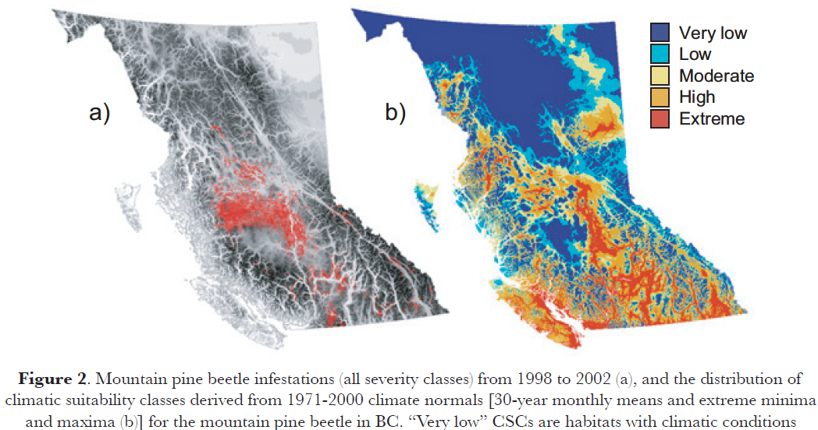
Modeling of inset and pest attacks
Insects are cold-blooded
Kirilenko el al (PNAS, 2007) has good stats
Points to Carroll et al (2003), from the Canadian forest service
For any point, the “climate” for the past 20 years was analyzed
Suit. Index based on:
Num. years with min
temp > -40ºC
Num. years with max
temp > 18.3 ºC
Num. years where
prec > avg
etc..
Notes:
23
This is the more uncertain and serious problem
Insects are cold blooded: “Every aspect of an insect’s life cycle is dependent upon temperature because they are cold blooded. Therefore, these organisms should respond quickly to changing climate by shifting their geographical distribution to take advantage of new climatically benign environments”. Also, they may be able to evolve faster
“Points to Carroll 2003…”: This is a paper titled “Effects of Climate Change on Range Expansion by the Mountain Pine Beetle in British Columbia”. There, a model that they used to predict the incidence of the mountain pine bark beetle is described. The model analyzes the climate of a place, looking at six parameters (some of which are listed).
The map shows the climatic suitability index (for the beetle) from their model on the right (multi-colours), while the actual observed infestation (around 2003) is seen on the left (grey/red map, where red=infestation). A good correlation can be seen.
23

Slide 24
Stand N Efficiency from Models
None of the models specifically examine N Use Efficiency
Growth & Yield model comes closest to allowing us to make recommendations regarding appropriate silvicultural prescriptions
Input variety of silvicultural parameters: stand age, density, stock, thinning, fertilization, etc.
Output: # of trees, volume, stand structure, etc.
If fertilizer is nitrogen based, we should be able to see how differing amounts changes the output amounts
For non-N fertilizers, more difficult to draw conclusions: would need to incorporate N measurements in the models
radiative transfer model
Remote sensing nitrogen analysis

Slide 25
Adaptation of pine forests to climate change
Adaptation may be required because:
Range shift: future climate not suitable
Fire frequency
A particular invasive species or disease comes in
Frequency of droughts and floods
A non-coniferous species (eg) may establish itself
Key in forest adaptation are(Millar et al 2007):
Promote resilience to change
Enable forests to respond to change
Notes:
25
“Key in forest adaptation..”: Recall reading from Millar et al 2007, “CLIMATE CHANGE AND FORESTS OF THE FUTURE: MANAGING IN THE FACE OF UNCERTAINTY”.
25

Slide 26
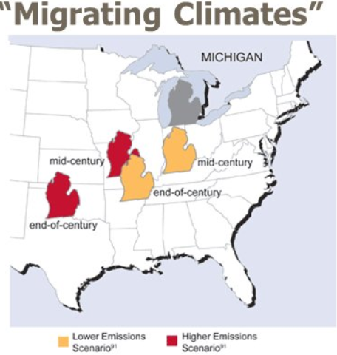
Understanding possible range shift
Future climate may not be suitable for present species
Use DGVMs to assess the
suitability of climate (eg: LPJ)
Input: Climate, soils of location
Output: Vegetation types
Proactively develop genetic
clones suitable for the projected
new climate
Notes:
26
“Future climate may not…”: First, one has to understand how much the climate over a place may change, on the future. For this, please refer to the presentation by Dr. Hayhoe (31st Jan), around 45 min into it. In mid-century, in the lower emissions scenario, the climate of the southern states will “migrate” to the northern ones (see map in slide). That is, for example, sites in Virginia will have the climate of south. Carolina, by the 2050s! This questions the viability of certain species, that may be highly adapted to the current climate.
“Use DGVMs…”. DGVMs are dynamic global vegetation models. They are much more process-oriented than usual forest models, they even project the optimal vegetation mix of a place, given the climate and soils. Hence, they can help in answering the question: “Will the species/vegetation-type of today be suitable for the climate of tomorrow”?
26

Slide 27
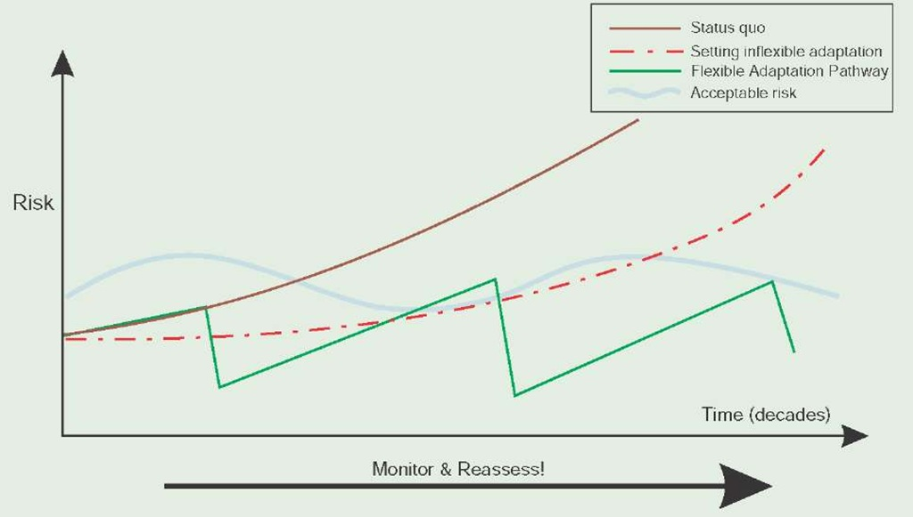
Adaptation of pine forests to climate change
Adaptation is best framed in terms of risk management (IPCC 2007)
Risk = (Prob. of event)*(impact, possibly in $)
Flexible adaptation pathways required
Prob. of event assessed
from various models
(DGVMs, fire, insects
discussed before)
Notes:
27
“Adaptation is best framed…”: Risk management is a well-defined and researched area. The basic idea is that you are able to project your “risk trajectory”, or how you think your “risk” will evolve with time (see the fig).
Flexible adaptation pathways : The idea is that you periodically re-assess the situation and change your adaptation plan. This is illustrated in the figure.
“Prob. of event…”: All the models that we had discussed before helps us to assess the probability of events such as fires, insect outbreak, etc. This will help us come up with better estimates of our risk trajectory.
27

Slide 28
Measurements required on tier-3 sites = Output of the models
Transpiration (3PG+ verification)
C allocation coeffecient (3PG+)
GPP (3PG+)
R_{h}, heterotrophic respiration (NASA-CASA)
NEP (NASA-CASA)
ET, PET (NASA-CASA)
Water yield HUC (WaSSI-C)
Water stress index (WaSSI-C)
Num trees, basal area (G&Y)
Stand structure (G&Y)
Notes:
28
The basic idea here is the validation (and calibration) of our models. So, we have to collect data corresponding to the output of our models. Of course, it is assumed that we have enough input data at these sites to run these models reliably.
28

