Slide 1
INTRODUCTION TO BARK BEETLES IN SOUTHEAST U.S.
A Brief Guide for the PINEMAP project
Kamal JK Gandhi
Warnell School of Forestry and Natural Resources
University of Georgia
kjgandhi@uga.edu; 706-542-4614
Note: If you suspect that you have pest issues on your trees, please contact me for further assistance

Slide 2
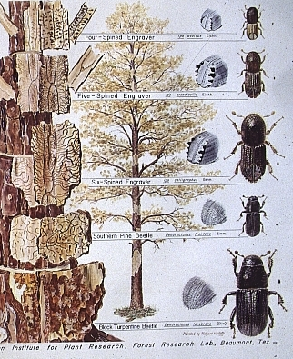
Five pine bark beetles generally tend to occupy different parts of the bole
3 Ips species
Southern Pine Beetle
Dendroctonus frontalis
Black Turpentine Beetle
Dendroctonus terebrans

Slide 3
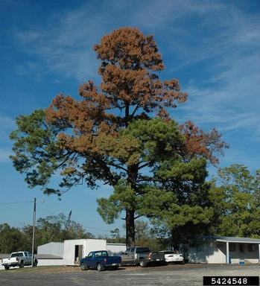
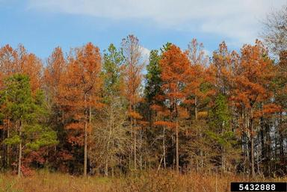
TREE SYMPTOMS: Dieback
A
B
B. The entire stand is affected above by bark beetles. The needles typically turn from green to yellow, reddish, and then brown color
A. The tree above shows flagging where individual branches are dying. Trees could show dieback either top-down (as seen in this image) or bottom-up

Slide 4
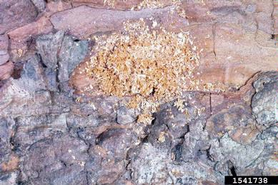
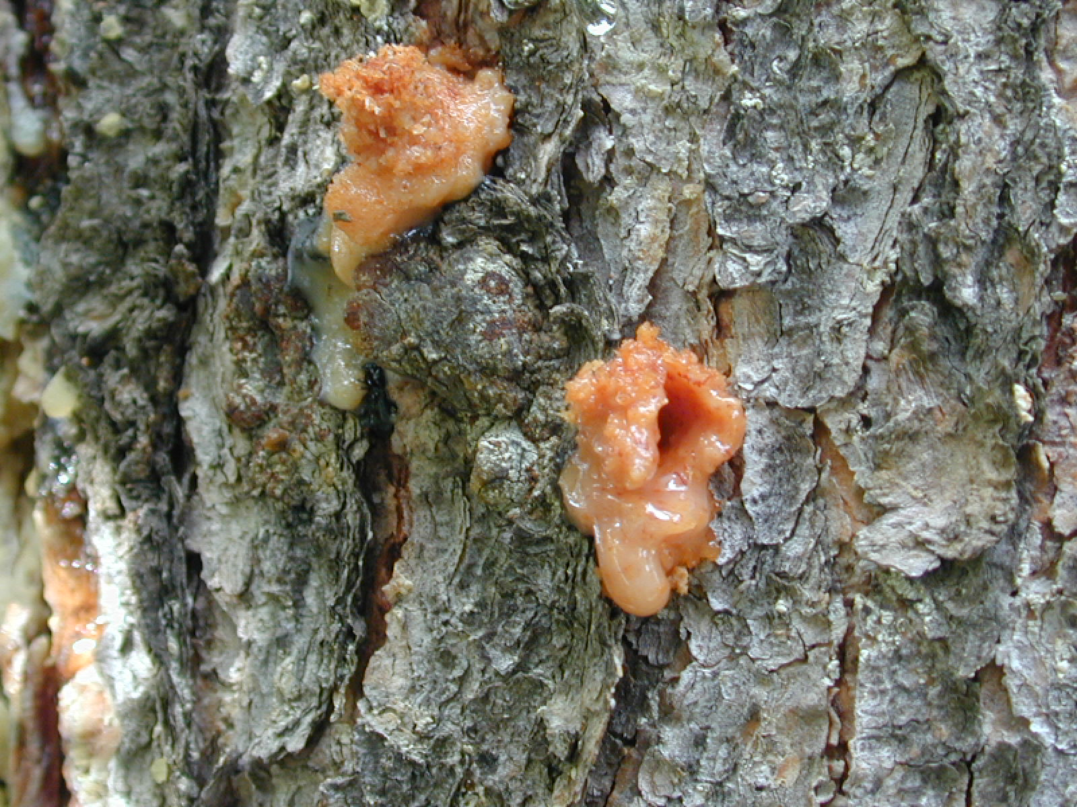
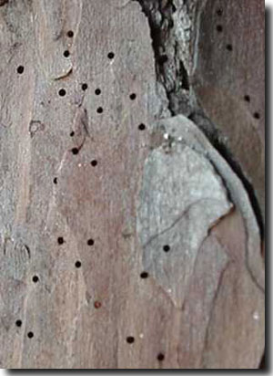
BARK BEETLES: Ips Beetles
A
B
A. On the bark, you may see boring dust that tends to get washed away by rain or wind
B. There could be resin pitch tubes on the bark as the tree is trying to defend itself from beetles. Typically, the healthier the tree, the greater the likelihood that there will be pitch tubes
C
C. You would also see small round exit/entrance made by adult beetles on the bark. All bark beetles will make these holes

Slide 5
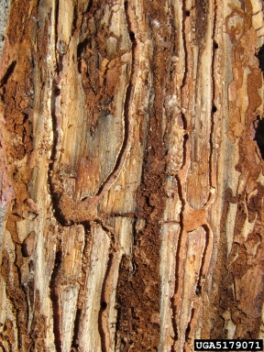
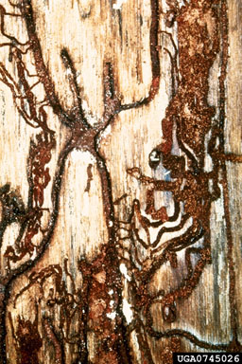
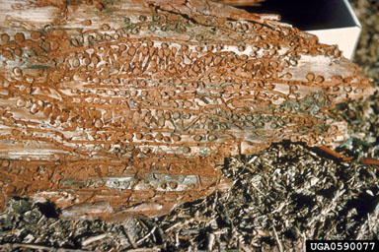
BARK BEETLES: Ips Beetles
B
C
A
A-C. If you peel bark, then you may galleries of Ips beetles as above. These galleries could be straight (A), and Y or X-shaped (B and C)

Slide 6
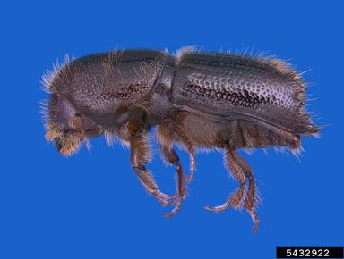
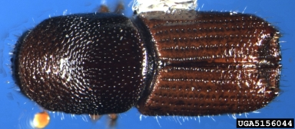
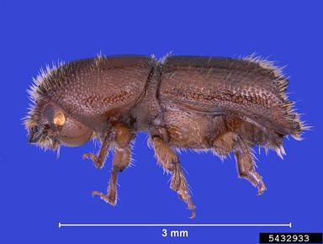
BARK BEETLES: Ips Beetles
A
B
C
A-C. The adult beetles themselves are quite small in size (see scale on C). All Ips beetles have spines at the end of their wing-cover (see arrows on A and C). The number of spines are species-specific. Ips beetles typically attacks stressed trees

Slide 7
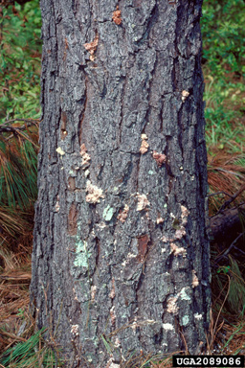
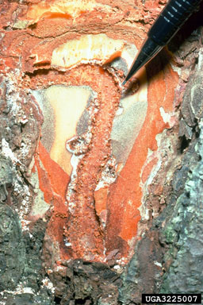
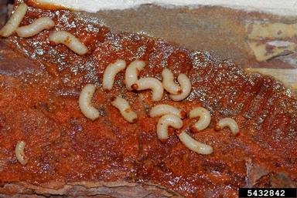
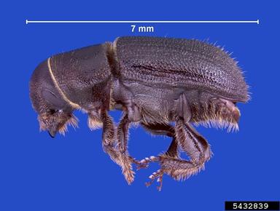
BARK BEETLES: Black Turpentine Beetle
A
B
C
D
A. Black turpentine beetles tend to attack the lower part of the bole, and have large pitch-tubes that are the size of a popcorn kernel. They typically attacks stressed trees
B-C. If you peel bark, you may find a ?-shaped gallery (B). More likely that you will find an area where white larvae are feeding under the bark (C)
D. Adults are the largest among bark beetles (see scale), and their end of the wing-cover is rounded (arrow)

Slide 8
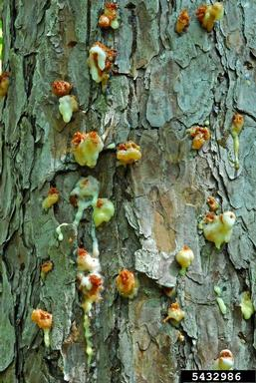
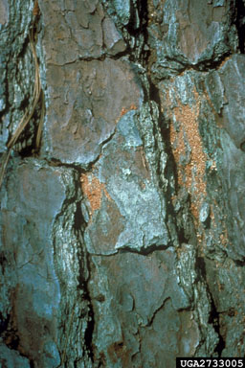
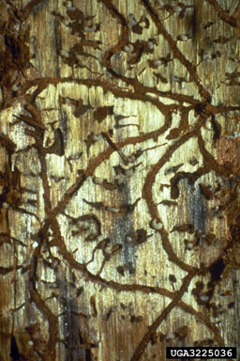
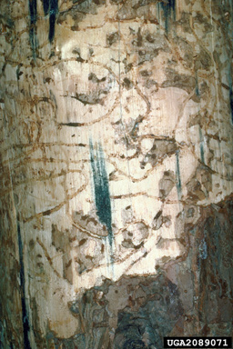
BARK BEETLES: Southern Pine Beetle
A
B
C
A. Southern pine beetle is amongst the most aggressive beetle. They also tend to have pitch tubes on the bark
B. Boring dust can be seen either on the bark or fallen at the base of the tree
D
C-D. Peeling of bark would reveal serpentine galleries with round chambers on the side

Slide 9
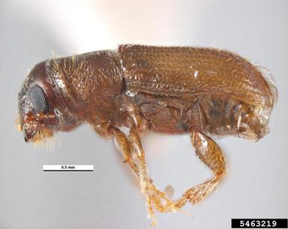
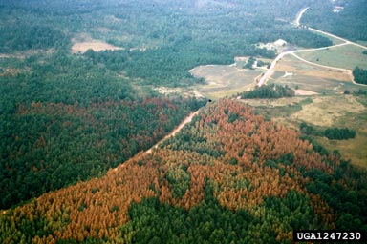
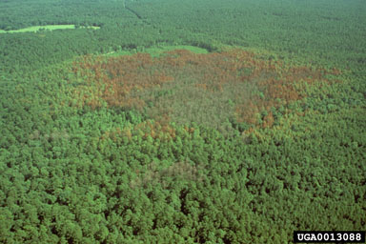
BARK BEETLES: Southern Pine Beetle
A
B
A. Southern pine beetles are small in size, and tend to mass attack trees. The end of their wing-cover is rounded (arrow)
C
B-C. This species can kill trees on a large scale, and can move through the forest relatively quickly

Slide 10
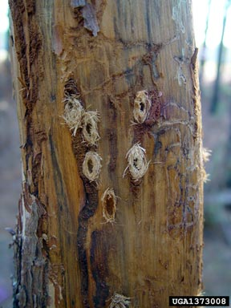
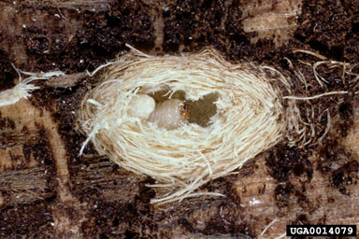
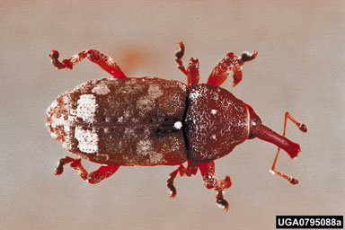
BARK BEETLES: Deodar Weevil
B. The chip cocoons typically had a larva or pupa in them. I didn’t rear out the insects, however I suspect that they were those of deodar weevil
C. Here’s an adult weevil which is about the same size as black turpentine beetle. They typically attacks stressed trees
A. I found chip cocoons as above on trees at GA site. There wasn’t much visible signs on the bark, but peeling of bark revealed these cocoons

